Slide 1

Data Analytics Internship Project
Sales Optimization & Customer Segmentation
Presented By:
Poorvi Malvi
Data Analytics Intern | Apex Planet

Slide 2



Project Objective
Goal: To analyze sales data ($2.26M) and identify revenue growth opportunities.
Approach: Used Python for Data Cleaning, RFM Segmentation, and Statistical Validation.
Outcome: Provide data-driven recommendations to optimize marketing spend and reduce churn.

Slide 3
Data Overview & Processing
Total Records Processed: 4,922 Orders
Total Revenue Generated: $2.26 Million
Average Order Value: $459.48
Active Customers: 793 Unique Customers
Data Quality: Cleaned missing values and duplicates using Python (Pandas) to ensure accuracy.

Slide 4
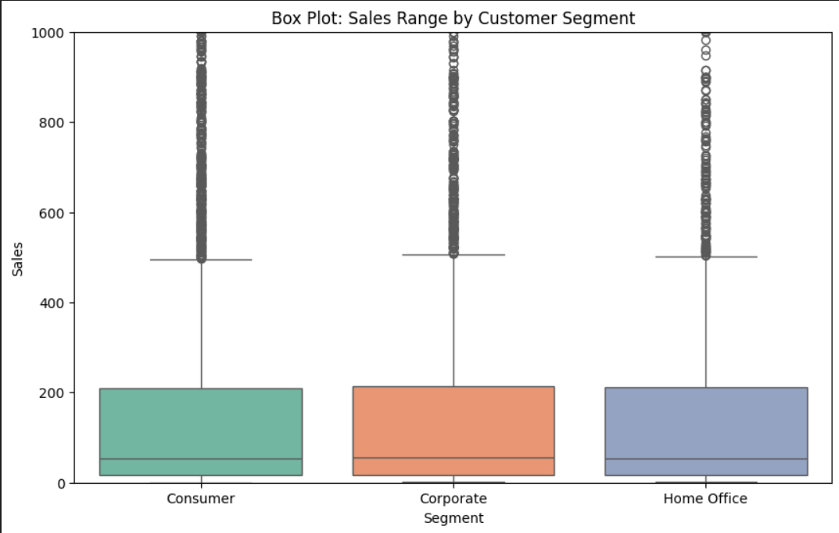
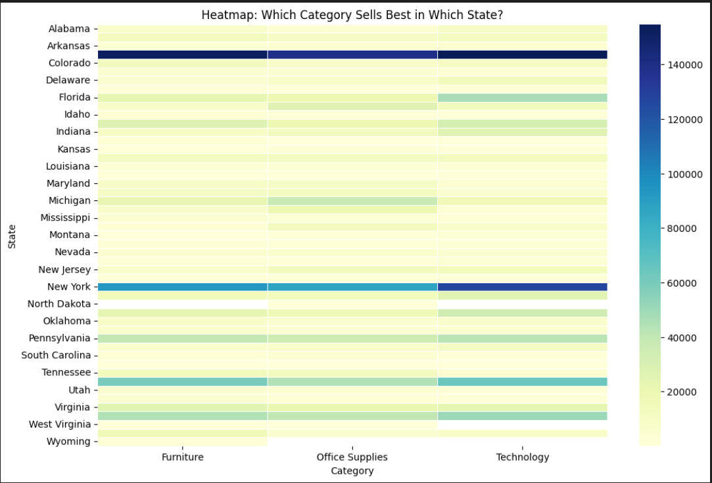
Key Sales Insights (Regional & Category)
Top Performing Region: The West Region contributes the highest revenue share.
Best Category: 'Technology' products have the highest profit margins.
Seasonal Trend: Sales show a significant spike in Q4 (November-December).
Insight: Resources should be allocated to capitalize on Q4 demand in the West.

Slide 5
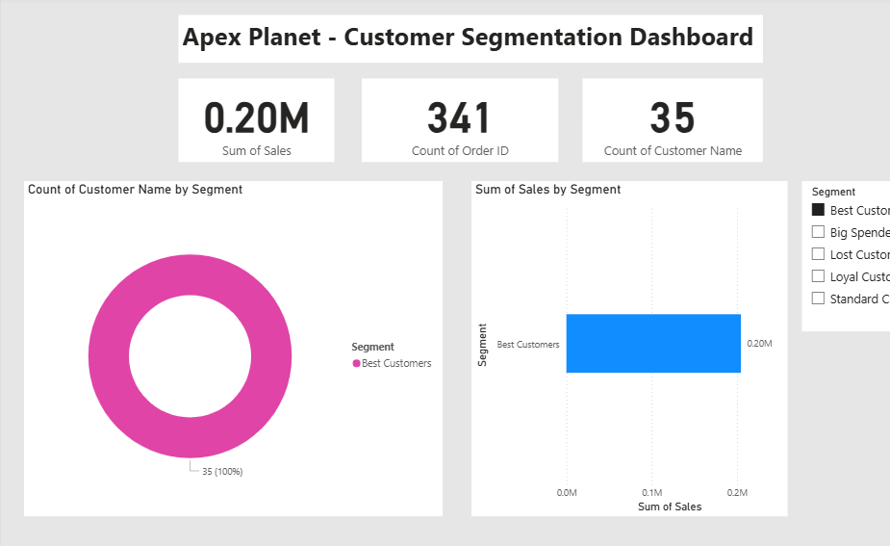
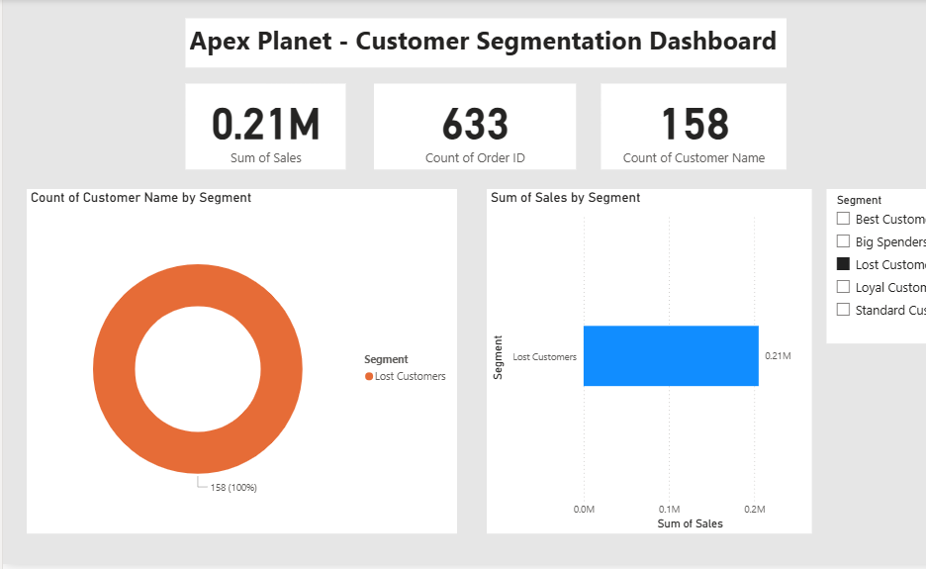
RFM Customer Segmentation
Methodology: Scored customers on Recency, Frequency, and Monetary value (1-4 scale).
Best Customers (35): High spending, frequent buyers. Strategy: VIP Rewards.
Lost Customers (158): Haven't bought recently. Strategy: Win-Back Campaigns.
Loyal Customers: Frequent buyers with consistent spend. Strategy: Upselling.

Slide 6

Hypothesis Testing (Scientific Proof)
Hypothesis: 'Is there a significant difference in spending between Consumer and Corporate segments?'
Test Performed: Independent T-Test (using Scipy).
Results:
- T-Statistic: -0.5896
- P-Value: 0.5555 (> 0.05)
Conclusion: FAIL TO REJECT Null Hypothesis.
Business Implication: Both segments have similar spending habits. A unified marketing strategy is cost-effective.

Slide 7




Strategic Business Recommendations
1. Unified Marketing Campaign: Since P-Value > 0.05, use the same campaign for Consumer & Corporate to save budget.
2. Targeted Win-Back: Send automated discount emails to the 158 'Lost Customers' immediately.
3. Regional Focus: Increase ad spend by 20% in the West Region to maximize high ROI.
4. Loyalty Program: Launch 'Apex Elite Club' for the 35 Best Customers to ensure retention.

Slide 8
Thank You
This project demonstrates how Data Analytics leads to smarter business decisions.
Connect with me:
GitHub: https://github.com/afjalalam09/ApexPlanet_Task4_Analysis
LinkedIn: linkedin.com/in/afjalalam

