Slide 1
Amazon Sales Dashboard Summary
Monthly Performance Overview - April 2025

Slide 2
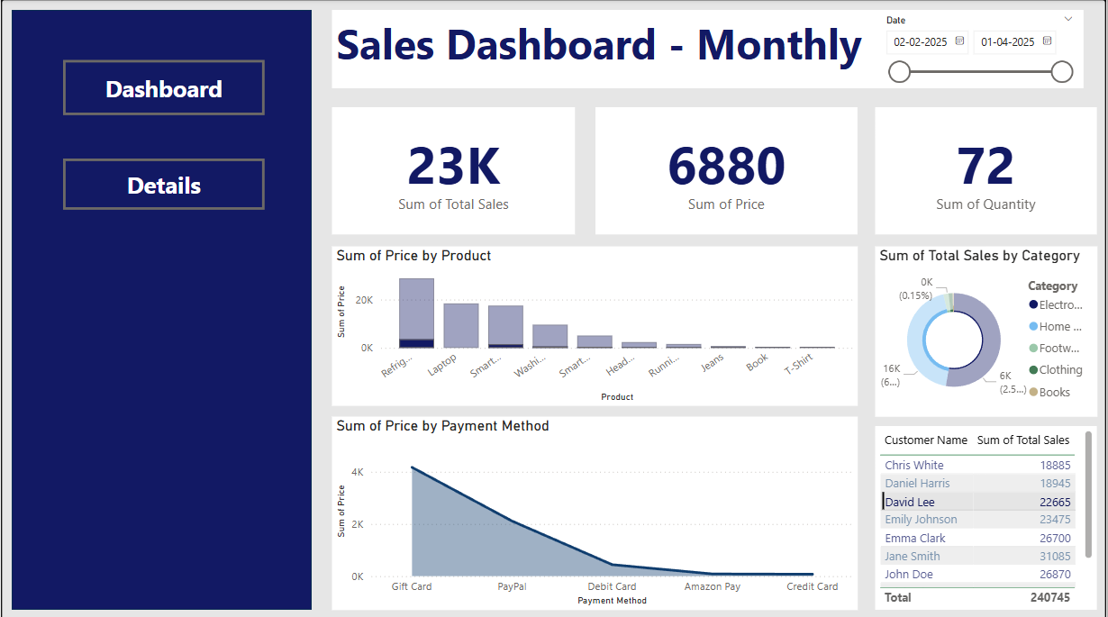
Dashboard Overview

Slide 3
Key Metrics (April 2025)
• Total Sales: 23K
• Sum of Price: 6880
• Quantity Sold: 72
• Top Products: Refrigerator, Laptop, Smartphone
• Popular Payment Methods: Gift Card, PayPal, Debit Card

Slide 4
Sales Breakdown & Insights
• Highest Sales by Category: Electronics
• Significant Sales from: Home Appliances and Footwear
• Customer Segmentation: Top customer - John Doe (26,870)
• Category Contribution: Electronics leads by volume and value
• Payment Trends: Gift Cards most used, followed by PayPal

Slide 5
Insights & Recommendations
• Focus promotions on high-selling products (Refrigerators, Laptops)
• Enhance marketing efforts around top customers
• Increase support for Gift Card-based purchases
• Track lower-performing categories for improvement (Books, T-Shirts)
• Consider bundled offers in Home and Footwear categories

