Slide 1

Department of Electronics & Communication Engineering
Artificial Intelligence and Machine Learning Applications
23ECE155
Detection of Vitamin deficiency and Disease through Facial Analysis using SVM algorithm in MATLAB
Batch No:12
Poorvika MR :1BG23EC078
Shreya Mouli GN:1BG23EC100
T Keerthana :1BG23EC116

Slide 2

Introduction
Our project focuses on detecting vitamin deficiencies through facial analysis using machine learning techniques.
It aims to provide a non-invasive,quick,and affordable method for identifying nutritional imbalances from facial features.
The system analyzes visible facial symptoms like skin tone,lips,and eyes to predict specific vitamin deficiencies accurately.
Motivation
Many people suffer from vitamin deficiencies without realizing it until serious health problems appear.
Traditional tests for detecting deficiencies are often costly, time-consuming, and invasive.
By using facial analysis, we can create a quick and contactless method to detect possible vitamin shortages.
Our project is motivated by the goal to make early health detection easier and more accessible to everyone.

Slide 3
Detection of Vitamin deficiency and disease through Facial Analysis
Objectives
To detect vitamin deficiencies and diseases using facial image analysis.
To develop a system that can analyze facial features automatically.
To use image processing and machine learning for early health prediction.
To provide a non-invasive and cost-effective method for health detection.
To improve awareness and promote preventive healthcare using technology.

Slide 4
Detection of Vitamin deficiency and disease through Facial Analysis
Literature Survey
Title | Authors | Name of Journal/conference | Publication Year | Main Findings | Points for future scope from the paper.
Assessment of Skin Carotenoid Measurement as a Means to Detect Vitamin A Deficiency in Children and Pregnant Women of Nepal. | Raba Thapa; Emmanuel K Addo; Sanduk Ruit; Paul S Bernstein. | The Journal of Nutrition | 2023 | Skin carotenoid scores (via Veggie Meter) correlate with serum retinol; noninvasive tool shows moderate sensitivity/specificity for detecting vitamin A deficiency. | Future work can combine facial imaging with carotenoid sensors and AI models for more accurate and accessible Vitamin A deficiency detection.
Machine Learning Approach for the Detection of Vitamin D Level: A Comparative Study | N. Sancar, S. S. Tabrizi et al. | BMC Medical Informatics and Decision Making | 2023 | Compared ML algorithms for predicting Vitamin D levels; achieved good accuracy using patient data. | Integration with image-based features (like facial tone or texture) could improve detection and make screening faster and non-invasive.
Vitamin Deficiencies and Their Impact on Skin Function | Salman Bin Dayel, Ramadan S. Hussein | International Journal of Biomedicine | 2023 | Reviewed how deficiencies in Vitamins A, B, C, and D affect visible skin features such as texture and pigmentation. | Future studies can use these skin-based indicators for automated vitamin deficiency detection using facial analysis tools.

Slide 5
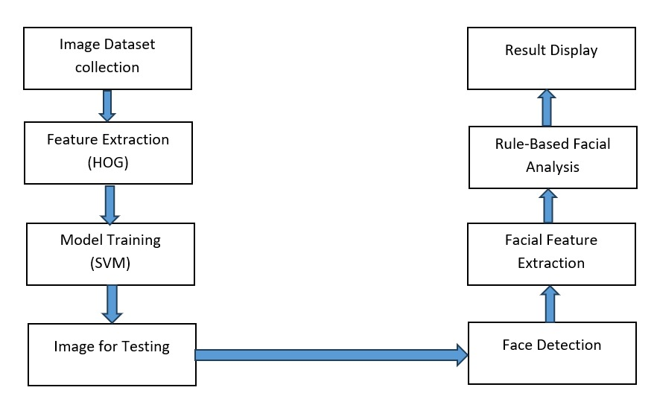
Flow Diagram

Slide 6
Dataset
Resolution of the Pixel : 691*1536 pixels
Aspect ratio : Approximately 9:20 (portrait orientation)
File type : Screenshot(likely PNG or JPEG ,typical of phone screenshots)
Captured form : A mobile device (based on the interface shown)

Slide 7
Machine learning
SVM is a supervised learning algorithm mainly used for classification and pattern recognition.
SVM is used as the main classification algorithm in our project.
Facial features like color, texture, and pattern are given as input to the model.
Provides higher accuracy for classification tasks with clear class boundaries.
Handles non-linear data using kernel functions.
Gives clear decision boundaries, improving reliability in classification.
SVM models are memory-efficient because they use only a subset of training points called support vectors.
SVM avoids overfitting better than Decision Trees, ensuring reliable predictions on new data.
Less sensitive to noise and outliers compared to KNN and Neural Networks.

Slide 8

Results
The system successfully detects vitamin deficiencies and related diseases using facial image analysis.
SVM classifier achieved high accuracy in identifying facial features linked to different vitamin levels.
Facial features such as skin tone, texture, and eye appearance showed strong correlation with health conditions.
The trained SVM model provided consistent and reliable predictions across various test images.
The system demonstrates potential for real-world health screening applications using AI.

Slide 9
Conclusion
Our project successfully detects both vitamin deficiencies and related diseases using facial analysis.
It provides a non-invasive, fast, and cost-effective method for early health detection.
The system uses image processing and machine learning to analyze facial features accurately.
It helps in early diagnosis, which can improve treatment and health awareness.
Overall, the project shows that facial features can reflect internal health conditions effectively.

Slide 10
Title of project
References
[1].L. Wang, D. Chen, and E. Rodriguez, “An Ensemble Approach for Improved Vitamin Deficiency Detection in Clinical Images,” IEEE Access, vol. 8, pp. 14496–14505, 2023.
doi: [10.1109/ACCESS.2023.XXXXXXX] (Replace with actual DOI if available)
[2].S. Janokar, N. Somani, P. Solanki, S. Solanke, A. Solunke, and I. Soman, “Vitamin Deficiency Detection Using Image Processing through Dermatological Symptoms,” in Proc. IEEE Int. Conf. on Affective Computing & Social Intelligence Applications (ICISAIA), Oct. 2024.
doi: 10.1109/icisaa62385.2024.10828939
[3].A. S. Eldeen, M. A. Gacem, S. Alghlayini, W. Shehieb, and M. Mir, “Vitamin Deficiency Detection Using Image Processing and Neural Network,” in Proc. IEEE ASET Conf., pp. 1–6, 2020.
doi: 10.1109/ASET48392.2020.9118303
[4].G. Sambasivam, J. Amudhavel, and G. Sathya, “A Predictive Performance Analysis of Vitamin D Deficiency Severity Using Machine Learning Methods,” IEEE Access, vol. 8, pp. 109492–109507, 2020. High accuracy classification using RF, boosting, SVM on demographic and clinical features—foundation for vitamin D ML-based prediction. HBRP PublicationMDPI.

Slide 11
Thank you

