Slide 1

CLOUD COMPUTING PROJECT
Implementing a CI/CD Pipeline
with Jenkins on AWS EC2
Automating build and integration workflows using Jenkins, deployed on
AWS EC2 and integrated with GitHub source control.
Presented by: Poovizhi
Platform: AWS EC2 (Ubuntu) | Tool: Jenkins | VCS: GitHub

Slide 2


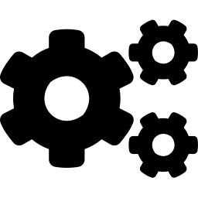
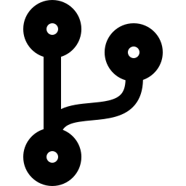


Agenda
Project Objective
Architecture Overview
What we set out to build, and why
How EC2, Jenkins, and GitHub fit together
Setup Walkthrough
GitHub Integration
EC2 instance, Jenkins install, pipeline creation
Connecting the pipeline to source control
Challenges & Fixes
Results & Demo
Real issues encountered and how they were resolved
The final, working pipeline in action
Jenkins CI/CD Pipeline on AWS | 2

Slide 3
1
Provision and secure a cloud server on AWS EC2
Project
Objective
2
Install and configure Jenkins as an automation server
3
Build a working Pipeline project inside Jenkins
A hands-on cloud computing assignment focused on real-world DevOps automation.
4
Integrate the pipeline with a GitHub repository so code changes can be pulled and built automatically
Jenkins CI/CD Pipeline on AWS | 3

Slide 4

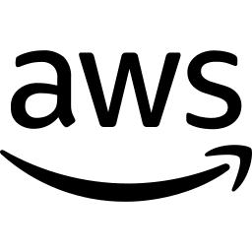
Architecture Overview
How the pieces connect: source control, automation server, and cloud infrastructure.
Poll / Trigger
Runs on
GitHub
Repository
Jenkins
(on EC2)
AWS EC2
Instance
Source code +
Jenkinsfile
Pulls code,
runs pipeline
Ubuntu server
hosting Jenkins
Access secured via Security Group rules: SSH (22), HTTP (80), HTTPS (443), Jenkins (8080).
Jenkins CI/CD Pipeline on AWS | 4

Slide 5

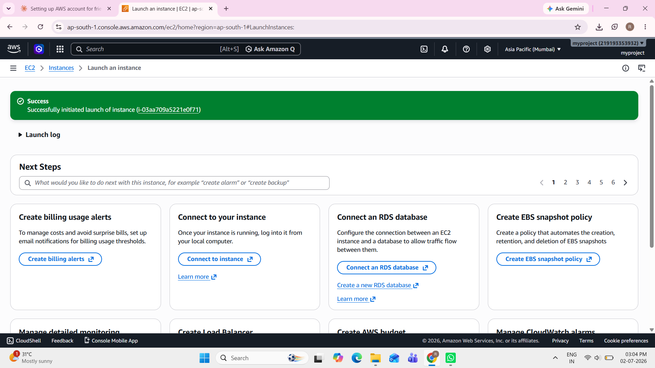


Step 1 — Launching the EC2 Instance
Ubuntu Server 26.04 LTS
Selected as the AMI (Free Tier eligible)
Key Pair (RSA, .ppk)
Generated for secure PuTTY access
Security Group
SSH, HTTP, HTTPS, and port 8080 opened
EC2 instance launched successfully
Jenkins CI/CD Pipeline on AWS | 5

Slide 6
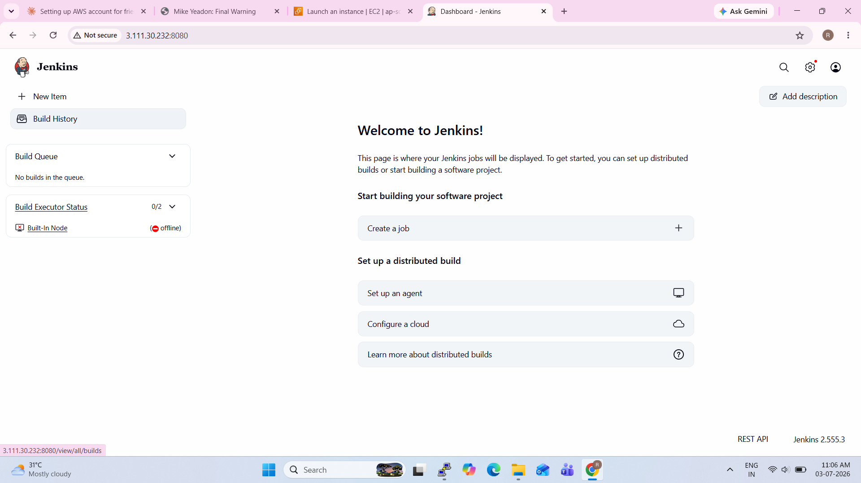
Step 2 — Installing & Accessing Jenkins
1
Connect via PuTTY
SSH into the instance using the public IP and key pair
2
Install Java (OpenJDK 21)
Required runtime for Jenkins
3
Install Jenkins
From the official APT repository, started as a system service
4
Unlock & Configure
Initial admin password, suggested plugins, admin account
Jenkins dashboard after successful setup
Jenkins CI/CD Pipeline on AWS | 6

Slide 7
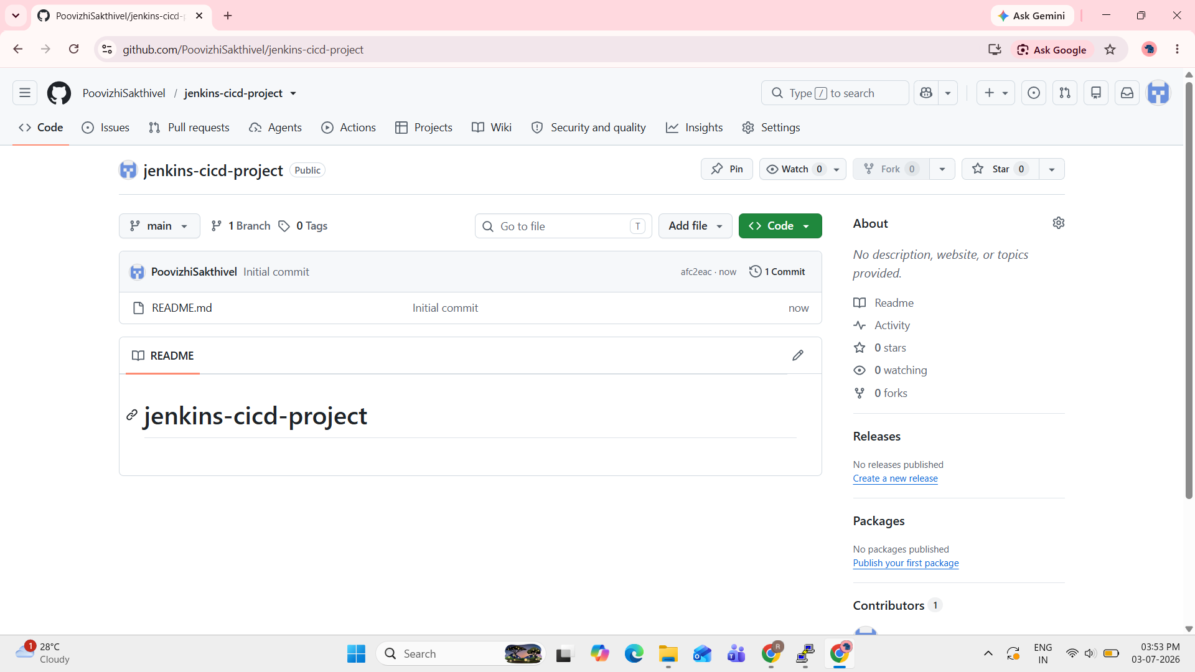
Step 3 — GitHub Integration
Jenkins was configured to pull its pipeline definition directly from source control.
Repository created
Public GitHub repo: jenkins-cicd-project
Jenkinsfile committed
Defines the pipeline stages (Hello, Build)
Pipeline reconfigured
“Pipeline script from SCM” pointing to the repo, branch main
GitHub repository with Jenkinsfile
Jenkins CI/CD Pipeline on AWS | 7

Slide 8
Challenges & How They Were Solved
Java version mismatch
GPG key errors
Node kept going offline
Issue: Jenkins required Java 21; server had Java 17 installed.
Issue: Jenkins' package repository key had rotated, breaking installation.
Issue: Low free space in /tmp repeatedly took the Jenkins node offline.
Fix: Installed OpenJDK 21 and set it as the default Java version.
Fix: Downloaded the current signing key and re-added the APT repository.
Fix: Resized the EBS volume and adjusted the temp-space monitor threshold.
Jenkins CI/CD Pipeline on AWS | 8

Slide 9
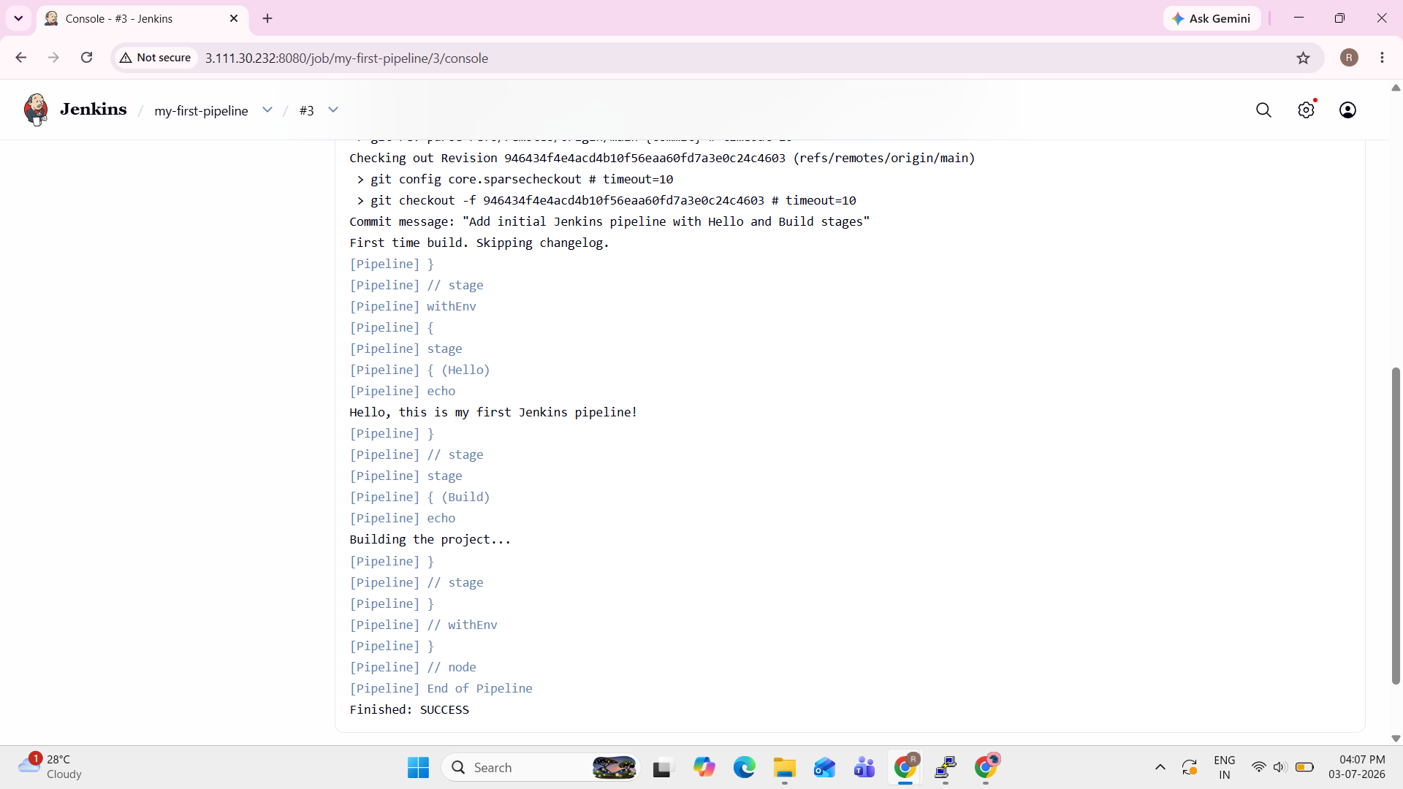
Results — Pipeline Success
The pipeline clones the GitHub repository, checks out the latest commit, and executes both stages end to end.
Repository cloned from GitHub
Latest commit checked out
Hello + Build stages executed
Finished: SUCCESS
Console output: Finished: SUCCESS
Jenkins CI/CD Pipeline on AWS | 9

Slide 10
Conclusion
A fully working CI/CD pipeline was built end-to-end: an AWS EC2-hosted Jenkins server
that automatically pulls pipeline definitions from GitHub and runs them on demand.
Every stage — provisioning, installation, configuration, and integration — was completed
and verified.
Thank You
Poovizhi | Cloud Computing Project

