Slide 1

UNIVERSITY OF NAPLES FEDERICO II
POLYTECHNIC AND BASIC SCIENCES SCHOOL
DEPARTMENT OF INDUSTRIAL ENGINEERING
MASTER’S DEGREE IN
AUTONOMOUS VEHICLE ENGINEERING
DIGITAL MODELLING OF INTERACTIVE SYSTEMS AND INTERFACES
PROJECT REPORT – PW33
“Electromechanical Active Suspension”
Pooya Zare Baravati | D18000079

Slide 2
Electromechanical Active
Suspension

Slide 3
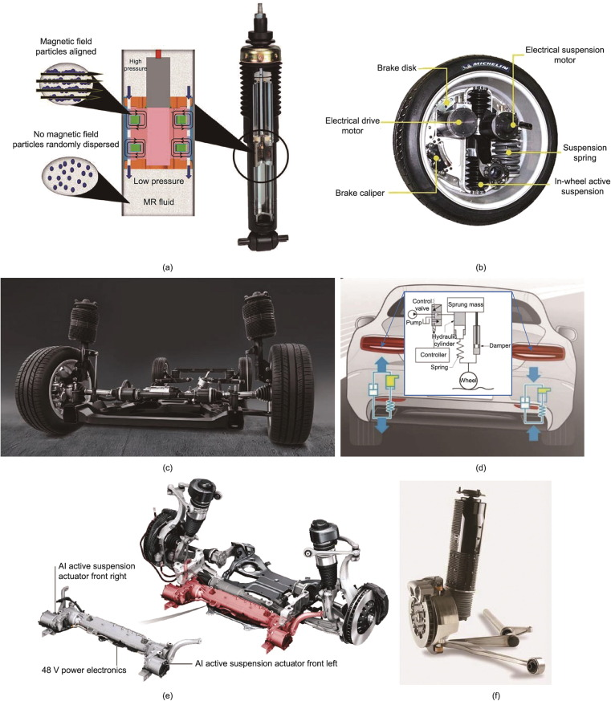
Introduction
Enhanced Comfort
Electromechanical active suspension systems improve ride comfort by adjusting stiffness and damping in real-time, providing drivers and passengers with a smoother driving experience over varied terrains.
1
Improved Handling
These systems optimize vehicle dynamics by enabling precise control of wheel movements, significantly enhancing handling and stability during turns and under different load conditions.
2
Safety Features
Active suspensions contribute to increased safety by maintaining tire contact with the road, minimizing the risk of skidding, and improving braking efficiency in adverse weather conditions.
3

Slide 4
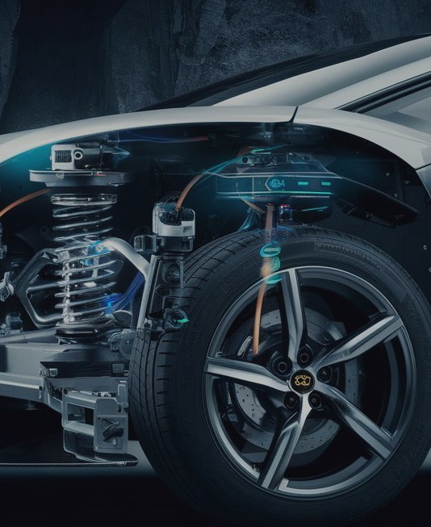

Starting Point
Research
Study various active suspension system types for development.
EAS Concept
Define system requirements concerning suspension characteristics clearly.
3D Modeling
Utilize SolidWorks for effective 3D component design and assembly.
FEA Analysis
Apply loads and define boundary conditions for structural analysis.
Control Strategy
Implement PID controllers for precise active suspension performance.
Simscape Simulation
Validate suspension response through dynamic motion studies effectively.

Slide 5
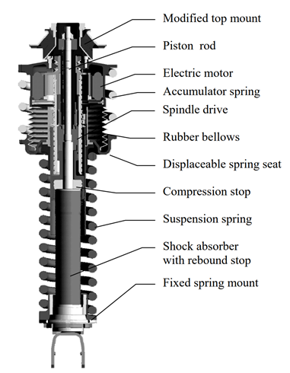
Electromechanical Active Suspension Systems how does it work?
Performance
Active suspension systems enhance vehicle performance by independently adjusting forces between sprung and unsprung masses. These systems leverage advanced electromechanical actuators and control algorithms to significantly improve ride comfort, stability, and handling characteristics in modern automotive engineering applications.
1
2
Control unit
This system uses a DC motor connected to a lead screw to convert electrical energy into linear motion. Controlled by sensors and a computer, it adjusts the suspension height and stiffness based on driving conditions.

Slide 6

Active Suspension Key Elements
Mechanical Arms
Connect wheel movement to vehicle body for stability.
Springs
Absorb shocks while maintaining vehicle height for comfort.
Dampers
Control oscillations to provide smooth vehicle dynamics.
Actuators
Adjust forces actively to respond to road conditions rapidly.
Control Algorithm
Implement real-time processing for optimal suspension adjustment.
Sensors
Provide data for monitoring vehicle dynamics and feedback.
Energy Management
Ensure efficient use of energy in system operation.

Slide 7
Hardware Elements
Spring
Acts as a fundamental component for shock absorption and support.
Wishbone
Connects wheel to chassis, maintaining alignment throughout travel.
Actuator
Provides responsive adjustments to suspension dynamics in real-time.
Damper
Controls oscillations, enhancing ride comfort and stability during movement.
Upright(knuckle)
Serves as a critical linkage between wishbones and wheel hub.

Slide 8
Active Components
Actuator
Utilizes electromechanical components for rapid force adjustments.
Control System
Employs real-time algorithms to optimize suspension dynamics effectively.
Sensors
Integrates feedback mechanisms for enhanced response to road conditions.
Power Supply
Ensures reliable energy source for consistent actuator performance.

Slide 9
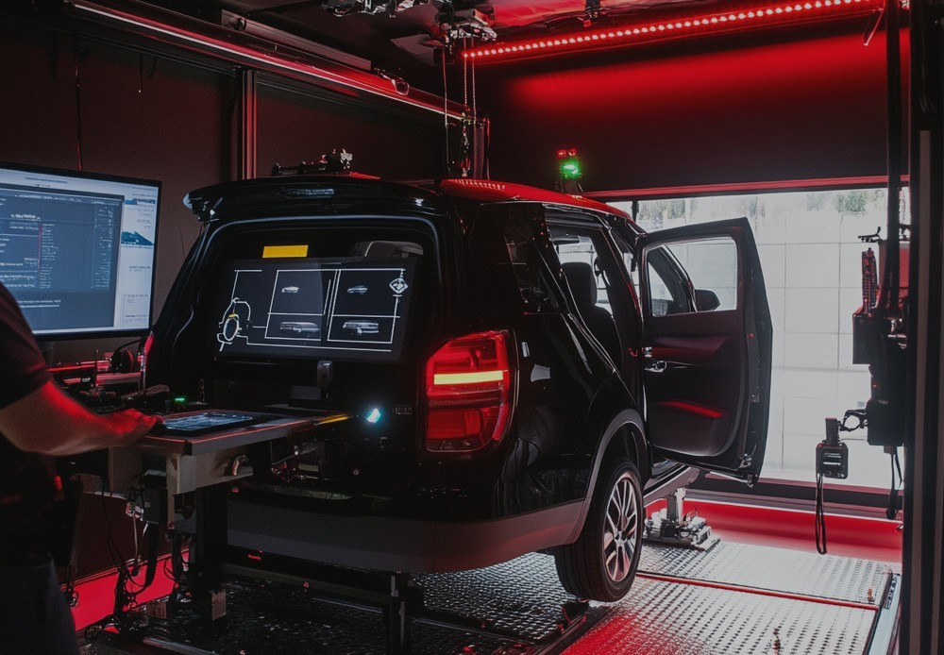
Project steps:
1. 3D Design of Mechanical Parts
Utilize SolidWorks for 3D modeling of suspension elements.
4. Matlab Simscape Model and Control
Utilize PID controllers for real-time adjustments of parameters.
2. Assembly and Motion Study
Conduct motion studies to validate suspension performance during operation.
3. FEA Analysis
Perform Finite Element Analysis to ensure structural integrity under load.

Slide 10
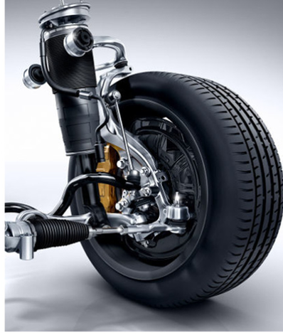
3D Modelling in SolidWorks
Design Verification
Conducting virtual simulations to ensure design integrity and performance before physical prototyping, minimizing costly errors.
1
Component Interactions
Analyzing the dynamics between different suspension components, improving overall assembly efficiency and reducing design conflicts.
2
Motion Analysis
Simulating movement behavior of the suspension system under various conditions to optimize component placement and functionality.
3
Rapid Prototyping
Creating quick 3D prints or models for testing and validation, accelerating the development process of the suspension system.
4

Slide 11
Design Approach:
- In this project, a bottom-up approach was employed for 3D modeling in SolidWorks to ensure a structured and efficient design process. This method involves creating individual components separately before assembling them into a complete system.

Slide 12
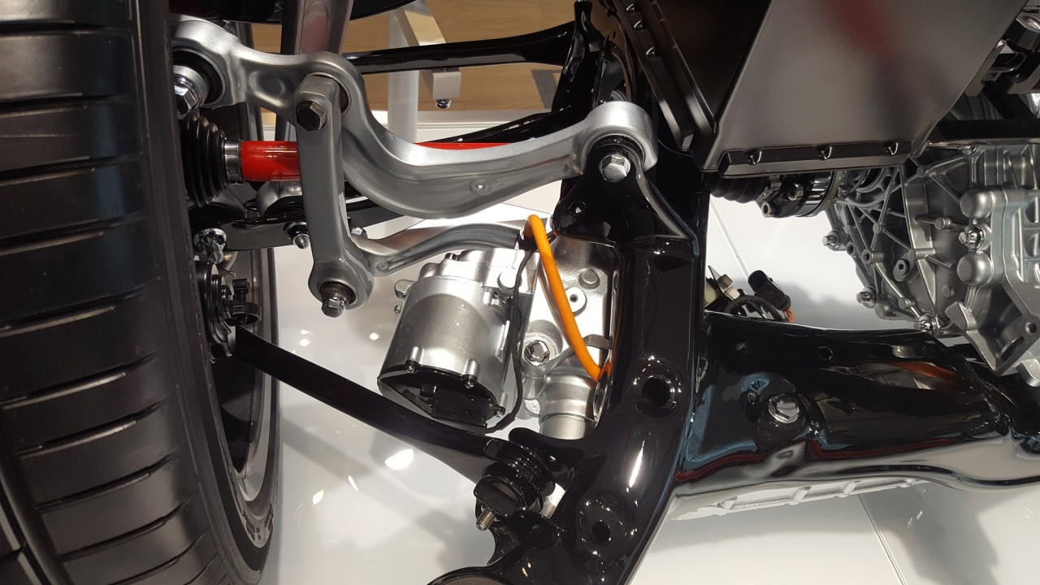
Predesign Considerations and Simplifications
To streamline the 3D modeling and FEA process, the DC motor and lead screw were excluded due to missing technical data and to reduce simulation complexity.
Since these components mainly affect actuation rather than structure, their omission allowed a clearer focus on mechanical stress and deformation.
However, their dynamic behavior was still analyzed using MATLAB Simscape to ensure system-level evaluation.

Slide 13
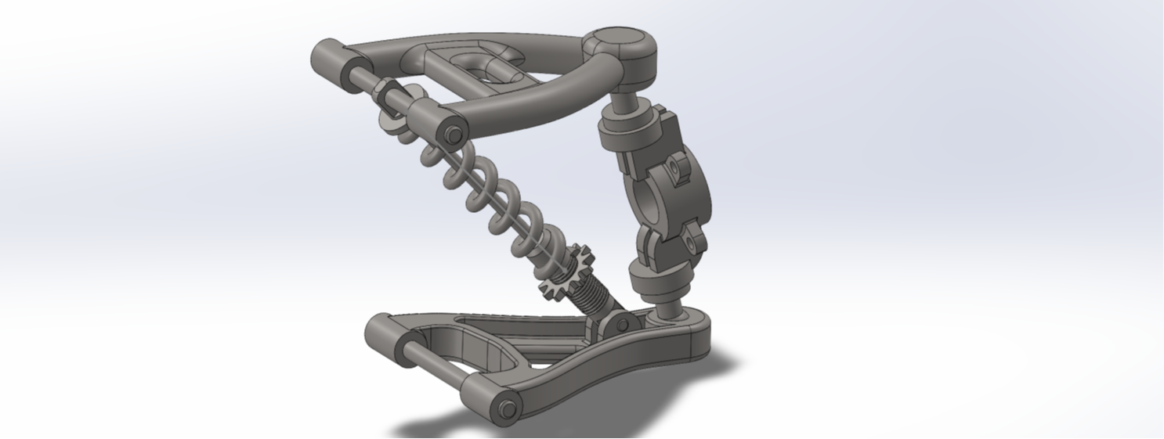
Component Design
Main Components of the Suspension System
. Upper and Lower Wishbones (Control Arms)
. Spring and Damper
. Upright (Knuckle)

Slide 14
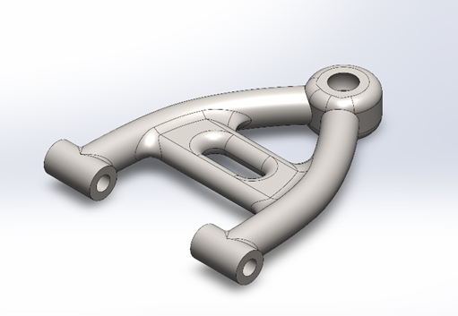
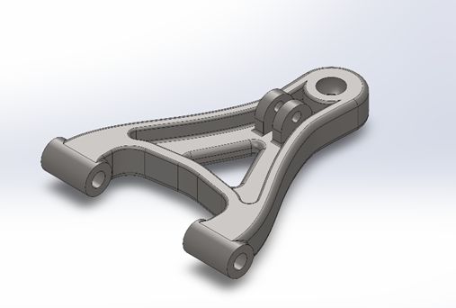
Upper and Lower Wishbone
Wishbones, also known as control arms, are essential parts that guide the wheel’s movement and maintain the vehicle’s structural stability. Together, they serve several key functions:
Control the vertical motion of the wheel while allowing for smooth suspension travel
Keep the wheel properly aligned and minimize camber change during motion
Provide a strong and stable link between the chassis and wheel assembly through pivot points
These elements play a vital role in ride comfort, handling, and safety

Slide 15
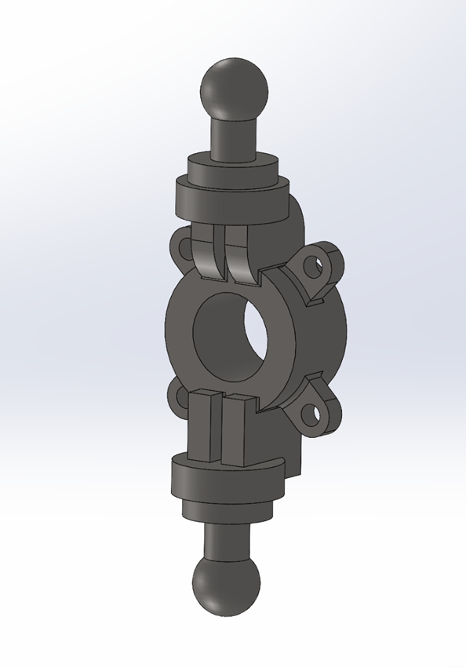
Upright (Knuckle)
Upright (Steering Knuckle) Overview The upright, or knuckle, is a key structural component that connects the upper and lower wishbones to the wheel assembly. It acts as the central mounting point for suspension and steering elements.
Key Functions:
Links the wheel hub to the suspension system
Supports steering movement while keeping the wheel properly aligned
Transfers forces between suspension, brakes, and steering components

Slide 16
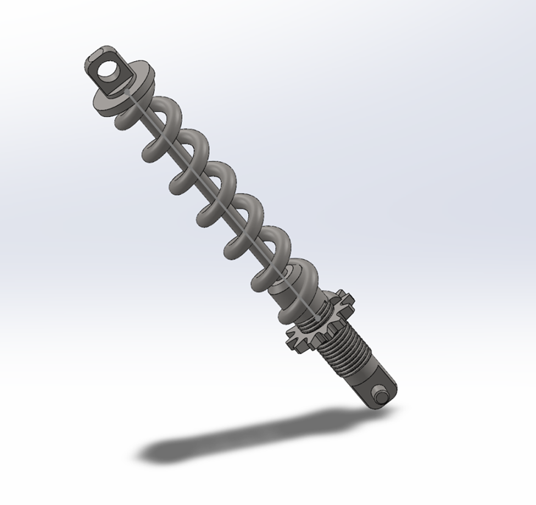
Spring and Damper
The spring and damper assembly is vital for absorbing shocks and maintaining vehicle stability. The spring supports the vehicle’s weight and absorbs bumps, while the damper (shock absorber) controls motion by dissipating energy.
Key Functions:
Absorbs road impacts to reduce shocks and vibrations
Controls suspension movement for better handling and stability
Improves ride comfort by minimizing bounce and oscillation

Slide 17
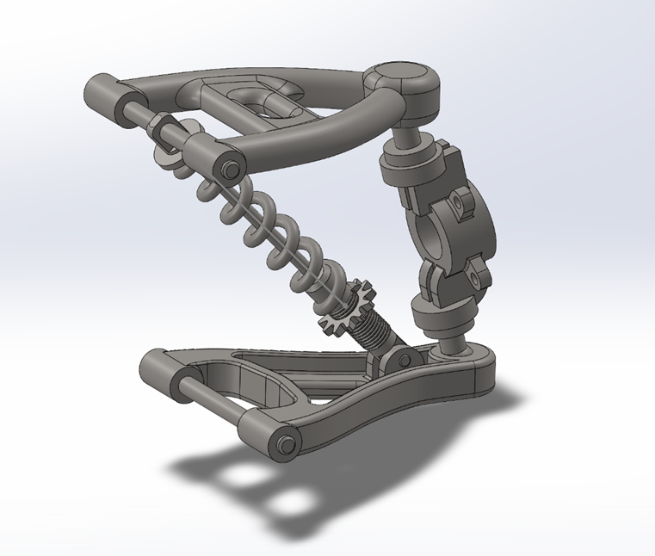
Whole Parts Assembly
The suspension system was assembled in SolidWorks by combining individually modeled parts using precise mates and constraints to simulate real motion and interaction.
A bottom-up design approach was used, modeling each part separately before integration. Care was taken to ensure correct alignment, movement, and structural consistency.

Slide 18
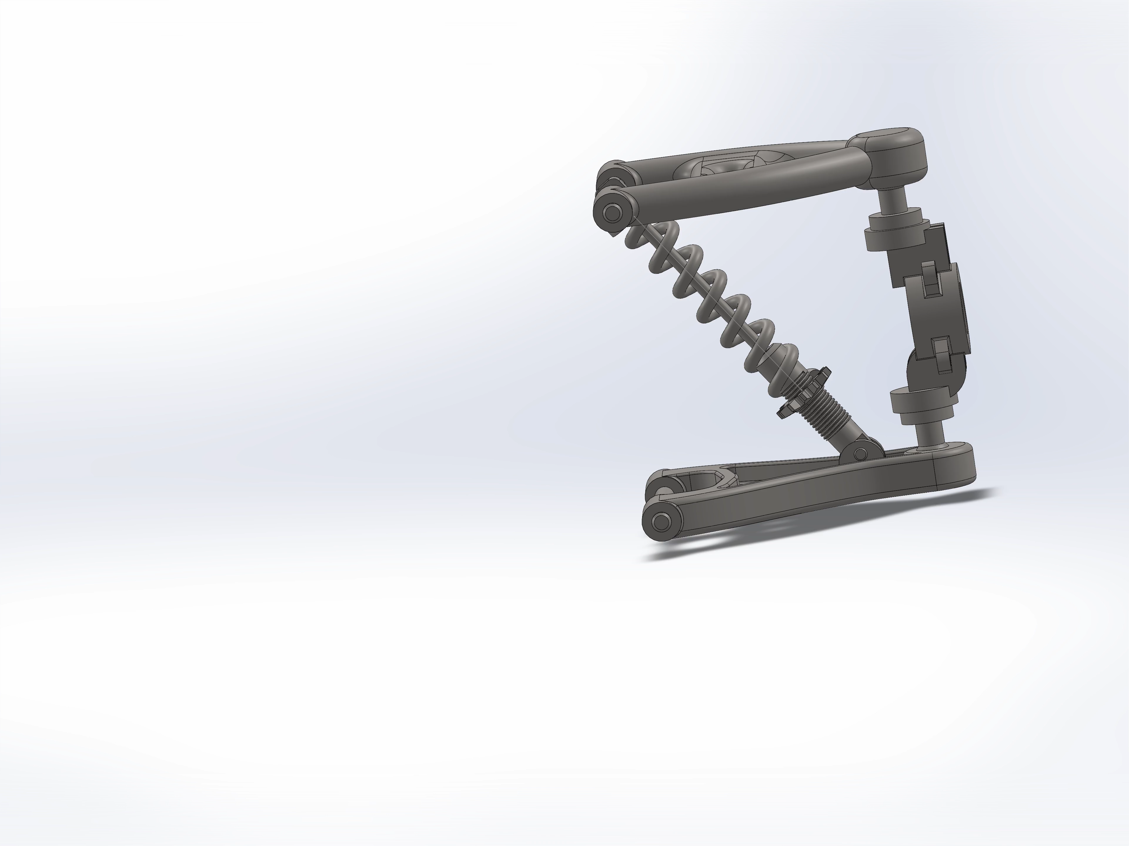
Motion Study of the Suspension System
Motion Study in SolidWorks To evaluate the dynamic behavior of the suspension, a motion study was performed in SolidWorks
.
Key Focus:
Spring length left partially undefined to allow dynamic adjustment
Mate constraints applied between spring ends and damper seats
This approach allowed SolidWorks to recalculate the spring’s length automatically, giving a realistic view of compression and rebound. The study also validated the system’s movement, ensuring smooth operation without collisions or unrealistic behavior.

Slide 19
Finite Element Analysis (FEA) in SolidWorks
Stress Analysis
Evaluate the stress distribution in suspension components under various loading conditions to ensure structural integrity and predict failure points before physical prototyping.
1
Design Optimization
Use FEA results to refine component designs, minimizing weight while maintaining strength and performance, leading to improved efficiency and reduced material costs.
2
Safety Validation
Perform safety factor assessments through FEA to confirm that suspension parts can withstand real-world operational stresses and enhance overall vehicle safety.
3

Slide 20
FEA Setup
Materials
Specify materials based on their application properties.
Loads
Implement realistic external loads to the model.
Validate
Confirm results match expectations for structural integrity.
1
2
3
4
5
Connections and Fixtures
Model connections to reflect mechanical behavior accurately.
Mesh
Develop a systematic meshing approach for analysis.

Slide 21
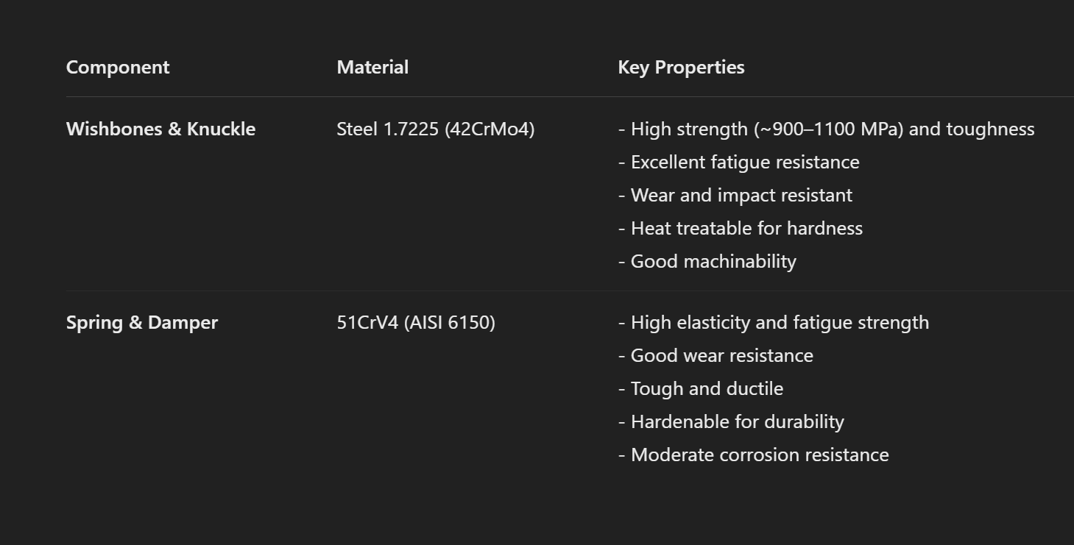
Material Definition

Slide 22
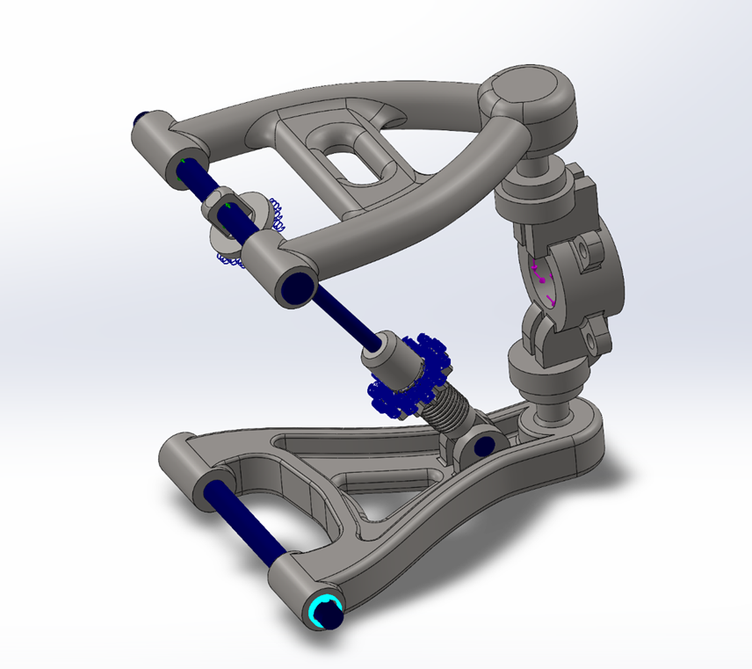
Connections
In the simulation, simplified connection methods were used to ensure accurate results and efficient performance:
Pins were set with zero rotational stiffness to allow free pivoting of components, replicating real-world behavior without adding artificial constraints.
Spring Connector replaced the physical spring model to reduce simulation complexity. A realistic stiffness value of 3.5×10⁷ N/m² was applied to represent the spring’s force-displacement behavior accurately.
These simplifications ensured reliable simulation results while keeping the model efficient and true to real suspension dynamics.

Slide 23
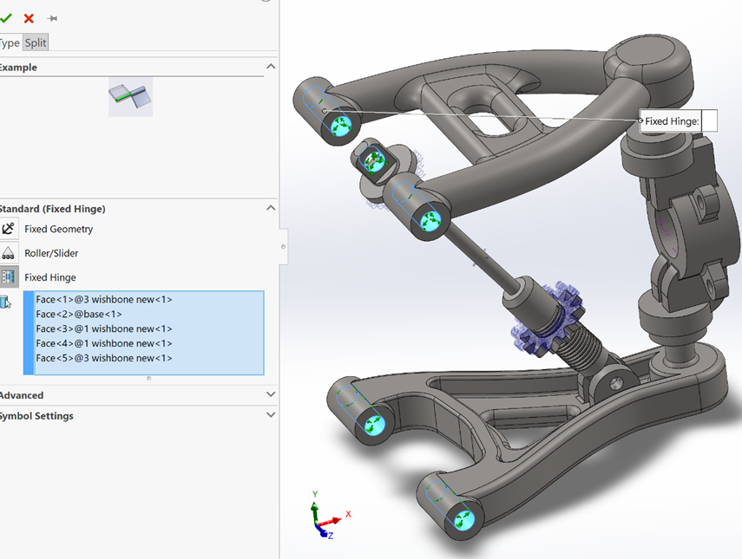
Fixture Selection
Simulation Constraints:
Fixed Hinge on Suspension Pins In the simulation, fixed hinge fixtures were applied to the upper and lower pins to reflect real-world behavior:
These pins are fixed to the chassis and act as pivot points, allowing rotation but preventing translation.
Applying a fixed hinge in SolidWorks accurately replicates this, ensuring realistic movement of connected components.
Freedom for Other Parts: Suspension elements like the wishbones and knuckle were left free to move, allowing proper articulation and load distribution during the simulation. This setup ensures accurate dynamic behavior under real driving conditions.

Slide 24
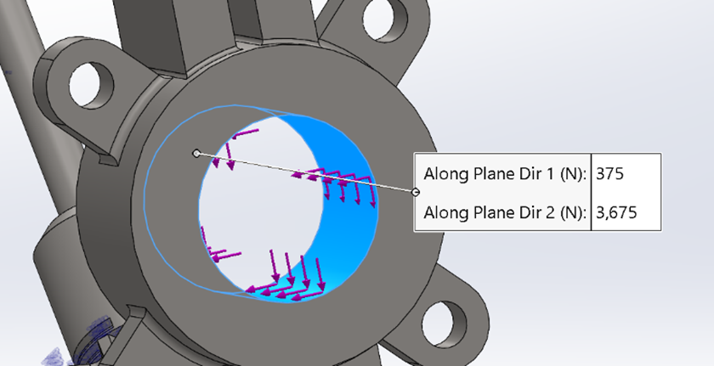
External Loads
Two main forces were applied in the simulation to represent real-world driving conditions:
Vertical Force: 3,675 N per wheel Represents the vehicle’s weight acting on each wheel.
Based on a total vehicle mass of 1,500 kg
Evenly distributed: 14,700 N ÷ 4 = 3,675 N
Reflects typical load on a passenger or light sports car
Longitudinal Force: 375 N per wheel Simulates moderate acceleration or braking forces.
Calculated using a 1 m/s² acceleration or deceleration
Total force: 1,500 N ÷ 4 = 375 N
Represents realistic driving dynamics

Slide 25
FEA Meshing Procedure and Refinement
Flow Chart
Start
Initial meshing
No
Refine mesh
Yes
End process
Enhance accuracy
End

Slide 26
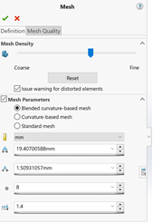
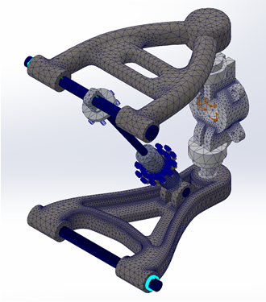
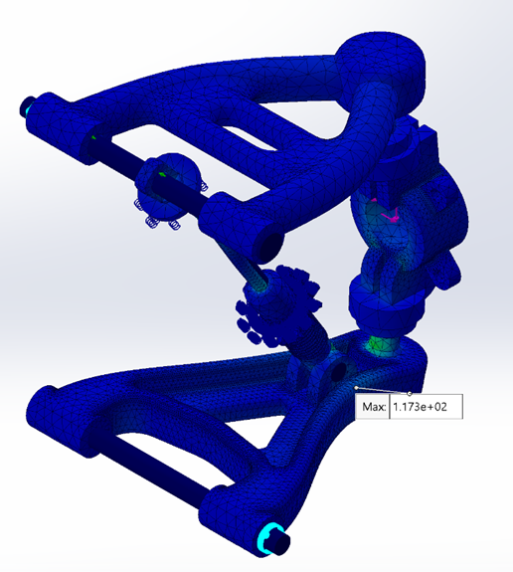
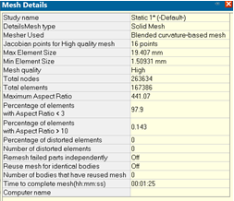
FEA Results and Validation
A structured three-step meshing process was used to balance simulation accuracy with computational efficiency:
Initial Low-Quality Mesh
Applied a coarse mesh for a quick, low-cost preliminary analysis
Helped identify critical stress areas for further refinement
Further refinement steps follow this stage to improve detail in key regions while managing simulation load.

Slide 27
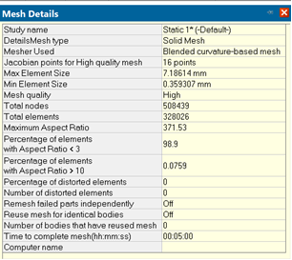
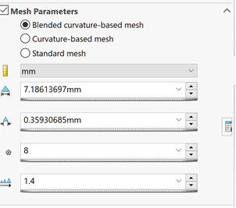
FEA Results and Validation
2. High-Quality Global Mesh Refinement
The mesh was then globally refined to improve the resolution of stress and strain distribution.
This step ensured that results became more accurate while maintaining an optimal element size across the model.

Slide 28
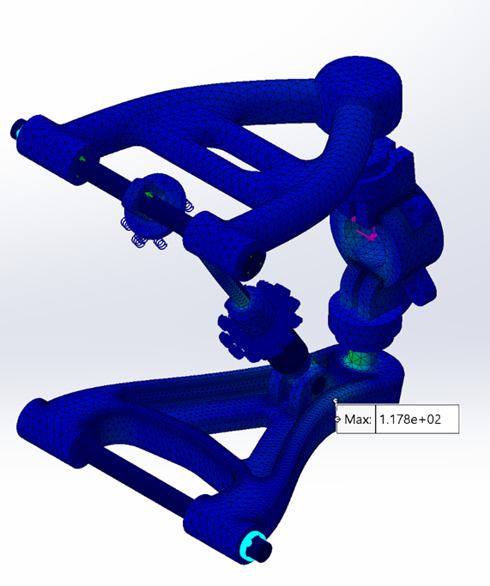
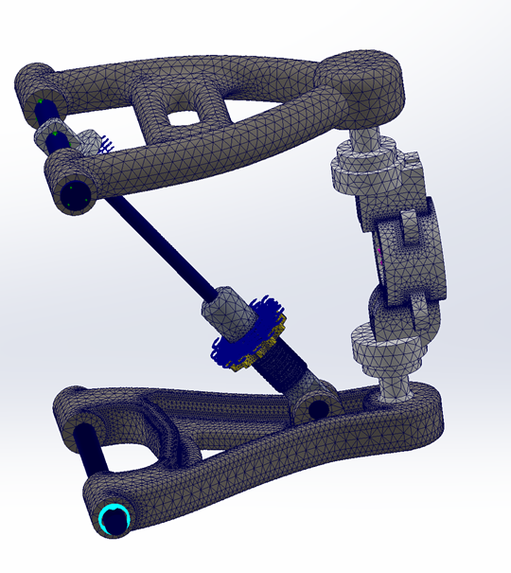
FEA Results and Validation
The maximum stress result in MPa:
2.High-Quality Global Mesh Refinement
The mesh was then globally refined to improve the resolution of stress and strain distribution.
This step ensured that results became more accurate while maintaining an optimal element size across the model.

Slide 29
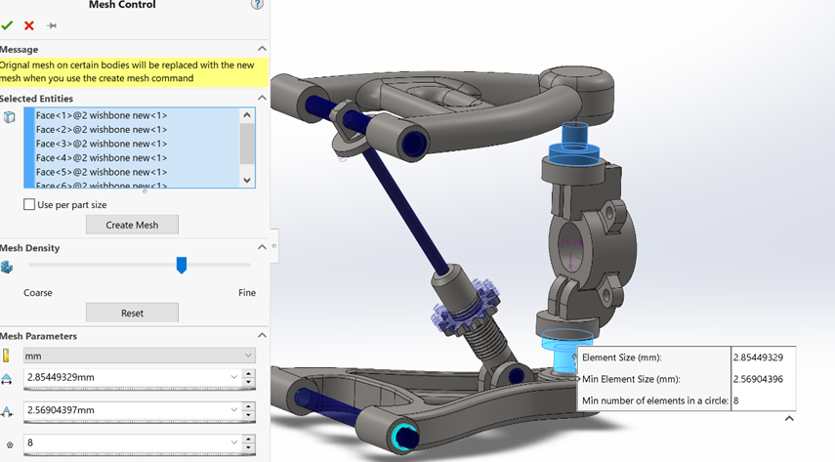
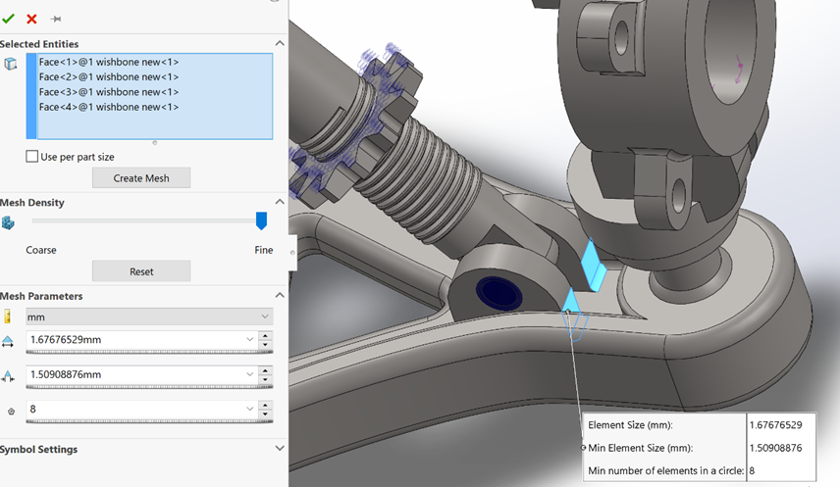
FEA Results and Validation
3. Localized Mesh Control for Critical Areas To improve accuracy, fine mesh controls were applied to regions with high stress identified in the initial analysis. This targeted refinement allowed:
More precise evaluation of stress distribution
Better insight into the performance of critical components
By combining coarse and fine meshes strategically, the simulation achieved a strong balance between accuracy, efficiency, and reliability.
The next section presents FEA result images showing the effects of mesh refinement on stress and deformation.

Slide 30
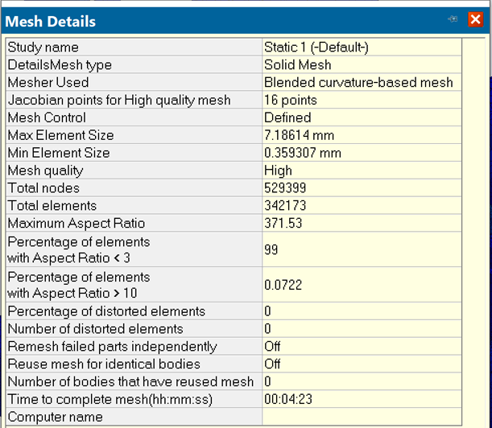
FEA Results and Validation
3. Localized Mesh Control for Critical Areas

Slide 31
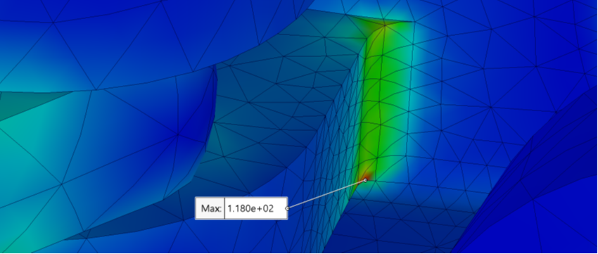
FEA Stress Analysis & Validation
The Finite Element Analysis showed a maximum stress of 118 MPa in the suspension system.
Material Properties Used:
Yield Strength: e.g., 250 MPa
Ultimate Tensile Strength (UTS): e.g., 400 Mpa
Conclusion:
The stress is well below the yield strength, indicating the design remains in the elastic range
No permanent deformation is expected under normal conditions
With standard safety factors considered, the structure is safe and reliable
The next section presents stress distribution images from the FEA results.

Slide 32
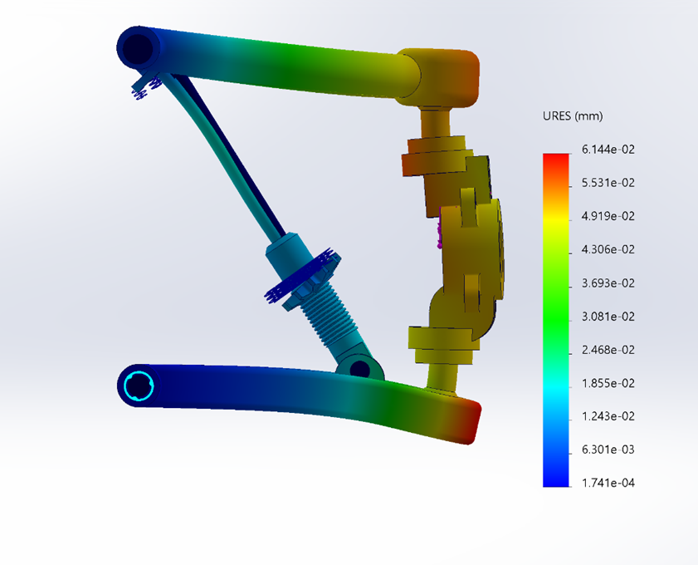
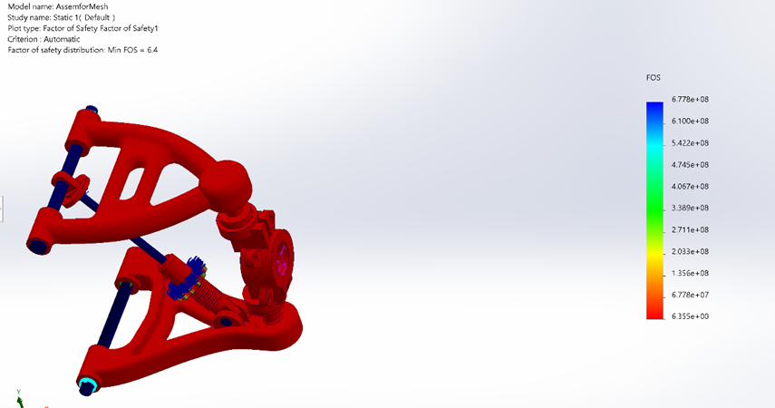
Safety Factor and Displacement Analysis
Safety Factor & Displacement Analysis Alongside stress evaluation, safety factor and displacement analyses were performed to verify structural reliability:
Safety Factor (SF):
Calculated as yield strength ÷ maximum stress
Results show the minimum SF is within safe limits, confirming the design can withstand applied loads without yielding
Displacement:
Measures how much components deflect under load
Results indicate displacement is minimal and acceptable, ensuring proper stiffness and performance
These findings confirm the suspension system is structurally sound and maintains its integrity under expected conditions.

Slide 33
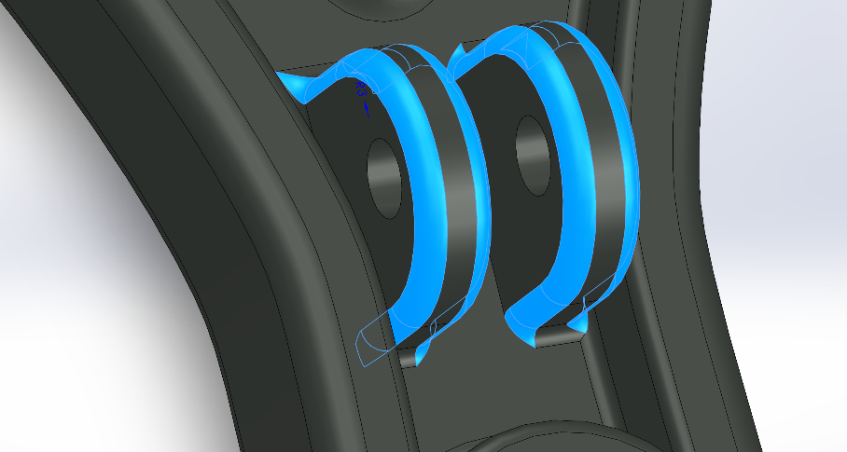
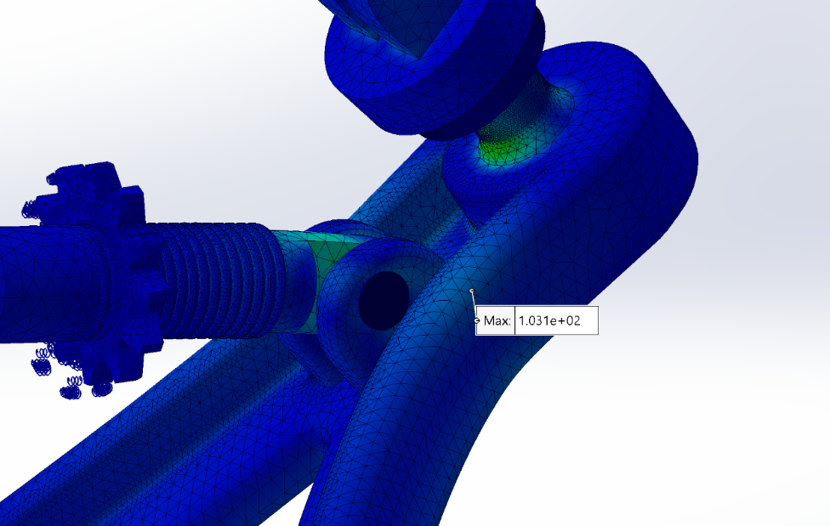
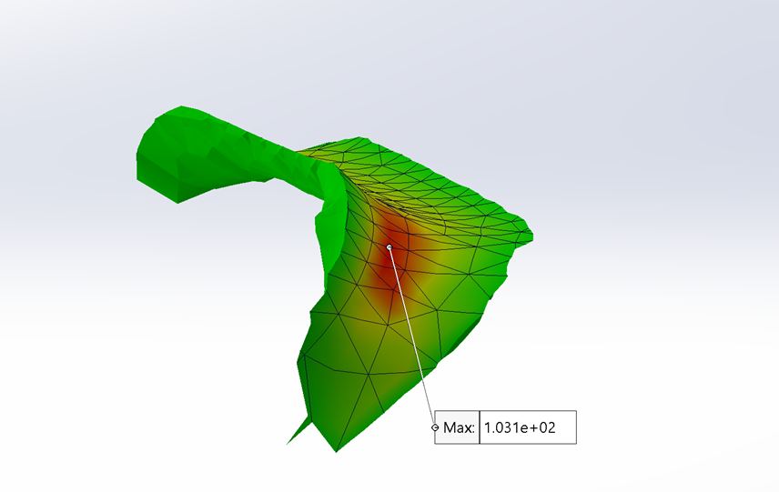
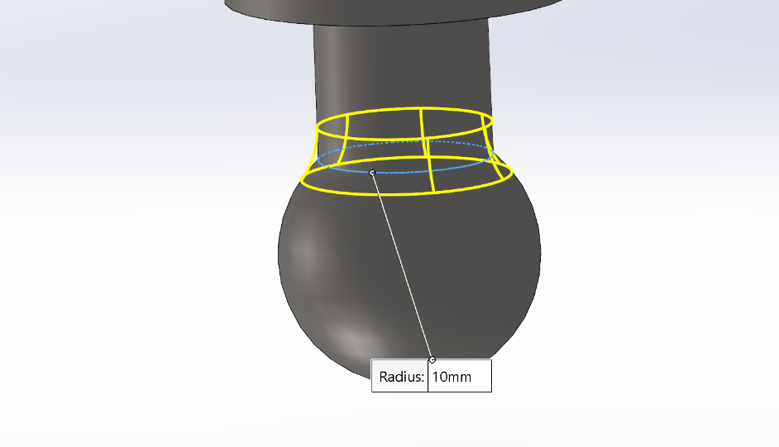
Design Update & Stress Reduction
I redesigned the areas in the assembly where the highest stress was concentrated. As a result, the maximum stress decreased from 118 MPa to 103 MPa. This improves the overall strength and reliability of the structure by reducing stress concentrations and increasing durability.

Slide 34
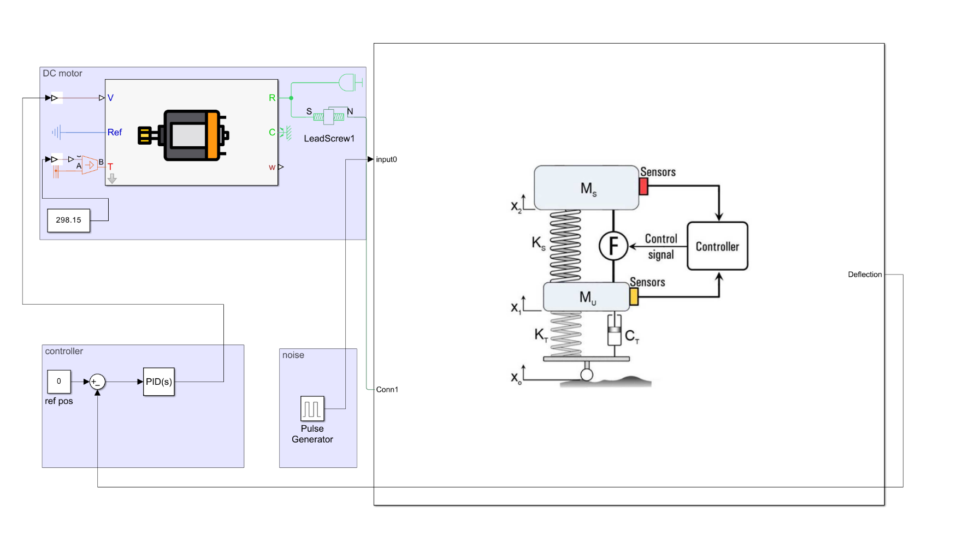
MATLAB Simscape Modeling and PID Control
System Integration
Seamlessly integrate various components of electromechanical suspension using MATLAB for enhanced design efficiency.
1
Real-Time Simulation
Conduct real-time simulations to assess suspension dynamics, improving design accuracy and performance.
2
Control Optimization
Utilize PID control optimization to enhance response times and stability in active suspension systems during operation.
3
Performance Evaluation
Evaluate the overall functionality and effectiveness of the active suspension system under different operational conditions.
4

Slide 35
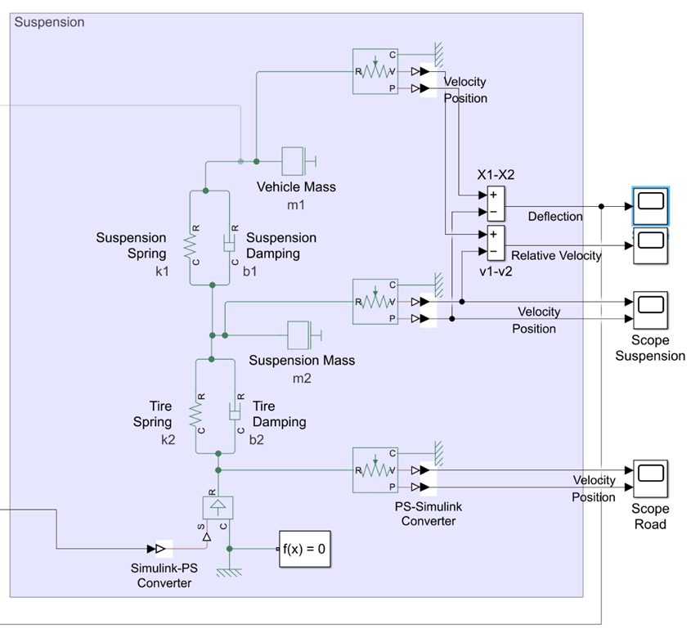
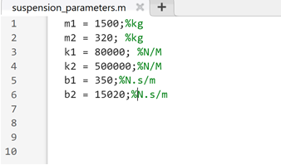
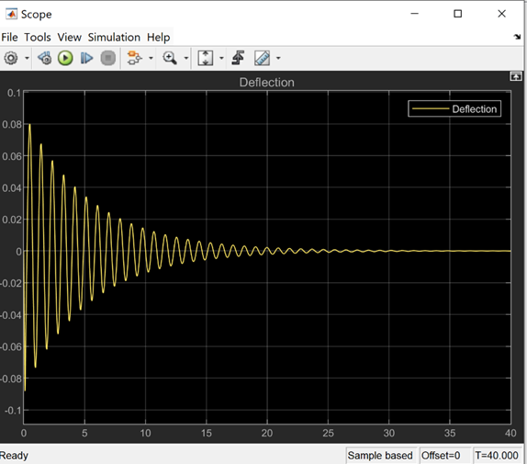
Passive Suspension System Modelling
A passive suspension system uses springs and dampers to absorb shocks and enhance ride comfort. It includes two key subsystems:
Suspension System (Body to Wheel)
Spring: Supports vehicle weight and absorbs road impacts.
Damper: Controls oscillations and dissipates energy.
Tire Model (Wheel to Road)
Tire Spring: Models tire elasticity under load.
Tire Damper: Represents energy loss and contact realism.
A pulse generator in MATLAB Simscape simulates a 10 cm road disturbance (e.g., a bump), allowing assessment of system performance under sudden shocks.
The displacement of car body (m):

Slide 36
Transition to Active Suspension System
Modeling
Begin with a detailed simulation of the traditional passive suspension system to gather baseline performance data.
Testing
Conduct real-time simulations to analyze the performance and responsive behavior of the new active suspension system.
1
2
3
Integration
Incorporate the electromechanical components and control algorithms into the existing suspension model for active control.

Slide 37
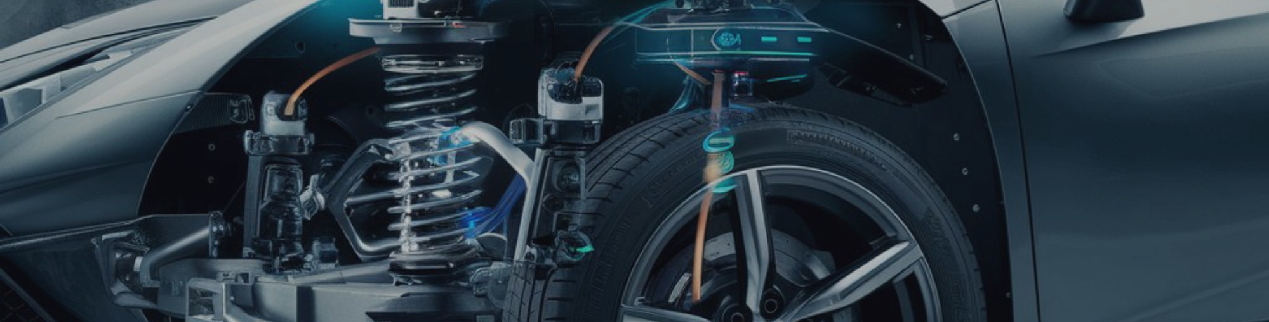
Active Suspension Components
To improve performance, an electromechanical active suspension was developed by integrating a DC motor and lead screw mechanism into the model.
Key Components:
DC Motor & Lead Screw
Converts electrical input into mechanical adjustment of the suspension.
Provides real-time control to respond to road disturbances.
Controlled Voltage Source
Powers the DC motor.
Regulated by a PID controller to ensure precise and adaptive suspension movement.
This setup enables active damping, enhancing ride quality beyond the capabilities of a passive system.

Slide 38
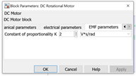
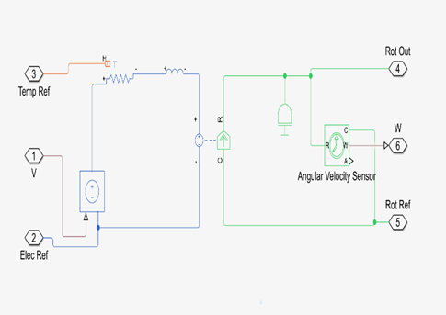
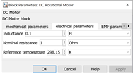
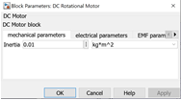
Specifications of the DC motor

Slide 39
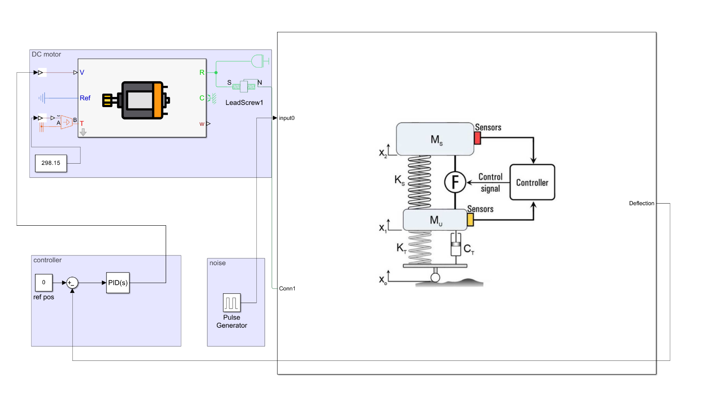
PID Controller
The PID controller ensures optimal ride comfort by minimizing suspension error.
Function:
Inputs:
Desired vertical position of the car body (ideal = zero displacement).
Actual suspension output from road disturbances.
Action:
Calculates the error between desired and actual values.
Adjusts motor voltage accordingly to correct suspension movement.
This feedback loop enhances ride comfort and vehicle stability through continuous, real-time control.

Slide 40
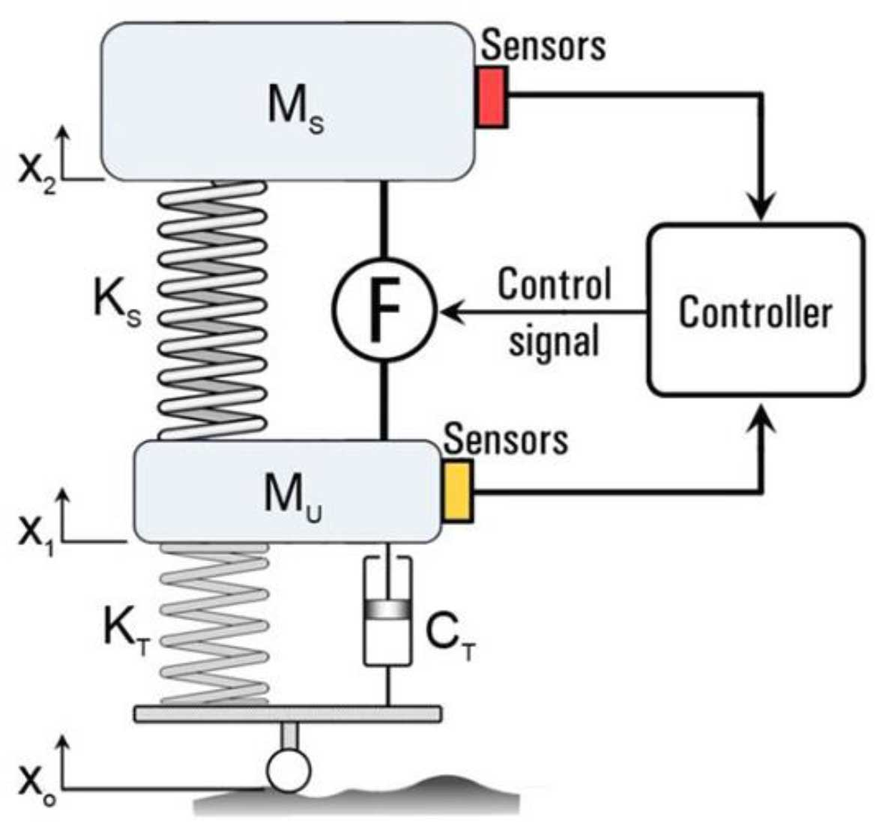
Functionality Results of the Active Suspension
When the pulse generator introduces a 10 cm road disturbance, the PID controller detects the resulting deviation.
The DC motor and lead screw actively adjust the suspension force to counteract this displacement.
This allows the suspension system to quickly adapt, reducing oscillations and enhancing overall ride quality compared to the passive system.

Slide 41
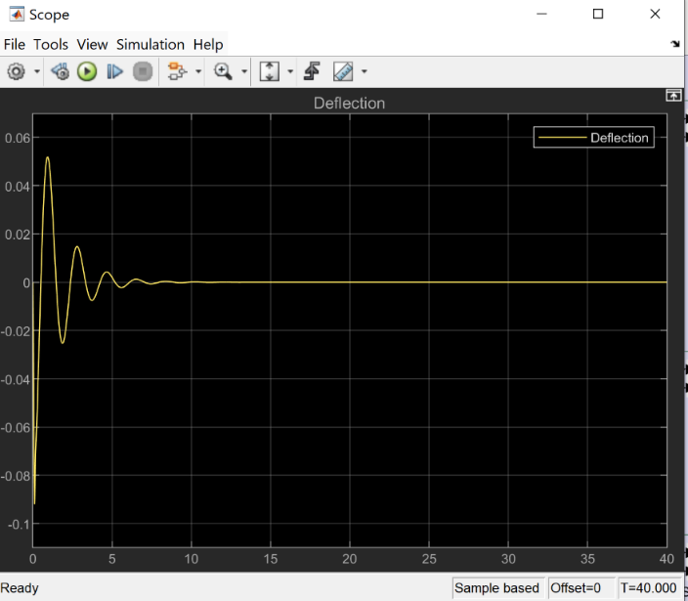
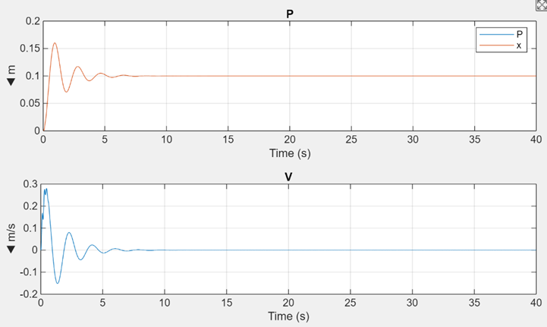
Results
The following section presents simulation results, showcasing the performance improvements achieved with the active suspension system:
The relative displacement between car body and tire after applying an active force:
The motion sensor (upper one) used to check the results of car body motion:

Slide 42
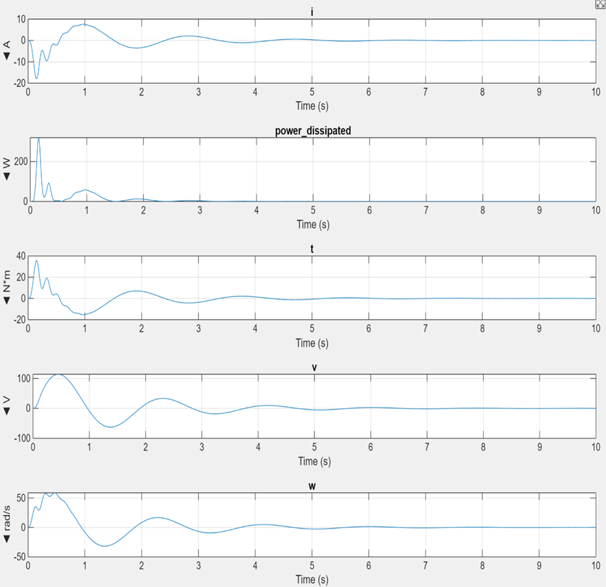
Results
The DC Motor results:

Slide 43

Thank You

