Slide 1

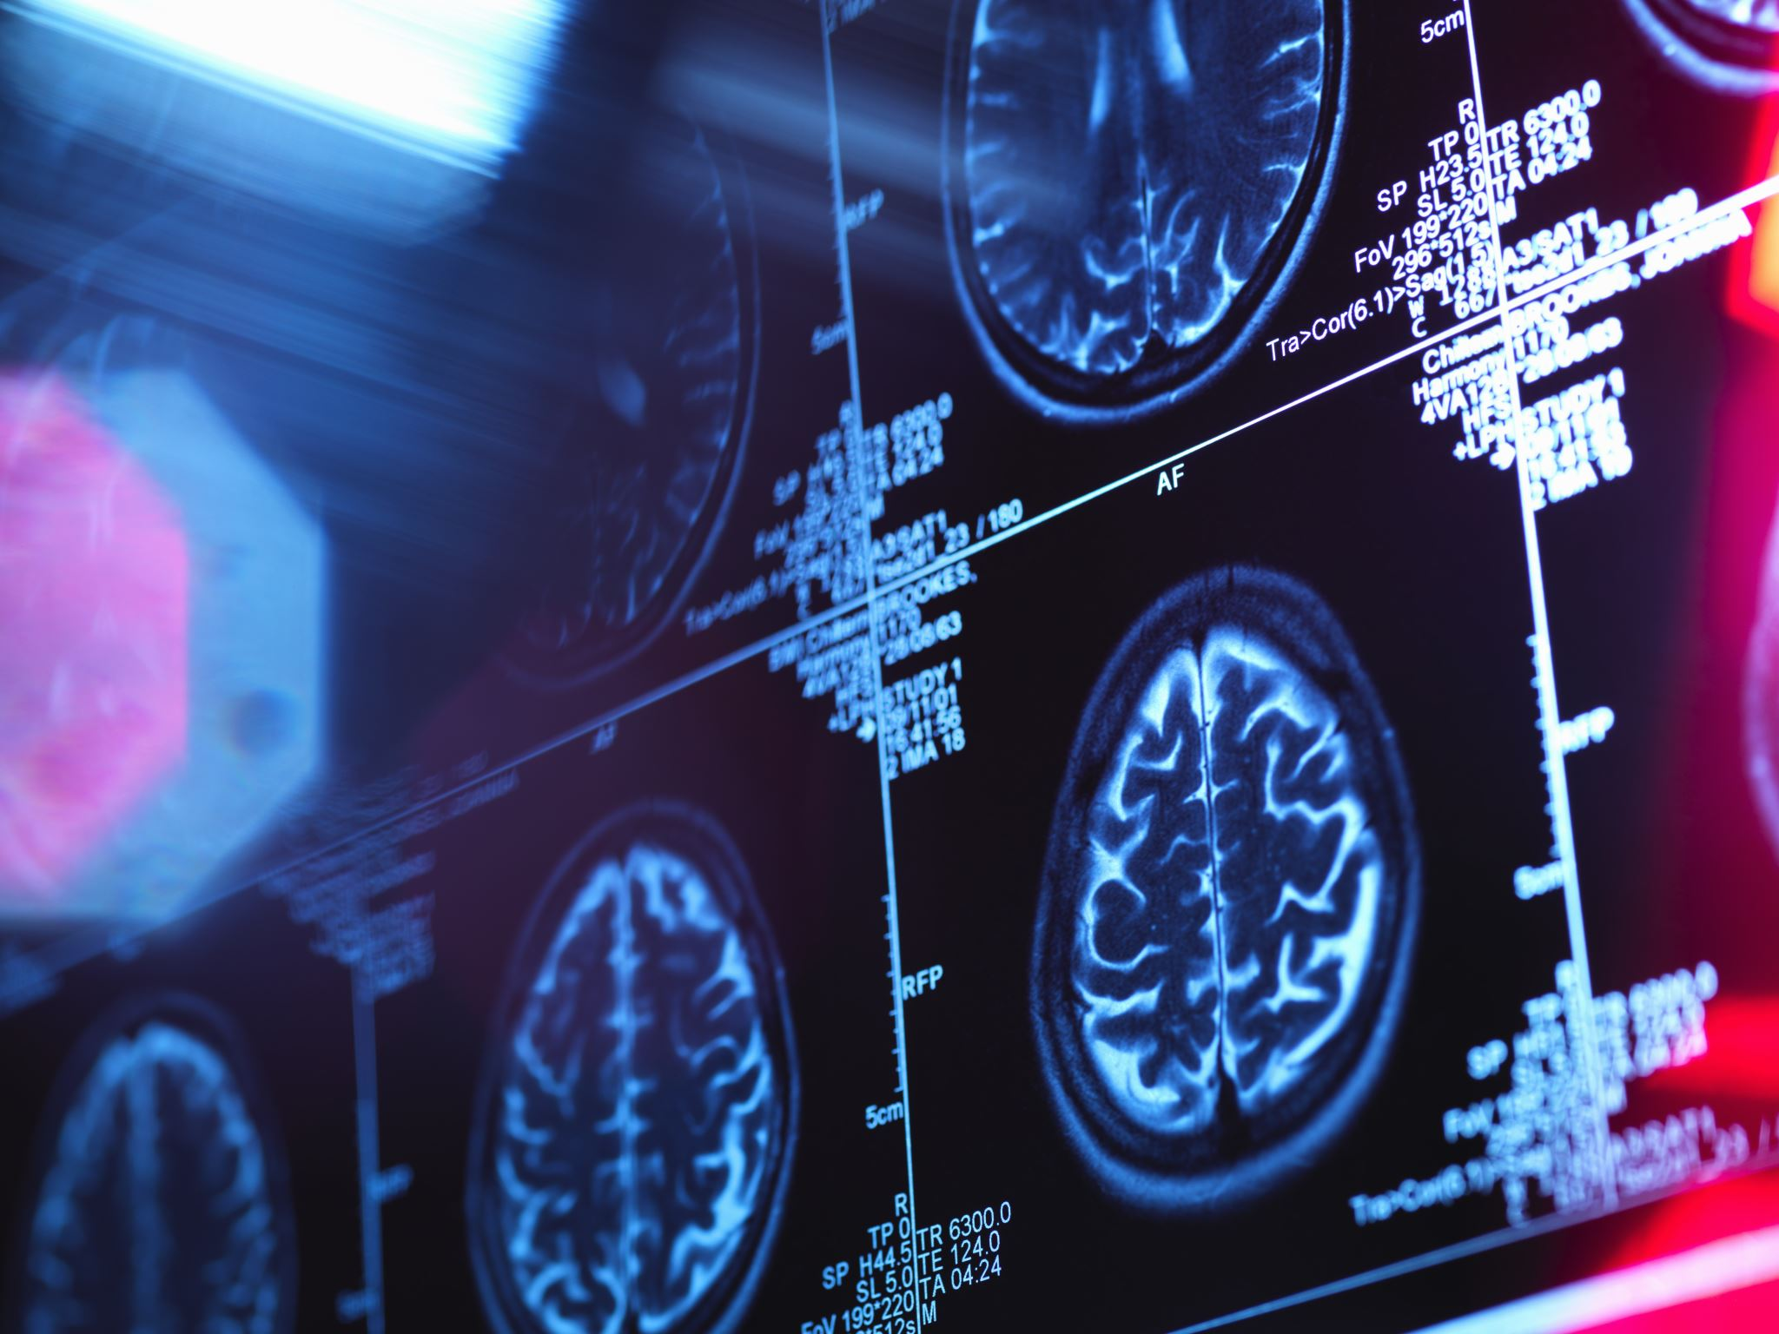
Improving Alzheimer's Detection from MRI Scans Using GAN-Generated Synthetic Data
Enhancing Model Performance through Data Augmentation
Presented by: Pop Dorian-Dumitru

Slide 2
Introduction
Alzheimer’s disease (AD) – a leading cause of dementia
MRI scans – crucial for early detection
Problem: Limited availability of annotated MRI scans
Solution: Use GAN-generated synthetic data to augment real datasets

Slide 3
Research Questions
Can GAN-generated synthetic MRI scans improve model performance?
How does synthetic data affect learning speed and accuracy?
What are the risks and limitations of using synthetic data?

Slide 4
Contributions
Novel approach for augmenting MRI datasets using GANs
Comparative analysis of models trained on real vs. combined data
Improved accuracy and generalization using synthetic data

Slide 5
Proposed Approach
Baseline Model: Trained on real MRI data only
Augmented Model: Trained on real + synthetic MRI data
GAN generates realistic synthetic MRI scans to expand the dataset

Slide 6
GAN Architecture
Generator: Creates synthetic MRI scans from random noise
Discriminator: Distinguishes real MRI scans from synthetic ones
Adversarial training improves the quality of synthetic images

Slide 7
Model Training Process
Dataset Preparation: Split real MRI data into train, validation, and test sets
GAN Training: Train for 1000 epochs with decaying instance noise
Detection Models: Train CNN models using real and combined datasets

Slide 8
Experimental Setup
Real Dataset: 300 MRI scans (100 per class)
Synthetic Dataset: Generated by GAN
Evaluation Metrics: Accuracy, loss, precision, recall, F1-score

Slide 9
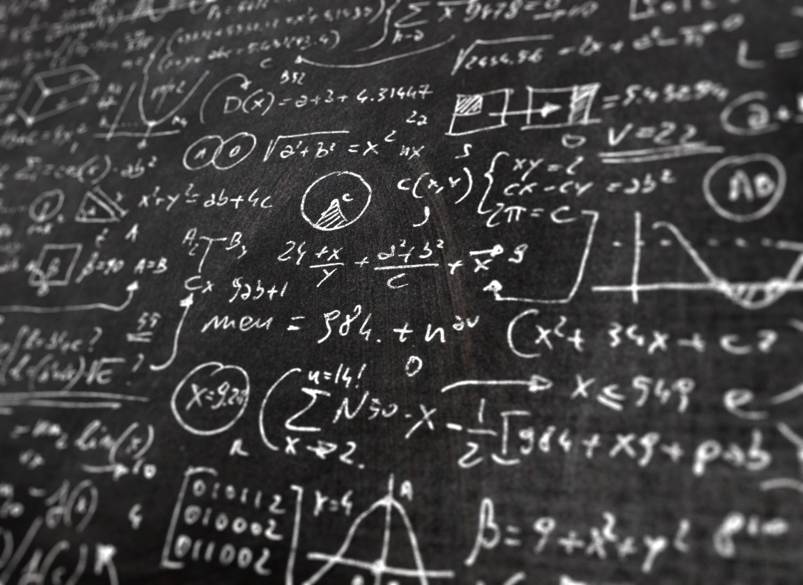
Hyperparameters
Learning rate (generator): 0.0002
Learning rate (discriminator): 0.0001
Batch size: 64
Epochs: 1000
Weight clipping: [-0.01, 0.01]
Instance noise: 0.05 (decaying to 0.01)

Slide 10
Results (Accuracy & Loss)
Epoch 10: Real Data Accuracy = 0.4579, Combined Data Accuracy = 0.3789
Epoch 20: Real Data Accuracy = 0.5788, Combined Data Accuracy = 0.5789
Epoch 30: Real Data Accuracy = 0.6923, Combined Data Accuracy = 0.6421
Epoch 40: Real Data Accuracy = 0.6740, Combined Data Accuracy = 0.7088
Epoch 50: Real Data Accuracy = 0.6898, Combined Data Accuracy = 0.6888

Slide 11
Test Set Results
Real Data: Accuracy = 0.6912, Loss = 0.7171
Combined Data: Accuracy = 0.7339, Loss = 0.6988

Slide 12
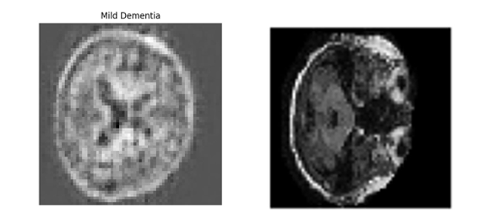
Example of a GAN generated MRI scan (left) and a real MRI scan (right)

Slide 13
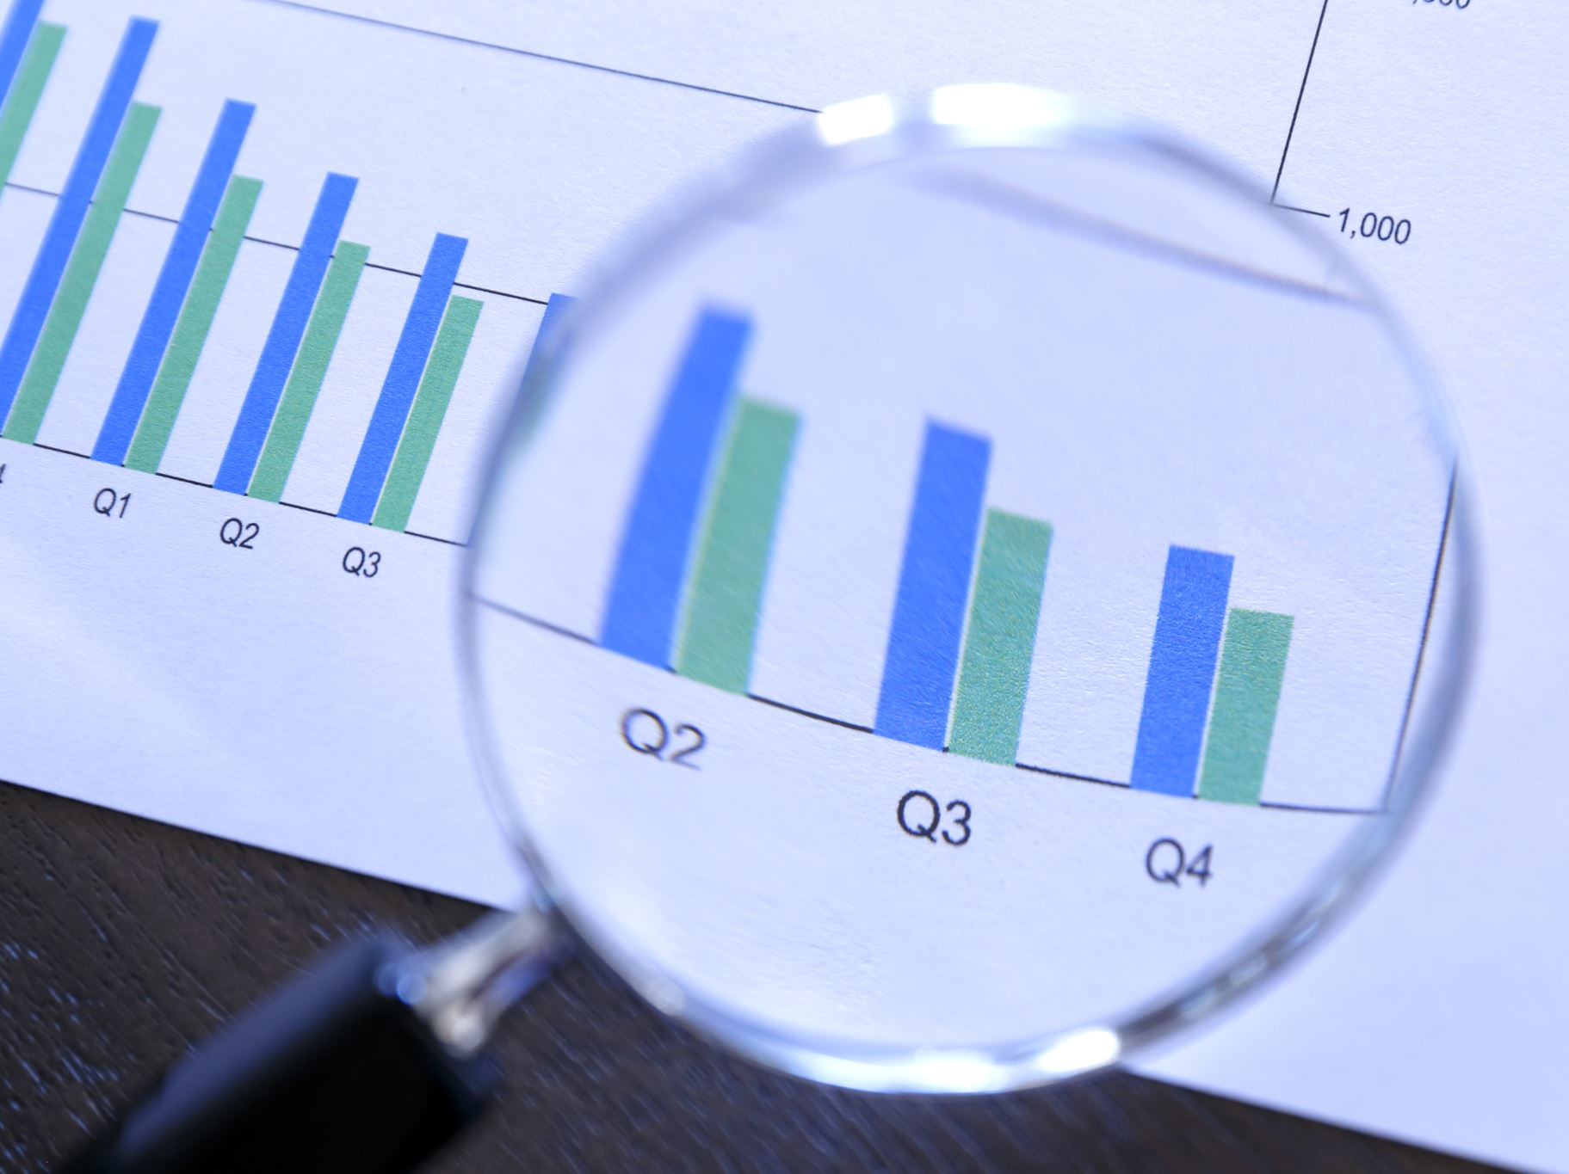
Interpretation of Results
Accuracy: Combined data improved test accuracy by ~4%
Loss: Lower loss for combined data indicates better model generalization
GAN-generated data helped overcome data scarcity and improved performance

Slide 14
Comparison with Existing Work
Traditional data augmentation – limited variations
GAN-generated data – more realistic and diverse variations
Results validate the potential of GANs in medical imaging

Slide 15
Future Work
Test on larger datasets
Experiment with advanced GAN architectures (e.g., WGAN-GP)
Apply the approach to other medical imaging tasks

Slide 16
Conclusion
GAN-generated synthetic data can effectively augment real MRI datasets
Improves model accuracy and generalization for Alzheimer’s detection
Addresses the challenge of limited data availability in medical imaging

Slide 17

Q&A
Questions?
Thank you for your attention!

