Slide 1
Getting Started With R Programming
Conrad Williams

Slide 2
Workshop Goals
Goals:
Install R and RStudio
Understand the RStudio layout
Understand basic programming in R
Variables, math, conditionals, loops, functions, etc.
Installing and importing packages from CRAN
Learn to read in, visualize, and analyze data in R
Examples covered are far from exhaustive, but will provide a baseline understanding
NOT covered:
Choosing appropriate statistical tests for your data and interpreting results

Slide 3


Installing R and RStudio
There is a short guide to installing R and RStudio in the OneDrive directory for this workshop (“01_Installing_R_and_RStudio.pdf”).
Let’s take the time now to step through that guide and make sure everyone has RStudio up and running.

Slide 4
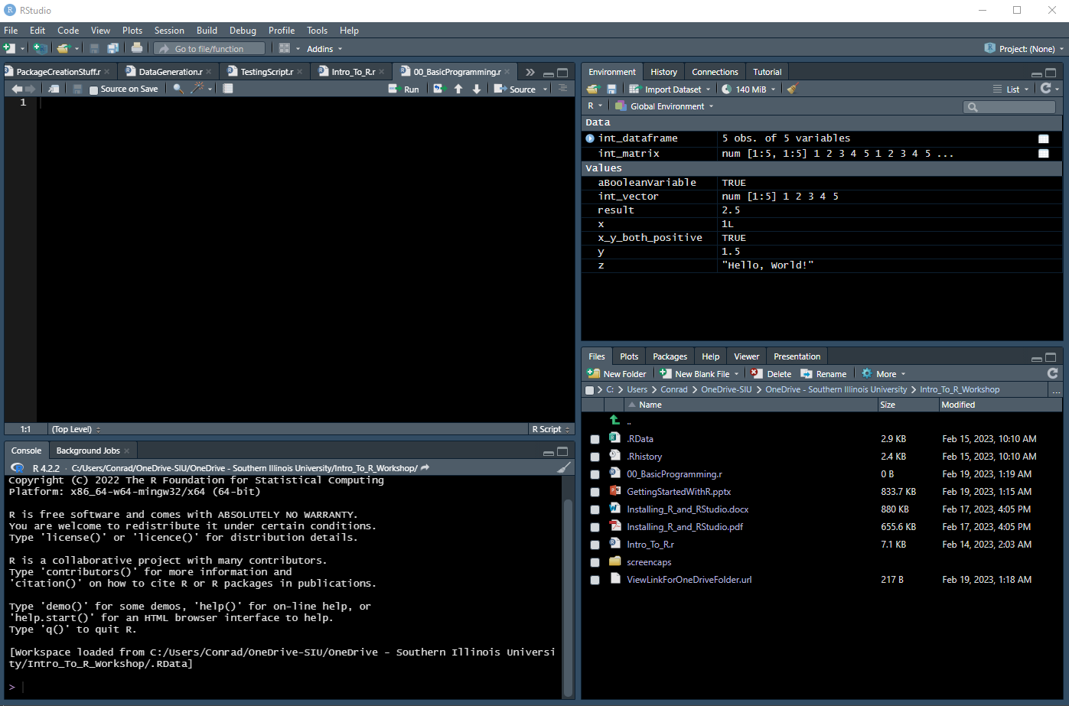
The RStudio Window: Regions
Open R Scripts
Environment, History, Etc.
Console
Files, Plots, Help, Etc.

Slide 5
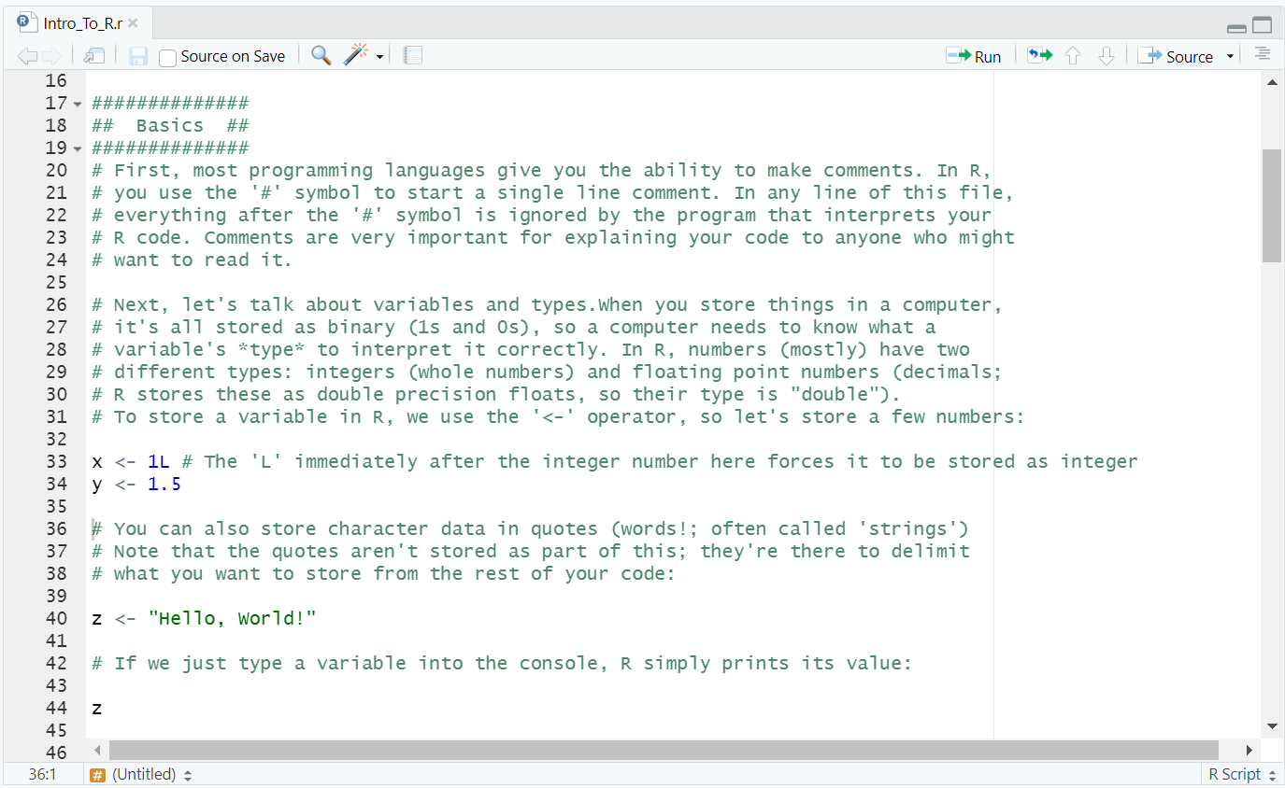
Scripts
Where R scripts open (files named like “filename.r”)
While you can run your commands one at a time in the console, it’s often better to encapsulate a series of commands in a script that you can save
You can run lines of code by clicking into a line and pressing “Ctrl + Enter”
You can also highlight multiple lines and run them

Slide 6
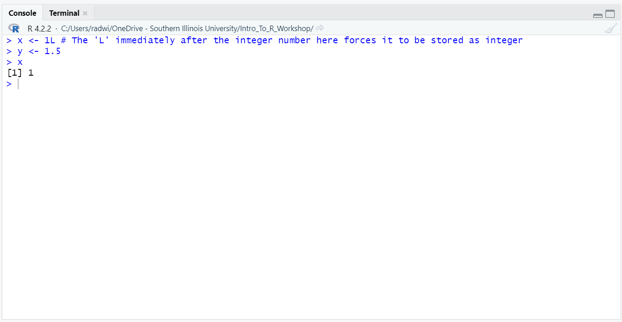
Console
An R prompt: where your commands are interpreted and run
You can type commands here one line at a time
The “Terminal” tab here opens your operating system’s terminal in R’s current working directory (we won’t use this today)

Slide 7
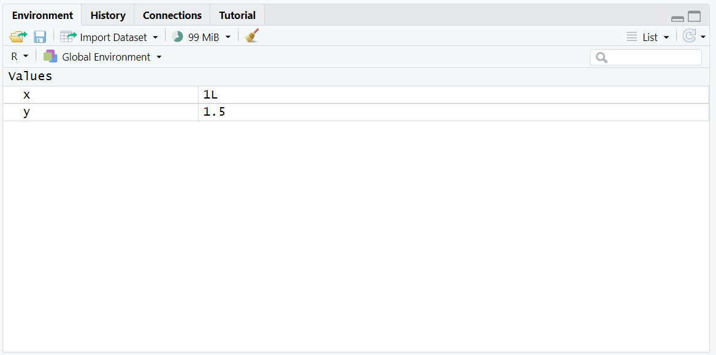
Environment, History, etc.
The Environment tab shows values that you’ve stored in memory
Includes variables and functions
Shows how much memory is currently allocated
Allows you to save your current environment and load saved environments (referred to as Workspaces)
You can also import datasets using the GUI here!

Slide 8
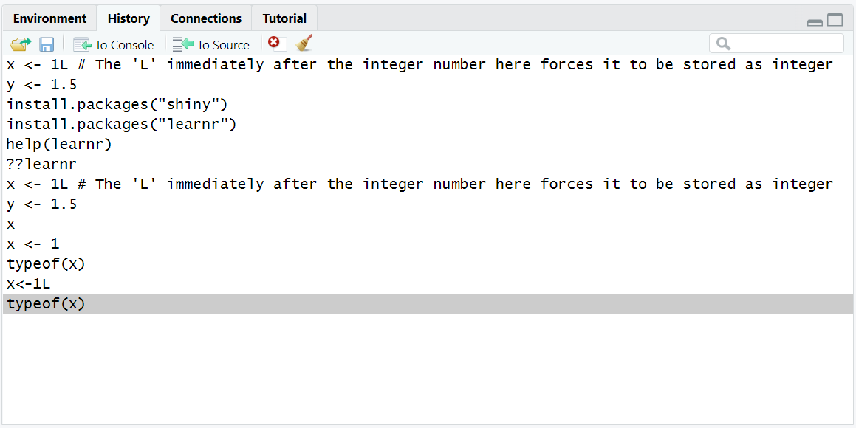
Environment, History, etc.
The History tab shows recently run commands
You can rerun commands here or send them to an open script
Mostly useful if you’ve been typing commands in the console instead of keeping them in a script
Can also save and load history to and from files (*.Rhistory)

Slide 9
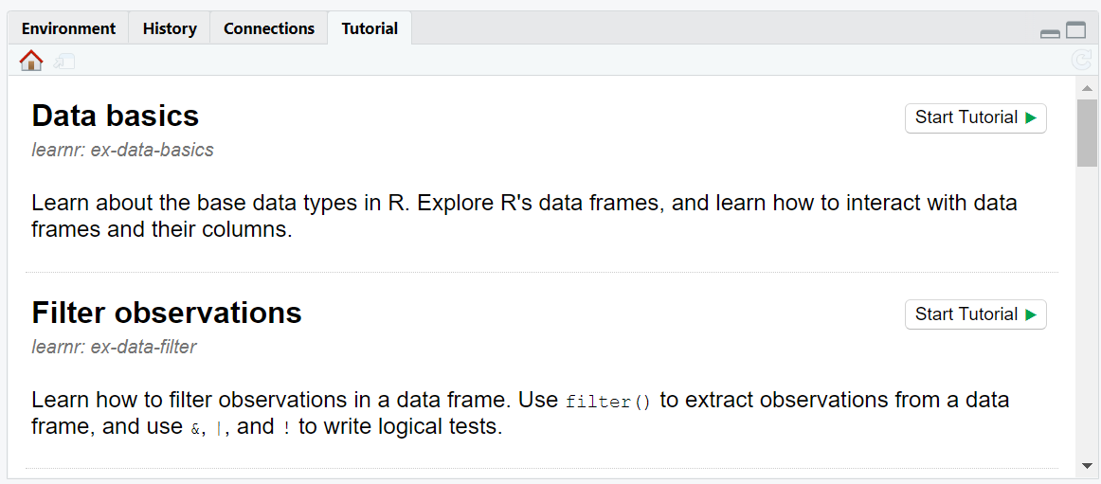
Tutorial Tab: Accessing Built-in Tutorials
RStudio has a series of built in tutorials that can introduce you to more advanced features and packages
This is contained in the “Tutorial” tab of the upper-right region
Prior to running these, you’ll need to install the “learnr” and “shiny” packages
Good place to keep learning after today’s workshop

Slide 10
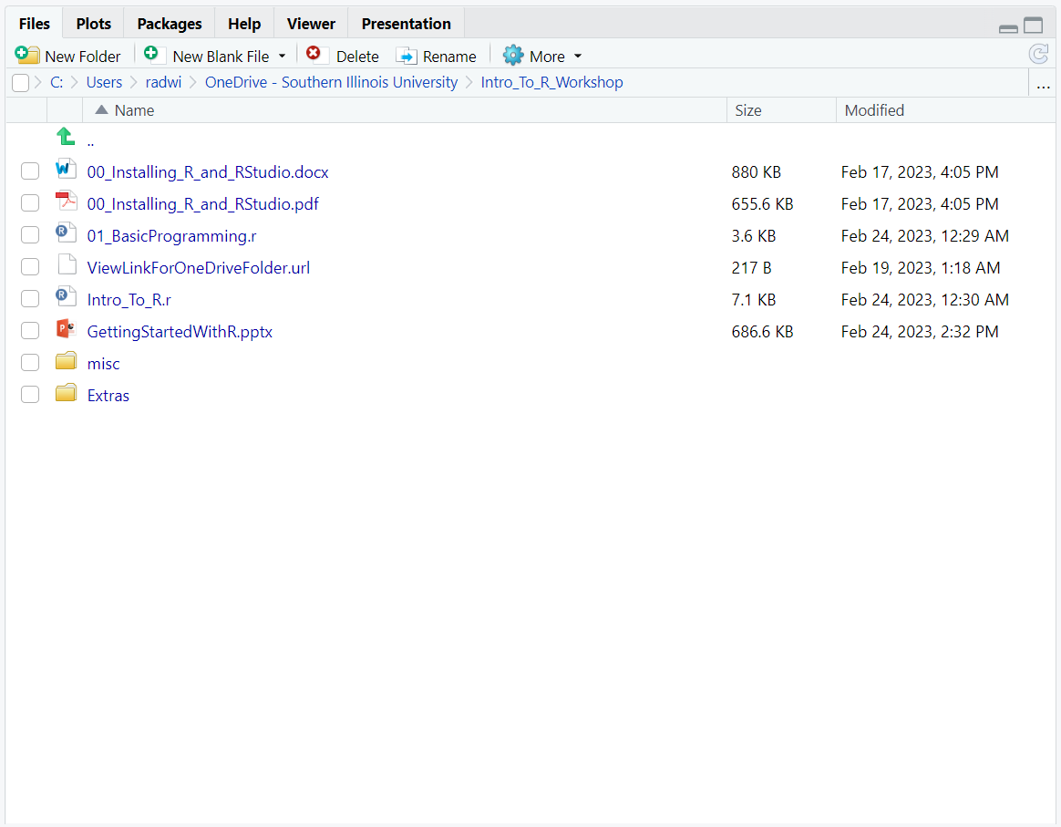
Files, Plots, Packages, Help
The Files tab shows files in the current working directory (more on that when we talk about reading in data later)

Slide 11
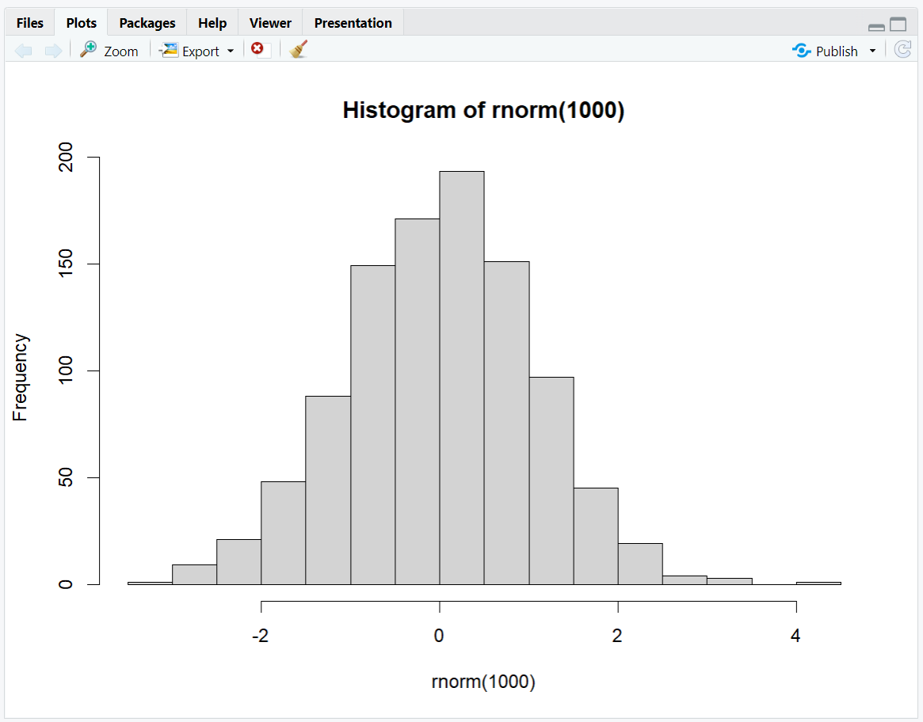
Files, Plots, Packages, Help, etc.
The Plots tab shows graphical output from functions you run in R
You can also save your plots from here using the “Export” drop-down menu (covered later)
The plot to the right is a histogram of 1000 random sample from a normal distribution generated with the following command:
hist(rnorm(1000))

Slide 12
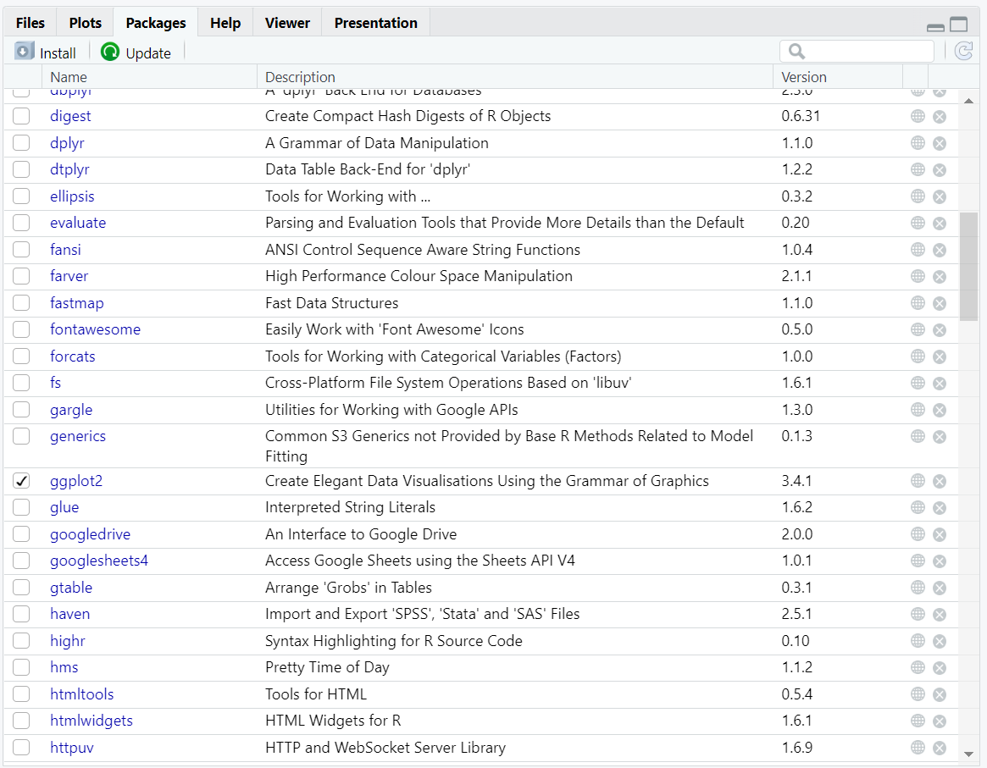
Files, Plots, Packages, Help
The Packages tab shows installed ‘packages’ which are collections of functions and other objects
☑ packages are loaded so we can call functions from them
You can also install new packages using the “Install” menu on this tab
More on packages later!

Slide 13
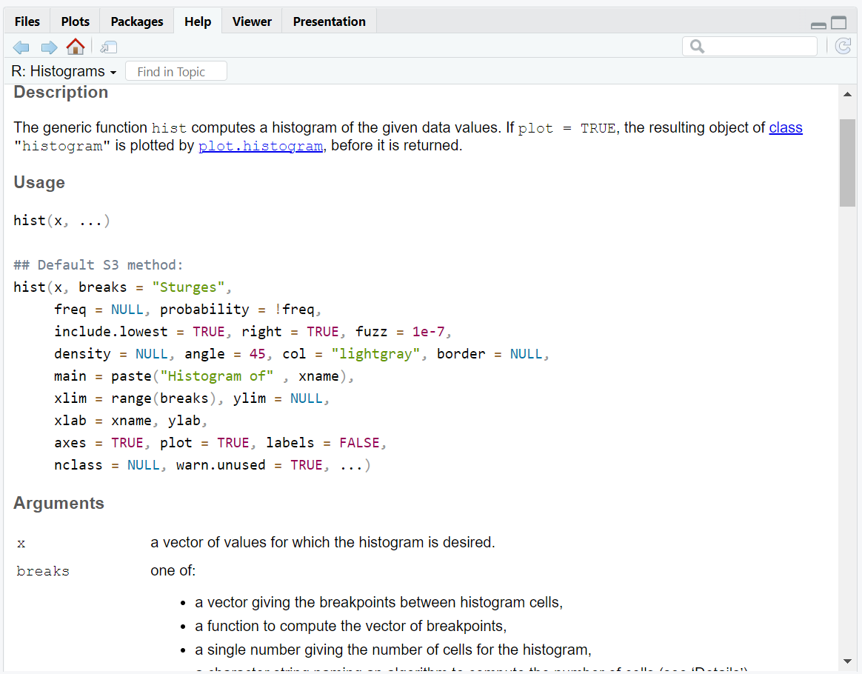
Files, Plots, Packages, Help
The Help tab shows the documentation for functions and packages.
Extremely useful
Try running the following in the console to get the documentation for the hist() function used earlier:
help(“hist”)

Slide 14
Starting Today’s Workshop Scripts
You should now have R and RStudio installed and have become somewhat familiar with RStudio's layout.
To start the first workshop script, locate “02_BasicProgramming.r” and double-click it.
This should prompt the OS to ask what program you want to open that file
Choose “RStudio” and allow the OS to associate the “*.r” file extension with RStudio.
The rest of the workshop will use the scripts in this directory

