Slide 1
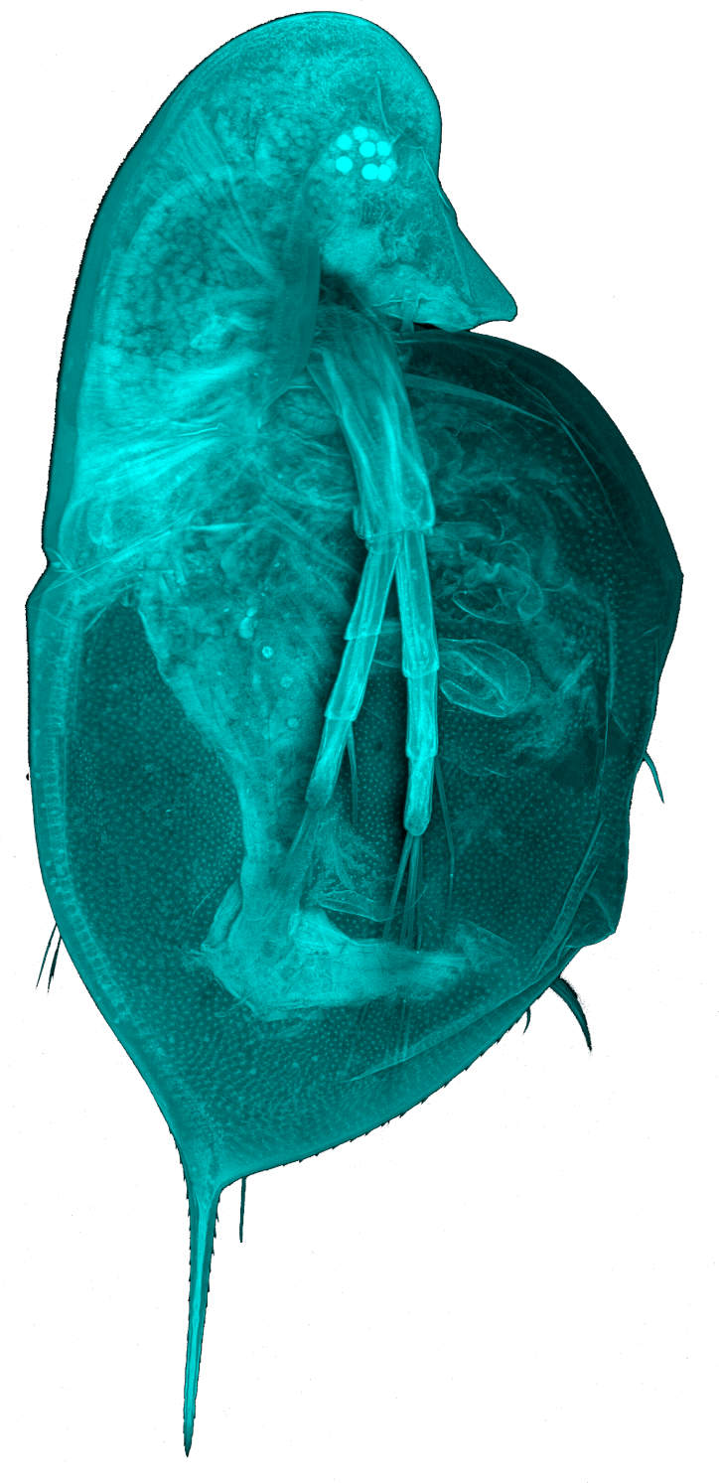
Hybridisation in European Daphnia - Practical
Mathilde Cordellier
Summer school – 26.07.2019

Slide 2
Variant analysis
Reference
ACTGCTCTCGGGATTACGATTTGGTATATAGGGTCTCTCTA
Pool 1
ACTGCTCTCGGGATGACGATTTGGTATATAGGGTCTCTCTA
ACTGCTCTCGGGATGACGATTTGGTATATAGGGTCTCTCTA
ACTGCTCTCGGGATGACGATTTGGTATATAGGGTCTCTCTA
ACTGCTCTCGGGATGACGATTTGGTATATAGGGTCTCTCTA
Pool 2
ACTTCTCTCGGGATTACGATTTGGTATATAGGGTCTCTCTA
ACTTCTCTCGGGATTACGATTTGGTATATAGGGTCTCTCTA
ACTGCTCTCGGGATTACGATTTGGTATATAGGGTCTCTCTA
ACTGCTCTCGGGATTACGATTTGGTATATAGGGTCTCTCTA
CHR POS REF ALT GEN Pool1 GEN Pool2
1 4 G T 0/0 0/1
1 15 T G 1/1 0/0

Slide 3


Genomes in diploid Daphnia
Nuclear genome:
Paternal/maternal inheritance
Diploid
1 diploid individual is either
Homozygous = carries only ONE allele
OR
Heterozygous = carries TWO alleles
Mitochondrial genome:
Maternal inheritance
Haploid
1 diploid individual has
only ONE allele
If I extract the DNA from 30 individuals, how many alleles will I observe in total?

Slide 4
Next gen sequencing approaches
High Throughput Sequencing produces large datasets.
Every piece of DNA is sequenced several times, depending on the size of the region of interest (it can be a 400bp DNA region or a whole genome). Mileage or rather coverage varies.
In our case, we obtained several thousands of sequences called „reads“ for each region of interest.
If the sample contained more than one allele, it will be visible in the data
We can use the frequencies of the reads to estimate the allelic frequencies

Slide 5
Poolseq approaches
Diag. Sp. A
Diag. Sp. B
Reference
ACTGCTCTCGGGATTACGATTTGGTATATAGGGTCTCTCTA
Pool 1
ACTGCTCTCGGGATGACGATTTGGTATATAGGGTCTCTCTA
ACTGCTCTCGGGATGACGATTTGGTATATAGGGTCTCTCTA
ACTGCTCTCGGGATGACGATTTGGTATATAGGGTCTCTCTA
ACTGCTCTCGGGATGACGATTTGGTATATAGGGTCTCTCTA
Pool 2
ACTTCTCTCGGGATTACGATTTGGTATATAGGGTCTCTCTA
ACTTCTCTCGGGATTACGATTTGGTATATAGGGTCTCTCTA
ACTGCTCTCGGGATGACGATTTGGTATATAGGGTCTCTCTA
ACTGCTCTCGGGATGACGATTTGGTATATAGGGTCTCTCTA

Slide 6
Poolseq approaches
Diag. Sp. A
Diag. Sp. B
Reference
ACTGCTCTCGGGATTACGATTTGGTATATAGGGTCTCTCTA
Pool 1
ACTGCTCTCGGGATGACGATTTGGTATATAGGGTCTCTCTA
ACTGCTCTCGGGATGACGATTTGGTATATAGGGTCTCTCTA
ACTGCTCTCGGGATGACGATTTGGTATATAGGGTCTCTCTA
ACTGCTCTCGGGATGACGATTTGGTATATAGGGTCTCTCTA
Pool 2
ACTTCTCTCGGGATTACGATTTGGTATATAGGGTCTCTCTA
ACTTCTCTCGGGATTACGATTTGGTATATAGGGTCTCTCTA
ACTGCTCTCGGGATGACGATTTGGTATATAGGGTCTCTCTA
ACTGCTCTCGGGATGACGATTTGGTATATAGGGTCTCTCTA
Pool 1:
species B
Pool 2:
species A
+
species B

Slide 7

Poolseq approaches
REF allele: yellow
ALT allele: pink
10 individuals
nucDNA
20 alleles: 100% REF allele
mtDNA
10 alleles: 100% REF allele

Slide 8
Poolseq approaches
REF allele: yellow
ALT allele: pink
10 individuals
nucDNA
20 alleles: 40% ALT alleles
mtDNA
10 alleles: 40% ALT alleles

Slide 9
Poolseq approaches
REF allele: yellow
ALT allele: pink
10 individuals
nucDNA
20 alleles: 20% ALT alleles
mtDNA
10 alleles: 40% ALT alleles
Mismatch mtDNA/nuc loci = hybrids in pool!

Slide 10
Poolseq approaches 1. Schleswig Holstein
Hybridization status of SH Lakes – How do we know quickly what is in a lake?
Pooled sequencing
30 individuals collected /lake -> DNA
PCR amplification of diagnostic markers + pooling = 1 library/lake
Illumina sequencing

Slide 11
Poolseq approaches 1. Schleswig Holstein
Hybridization status of SH Lakes – How do we know quickly what is in a lake?
Pooled sequencing
30 individuals collected /lake -> DNA
PCR amplification of diagnostic markers + pooling = 1 library/lake
Illumina sequencing
Bioinformatics in Galaxy/Python
Quality control of sequencing data
Filtering data
Mapping (i.e. alignment) against reference
Variant calling = identification of non galeata nucleotides!

Slide 12
Poolseq approaches 1. SH – Reference samples
Nuclear loci
Mitochondrial locus

Slide 13
Which samples do these pie charts represent?
Nuclear loci
Mitochondrial locus
Notes:
Hybrid (probe H)
Pure (probe A, B,C)
Probe G= D longispina (15) + Hybrid (15): nuc 75-25-0, mt 50 -50-0

Slide 14



WRD?

Slide 15
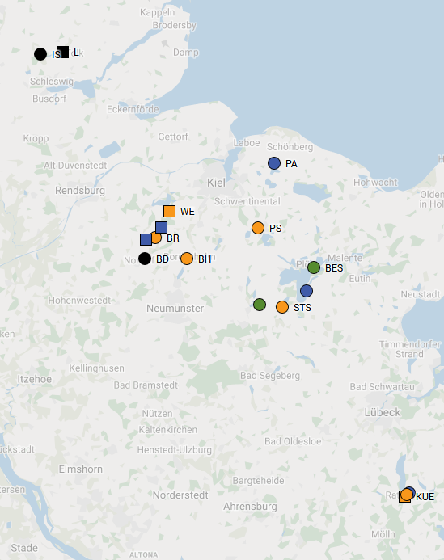
Poolseq approaches 1. SH is full of hybrids
3 species
2 species
No mismatch nuc/mt
Strong mismatch nuc/mt
Mismatch nuc/mt
No mt result

Slide 16
Thank you!
Mathilde Cordellier
Summer school – 25.07.2019

