Slide 1

Welcome to Healthify
Group 40

Slide 2



Contents
What sustainable goal we are targeting
Our target users and who it helps
Value Proposition
Key revenue Streams
https://www.youtube.com/watch?v=tLT_PGFphtc – web-app presentation

Slide 3
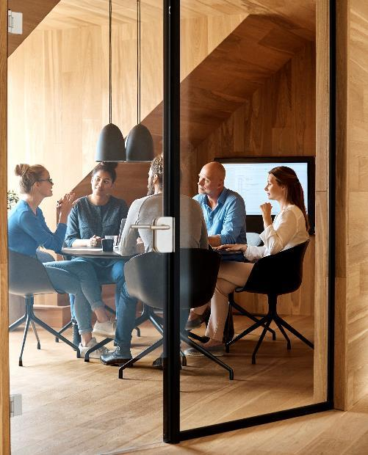



What is Healthify
A Health oriented Web-app that provides users with key health tips
Allows users to interact with doctors
Provides valuable information on how to live healthy

Slide 4

User Segments
No age limit
Available to everyone that has access to the internet
Any geographic or demographic background
The app targets users with any positive personalities, interests, values, attitudes and lifestyles

Slide 5

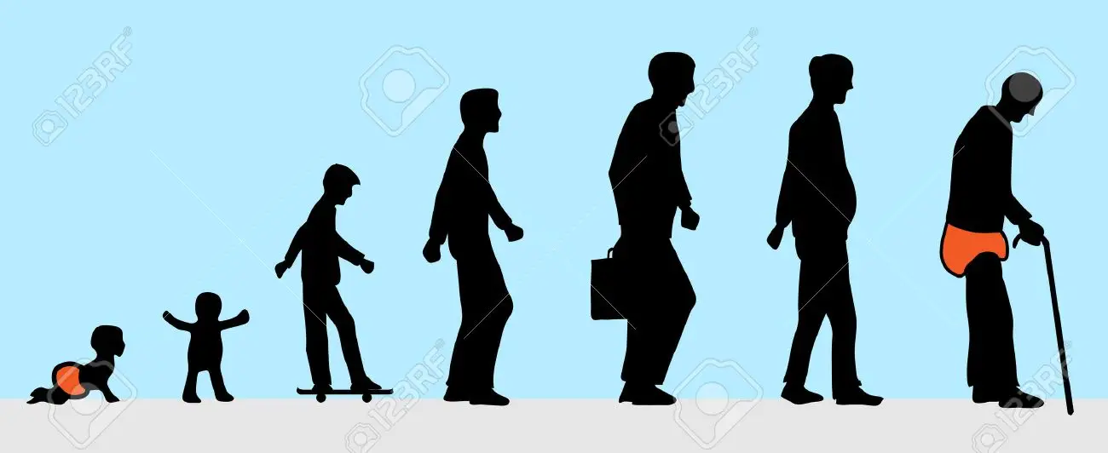
What Sustainable Development Goal are we targeting ?
SDG 3 – Good Health and Well - Being was a our key target when developing this app
Our Health app is designed to promote healthy living techniques and well-being across all ages
Who is our target audience?
Everyone is entitle to living healthy and improving their wellbeing. This can range from young to the eldest of people without any prejudice.

Slide 6

Who does this web-application help ?
This web app targets users that are not comfortable with booking appointments with doctors to get answers about their health consultations.
The app also provides information about healthy living that users may not have known.

Slide 7


Value Proposition
Health consultations and heath tips made easy
A health web app that allows you to get quick consultations from health professionals. A platform that seamlessly informs users of healthy living habits and a healthy living quiz to test your knowledge. Healthify for a healthy lifestyle!

Slide 8
Key Revenue Streams
Healthify doesn’t target and revenue streams.

Slide 9



Thank You
Presented by Group40
Healthify for a healthy lifestyle!

