Slide 1
Bangla News Content Classification using Machine Learning Techniques
Presented By:
Towkir Ahmed – 17.01.04.110
Md Siam Islam – 17.01.04.124
Popin Saha – 17.01.04.132

Slide 2
Introduction
The automatic categorization of Bangla content has been explored in this research, and many supervised learning models have been presented using a huge corpus of textual data. Despite the availability of several complete textual datasets for other languages, only a few tiny datasets are prepared for the Bangla language. As a result, few research addresses Bangla document categorization, and lack of training data prevents advanced supervised learning models. There are around 77768 Bangla articles in this dataset consisting of various news from Prothom Alo. We use a variety of complex textual characteristics, such as TF-IDF, to train various supervised learning models on this immense and varied dataset. We observed that the Support Vector Machine (SVM-RBF)outperformed among all classifiers with 91.80% accuracy.

Slide 3
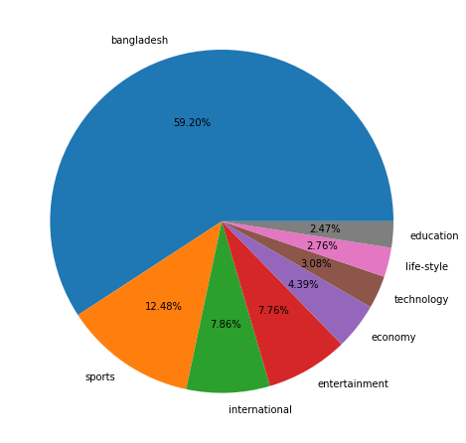
Dataset
The Bangla Newspaper dataset contains 392772 Bangla contents, each of which is labeled with one of eight document types. This data was obtained via Kaggle. Fig. 3.1 depicts the data distribution of the gathered dataset.
Figure 3.1: Data Distribution of the collected dataset
.

Slide 4
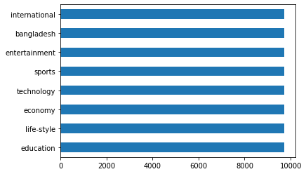
Dataset Contd.
Since the dataset is unbalanced, we selected samples from each label that had the same length. Because the sample size of 2.47 percent in Fig. 3.1 shows it to be the lowest pro-portion of all, we picked it as our sample size. There are 77768 Bangla contents in total in our final dataset and the data distribution is shown in Fig. 3.2.
Figure 3.2: Data Distribution of the finalized dataset

Slide 5
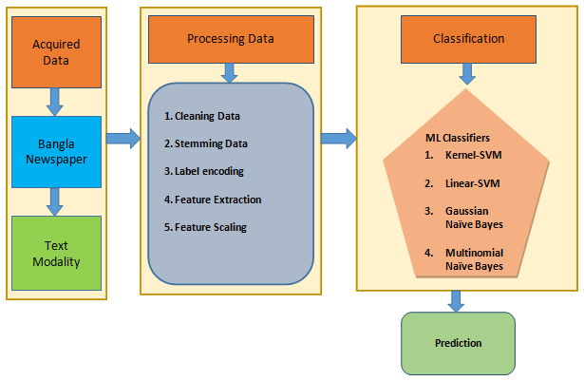
Proposed Methodology
The proposed framework relies on text modality. The details of the proposed method were depicted in Fig. 4.1. The whole workflow is divided into four phases to classify Bangla news content, including data acquisition, data processing, and data classification using the proposed machine learning classifiers.
Figure 4.1: Diagram of proposed methodology

Slide 6
Data Preprocessing
Usually, Bangla sentences contain a lot of words that help to provide the meaning of the sentences but they do not have any effect in categorization. So in order to make our algorithm efficient, we need to clean our dataset by removing these words.
Stop words are words that have no effect on documents or sentences. So, these words are removed using BNLP.
Fig. Stopwords in Bangla
Punctuations have no effect in classification. So, punctuations were removed.
For Normalizing our dataset, we used stemming method from BNLP toolkit to reduce a word to its root.

Slide 7
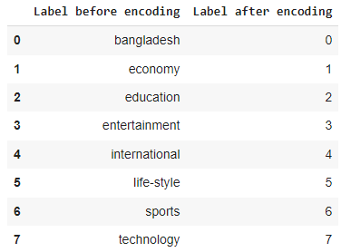
Encoding
As our dataset contain categorical label, we needed to convert these labels into numerical
format for Machine Learning implementation. We used label encoding to encode our categorical labels to numerical label.
Fig. Labels after encoding

Slide 8
Feature Extraction
TF-IDF Feature: TF-IDF is a method that is often used in Information retrieval. It is a method of giving numerical values to words in a text. The TF-IDF score for a word w in a corpus document D may be computed as follows:
TF=Frequency of w in D/Total number of words D,
IDF=loge(Total number of documents/Number of documents containing w),
T F−IDF=T F∗IDF
We extracted a total of 3500 sized feature vector. After extracting these features, we used them to train multiple supervised learning models. Then, we selected the best model for the TF-IDF features and presented a comparison of all models.
For feature scaling, we used the Standardization technique in our study. Standardization ensures that values are centered on the mean and have a single standard deviation. This results in a zero mean for the attribute and a unit standard deviation for the resulting distribution.

Slide 9
Machine Learning Techniques
We trained our dataset through 4 Machine Learning Techniques.
Linear SVM
RBF SVM
Gaussian Naïve-Bayes
Polynomial Naïve-Bayes

Slide 10
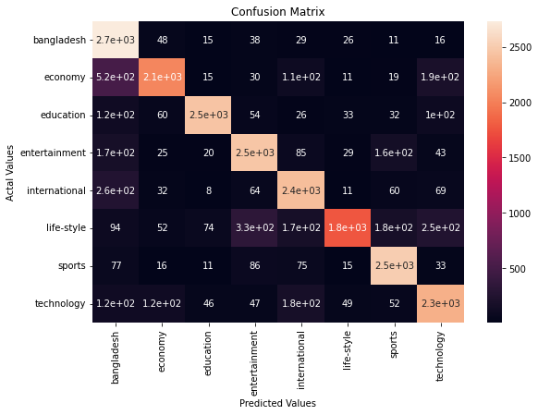
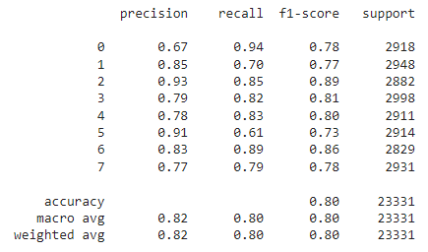
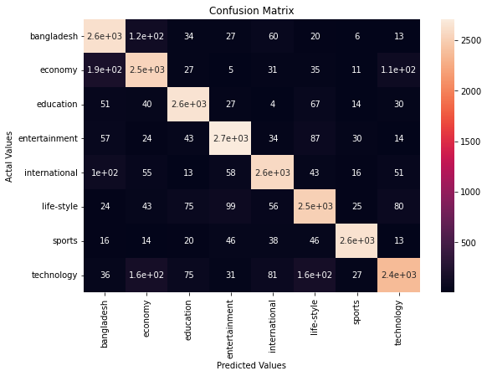
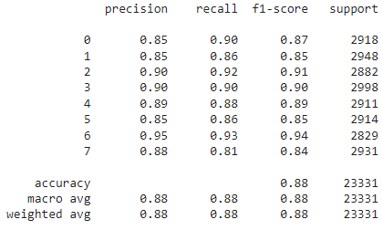
Confusion Matrix and Classification Report
Fig. Confusion matrix and Classification report for Gaussian Naïve-Bayes
Fig. Confusion matrix and Classification report for Linear SVM

Slide 11
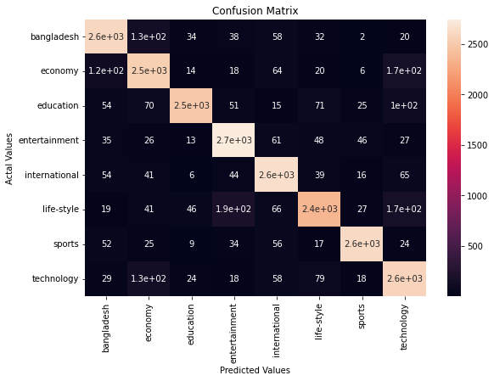
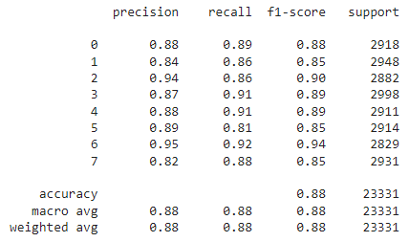
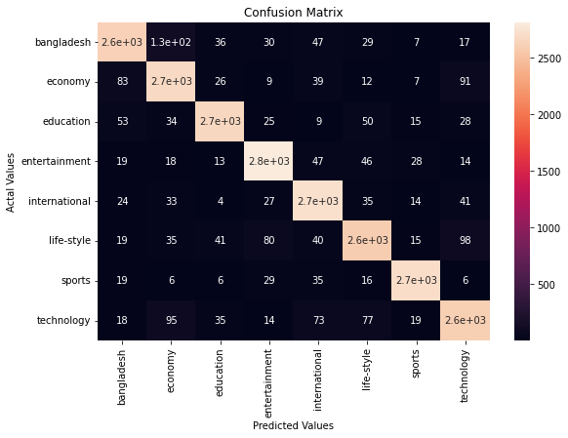
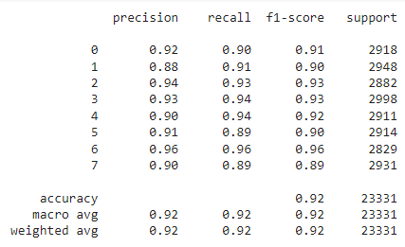
Confusion Matrix and Classification Report (Contd.)
Fig. Confusion matrix and Classification report for Gaussian Naïve-Bayes
Fig. Confusion matrix and Classification report for Radial Basis Function SVM

Slide 12
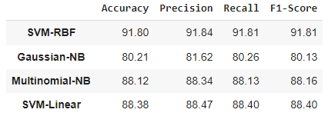
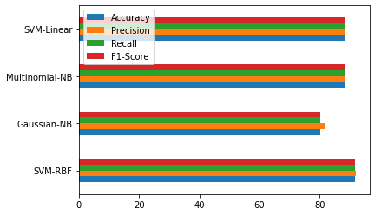
Result

Slide 13
Conclusion
The growing domain of online newspaper presents a rich area, which can benefit immensely from automatic classification approach. In this project we present a system of automatically classifying Bangla News documents. This system has the capability to provide users with efficient and reliable access to classified news from different sources. We used Linear SVM, RBF SVM, Gaussian Naïve-Bayes, Multinomial Naïve-Bayes. Among them, RBF SVM preformed best with the accuracy of 91.8%.
In future, we have a plan to extend this dataset so that it can be used to solve other Bangla NLP related problems. Furthermore, Deep learning model, such as CNN, LSTM, can also be considered to improve the prediction model.

