Slide 1


Song Recommendation Tool
Leonidas Ioannou – 2454882I
Supervisor: Chris McCaig

Slide 2
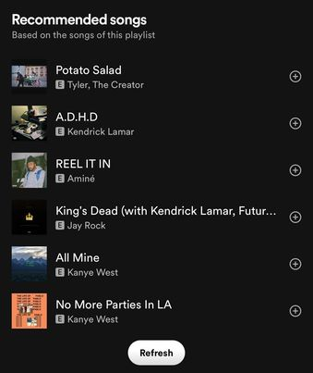
music recommendation
With the advancement of Recommender Systems, music platforms have integrated these systems into their products and services to boost user engagement and help users discover new music.
Music Recommender Systems can be integrated in various forms:
Automatic Playlist Continuation
Recommending music friends are listening to.
Recommending songs/albums/artists similar to the user’s music taste.
Large amounts of recommendations could be overwhelming for users.

Slide 3
APPROACHES & CHALLENGES
Content-based filtering: Recommend items that are similar to items in the user’s profile, with similarity being dependent on the way items are classified(genre, acoustic features, etc.).
Collaboration-based filtering: Recommend items that users with similar taste to the user listen to.
Both approaches suffer from drawbacks like the Cold-start problem.
Solution is to combine these approaches and create hybrid Music Recommender Systems, which research shows achieve the best results.
Other novel approaches to Music Recommender Systems are emotion-based filtering, context-based models, and cross-domain recommendations

Slide 4
This Project
Implemented a hybrid Music Recommender System with the sole focus of providing music recommendations based on explicit preferences.
Design philosophy of a simple to use and understand Front-end combined with a Data Science focused Back-end that processes data and derives recommendations.
Front-end and Back-end communicate to exchange information like user input and recommendations.
Create a Spotify Playlist feature included, where recommended tracks are found on Spotify and are added to a new playlist on the user’s profile.

Slide 5
IMPLEMENTATION
React was used to implement the Front-end as it is very efficient, especially by using components and useState functions.
When a user inputs a song, a component is created to display their input.
Multiple useState functions are used to track and update variables.
The Back-end was developed using Flask and Python.
Flask enables the communication between the Front-end and the Back-end.
Python was appropriate and useful to implement the different features like input parameters, recommendations, and Spotify playlist creation.

Slide 6
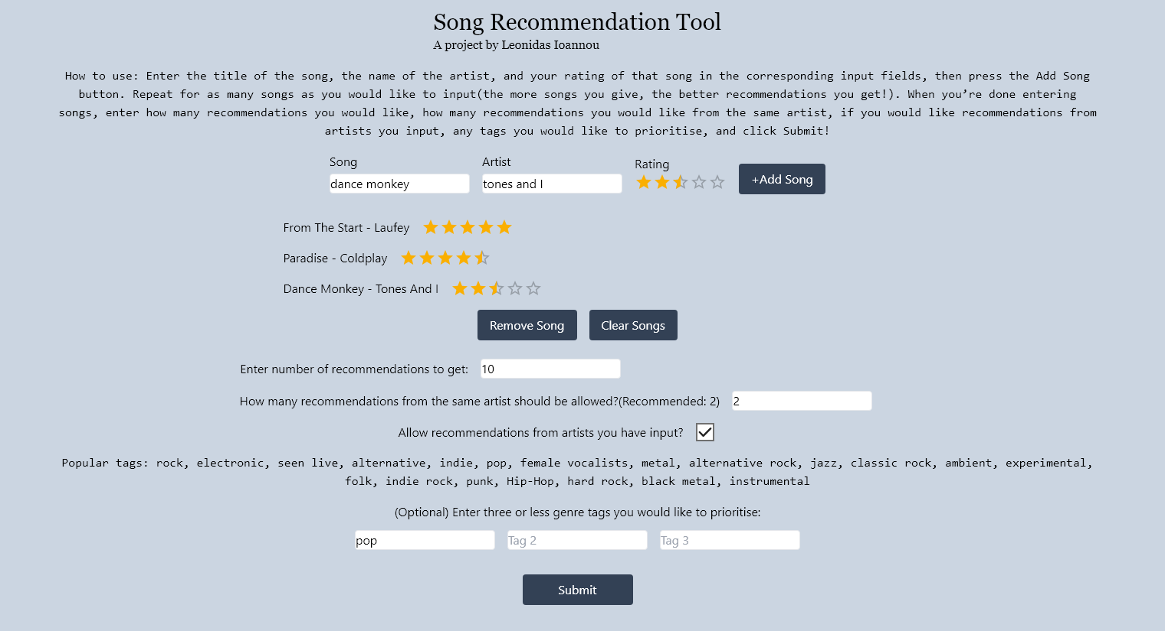

Slide 7
DATA
Initially suggested datasets were at least a few years old and not very large, unrealistic for modern use by actual users.
Decided to use the Last.fm API:
Up-to-date data
User-defined item classifications(form of collaboration-based filtering)
Wider range of data
This decision also results in a lightweight application as there is no need to store massive volumes of song data.
There are still some drawbacks like songs not being found, rate limits, or songs not having genre/sub-genre tags attached to them.

Slide 8
DEMONSTRATION

Slide 9
Evaluation
Gathered 10 participants. Procedure was to go through two cycles of application use seeking music recommendations, listen to the recommendations, and respond to a survey,
Positive results:
Participants believed they received high-quality recommendations.
User interface design was generally liked.
The different features were considered useful.
Overall, participants believed that their experience with the Song Recommendation Tool was positive, and that they would use it again.
Participants also suggested multiple useful potential improvements.

Slide 10
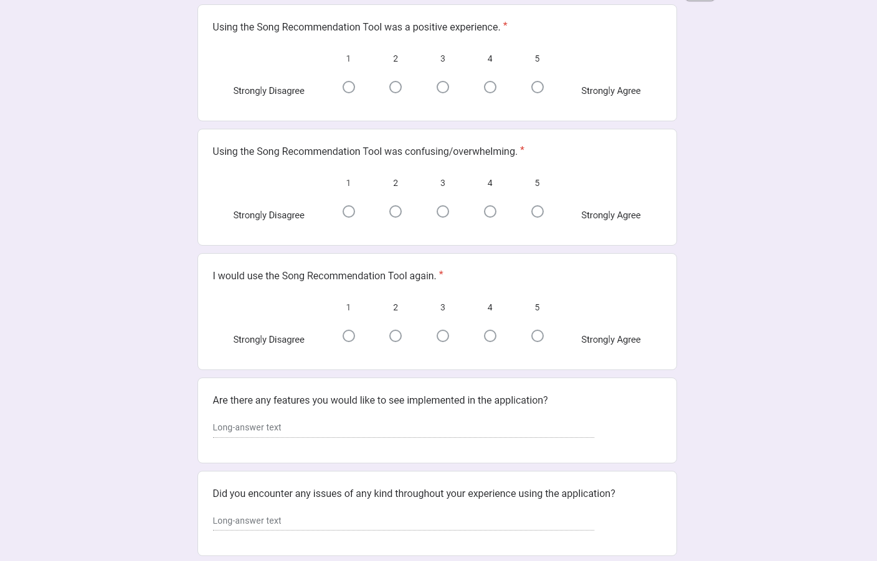
Evaluation

Slide 11
CONCLUSION
Project successful in implementing all important requirements and achieving good evaluation results.
Result is a sleek hybrid Music Recommender System which allows users to influence their recommendations through ratings and parameters.
The Song Recommendation Tool could be further improved and become more competitive in the future.

Slide 12
Thank you for your time

