Slide 1
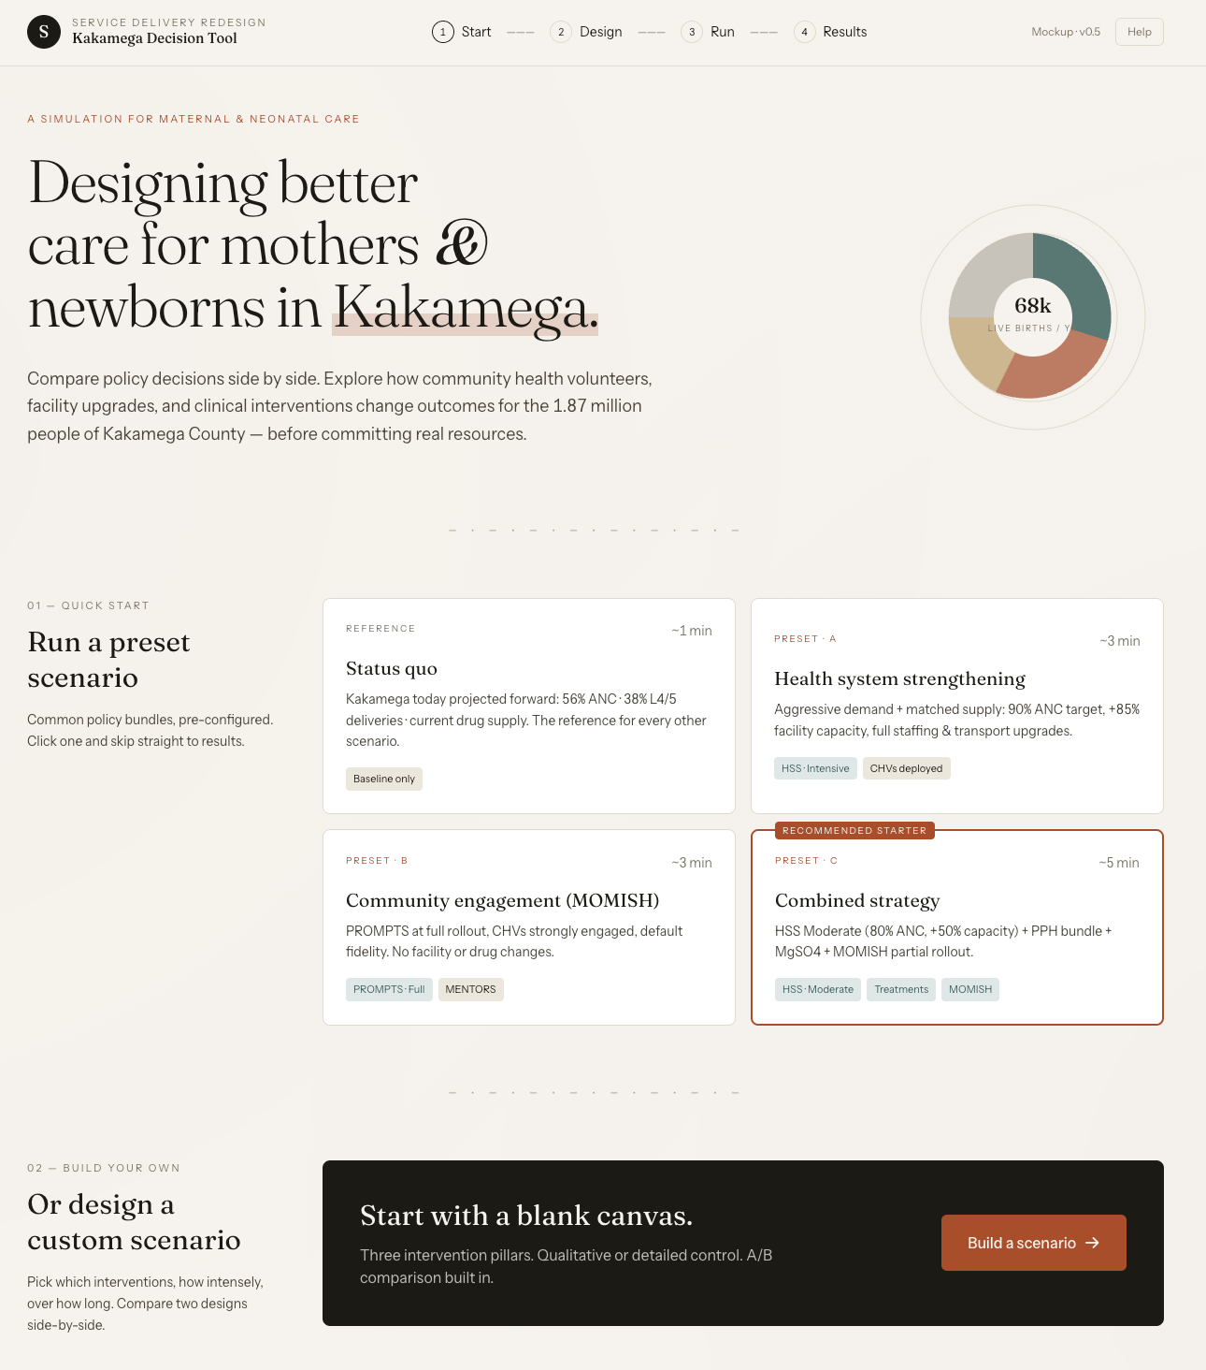

Slide 2
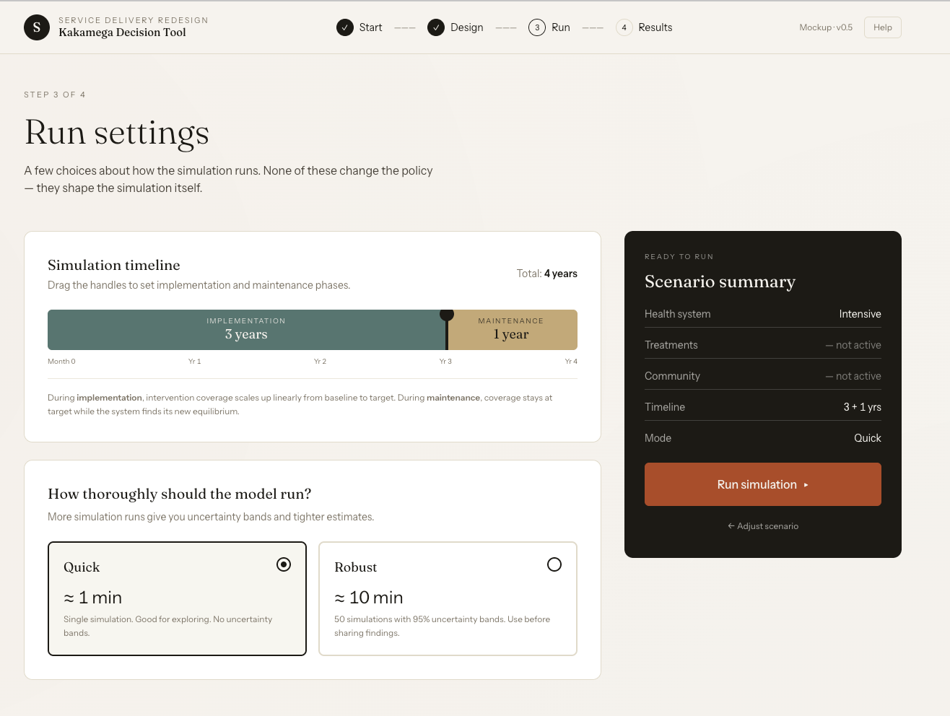

Slide 3
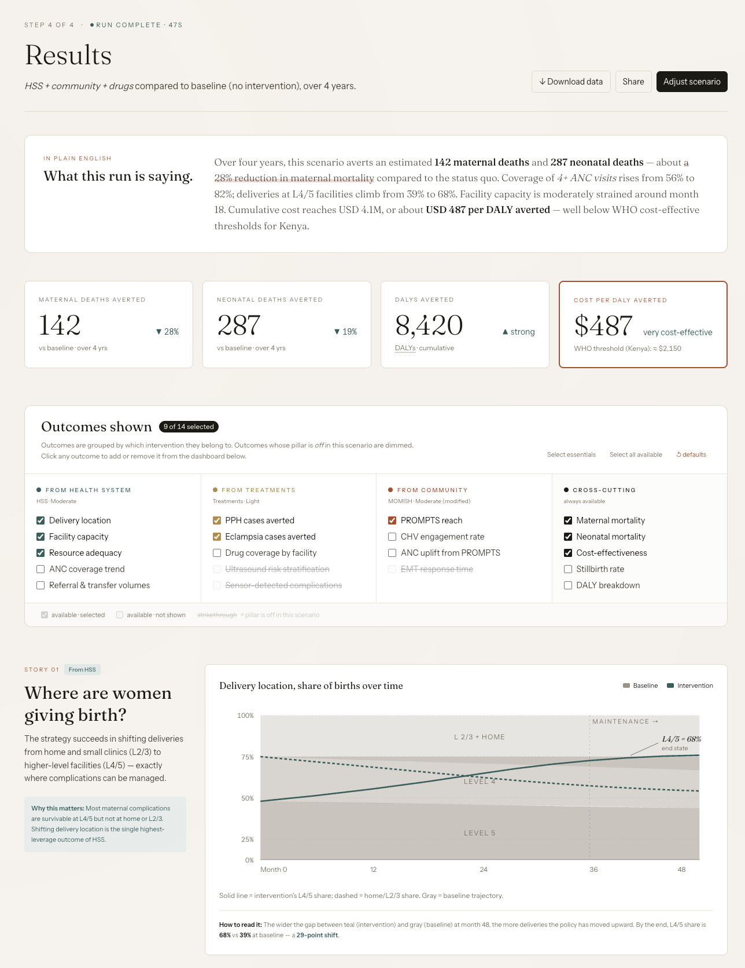

Slide 4
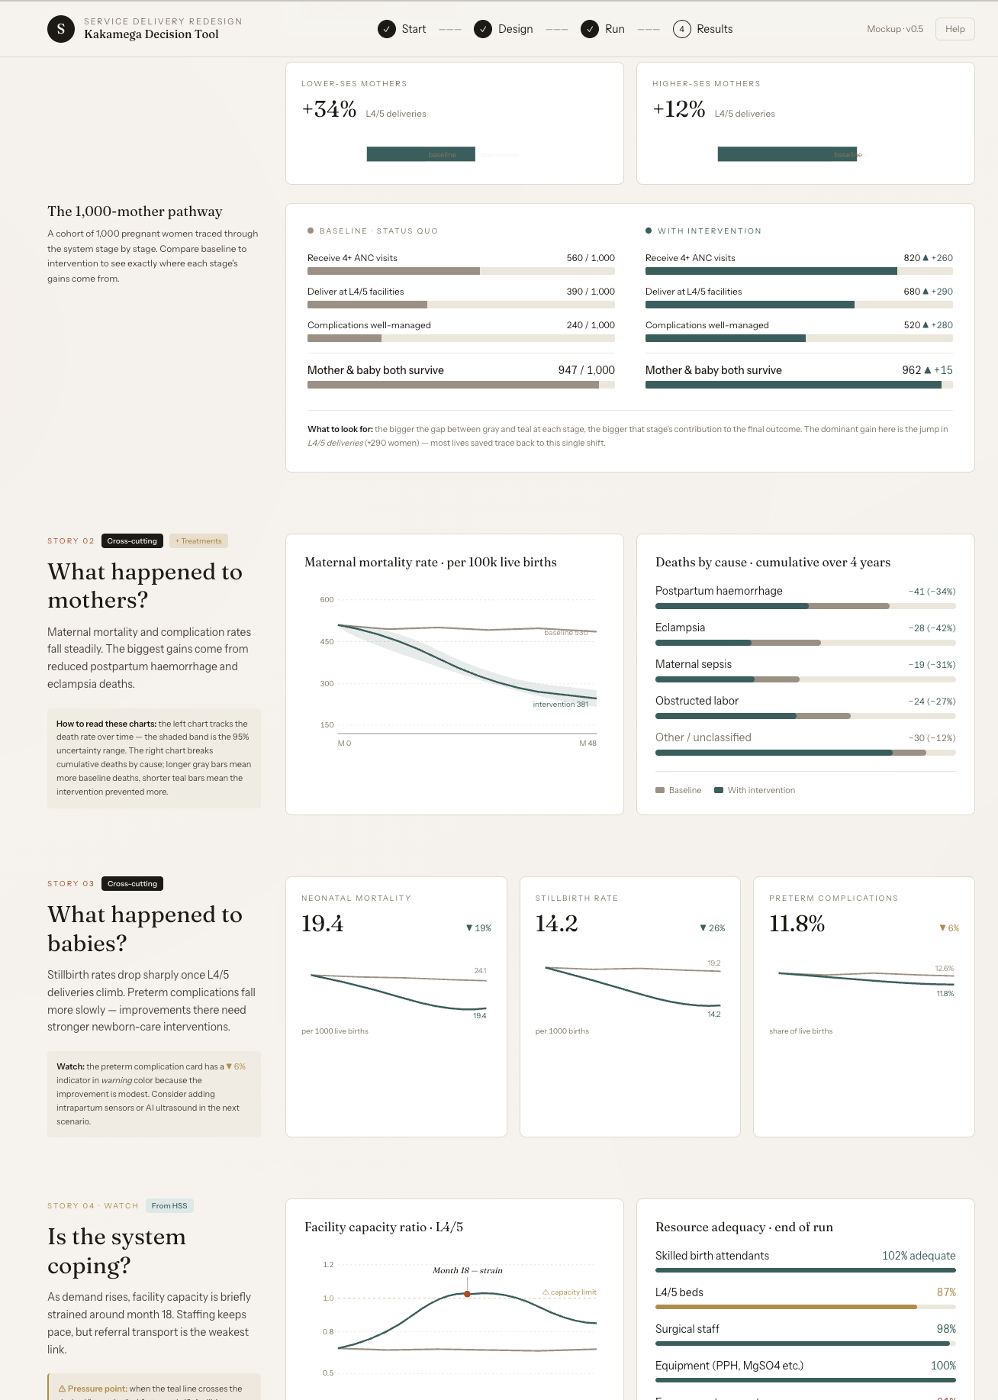
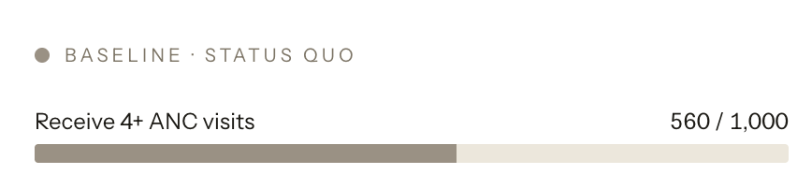


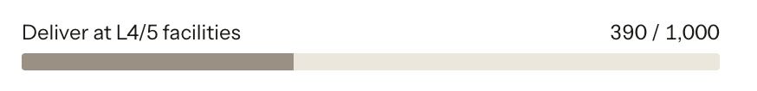

Idea for 1000 mother pathway visual

Slide 5
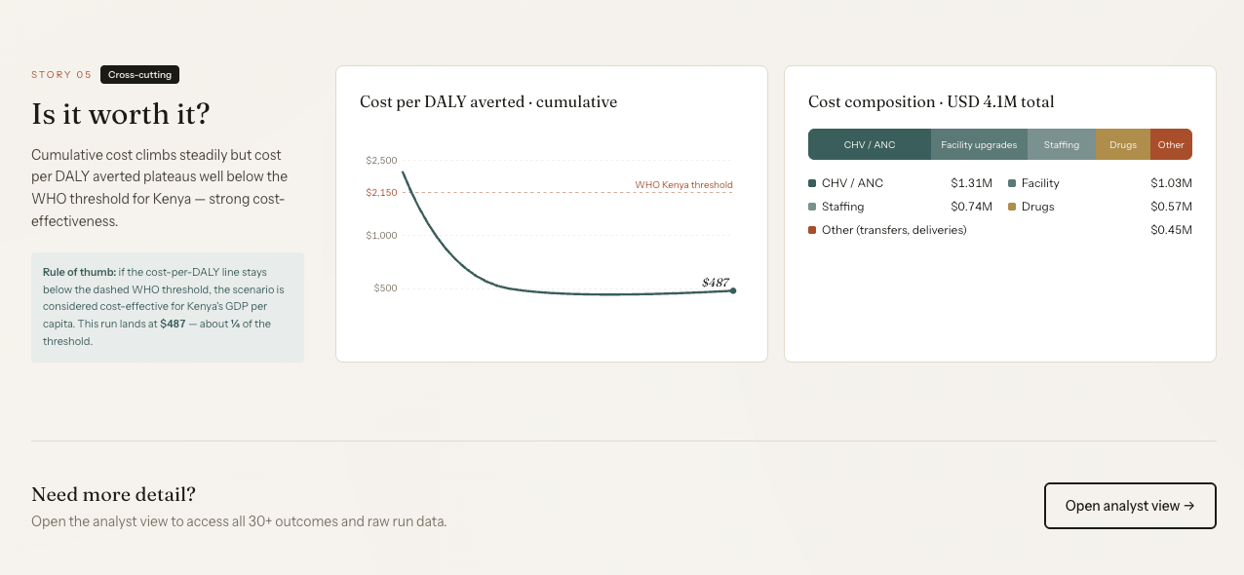

Slide 6
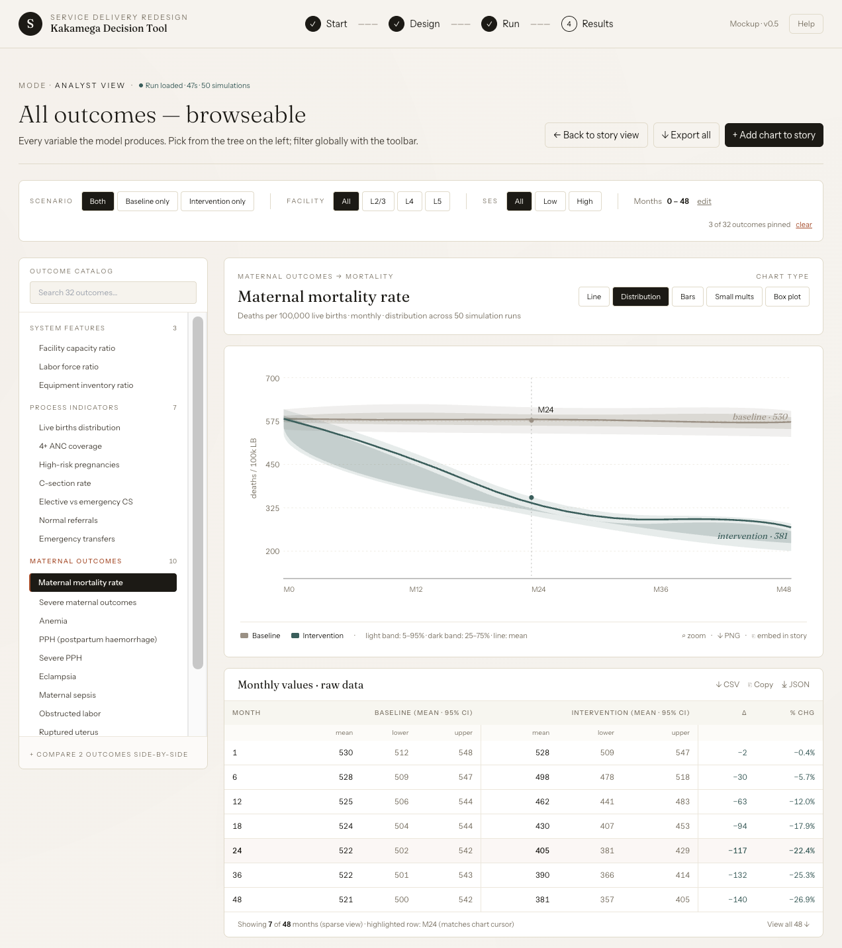

Slide 7
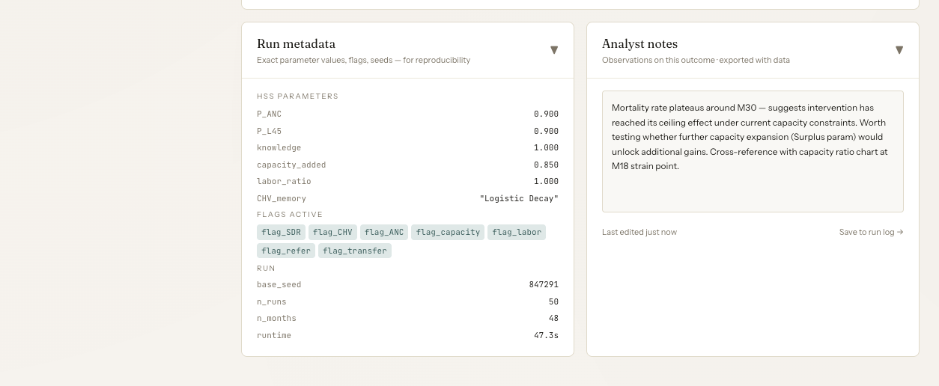

Slide 8
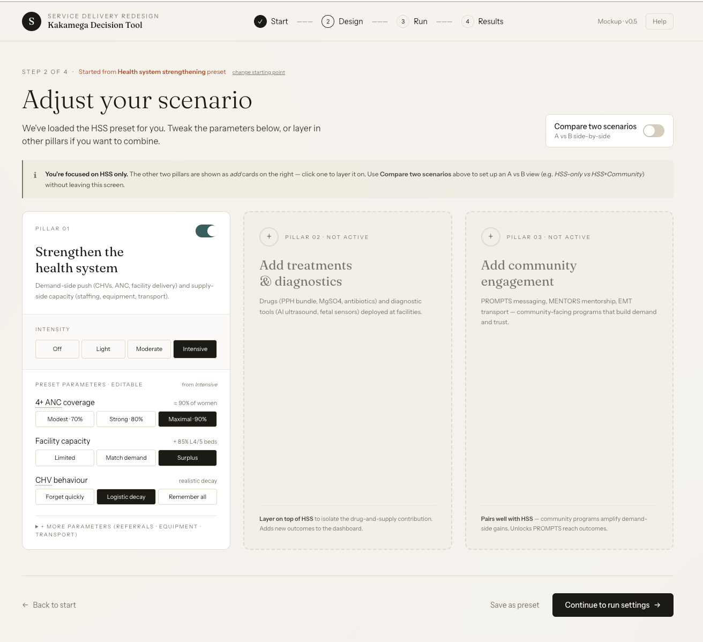

Slide 9
Big lift changes
Assumptions and choices made are clearly noted at the top of the results
For example – noting that user selected iron folate and PPH bundle
About the model page at the top of the screen (similar to wiki survey help button)
Scenario comparison
Intervention v. Intervention
Implementation intensity
Smaller changes
Change Kakamega to Kenya, and add ability to switch between counties
Note we don’t have the different counties data in there yet but will in the next few weeks
Remove donut chart
Update “S” icon to a different logo
Consider name of Title
Remove all references to neonatal
Analyst notes may not be needed if time is short or it is higher effort
Consider level of analysis / annotation needed (i.e. just sentences saying #s or how to read a graph may be easier, some of the types of analysis/annotation may be harder)
Analyst view may be better to add as an enhancement due to high effort

Slide 10
General notes
HTML shows user flow
Underlying model reflects results
There may be some need to change the underlying model to be able to support the new UI
Code will be in react
Next steps
[Skip for now] Consider whether to revise the buckets for the preset scenarios and pillars
i.e. Demand-side (e.g. PROMPTS), Supply-side, Care
Provide explicit feedback on phrasing/naming
Section “Adjust your scenario,” Confirm approach for sliders vs options, default values
Consider qualitative approach, such as a range of values (e.g. 79-100% is the possible range, bucketed as high med low)
Out of scope for first release / consider for future enhancement
Analyst view
Analyst notes
Recategorization of pillars (demand-side, supply-side, care)
Neonatal
Very analytically in-depth analysis notes (i.e. we will keep basic logic for now)
AI integration

