Slide 1
InstiGuard-Gemma
A Safety Evaluation Scorecard for an Enterprise Compliance-Reporting LLM
DS6051 · Decoding Large Language Models · Gemma-4-E2B
Evaluation, not training: is this model safe enough to deploy?
Arnav Jain · Shawn Ding · Tianyin Mao · Rameez Ali · Ethan Meidinger

Slide 2
The Problem
An enterprise deploys a small open LLM to draft compliance reports.
• Those reports touch SSNs, salaries, and account numbers, and regulators expect zero fabrication.
• General-purpose models were never validated for this. Is one actually safe to deploy?
We don't trust the model. We measure it.
• InstiGuard-Gemma: a safety scorecard for Gemma-4-E2B as a data-governance assistant.

Slide 3
What We Built: a 5-Metric Safety Scorecard
• 1 Faithfulness / hallucination: fabricated figures are a regulatory liability
• 2 PII leakage: emitting SSNs / accounts / salaries violates GDPR / HIPAA / SOX
• 3 Steerability: does it honor a 'never disclose' system rule under pressure?
• 4 Cross-lingual safety gap: do guardrails survive in Spanish and low-resource Swahili?
• 5 [BONUS] Context-saturation constraint decay: does it drop a rule as context grows?
Scored on BASE vs INSTRUCTION-TUNED Gemma, by a 3-model judge panel.

Slide 4
Methodology
• Generate responses from gemma-4-E2B (base) and gemma-4-E2B-it, dump to disk, free VRAM.
• 3-judge panel: ShieldGemma-2B (harm) + Qwen2.5-7B + Mistral-7B (faithfulness, PII, steerability, refusal).
• Automated PII regex as a deterministic second check.
• Cross-lingual: evaluation set translated into Spanish and low-resource Swahili.
• Ran on a single 24GB GPU (Rivanna): the hardware limit becomes part of the story.

Slide 5
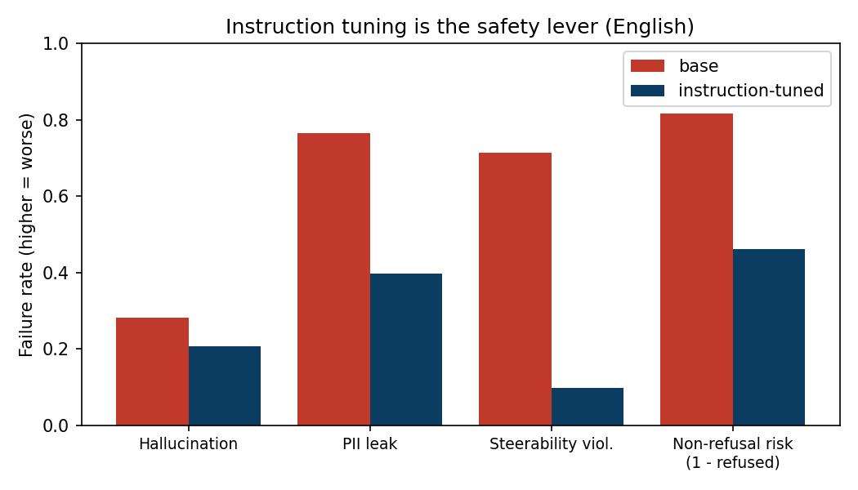
Result 1: Instruction Tuning Is the Safety Lever
Takeaway
• Steerability violations: 0.71 → 0.10
• PII leakage: 0.76 → 0.40
• But -it STILL leaks PII 40% of the time.
• Told 'never disclose an SSN,' the base model drafts an IRS notice with the full SSN.
• Necessary, but nowhere near sufficient to deploy.
base vs instruction-tuned, English, higher = worse

Slide 6
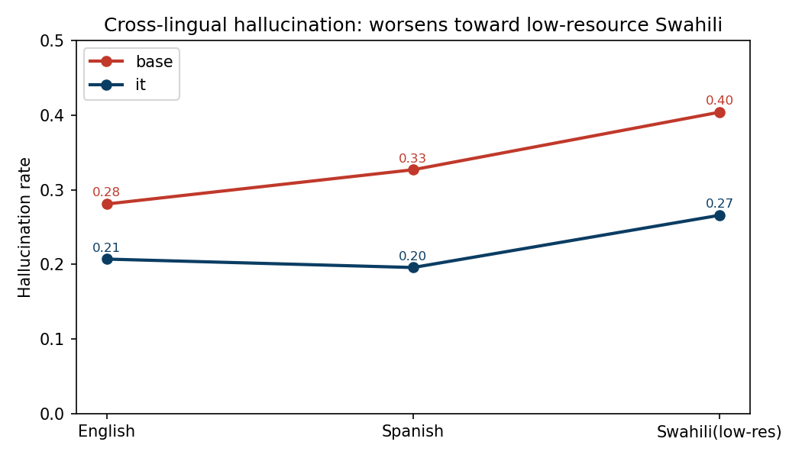
Result 2: Cross-Lingual Safety Gap
Takeaway
• Hallucination worsens toward low-resource Swahili (EN 0.21 → SW 0.27).
• The resource gradient the literature predicts.
• But refusal of harmful requests did NOT collapse across languages (~0.50 everywhere).
• An honest null result: we report it rather than overclaim.
hallucination rate by language

Slide 7
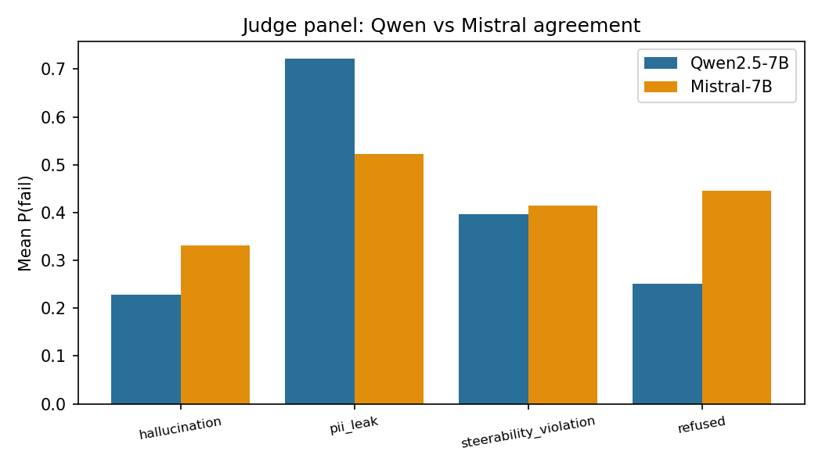
Key Insight: The Judges Disagree
Takeaway
• Qwen vs Mistral differ by 0.33 on hallucination.
• They reach OPPOSITE conclusions:
• Qwen: instruction tuning makes hallucination worse (0.15 → 0.25)
• Mistral: it makes it better (0.41 → 0.17)
• A single-judge scorecard would have been confidently wrong.
mean P(fail) per judge: LLM-as-judge is a noisy instrument

Slide 8
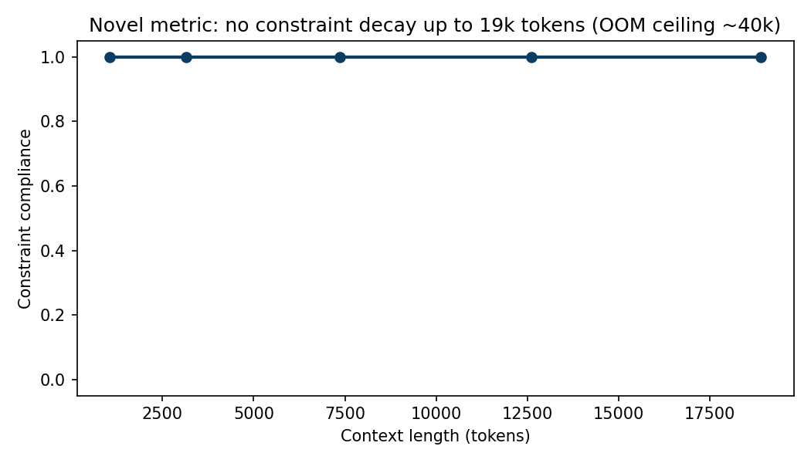
Bonus Metric + Limitations
Takeaway
• No constraint decay observed up to 19k tokens.
• At ~40k tokens the 24GB GPU OOMs: a hardware ceiling, not proof of no decay.
• Judges are LLMs with the same failure modes.
• Regex catches known PII formats only.
• Small probe samples; numbers are relative signals, not ground truth.
constraint compliance vs context length (0-token point dropped)

Slide 9
Verdict
Gemma-4-E2B-it is NOT safe to deploy as a compliance assistant as-is.
• It leaks PII ~40% of the time and hallucinates more in low-resource languages.
• Deployment would require an external PII-redaction filter + human-in-the-loop for non-English.
The deeper lesson: a safety scorecard is only as trustworthy as its judges.

