Slide 1
Mockaroo
Test Data Generation tool

Slide 2
Agenda
1. . Test data generation
2. . What is Mockaroo?
3. . Steps to get sample data

Slide 3
Test Data Generation
Testing data-aware applications with realistic data is most important task
For testing databases and database management software (DBMS) often need large amount of data.
Helps to test the application under conditions that closely simulate production environment

Slide 4
What is Mockaroo?
Mockaroo is a specialized software tool that generates mock data to use in testing software applications.
It is used to create structured and formatted data generated randomly.
Tool lets you generate up to 1,000 rows of realistic test data in CSV, JSON, SQL, and Excel formats at a time.
You can also create mock API to use it in your application.
It is also available as a Docker Image so that it can be deployed on your cloud as well.

Slide 5
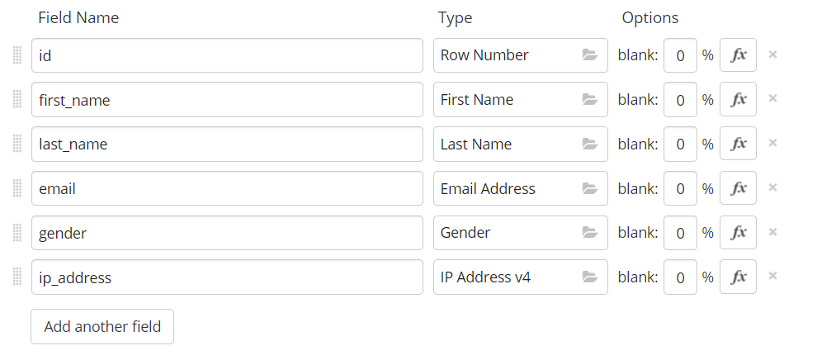
Steps to get sample data
Step 1. . choose the number of fields you need in your database, with over 200 inbuilt Database.

Slide 6
Steps to get sample data (Continued…)
Step 2. . Choose the number of rows you want in sample data file .You can choose a maximum of 1000 rows , and can choose from various data formats

Slide 7
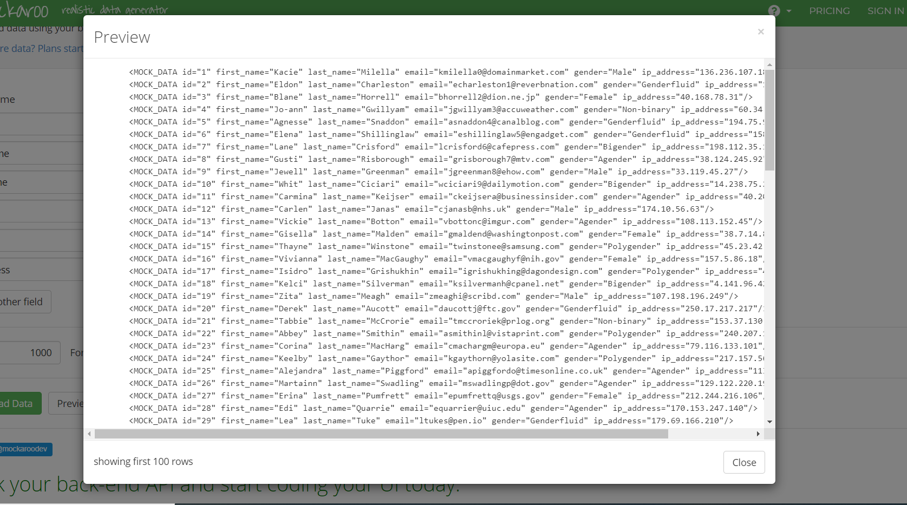
Steps to get sample data (Continued…)
Step 3. . You can preview your data on the browser itself and you can download a specific type of file for your data.

Slide 8
References
Video for generating data using Mockaroo:
https://www.youtube.com/watch?v=XATDlwG1azU&list=PLKMZcxOsC3u0Y-4CHg5SDpVjTcrvGttTt&index=1

