Slide 1

Healthcare Dataset analysis
Welcome to my Presentation

Slide 2


OUR BIG IDEA
Our mission is to become the recognized as Data Analyst leader in its target market for providing healthcare and service tailored to each patient’s individual needs, safe the data’s for future and expectations in all over India.

Slide 3


objectives
We are going to analyze a Healthcare dataset. First of all, the given dataset contained 5,700 records. After obtaining the dataset, it was cleaned and analyzed. The empty cells were filled with a hyphen (“-”) or “Not-Provided” or “N/A” where required. Next, the data was sorted, and duplicate values were checked. Out of the 5,700 records, 200 duplicate values were removed, leaving 5,500 unique records. After that, functions, logical functions, and data validation tools were used according to the client’s requirements. Then, the required details were converted into PivotTables and PivotCharts. Finally, a dashboard was created to provide a visual representation of the data, which helps in gaining insights and supporting decision-making based on the dashboard content.

Slide 4


OUR SERVICES
Extended Hospital Hours
Department List
Available Doctors List
Mon - Sun: 24/7 Available No Holidays
Cardiology, Dermatology, General Medicine, Neurology, Oncology, Orthopedics, Pediatrics
Dr Iyer, Dr Mehta, Dr Nair, Dr Rao, Dr Reddy, Dr Sharma, Dr Singh
Diagnosis
Treatment Type
Asthma, Covid, Diabetes, Fever, Fracture, Hypertension, Migraine, Skin Allergy
Injection, Medication, Observation, Surgery, Therapy

Slide 5
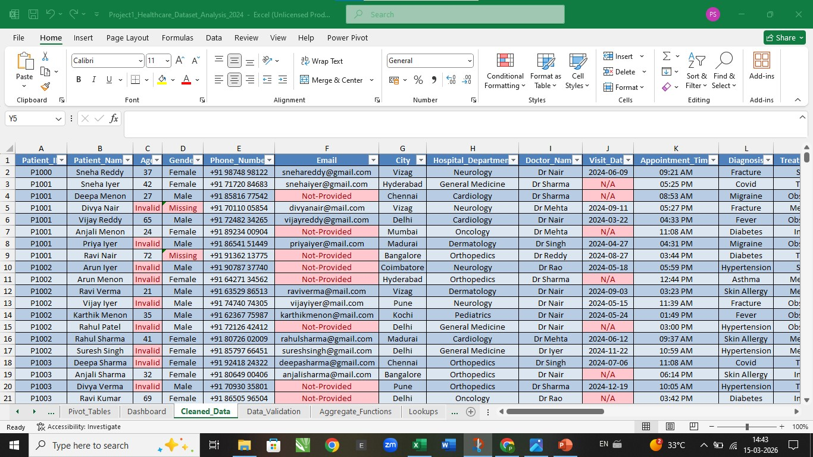
blank fills
5

Slide 6
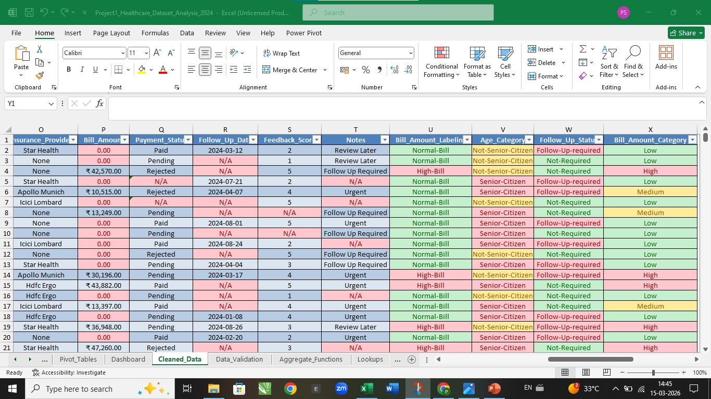
Client requirements
6

Slide 7





hospital outlook
7
7
5500
456.44 L
3.04
Total Number of Hospital Department
Total Number of Doctors
Total Number of Admissions
Total Number of Bill Amount
Average Feedback Score by Doctors
Records

Slide 8






patient outlook
521
2227
2189
10
4
Total Number of Senior Citizen Patients
Total Number of Female Patients
Total Number of Male Patients
Total Number of Patient Cities
Total Number of Insurance Provider
Records
8

Slide 9


Cleaned Dataset MODEL
Hospital Department
Diagnosis
Treatment Category
Datasets consists of 7 Departments they are classified with total number of Patients in each Departments:
Cardiology-785, Dermatology-769, General Medicine-774, Neurology-779, Oncology-771, Orthopedics-832, Pediatrics-790.
Datasets consists of 8 Diagonosis they are classified with total number of patients in each Diagonosis:
Asthma-657, Covid-697, Diabetes-712, Fever-661, Fracture-731, Hypertension-671, Migraine-691, Skin Allergy-680.
Datasets consists 5 Treatments they are classified with total number of patients in each Treatments:
Injection-1095, Medication-1084, Observation-1135, Surgery-1107, Therapy-1079.

Slide 10
Revenue by Department

Slide 11
MAJOR eXPLANATION 1
Revenue by Department
Revenue by each department vary in their bill amount. The chart shows revenue across various departments. Especially Orthopedics (68.2 L) and Cardiology (72.5 L) are among the highest contributors.

Slide 12
Patient Geographic Distribution

Slide 13
MAJOR eXPLANATION 2
Patient Geographic Distribution
Analysis of patient volume by city. Helps identify key regional
hubs for the hospital. The Least cases from Hyderabad (513).

Slide 14
Doctor average Feedback Scores

Slide 15
MAJOR eXPLANATION 3
Doctor average Feedback Scores
Performance evaluation based on patient feedback. Most doctors maintain a score around 3.0. The chart shows most Least score for Dr.Rao (2.94) and Top score for Dr.Nair (3.10).

Slide 16
Insurance Provider Mix

Slide 17
MAJOR eXPLANATION 4
Insurance Provider Mix
Look at the chart they have most commonly None insurance patients is Higher than others insurance patients.

Slide 18
Admission Types

Slide 19
MAJOR eXPLANATION 5
Admission Types
Breakdown of how patients are admitted. Emergency and Online bookings represent a significant portion. The chart shows Most cases from Online and Least cases from Referral.

Slide 20
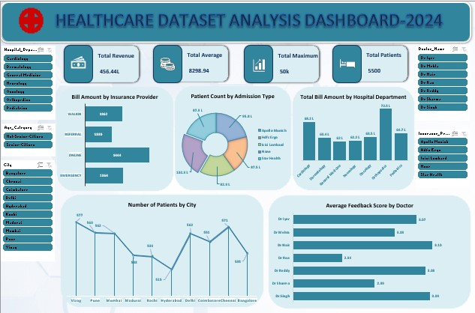
DASHBOARD

Slide 21


Thank you
Pornimaa S
DATA ANALYST
spornimaa0504@gmail.com
+91 9360461108
https://github.com/PornimaaS-050421/Project1_Healthcare_Dataset_Analysis_2024

