Slide 1
The data Visualization of Predicting Chinese citizen’s intention of building home gardens
Yunjie Liang 1007410

Slide 2
Research Introduction
In China, with urbanization, it is widely discussed how to create more green space in limited urban areas. Encouraging residents to build home gardens can effectively increase urban green space while helping to control and mitigate the urban heat island effect. Based on the Theory of Planned Behavior (TPB), this study proposes an extended TPB model with the addition of environmental concerns, with the aim of elucidating the factors that influence residents' intentions to build home gardens.
A quantitative research method was used to obtain primary data through a questionnaire survey of Taiyuan and Shanghai citizens. The results confirm that intention, subjective norms, Perceived Behavior Control (PBC), and environmental concerns all have significant positive impacts on people's intention to build home gardens.

Slide 3
Conceptual TPB model (Flow chart)
Hypothesis
Attitude
Subject Norm
Intention
Perceived Behavior Control
Environmental Concern
Notes:
A dendrogram shows a hierarchical structure. It is constituted of a root node that gives birth to several nodes connected by edges or branches.

Slide 4
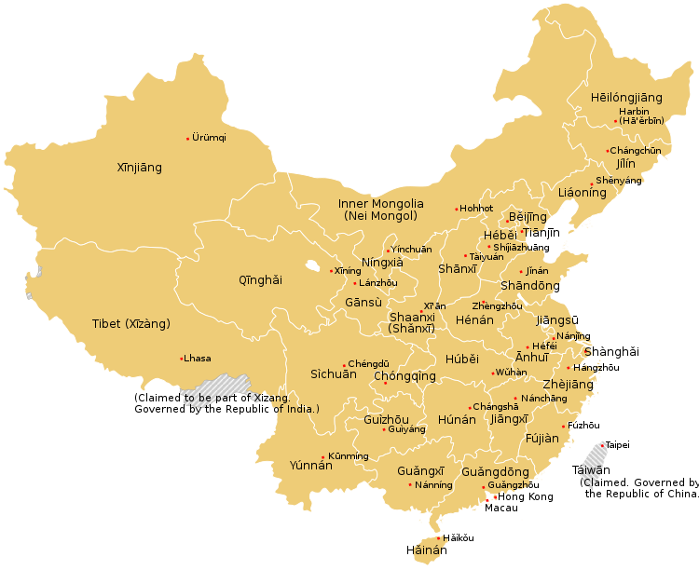
Sample Selection (Map/Bubble map)
Taiyuan is located in the inland area of China, and its economic development is relatively lagging behind that of China's economic centre, Shanghai. It serves as a supplement in the sample selection process.
Taiyuan home garden is still in its early stages. Home garden in Shanghai has a good history of home garden. The two cities complement each other in terms of research.
Taiyuan is geographically located in northern China, and Shanghai is geographically located on the southeast coast. Northern China has a temperate monsoon climate, with hot, rainy summers and mild, dry winters. A subtropical monsoon climate dominates the south-eastern coastal area, with hot and rainy summers and warm and humid winters. These two climates are relatively representative climates in mainland China.
Notes:
Highlight the survey sample on the map

Slide 5
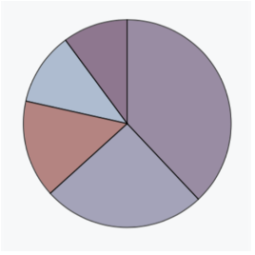
Sample Descriptive Analysis (Pie chart)
City of residence
(Gender distribution)

Slide 6
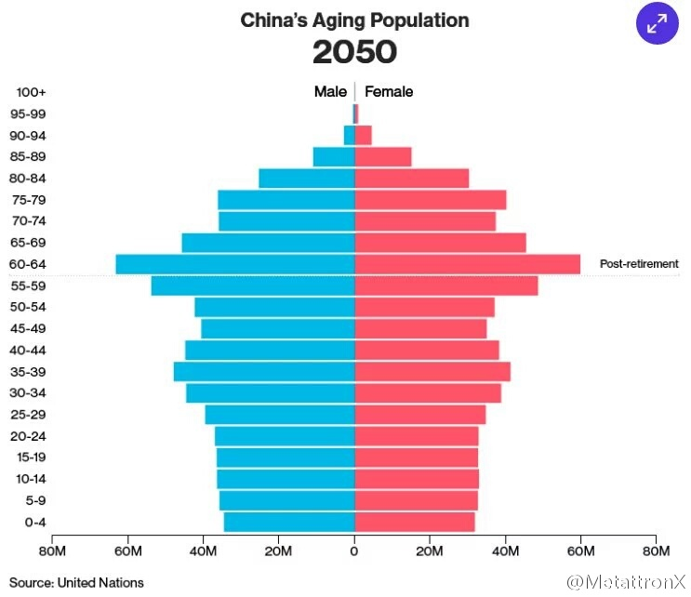
Sample Frequency Analysis (bar chart/line chart)
Age/Gender

Slide 7
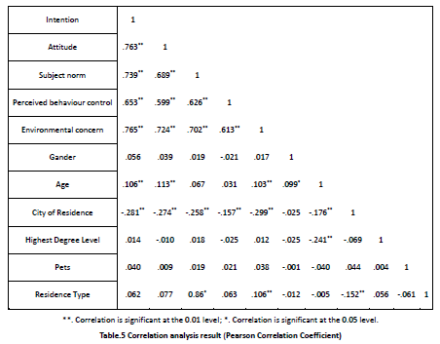
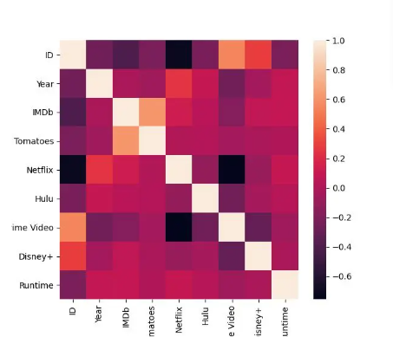
Correlation Analysis (Heatmap)
Notes:
Correlation analysis is performed by calculating the correlation between two factors and visualizing the obtained matrix of values through a heat map. The information about the data in the two-dimensional matrix or table is reflected by the color change, and the color shades indicate the magnitude of the data values, which can be visualized in the defined color shades.

Slide 8
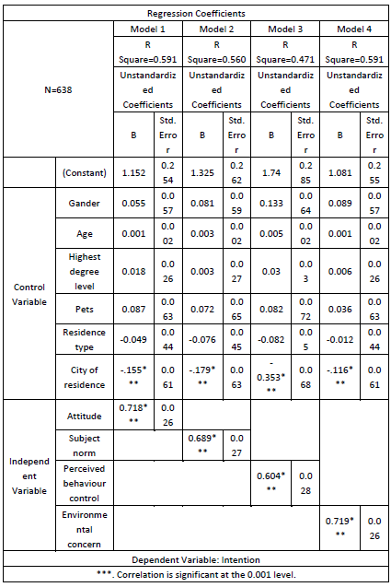
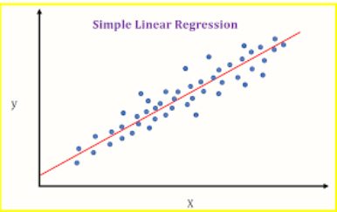
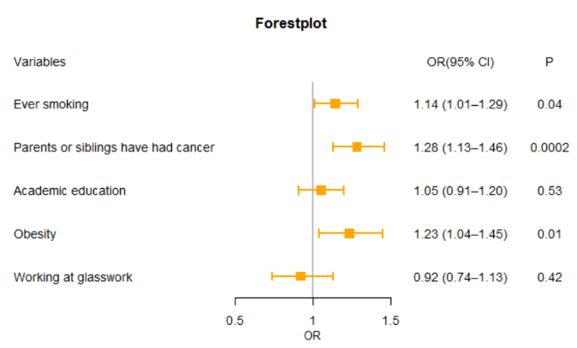
Regression Analysis results
Hypothesis testing
Single variable
(Scatter)
Multivariate
(Forest plot)
Notes:
sketch map

