Slide 1

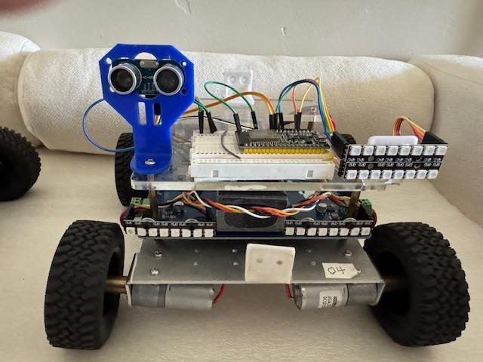
LESSON 5
Sensors, Self-Test and Diagnostics
I2C, shunt resistors, current signatures, and a vehicle that can tell you which motor is unplugged.
PORPOISE ROBOTICS - Precision Oceanographic Program On and In the Sea Environment
porpoiserobotics.org
Kevin Bowen, President - kbowen6@icloud.com
Malcom Graham, VP Education Louis Parker, VP Technology
Valen Farre, System Engineer Gary Howland, Animation
Eddie Revollo, Artificial Intelligence
Interns: Oscar Canazales, Krishnansh Vemulapalli, Soham Gangal, Erik Olsen
Three hours. Gen 3 vehicles for the sensor work.
Porpoise Robotics - proprietary. For use with Porpoise Robotics lessons.
Notes:
You need at least one Gen 3 vehicle per two groups for the sensor work. A Gen 2 is still useful - the second step of the first activity needs one.
Blocks out again. The current measurements need a motor spinning freely and then held.
This is the last lesson. Leave time at the end for the capstone slide - it is what they take away.

Slide 2
What you will be able to do by the end
By the end of this lesson you will be able to:
1. Test whether a device is present on an I2C bus, and diagnose an empty scan
2. Explain how a shunt resistor measures current, and why it is small
3. Read a chip register from its datasheet with no library
4. Recognise the current signature of a healthy, disconnected and jammed motor
5. Say why self-test thresholds are measured against a baseline
6. Add a subsystem to Op Program 12 without making it worse
Pathfinder Advanced - Op Program 12 | Lesson 5
2
Notes:
Objective six is the real one. Everything before it is groundwork for being able to extend the program without making it worse.

Slide 3
Today, in order
Time | What we do
0:00 | Recap. I2C addressing, acknowledgement, pull-ups
0:25 | Upload a5a_i2c_scan. Find the sensor, then lose it
0:50 | Measuring current without interrupting it
1:15 | BREAK (10 minutes)
1:25 | Driving a chip from its datasheet, with no library
1:50 | Upload a5b_ina219_current. Measure a motor
2:20 | BREAK (10 minutes)
2:30 | Current signatures, and the self-test state machine
2:50 | Adding a subsystem of your own, properly
Pathfinder Advanced - Op Program 12 | Lesson 5
3
Notes:
Two breaks. The capstone discussion at 2:50 will overrun if you let the measurement activity run long.

Slide 4
I2C in ten lines
Two wires, SDA and SCL, shared by every device on the bus. Each answers to a 7-bit address; 0x00-0x07 and 0x78-0x7F are reserved, leaving 0x08 to 0x77 to scan.
To TEST an address, start a transmission to it and end it immediately, sending no data. A device that is there pulls SDA low to acknowledge:
0 acknowledged - something is there
2 no acknowledge - nothing there
PULL-UP RESISTORS. I2C devices can only pull a line DOWN, so something has to pull it back up: a pair of resistors to 3.3 V, usually 4.7k. On the Pathfinder they are on the control board.
Nothing at all on EVERY address is the classic missing pull-up.
KEY POINT On this board I2C is on GPIO 32 and 33, not the ESP32 defaults.
Pathfinder Advanced - Op Program 12 | Lesson 5
4
Notes:
Ten lines, and it covers what they need. Do not turn this into a bus protocol lecture.
Two facts that were on the slide and are now yours to say: GPIO 34-39 are input-only and cannot drive a bus at all, and the missing pull-up matters the moment they add their own sensor on the breadboard.
The acknowledge mechanism is the clever bit: address it, send nothing, and see whether anything pulls SDA low.
The pull-up point is the one that will save them an afternoon. Devices can only pull a line DOWN, so something has to pull it back up.
Nothing on every address is the classic missing-pull-up symptom. It matters the moment they wire their own sensor on the breadboard.

Slide 5
Finding the sensor
About 25 minutes
done
NOW
I2C
Finding the sensor
Measuring a motor
Pathfinder Advanced - Op Program 12 | Lesson 5
5
Notes:
Twenty seconds. First activity.

Slide 6
Do it now - find the sensor
UPLOAD AND RUN: a5a_i2c_scan (25 minutes)
1. Upload it to a Gen 3 vehicle. You should find 0x40.
2. Upload it to a Gen 2 vehicle. You should find nothing, and that is the CORRECT answer.
3. Type watch, then unplug the sensor. How quickly does it notice?
4. Try pins 21 22, the ESP32 defaults. Does the sensor still answer? Why not?
5. Try pins 34 35. Read what the sketch tells you.
6. If you have a spare I2C sensor, wire it on the breadboard and find its address.
What you should see
Gen 3: one device at 0x40, named. Gen 2: nothing, with an explanation of why that is fine.
Answer these
This is exactly what is_ina219_present() does in Op 12. What decision does the program make from the answer?
Pathfinder Advanced - Op Program 12 | Lesson 5
6
Notes:
Step 2 is the important one and it is counter-intuitive: finding nothing on a Gen 2 is the CORRECT answer, not a failure.
Step 4 uses the ESP32 default pins, which are not the ones this board wires the sensor to. Nothing answers, and that is the point.
Step 5 tries input-only pins. The sketch explains why that cannot work.
The question ties it back: this is exactly what is_ina219_present() does in Op 12, and the decision it drives is which capability flags get set.

Slide 7
Measuring a motor
About 80 minutes
done
done
NOW
I2C
Finding the sensor
Measuring a motor
Pathfinder Advanced - Op Program 12 | Lesson 5
7
Notes:
Twenty seconds. Second activity.

Slide 8
Measuring current without getting in the way of it
A tiny resistor, and Ohm's law
You cannot measure current directly. What the INA219 does is put a very small known resistor - a SHUNT - in the path and measure the voltage across it. Ohm's law does the rest:
I = V / R
The shunt on this board is 0.0025 ohms. So two amps drops:
V = 2 A x 0.0025 ohm = 0.005 V, five millivolts
That is deliberate. A bigger resistor would be easier to read, but it would waste power and steal voltage from the motors:
P = I^2 x R = 4 x 0.0025 = 0.01 W at 0.0025 ohm
P = I^2 x R = 4 x 0.1 = 0.4 W at 0.1 ohm
Reading five millivolts accurately is the sensor's entire job. The shunt register reports in units of 10 microvolts, which is where the 0.01 in the math comes from.
Pathfinder Advanced - Op Program 12 | Lesson 5
8
Notes:
You cannot measure current directly. Say that first - it is the reason the whole shunt idea exists.
Do both power calculations on the board. 0.01 W against 0.4 W is the whole argument for a tiny resistor.
Five millivolts at two amps. Reading that accurately is the sensor's entire job, and it is why an INA219 exists rather than an analog input.
This is Ohm's law from the beginner course doing real work. Point back at it.

Slide 9
The two relationships the whole lesson rests on
OHM'S LAW
POWER LAW
ONE NEOPIXEL
at full white
3 LEDs x 20 mA
= 60 mA
P = I x V
= 0.06 x 5
= 0.3 W
x 32 pixels
= 1.92 A
= 9.6 W
V
P
I
R
I
V
V = I x R
I = V / R
R = V / I
P = I x V
I = P / V
V = P / I
V volts I amps R ohms
P watts I amps V volts
KEY POINT Cover the quantity you want with your thumb and the triangle shows you the sum. These two turn up again in the LED budget, the shunt resistor, and how long your battery lasts.
Pathfinder Advanced - Op Program 12 | Lesson 5
9
Notes:
Two relationships, and between them they explain every resistor and every current budget on this vehicle.
Do one worked example on the board before they look at the slide, and make them tell you which quantity is the unknown.
Units matter more than the algebra here. Volts, amps, ohms, watts - keep saying them.
The reason this is in a robotics course: the LED resistor and the 32-LED current budget are both this, and getting them wrong smells of hot plastic.

Slide 10
Driving a chip with no library
Sensors.ino
uint16_t ina219_read16(uint8_t reg) {
Wire.beginTransmission(INA219_I2C_ADDR);
Wire.write(reg);
Wire.endTransmission(false); // REPEATED START, keep the bus
Wire.requestFrom((uint8_t)INA219_I2C_ADDR, (uint8_t)2);
return Wire.available() >= 2 ? (Wire.read() << 8) | Wire.read() : 0;
}
float readCurrentAmps() {
int16_t raw = (int16_t)ina219_read16(0x01); // shunt reg, SIGNED
return (raw * 0.01f) / (SHUNT_RESISTOR_OHMS * 1000.0f);
}
float readBusVolts() {
uint16_t value = ina219_read16(0x02);
return (float)((value >> 3) * 4) * 0.001f; // top 13 bits, 4 mV/count
}
endTransmission(FALSE) is a repeated start. A full stop would let another master grab the bus mid-read.
The shunt register is SIGNED. Read it unsigned and every braking current becomes a huge positive number.
Bus voltage sits in the top 13 bits, so it is shifted down.
Forty lines of your own beats a library you cannot read.
Pathfinder Advanced - Op Program 12 | Lesson 5
10
Notes:
No library. Two functions and a datasheet. That is the point of the slide.
The repeated start matters: a full stop would let another master grab the bus between writing the register number and reading the answer.
The signed read is the trap. Read the shunt register unsigned and every regenerative spike comes back as a huge positive number.
The bus voltage register keeps flags in the bottom three bits, which is why it shifts right by three. That is normal for register maps, and reading a datasheet is a skill worth naming.

Slide 11
Do it now - what a motor costs
UPLOAD AND RUN: a5b_ina219_current (35 minutes)
1. baseline with everything off, then with the headlights on. Where did the difference go?
2. spin 0 wheel free, then HOLD the wheel. Compare peak and average.
3. Unplug one motor and run test. What gives it away?
4. regs - check them against the datasheet comments.
5. How long does a 3300 mAh pack last at your average?
6. Compare with the LED power budget. Which wins?
What you should see
A spike then a settle for a healthy motor. Almost nothing for a disconnected one. A high draw that never settles for a jammed one.
Answer these
What is your vehicle's resting current?
How long will your battery last at your measured average?
SAFETY Wheels off the ground. The test drives every motor at full power.
Pathfinder Advanced - Op Program 12 | Lesson 5
11
Notes:
Step 2 needs care: hold the wheel firmly but keep fingers out of the spokes, and do not hold a stalled motor for more than a second or two.
Step 3 is the diagnostic payoff - an unplugged motor draws almost nothing, and that is unmistakable in the numbers.
Steps 5 and 6 connect this to the beginner course. Get them to compare the motor draw with the LED power budget and say which dominates.
Collect resting currents from a few groups. They vary, and the variation is itself interesting.

Slide 12
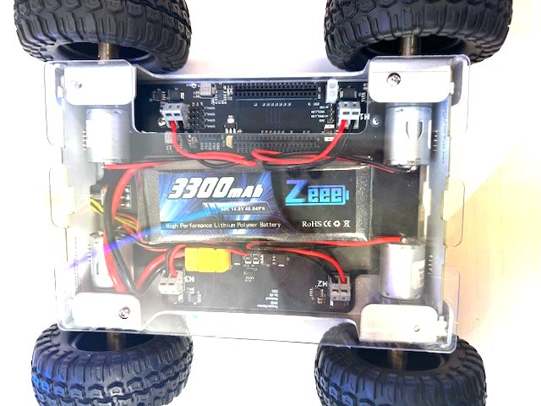
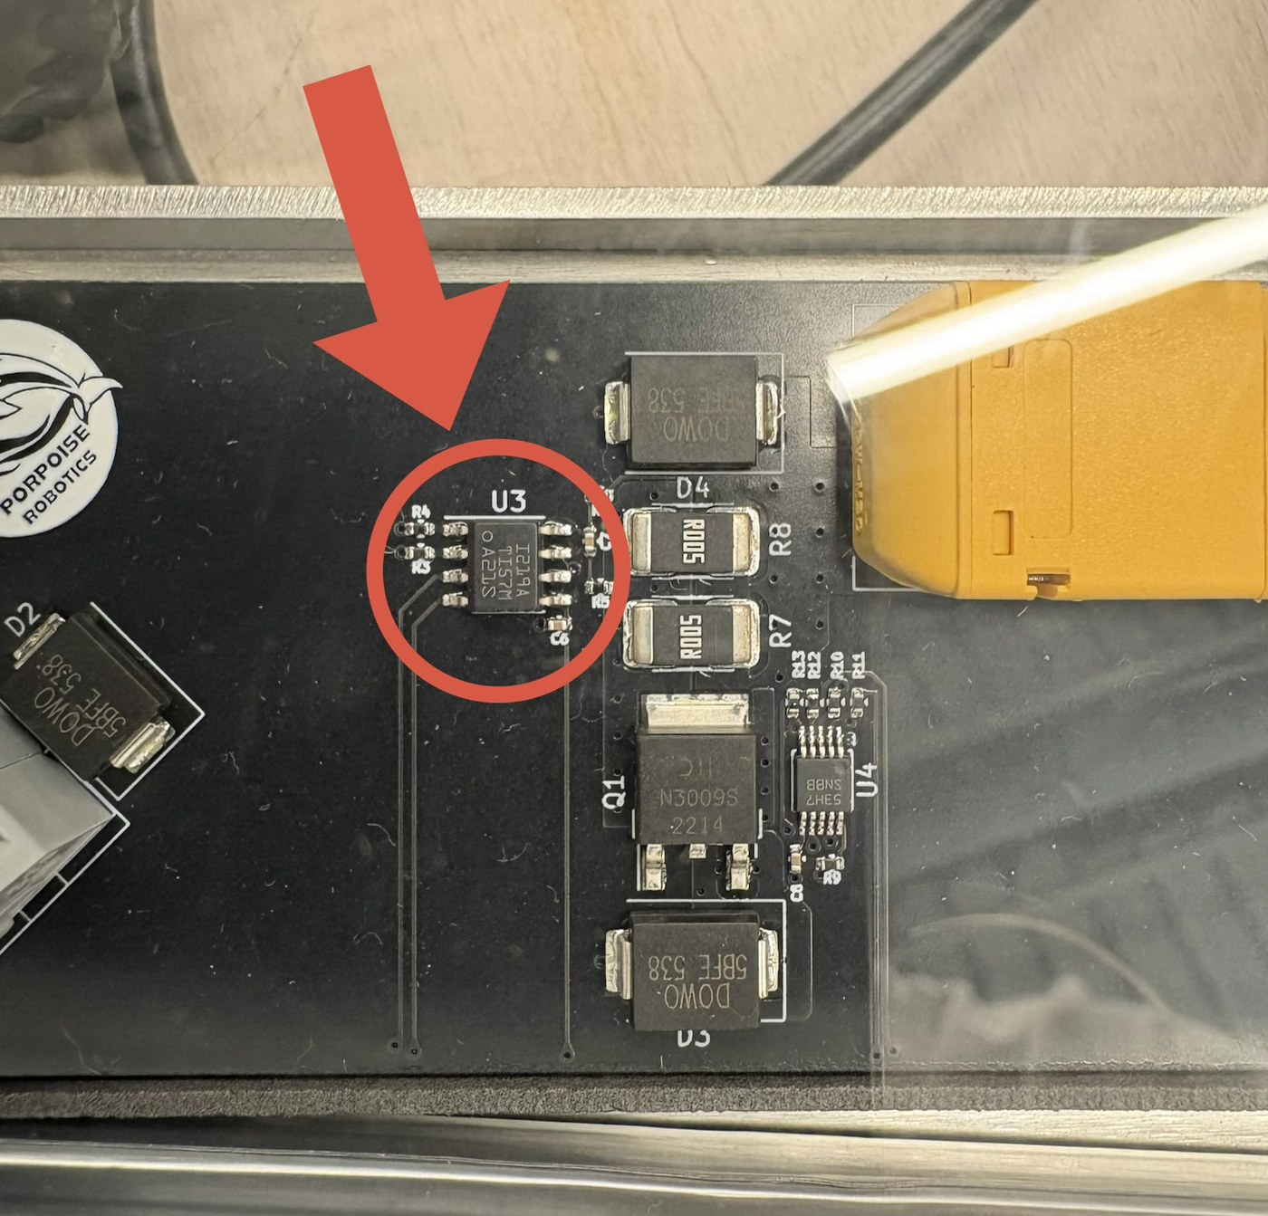
Where the current sensor actually is
Everything in this lesson depends on one small part that only Gen 3 vehicles carry. Find it before you write code that assumes it.
A Gen 3, looking down through the lexan top plate
Circled: the INA219. Beside it, R7 and R8 - the shunt it measures across
Pathfinder Advanced - Op Program 12 | Lesson 5
12
Notes:
Have a Gen 3 open on the desk and let people look at the actual part before the theory starts.
The shunt is the small, low-value resistor next to it. That is what the whole measurement happens across.
Two wires to GPIO 32 and 33 is the entire electrical interface. Everything else is I2C protocol.
In the photograph the shunt is the pair marked R005 immediately right of the circled part. Point at them - a five-milliohm resistor looks like nothing, and that is the point.

Slide 13
What a healthy motor looks like to a current sensor
HEALTHY
DISCONNECTED
JAMMED
baseline
spikes as it breaks away,
then settles
no spike, almost no draw
draws a lot and never settles
Both thresholds are measured ABOVE the baseline that was just taken, not as absolute amps:
peak - baseline >= 1.500 A AND average - baseline >= 1.000 A
WATCH OUT Op 11.2 measured a baseline, printed it, then compared against fixed absolutes anyway - so a vehicle idling at half an amp failed every motor. Op 12 fixed it.
Pathfinder Advanced - Op Program 12 | Lesson 5
13
Notes:
Current is the cheapest sensor on the vehicle, because it is already there. Every fault has a shape.
Walk the three regions: no load, working, stalled. A stalled motor draws the most and moves the least, which is the worst of both.
Ask what a broken wire looks like. Near zero current with the command still on - and the vehicle limping in a circle.
This is the foundation of the powered self-test later in the lesson.

Slide 14
The self-test as a state machine
Jumper GPIO 34 high at boot. Each motor is driven forward then reverse while the current sensor watches.
CHECK_TRIGGER wait for the pin to settle, then decide
BASELINE_CURRENT measure the resting draw, motors off
RUNNING_TESTS eight steps: four motors, two directions
TEST_RESULT green blinks for pass, red for fail
TEST_DISABLED hand over to normal driving
Driven from loop(), not blocking, so the LEDs keep animating and the console keeps responding throughout.
GPIO 34 is input-only with NO internal pulls, so the board carries an external pull-down.
KEY POINT A test that freezes the machine while it runs is a test nobody will leave enabled.
Pathfinder Advanced - Op Program 12 | Lesson 5
14
Notes:
Five states, and it is driven from loop() rather than blocking. That is the same discipline as the lighting lesson.
So the LEDs keep animating and the console keeps responding while the test runs. Ask why that matters - because a machine that goes deaf during a self-test cannot be interrupted.
The GPIO 34 note is a real hardware trap. Input-only, no internal pulls, so the board carries an external pull-down.
Also worth saying, and no longer on the slide: any button press clears the pass/fail screen and hands over to normal driving.
A floating input-only pin reads whatever the room's electrical noise says. Worth saying, because somebody will try this on a breadboard.

Slide 15
Diagnostics, and the battery math you can now do
What diag gives you
Work it out for your vehicle
Every five seconds, while it is switched on:
VBat - bus voltage, straight from the sensor
I-Avg - mean current since the last report
I-Max - the largest positive spike
I-Min - the largest negative excursion
Negative current is real: cut the throttle and a spinning motor becomes a generator. That is why the shunt register is signed.
A 4S 3300 mAh pack holds 3.3 amp hours.
hours = 3.3 / average current in amps
At 2.0 A: 3.3 / 2.0 = 1.65 h, 99 min
At 6.0 A: 3.3 / 6.0 = 0.55 h, 33 min
Now add the LEDs: 32 pixels at full white is nearly 2 A, moving or not.
Measure yours, then decide what you can afford.
SAFETY Never run a lithium pack flat. Below about 3.0 V per cell - 12 V for a 4S - you are damaging it.
Pathfinder Advanced - Op Program 12 | Lesson 5
15
Notes:
The negative current is the interesting column. A spinning motor with the throttle cut becomes a generator and pushes current back.
That is why the shunt register is signed, and it links straight back to the previous code slide.
The right column is arithmetic they can do for their own vehicle. Get everybody to compute a runtime from their own measured average.
Point out that the tracking resets after each report, so each line describes the last five seconds, not the whole session.
The vehicle knows its own voltage, so a low-battery warning is a short job and a good exercise. Suggest it to anybody looking for a project.

Slide 16
Adding a subsystem of your own
The seven things that keep a program from rotting
Say you want a range finder that stops the vehicle before it hits something. Do it the way the program is already built:
1. Every tunable number goes in Config.h. Pins, thresholds, timings. Nothing hard-coded in the logic.
2. One new tab, RangeFinder.ino, owning all of it.
3. A setup_rangefinder() called from setup(), after the motors.
4. An update_rangefinder(now) called every pass, that returns immediately if it is not time. No delay(), ever.
5. A capability flag, so a vehicle without the sensor still runs this binary.
6. A console command, so it can be tested and tuned without recompiling.
7. Keep its state in static file-scope variables. Expose functions, not variables.
If you can do those seven things, you can extend this program without making it worse. That is the actual skill.
Pathfinder Advanced - Op Program 12 | Lesson 5
16
Notes:
Seven rules, and they are the summary of the whole course. Read them slowly.
Every one of them is something Op 12 already does, so they can check each against the real program.
Rule seven is the one people skip: expose functions, not variables. Ask what goes wrong when another tab writes your state directly.
If they can do these seven things, they can extend this program without making it worse. That is the whole point of five lessons.

Slide 17
Where this goes
On the vehicle
Beyond it
Obstacle avoidance from the range finder.
Line following.
Battery protection - the current sensor already knows the voltage, so flashing amber below 12 V and red below 10 V is a short job.
Stall detection while driving, using the same current signature logic as the self-test.
ESP-NOW, so vehicles talk to each other with no router.
Everything here is how embedded software is written generally: subsystem separation, non-blocking state machines, defensive loading, capability detection, self-test, and a console.
The same patterns run cars, medical devices, satellites and industrial controllers.
Six of the ideas in this course exist because somebody shipped the bug first. That is also how it works in industry.
KEY POINT Read the change log at the top of Pathfinder_Op_Program12.ino again now. It should read very differently than it did in Lesson 1.
Pathfinder Advanced - Op Program 12 | Lesson 5
17
Notes:
The left column is concrete next steps. The right column is why any of it mattered.
Say the last line plainly: six of the ideas in this course exist because somebody shipped the bug first. That is also how it works in industry, and it is not a shameful thing.
The same patterns run cars, medical devices, satellites and industrial controllers. That is not hyperbole.

Slide 18
The same test, done twice: on the bench and in software
The factory bench test
The self-test in the program
Before a control board leaves the factory:
Check 15 V, 5 V and 3.3 V rails
Break the motor 1 high side into an ammeter
Issue a full throttle 255 command
Measure current at no load, then at stall
Repeat for motors 2, 3 and 4, then reconnect
Calibrate and test the I2C devices
Accurate. Needs a meter, a bench and a person.
Jumper GPIO 34 high at boot and the vehicle does the same to itself:
Measure the resting current, motors off
Drive each motor full throttle, both ways
Watch peak and average against that baseline
Blink green for pass, red for fail
Less accurate. Runs in ten seconds, in a classroom, with no equipment and nobody who can use a multimeter.
KEY POINT That is usually the trade with built-in test: you give up precision to get a check that will actually be run. A test that needs a bench is a test that happens once.
Pathfinder Advanced - Op Program 12 | Lesson 5
18
Notes:
Two versions of the same test, and the comparison is the lesson.
The bench test is more accurate and needs a meter, a bench and a person. The self-test is less accurate and runs in ten seconds, anywhere, on every vehicle.
Ask which one you would want in a classroom of thirty vehicles. Then ask which one you would want before a board ships.
The answer is both, for different reasons. That is a real engineering judgement rather than a right answer.

Slide 19
Capstone - choose one, and build it properly
One subsystem, done to the standard of the rest of the program
The rest of the course is yours. Pick one and apply the seven rules from the previous slide.
LOW BATTERY WARNING. The vehicle already knows its voltage. Flash amber below 12 V, red below 10 V, and make it a lighting mode rather than something bolted on the side.
STALL DETECTION. You have the current signature logic from the self-test. Apply it while driving: if a motor draws a jammed signature for more than half a second, cut it and say so.
OBSTACLE STOP. An ultrasonic range finder, a threshold in Config.h, and a rule that overrides the throttle. Think hard about what happens when the sensor gives one bad reading.
TELEMETRY. Stream voltage, current and speed over ESP-NOW to a second ESP32 with its own LED bar.
You will be marked on whether somebody else can find your code, tune it without recompiling, and run the binary on a vehicle that does not have your hardware fitted.
Pathfinder Advanced - Op Program 12 | Lesson 5
19
Notes:
This is the last teaching slide. Give it proper time.
Insist on the seven rules from the earlier slide. A capstone built badly teaches the wrong thing.
The obstacle-stop option has the best hidden question in it: what happens when the sensor gives one bad reading? Push whoever picks it.
If anybody is continuing after the course, get them to commit to one today while the enthusiasm is still there.

Slide 20
Check yourself
That is the course. Go and add something.
1. How do you test whether an I2C device exists at an address?
2. A scan finds nothing on any address. What is the classic cause?
3. Why is the shunt resistor 0.0025 ohms and not 0.1?
4. Why must the shunt register be read as SIGNED?
5. What is a repeated start, and why not just stop and start again?
6. Describe the current signature of a healthy motor, a disconnected one, and a jammed one.
7. Why are the self-test thresholds measured above the baseline rather than as absolute amps?
8. Why is the self-test a state machine rather than a blocking routine?
9. List the seven things you would do to add a range finder.
Pathfinder Advanced - Op Program 12 | Lesson 5
20
Notes:
Conversation, not a test. This is the last thing they do.
Answers: address it and end the transmission with no data, then check the acknowledgement; nothing on any address means a missing pull-up; a small shunt wastes less power and steals less voltage from the motors.
Signed, because a motor pushes current back when the throttle is cut.
A repeated start keeps the bus so no other master can take it mid-read.
Healthy: a spike then a settle. Disconnected: almost nothing. Jammed: high and never settling.
Thresholds sit above a measured baseline because the resting draw differs between vehicles and with battery charge.
The self-test is a state machine so the LEDs and console keep working.
Question 9 is the seven rules. If they can list them, the course did its job.

