Slide 1

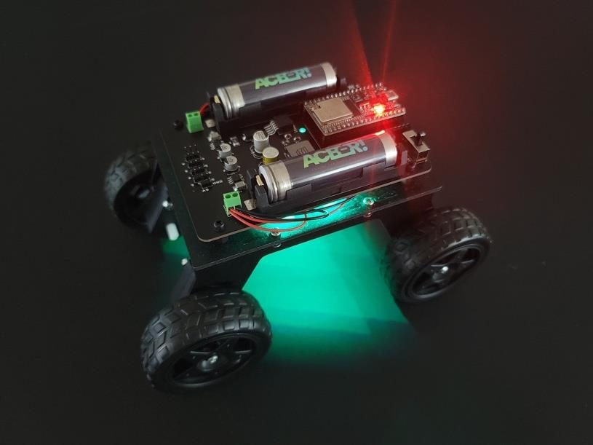
LESSON 4
NeoPixel LEDs
Addressable LEDs, color, power budgets, and making 32 lights do what you tell them.
PORPOISE ROBOTICS - Precision Oceanographic Program On and In the Sea Environment
porpoiserobotics.org
Kevin Bowen, President - kbowen6@icloud.com
Malcom Graham, VP Education Louis Parker, VP Technology
Valen Farre, System Engineer Gary Howland, Animation
Eddie Revollo, Artificial Intelligence
Interns: Oscar Canazales, Krishnansh Vemulapalli, Soham Gangal, Erik Olsen
Three hours. Nothing moves today.
Porpoise Robotics - proprietary. For use with Porpoise Robotics lessons.
Notes:
Nothing moves today, so the blocks can stay in the box and the vehicles can sit on the desks.
Dim the room if you can. Everything today is easier to see with the lights down.
Ask for the LED drawings they made in Lesson 1. Today is the day they get used.

Slide 2
What you will be able to do by the end
By the end of this lesson you will be able to:
1. Explain how 32 LEDs are controlled independently over one wire
2. Mix any color from red, green and blue values
3. Work out the current a lighting pattern will draw, and say whether the battery can afford it
4. Find any LED on the vehicle from its number, and the LED opposite it
5. Write a for loop that lights a chosen run of LEDs
6. Write a lighting pattern of your own as a function
Pathfinder Beginner - PS3 | Lesson 4
2
Notes:
Objective three - working out the current a pattern draws - is the one that connects this lesson back to Ohm's law in Lesson 2.
The last objective is the twenty-minute design exercise at the end. Flag it now so they start thinking early.

Slide 3
Where we got to last lesson
You know how a controller reaches the vehicle, and why every vehicle needs its own address.
You know what a deadzone is and why it exists.
You can turn a stick reading into a motor speed, and mix forward with turn.
You can drive.
Today: the 32 lights. Nothing on the vehicle moves, so the wheels can stay on the desk.
KEY POINT Next lesson everything comes together and we race.
Pathfinder Beginner - PS3 | Lesson 4
3
Notes:
Sixty seconds.
Say clearly that nothing moves today. It changes how the room behaves.

Slide 4
Today, in order
Time | What we do
0:00 | Recap. What an addressable LED is
0:25 | Color: RGB, wavelength, and how your eye works
0:50 | The power budget. Upload l4a_all_one_color
1:15 | BREAK (10 minutes)
1:25 | Mapping the loop. Upload l4b_led_map
1:55 | for loops, and four patterns. Upload l4c_patterns
2:20 | BREAK (10 minutes)
2:30 | Design a pattern of your own
2:55 | Recap
Pathfinder Beginner - PS3 | Lesson 4
4
Notes:
Two breaks, and the design exercise at 2:30. Tell them the best pattern gets used in the race next lesson - that is worth ten minutes of extra effort from everybody.

Slide 5
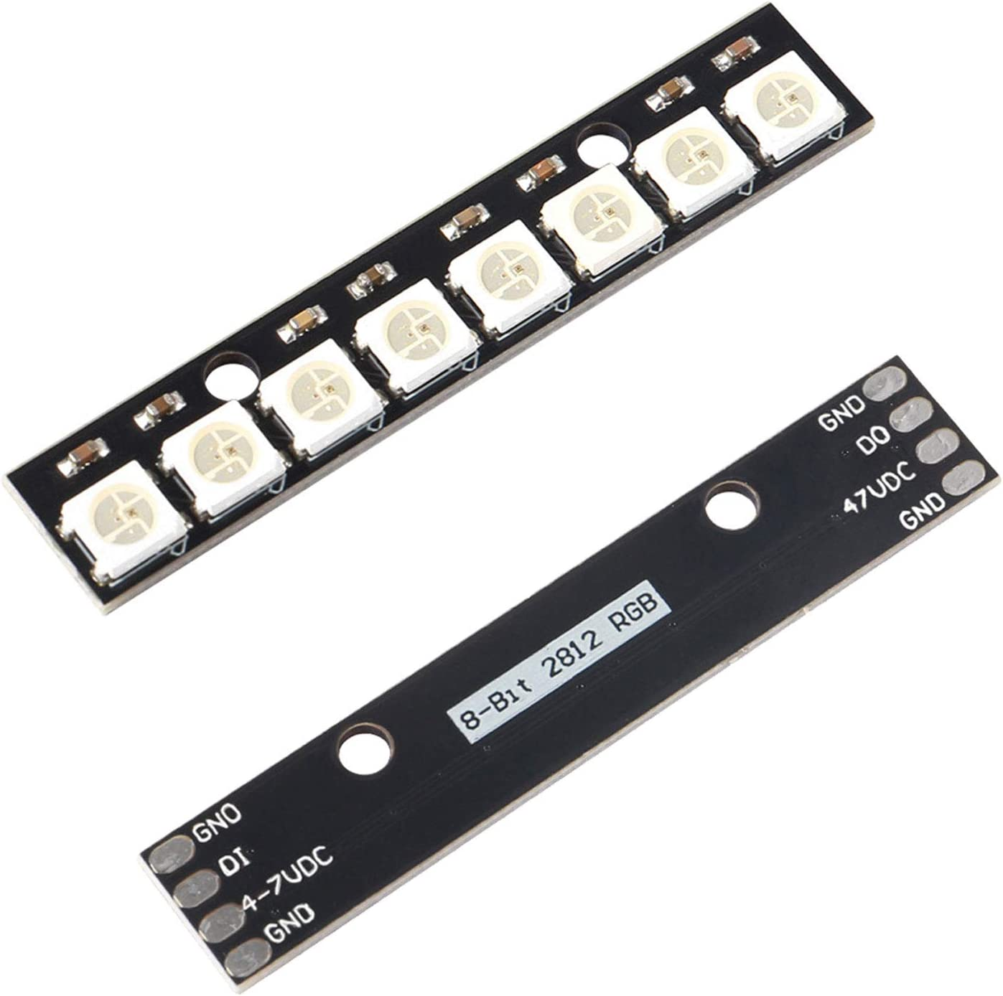
What makes a NeoPixel different
An ordinary LED has two legs, is on or off, and needs a pin of its own.
A NeoPixel - the part is a WS2812B - has FOUR connections: 5 volts, ground, DATA IN and DATA OUT. Inside are a tiny controller chip and three LEDs, one red, one green, one blue.
Send a stream of color messages into the first pixel. It keeps the FIRST message and passes the rest out to the next one, which does the same.
So ONE WIRE drives the whole chain. Our vehicle has 32 on GPIO 5, numbered in the order the data flows.
Eight WS2812Bs, front and back: 5 V, ground, DI, DO
KEY POINT In theory a chain can be any length. In practice the whole chain is refreshed every frame, so about 350 pixels is the limit before the refresh rate drops below 40 Hz.
Pathfinder Beginner - PS3 | Lesson 4
5
Notes:
The chain idea is the whole lesson. Draw it on the board: data in, keep the first message, pass the rest out.
That is why one wire drives thirty-two lights, and why the numbering runs in data order rather than in any order that looks tidy.
The 350-pixel practical limit answers the question somebody always asks about how long a chain can be.
WS2812B is the part number. Worth saying once - they will meet it everywhere.
The photograph is a stick of eight rather than a single pixel, and the back is worth pointing at: DI at one end, DO at the other, and 5 V and ground shared down the whole strip. That is the chain, in one picture.
The next slide is the same thing as a drawing, which is where the wiring becomes obvious. Do not explain the chain twice - say it here and prove it there.

Slide 6
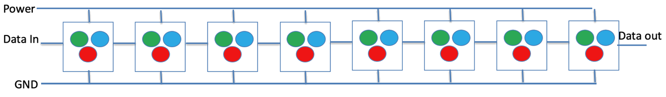
One wire, thirty-two lights
Each box is one NeoPixel: a controller chip and three LEDs, one red, one green and one blue. Eight are drawn here; your vehicle has 32.
KEY POINT Power and ground are RAILS - every pixel taps the same two wires. Data is a CHAIN - each pixel keeps the first message and passes the rest out to the next one. That is why one pin drives the whole strip, and why a break in the data line puts out every pixel after it and none before it.
Pathfinder Beginner - PS3 | Lesson 4
6
Notes:
Draw this on the board before you show the slide. Three wires in at the left, three wires out at the right, and eight identical parts in between.
Ask which of the three wires is different from the other two, and why. Power and ground go to every pixel the same way; the data wire does not.
Then walk a message along it with your finger: the first pixel keeps the first color and passes the rest out of DATA OUT, which is the next pixel's DATA IN.
That is the whole reason one pin can drive thirty-two lights, and the reason the numbering runs in data order rather than in whatever order looks tidy from outside.
Worth saying out loud: unplug the data lead going into pixel 4 and pixels 4 to 31 all go dark, while 0 to 3 carry on. Power and ground are a rail; data is a chain.

Slide 7
The whole NeoPixel API you need
Nine calls. Everything in Lesson 4 and everything in the vehicle program is built from these.
Call | What it does
strip.begin() | Wakes the strip up. Once, in setup(). Always required.
strip.setBrightness(n) | Master scale, 0 to 255, applied to every pixel
strip.Color(r, g, b) | Packs three 0-255 numbers into one color value
strip.setPixelColor(i, c) | Sets pixel i - IN MEMORY ONLY
strip.fill(c) | Sets every pixel to the same color, in memory
strip.clear() | Sets every pixel to off, in memory
strip.show() | Sends the memory to the hardware. Nothing happens without it.
strip.numPixels() | How many there are - 32 here
strip.gamma32(c) | Corrects a color so fades look even to your eye
KEY POINT Six of those nine only touch memory. Exactly one of them, show(), changes what you can see.
Pathfinder Beginner - PS3 | Lesson 4
7
Notes:
Nine calls, and everything in this lesson and in the vehicle program is built from them. Tell them to photograph this slide.
The note is the thing to land: six of the nine only touch memory. Nothing reaches the vehicle until show().
gamma32 is on the list for completeness. One sentence - it makes fades look even to your eye - and move on.

Slide 8

One pixel is three LEDs, and color is a mixture
Red + green = yellow. All three at full = white. This is ADDITIVE mixing, and it is not how paint behaves.
Pathfinder Beginner - PS3 | Lesson 4
8
Notes:
Additive mixing, not the subtractive kind they learned with paint. Red and green light make yellow; red and green paint make mud. Say it, because it genuinely surprises people.
strip.Color(r, g, b) is this picture in three numbers. Point at the overlaps and give the call for each one.
Ask for the numbers that make yellow before you show them. 255, 255, 0 - and somebody will guess it.
White costs three channels, which is the whole of the power budget slide two on from here.
Do not read the table on the next slide out. Put it up, give them a minute, and ask for the two that surprise them.

Slide 9
The colors, and what to write for each one
Start from these, then change one number at a time and watch what it does. Nothing here is a magic value - every one is three numbers between 0 and 255.
Color | The call | Channels lit
Red | strip.Color(255, 0, 0) | 1
Green | strip.Color(0, 255, 0) | 1
Blue | strip.Color(0, 0, 255) | 1
Yellow | strip.Color(255, 255, 0) | 2
Cyan | strip.Color(0, 255, 255) | 2
Magenta | strip.Color(255, 0, 255) | 2
Orange | strip.Color(255, 100, 0) | 2
Purple | strip.Color(128, 0, 255) | 2
Pink | strip.Color(255, 100, 100) | 3
White | strip.Color(255, 255, 255) | 3
Warm white | strip.Color(255, 160, 80) | 3
Off | strip.Color(0, 0, 0) | 0
KEY POINT The third column is the power budget in disguise. Orange costs twice what red does, and white costs three times - which is why a strip set to white is the one that browns out a battery.
Pathfinder Beginner - PS3 | Lesson 4
9
Notes:
These are the starting points, not the answer. Say that first, or somebody will copy the table and never change a number.
Orange is the interesting row. Ask why it is not (255, 128, 0) - it can be, and 100 just looks better on these LEDs. Color is judged by eye, not calculated.
Purple and magenta are worth a moment. Neither is a wavelength; they only exist as mixtures, which is the point of the wavelength slide before this one.
The Channels lit column is the bridge to the power budget two slides on. White costs three times what red costs, and that is an ampere question, not an aesthetic one.
Warm white is the practical one for headlights. Straight white looks blue-ish next to daylight.

Slide 10
How your eye turns wavelengths into color
The physics
The biology
Visible light runs from about 380 nanometers, which you see as violet, to about 750, which you see as deep red.
Red 625 - 740 nm
Yellow 565 - 590 nm
Green 500 - 565 nm
Blue 440 - 485 nm
Violet 380 - 440 nm
A single LED emits one narrow band.
Your retina has three kinds of cone cell, each most sensitive to a different wavelength: long, medium and short - or red, green and blue.
Your brain compares them, which is called OPPONENCY.
So three LEDs can fake every color you can see. They do not make yellow light - they make red and green light in the ratio that makes your cones report yellow.
Dogs have two cone types. Some birds have four.
KEY POINT Magenta and pink are not on the spectrum at all. There is no single wavelength for them - they exist only as mixtures, which means they are made by your brain rather than by the light.
Pathfinder Beginner - PS3 | Lesson 4
10
Notes:
This is the science half of the lesson and it is genuinely interesting. Do not rush it because it is not code.
The key idea: three LEDs can fake every color because your eye only has three kinds of sensor to fool.
Yellow light and red-plus-green light are physically different and look identical. That surprises people, and it should.
If somebody asks why a rainbow on the strip does not look even: that is gamma, and it is the last row of the API table.

Slide 11
setBrightness is not the same as a smaller color value
Two different dimmers
There are two ways to make an LED dimmer, and they are not interchangeable.
strip.Color(60, 0, 0) sets the RED channel to a quarter. The green and blue channels are untouched. This changes the COLOR you asked for.
strip.setBrightness(60) scales EVERY channel of EVERY pixel on the way out. It changes how bright the whole strip is without changing any of the colors you set.
Two things worth knowing about setBrightness:
It is applied when show() is called, so changing it does nothing until the next show().
It is LOSSY. Set a pixel to 4, scale by 60/255, and it rounds to 0. Very dim colors disappear rather than getting dimmer, which is why a fade can end abruptly.
Rule of thumb: use setBrightness once, in setup(), to fix the overall level for the room and the power budget. Use the color values for everything else.
Pathfinder Beginner - PS3 | Lesson 4
11
Notes:
This distinction confuses people for years. Ten minutes here saves hours later.
Color value changes WHAT you asked for. Brightness scales EVERYTHING on the way out.
The lossy point explains a real bug they will hit: a fade that ends abruptly instead of going smoothly to black.
Rule of thumb worth repeating: set brightness once in setup, then work in color values.

Slide 12
The power budget - read this before turning the brightness up
The arithmetic
What keeps it sane
Each of the three LEDs inside a pixel draws about 20 mA at full brightness.
One pixel, full white: 3 x 20 = 60 mA
All 32, full white: 32 x 60 = 1920 mA
Nearly two amps.
At 5 volts: 1920 mA x 5 V = 9.6 watts
That is real heat through a small board.
setBrightness() scales EVERY pixel before it is sent. At 60 out of 255 you draw about a quarter of the worst case.
Colored light is cheaper than white. Pure red lights one channel of the three, so it costs about a third.
Which is why the vehicle programs run at about 120 rather than 255, and why full white across all 32 is used for a moment and never held.
WATCH OUT Power = voltage x current. Energy from the battery becomes light and heat, and the ratio is not as favourable as you would hope.
Pathfinder Beginner - PS3 | Lesson 4
12
Notes:
Do the arithmetic on the board with them. It is four multiplications and it makes the constraint real.
Nearly two amps and nearly ten watts through a small board. That is why the number in the program is 120 and not 255.
Colored light is cheaper than white - pure red lights one of the three channels instead of all three. Ask them to work out yellow before you tell them.
This is Ohm's law from Lesson 2, used for something real. Point back at it explicitly.

Slide 13
Ohm's law, and the power law you need for the LEDs
OHM'S LAW
POWER LAW
ONE NEOPIXEL
at full white
3 LEDs x 20 mA
= 60 mA
P = I x V
= 0.06 x 5
= 0.3 W
x 32 pixels
= 1.92 A
= 9.6 W
V
P
I
R
I
V
V = I x R
I = V / R
R = V / I
P = I x V
I = P / V
V = P / I
V volts I amps R ohms
P watts I amps V volts
KEY POINT Cover the quantity you want with your thumb and the triangle shows you the sum. These two turn up again in the LED budget, the shunt resistor, and how long your battery lasts.
Pathfinder Beginner - PS3 | Lesson 4
13
Notes:
Two relationships, and between them they explain every resistor and every current budget on this vehicle.
Do one worked example on the board before they look at the slide, and make them tell you which quantity is the unknown.
Units matter more than the algebra here. Volts, amps, ohms, watts - keep saying them.
The reason this is in a robotics course: the LED resistor and the 32-LED current budget are both this, and getting them wrong smells of hot plastic.

Slide 14
The power budget
About 25 minutes
done
NOW
Addressable LEDs
The power budget
The LED map
Patterns
Pathfinder Beginner - PS3 | Lesson 4
14
Notes:
Twenty seconds. First of three.

Slide 15
Do it now - all 32, one color at a time
UPLOAD AND RUN: l4a_all_one_color (20 minutes)
1. Upload it. Watch both the vehicle and the Serial Monitor.
2. Note the estimated current for each color. Which is cheapest? Which is most expensive? Why?
3. Change BRIGHTNESS to 255 and upload. After a minute of white, put your hand near the LED bars - carefully.
4. Put it back to 60.
5. Change the for loop to i = i + 2. What happens, and why?
6. Replace the whole loop with ONE line: strip.fill(c); then strip.show(). Same result, six lines shorter.
What you should see
All 32 LEDs cycling through seven colors and off, with the estimated current printed for each.
Answer these
Yellow costs about twice what red costs. Why?
At brightness 60, what is the worst-case current?
Pathfinder Beginner - PS3 | Lesson 4
15
Notes:
Step 3 is a deliberate, supervised look at what full brightness costs. Say carefully, and do not let anybody hold a hand against the bars.
Yellow costs about twice red because it lights two channels rather than one. Get that answer from the room.
Step 6 is the one to make a point of. They have just written a for loop, and strip.fill() does the same job in one line. The lesson is not that loops are bad - it is that when every pixel gets the SAME color, the library already has a call for it, and reaching for the loop first is a habit worth noticing.
Have somebody read both versions out. Six lines against one, identical on the vehicle.
At brightness 60 the worst case is roughly a quarter of two amps, so about 450 mA.

Slide 16
Where every LED number is on the vehicle
FRONT - data goes in at LED 0
0
1
2
3
4
5
6
7
8
9
10
11
12
13
14
15
LEFT
side
RIGHT
side
front LED p and rear LED 31 - p are directly opposite each other
0 pairs with 31 5 pairs with 26 10 pairs with 21 15 pairs with 16
31
30
29
28
27
26
25
24
23
22
21
20
19
18
17
16
REAR - numbering runs the other way, right to left
KEY POINT LEFT is 0-7 and 24-31. RIGHT is 8-15 and 16-23. The strip is one loop, so each side is in two pieces.
Pathfinder Beginner - PS3 | Lesson 4
16
Notes:
Put a vehicle on the desk in the same orientation as the diagram before you say anything. Students who cannot match the picture to the object will guess for the rest of the lesson.
The numbers run in the order the data flows, not in any order that looks tidy from outside. Say so - it is the answer to the question they are about to ask.
Get them to point at LED 0 and LED 31 on a real vehicle before moving on.
This map is worth printing. They will use it in every lighting exercise from here to the end of the course.

Slide 17
The LED map
About 30 minutes
done
done
NOW
Addressable LEDs
The power budget
The LED map
Patterns
Pathfinder Beginner - PS3 | Lesson 4
17
Notes:
Twenty seconds. Two of three.

Slide 18
Do it now - learn the map
UPLOAD AND RUN: l4b_led_map (25 minutes)
1. Sit the vehicle in front of you where you can see all four bars.
2. Upload it. Follow the walking dot with your finger.
3. Write the numbers onto a sketch of the vehicle. Keep it.
4. During the four-sides section, check that LEFT really is 0-7 and 24-31.
5. During the mirror section, check that the two lit LEDs really are opposite each other.
6. Change showSide so that FRONT lights only the middle four LEDs. Which numbers are those?
7. Add a section that lights the four CORNERS.
What you should see
A dot walking all the way round, then each side in turn, then front and rear LEDs lighting in matched pairs.
Answer these
Which LED is directly behind number 3?
You want to light the whole right side. Which two ranges?
Pathfinder Beginner - PS3 | Lesson 4
18
Notes:
This is the activity that pays off for the rest of the course. Make sure every group finishes with a labeled drawing they keep.
Vehicles all facing the same way, or the left-and-right conversation gets confusing fast.
Steps 6 and 7 are the real work. The middle four of the front bar and the four corners both need them to reason about the numbering rather than read it off.
The LED directly behind number 3 is the one the mirror section shows them. Let the program answer it, not you.

Slide 19
for loops: doing something 32 times without writing it 32 times
the pattern you will use all day
// The long way. Nobody writes this.
strip.setPixelColor(0, white);
strip.setPixelColor(1, white);
strip.setPixelColor(2, white); // ...and 29 more
// The for loop. Same thing.
for (int i = 0; i < 32; i++) {
strip.setPixelColor(i, white);
}
// ALL of them the same color? Do not write a loop at all.
strip.fill(white);
// Just the front. Here you do need the loop:
for (int i = FRONT_FIRST; i <= FRONT_LAST; i++) {
strip.setPixelColor(i, headlight);
}
int i = 0 start here
i < 32 keep going while this is true
i++ add one each time round
EVERY pixel the same? strip.fill() already does it. Save the loop for when the pixels differ.
Watch < against <=. With FRONT_LAST = 15 you want <= or you will miss LED 15. Off-by-one is the most common bug in programming, and this is where you meet it.
Pathfinder Beginner - PS3 | Lesson 4
19
Notes:
Show the long way first and let somebody groan. That is the motivation for the loop.
Then land strip.fill(): if every pixel gets the same color, the loop is not needed either. The rule is that the loop earns its place when the pixels DIFFER, which is exactly what the last example shows.
Read the three parts of the for header out loud as a sentence: start here, keep going while this is true, add one each time.
The < versus <= point is worth a full minute. With FRONT_LAST at 15 they need <= or they lose LED 15.
Say out loud that off-by-one is the most common bug in programming and that this is where they meet it. It normalises getting it wrong.

Slide 20
Four patterns, four ideas
colorWipe and theaterChase
rainbow and scanner
colorWipe fills the strip one LED at a time, in order, so the color sweeps along it.
One loop, one delay per LED.
theaterChase lights every third LED and shuffles the pattern along by one each frame, so they chase each other.
Three nested loops: how many repeats, which of the three positions is lit, and stepping along in threes.
rainbow uses HUE instead of red, green and blue - one number all the way round the color wheel, 0 to 65535.
Each LED gets a hue further round, and the start point creeps forward so it flows.
scanner is the KITT effect: one bright dot with a fading tail, and the rear LED at 31 - p to stay lined up.
The tail uses >> tail to halve each step: 255, 127, 63.
KEY POINT gamma32() corrects for the fact that your eye does not see brightness in a straight line. Without it, the middle of a fade looks too bright.
Pathfinder Beginner - PS3 | Lesson 4
20
Notes:
Four patterns, four different ideas. Do not read all the detail - name the idea behind each and let the code teach the rest.
theaterChase is the one with three nested loops. If anybody is going to get lost today it is here, so slow down.
Hue is the interesting one: a single number that goes all the way round the color wheel, instead of three separate channels.
The scanner is the one they will remember. Mention that it comes back in Lesson 5, done properly without delay().

Slide 21
Patterns
About 50 minutes
done
done
done
NOW
Addressable LEDs
The power budget
The LED map
Patterns
Pathfinder Beginner - PS3 | Lesson 4
21
Notes:
Twenty seconds. Last activity before the design exercise.

Slide 22
Do it now - four patterns
UPLOAD AND RUN: l4c_patterns (25 minutes)
1. Upload it and watch all four run.
2. In colorWipe, change the wait from 30 to 5, then to 150.
3. In theaterChase, change BOTH 3s to 4s. What changes?
4. Change SCANNER_TAIL from 3 to 0, then to 8.
5. Change the scanner color to blue. You now have a Cylon instead of KITT.
6. Copy colorWipe, rename it, and make it run BACKWARDS. Call it from loop().
What you should see
Color wipe, theatre chase, a flowing rainbow, then the scanner sweeping front and rear together.
Answer these
In theaterChase, why does the inner loop step in threes?
What does >> 1 do to a number? Why does that dim an LED?
Pathfinder Beginner - PS3 | Lesson 4
22
Notes:
Every step here is change-one-thing-and-look. Keep them to one change at a time.
Step 6 - copying a function, renaming it and running it backwards - is the first time they write something rather than adjust it. Give it time.
The inner loop steps in threes because only every third LED is lit at once. Get that from the room.
>> 1 halves a number by shifting its bits right, which is a cheap way to dim a color. Show it on the board if they have not met bit shifts.

Slide 23
Design a pattern of your own
Twenty minutes, in your groups
Invent a lighting pattern for your vehicle and write it as a function. Some starting points:
Police lights - left red, right blue, alternating
A countdown - all 32 red, then fewer, then green
A battery gauge - green to amber to red across the front
Breathing - all 32 fading smoothly up and down
A collision warning that flashes faster as you close in
A stoplight - front bar red, amber, green, on a timer, with the rear bar matching
D-pad quadrants - light only the quarter you press
Rules: a function you call from loop(), using at least one for loop. Then show the class - the best one gets used in the race next lesson.
Pathfinder Beginner - PS3 | Lesson 4
23
Notes:
Twenty minutes, hands off, let them build. Circulate but do not solve.
The two rules matter: it has to be a function called from loop(), and it has to use a for loop. Those are the two things this lesson taught.
Leave five minutes at the end for showing. Every group demonstrates, even if it half works.
Pick a winner and mean it - it gets used in the race next lesson.
The stoplight and the D-pad quadrants are the two easiest starting points if a group is stuck - both are for loops over a known range, which is exactly what they just practiced.

Slide 24
When the lights will not do what you want
Work down this list before you change any code.
Symptom | Most likely cause | What to do
Nothing lights at all | No show() call | Add strip.show() after the setPixelColor calls
Only the first few light | LED_COUNT too small | It must be 32, not 12 or 16
Colors are wrong - red shows green | Wrong color order | Check NEO_GRB in the constructor
The last few flicker | Not enough power, or a long data run | Lower the brightness and try again
A pattern leaves a trail behind it | The strip was not cleared | strip.clear() at the start of each frame
Lights work, vehicle stutters | delay() inside an animation | Lesson 5 - use millis() instead
One LED stays dark forever | That pixel or its solder joint has failed | Everything after it still works - it passes data through
Pathfinder Beginner - PS3 | Lesson 4
24
Notes:
Do not read this out. Point at it and tell them to work down it before changing any code.
Row one will happen to somebody in the next ten minutes.
The last row is a good one: a dead pixel still passes data through, so everything after it keeps working. That is the chain idea again.

Slide 25
Check yourself
Next lesson: everything at once, and a race.
1. How can 32 LEDs be controlled independently over one wire?
2. What are the four connections on a NeoPixel?
3. You call setPixelColor for LEDs 0 to 15 but nothing lights up. What did you forget?
4. What color is strip.Color(255, 255, 0)? Why?
5. 32 pixels of full white draw about how much current?
6. Which LEDs are on the LEFT side of the vehicle?
7. Which LED is directly opposite front LED 6?
8. Write a for loop that lights only the rear bar in red.
Pathfinder Beginner - PS3 | Lesson 4
25
Notes:
Conversation, not a test.
Answers, in order: each pixel keeps the first message and passes the rest along; 5 V, ground, data in, data out; you forgot strip.show(); yellow, because red and green together look yellow to your eye; about 1.9 amps.
Questions 6 and 7 they should answer from their own drawing, not from memory.
Question 8 should be written out. Check a few.
Tell them next lesson is everything at once, and a race.

