Slide 1

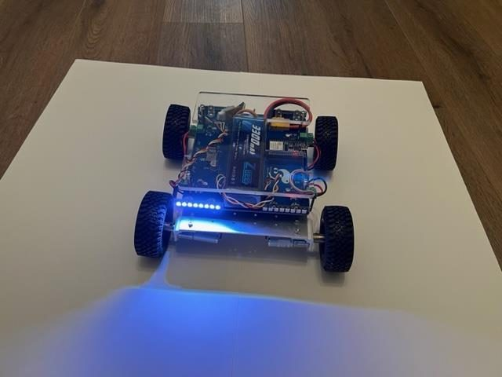
LESSON 1
Introduction
Mechatronics, the Pathfinder vehicle, the Arduino IDE, and your first three programs.
PORPOISE ROBOTICS - Precision Oceanographic Program On and In the Sea Environment
porpoiserobotics.org
Kevin Bowen, President - kbowen6@icloud.com
Malcom Graham, VP Education Louis Parker, VP Technology
Valen Farre, System Engineer Gary Howland, Animation
Eddie Revollo, Artificial Intelligence
Interns: Oscar Canazales, Krishnansh Vemulapalli, Soham Gangal, Erik Olsen
Three hours. Work in groups of three.
Porpoise Robotics - proprietary. For use with Porpoise Robotics lessons.
Notes:
Start the clock here. Three hours, two ten-minute breaks, and by the end every group has uploaded three programs.
Introduce yourself and get their names. Ask who has written any code before - the answer shapes how fast you can go through the IDE section.
Have the vehicles out on the desks already, switched off. People settle faster when there is something in front of them.
Say what today is NOT: nothing drives today. Motors are next lesson.

Slide 2
What you will be able to do by the end
By the end of this lesson you will be able to:
1. Say what mechatronics is, and point to three parts of the Pathfinder that are mechanical, electrical and software
2. Set up the Arduino IDE, the board package and the libraries, and get the course files into your Arduino folder
3. Name the three parts of every Arduino program and say when each runs
4. Build a working LED circuit on a breadboard, and say why the resistor is there
5. Upload a program to the vehicle and change it
6. Read what the vehicle prints back on the Serial Monitor
7. Light any one of the 32 LEDs, in any color
Pathfinder Beginner - Nintendo Switch | Lesson 1
2
Notes:
Read these out. It takes forty seconds and it tells the room what success looks like.
Come back to this slide in the last five minutes and ask them to score themselves against it. Anything nobody can do is what you open with next lesson.
Ask first, before any of this: hands up for anybody who has met Arduino, the ESP-32, C++ or Ohm's law before. It changes who you pair with whom, and it tells you which of the four objectives is going to be the slow one.
Objective four - saying why the resistor is there - is the one that separates following instructions from understanding. Watch for it.

Slide 3
Welcome
This is a five-lesson course. Each lesson is three hours, and each one ends with your vehicle doing something it could not do at the start.
Please make it interactive. Questions, comments and better ideas are all welcome, and the best ones usually come from somebody who has just broken something.
You work in groups of three and share a vehicle. There are more vehicles if your group wants one each.
You will read programs, change them, upload them, and see what happens. Modifying a working program is the fastest way to learn to write one.
Very often the vehicle will do exactly what you told it to do, and not at all what you meant. That is not a setback. That is the job.
KEY POINT By the end of Lesson 5 you will be driving a vehicle you understand line by line, and racing it.
Pathfinder Beginner - Nintendo Switch | Lesson 1
3
Notes:
The tone of the whole course is set in the next two minutes. Interruptions are wanted, not tolerated.
Groups of three: one driving the laptop, one reading the slide out, one on the vehicle. Tell them to swap roles every activity, and mean it.
The last bullet is the important one. Say it slowly. Students who think a misbehaving vehicle means they are bad at this will give up in Lesson 2.

Slide 4
Where this course goes
Lesson | Subject | What your vehicle can do by the end
1 | Introduction and the toolchain | Blink an LED, print to the screen, light one pixel
2 | Motor control | Drive itself round a square you calculated
3 | Controller programming | Be driven by you, with a thumbstick
4 | NeoPixel LEDs | Run headlights, signals and light patterns
5 | Maneuvers with lights | Everything at once - and race
KEY POINT Every lesson builds directly on the one before it. Nothing gets thrown away.
Pathfinder Beginner - Nintendo Switch | Lesson 1
4
Notes:
One line each, no more. This is a map, not a syllabus.
Point at Lesson 5 and say that the program they end on is the same one that leaves the factory on a finished vehicle. That lands.
If somebody asks about the advanced course, hold it - it is on the last slide of Lesson 5.

Slide 5
Today, in order
Time | What we do
0:00 | What mechatronics is, and what a Pathfinder is
0:30 | A tour of the vehicle: computer, motors, lights, battery
0:55 | BREAK (10 minutes)
1:05 | Install the Arduino IDE, the board package and the libraries
1:40 | The three parts of every program. Upload l1a_blink
2:05 | BREAK (10 minutes)
2:15 | Talking back: the Serial Monitor. Upload l1b_serial_monitor
2:40 | Your first light. Upload l1c_first_pixel
2:55 | Safety, batteries, and what to expect next lesson
Pathfinder Beginner - Nintendo Switch | Lesson 1
5
Notes:
Put the two break times on the whiteboard as well. People relax when they know when the next one is.
The timings are a guide. The IDE install is the one that runs over; if it does, take it out of the Serial Monitor section, not out of the blink activity.
If the whole room is installed and ready early, go straight to the breadboards. Never fill time.
Breaks are about every hour, or wherever the work reaches a natural stop. Say so at the start, so nobody is wondering.

Slide 6
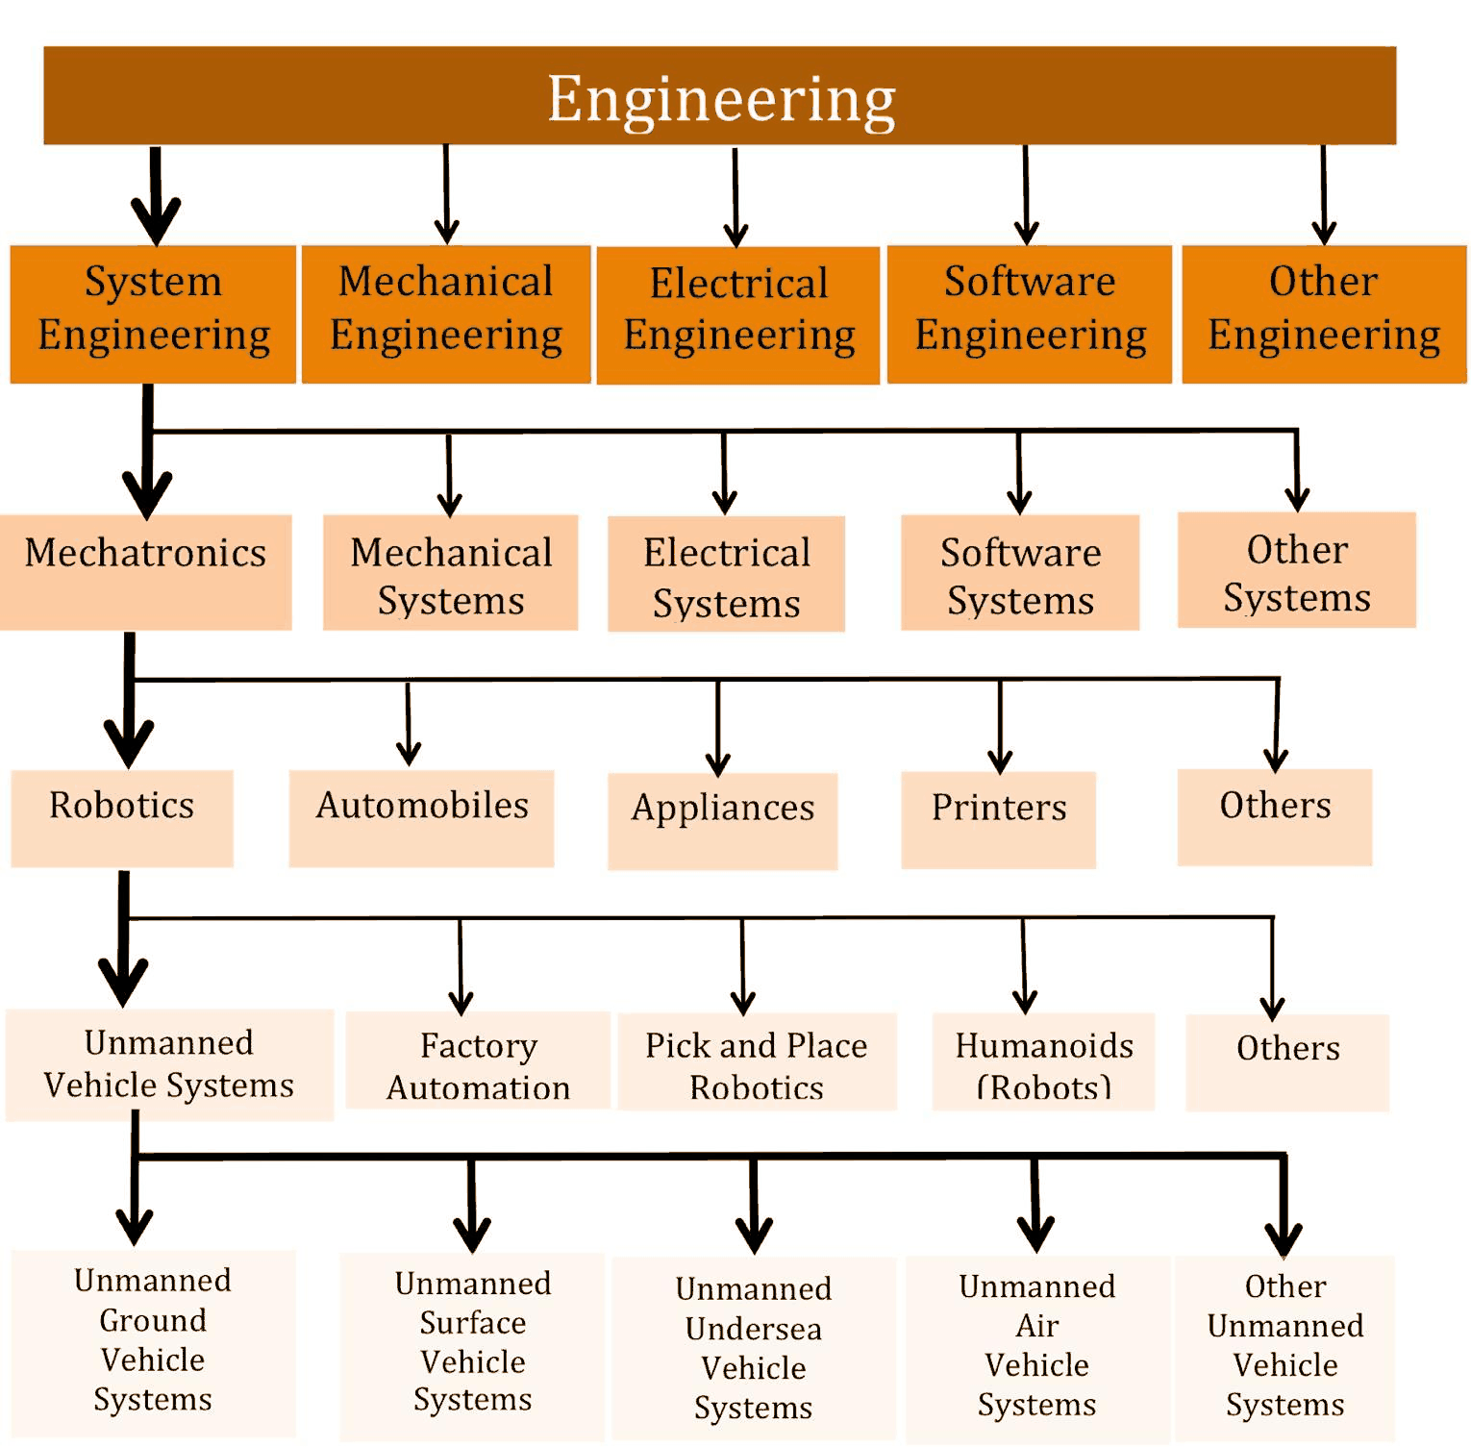
Mechatronics
Much of the design and building of robots belongs to a field called MECHATRONICS - mechanical systems, electrical systems, and the computers that control them, treated as one thing.
An unmanned ground vehicle is one small corner of it.
What you learn here applies to the rest: factory automation, appliances, printers, cars, aircraft, and undersea vehicles.
The reason we teach it with a rover is that you can watch a rover, reach it when it gets stuck, and a mistake means a bumped wall rather than a flooded electronics bay.
Engineering, narrowing down to what you are about to build
Pathfinder Beginner - Nintendo Switch | Lesson 1
6
Notes:
Get the word MECHATRONICS said out loud by somebody other than you.
The figure narrows from all of engineering down to what is on the desk. Walk it inwards with a finger.
Ask for three mechatronic things in the room. Printer, car, washing machine, lift, and the vehicle in front of them all count.
Do not get drawn into a definitions argument. The point is that the three disciplines are one job, not three.

Slide 7
STEM, and where it shows up in this course
Math and science you will actually use
Engineering practice
Circumference and pi, for wheel travel
Distance = speed x time, for maneuvers
Ratios and percentages, for duty cycle
Linear mapping, stick reading to speed
Ohm's law and power, for the LED budget
Wavelength and color, for the lighting
Trigonometry, to plot where you end up
Reading a program before changing it
Changing ONE thing at a time
Measuring rather than guessing
Writing down what you measured
Mechanical, electrical or software?
Version control, so work is never lost
KEY POINT STEM is not four subjects. It is using math and science to build something that has to actually work.
Pathfinder Beginner - Nintendo Switch | Lesson 1
7
Notes:
This is the slide to point at when somebody asks why they are doing math in a robotics class.
Every item on the left is used in a specific lesson, not in general, and the slide is deliberately terse so you can say which. Circumference and trigonometry in Lesson 2, linear mapping in Lesson 3, Ohm's law in Lessons 2 and 4, wavelength and color perception in Lesson 4.
"Mechanical, electrical or software?" is the diagnostic question of the whole course. Ask it out loud every time something does not work, and they will start asking it themselves by Lesson 3.
The right-hand column is what actually gets people hired. Read it as a list of habits, and tell them you will be marking those habits all term.

Slide 8
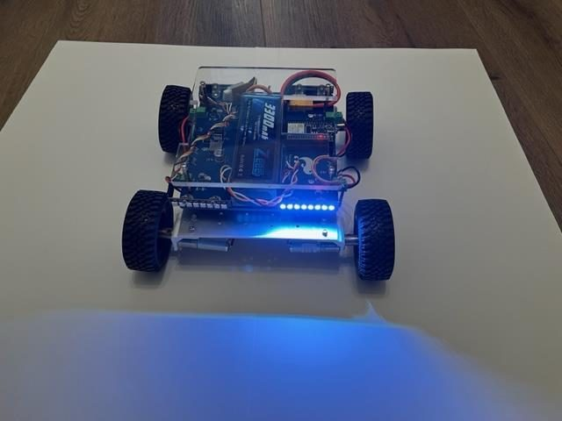
The Pathfinder
A fast, rugged, four-wheel-drive vehicle with an ESP32 computer, four independently driven motors, 32 programmable LEDs, four servo outputs and a rechargeable lithium battery.
LEFT turn signal, from the front. The rear bar is lit on the same side at the same time.
RIGHT turn signal. Same vehicle, same program, same 32 LEDs - the D-pad just went the other way.
Pathfinder Beginner - Nintendo Switch | Lesson 1
8
Notes:
Pass a vehicle round while you talk over this slide. Let them pick it up - it is built to be handled.
Both pictures are the same vehicle running the SAME PROGRAM. Nobody reprogrammed anything between them - somebody pushed the D-pad the other way. Say that explicitly, because it is easy to assume two pictures mean two programs.
Both photographs are taken from the front, so you can only see the front bar. Say what the camera cannot show: the rear bar is indicating on the same side at the same time, the way a car does. It is one SIDE of the vehicle lighting up, not one end.
That is the through-line of the whole course: the hardware is fixed, one program covers every behavior, and what changes is the input it is given.

Slide 9
What is on the vehicle
ESP32 computer - a small, fast microcontroller with Bluetooth and Wi-Fi built in. Your program runs here.
Four brushed DC motors, each with its own DRV8871 H-bridge driver.
32 WS2812B addressable LEDs, in two bars of 16.
Four servo outputs on the control board.
A 4S 3300 mAh lithium polymer battery, about 16 volts charged.
A top plate with a breadboard area, for the sensors you add later.
KEY POINT No steering rack. It turns by driving one side faster than the other, like a tank. That matters from Lesson 2 onwards.
Pathfinder Beginner - Nintendo Switch | Lesson 1
9
Notes:
Name each part while holding a vehicle, then put the labeled picture up on the next slide and let them match the two.
The tank-steering point is the one to land. Everything in Lesson 2 follows from it.

Slide 10
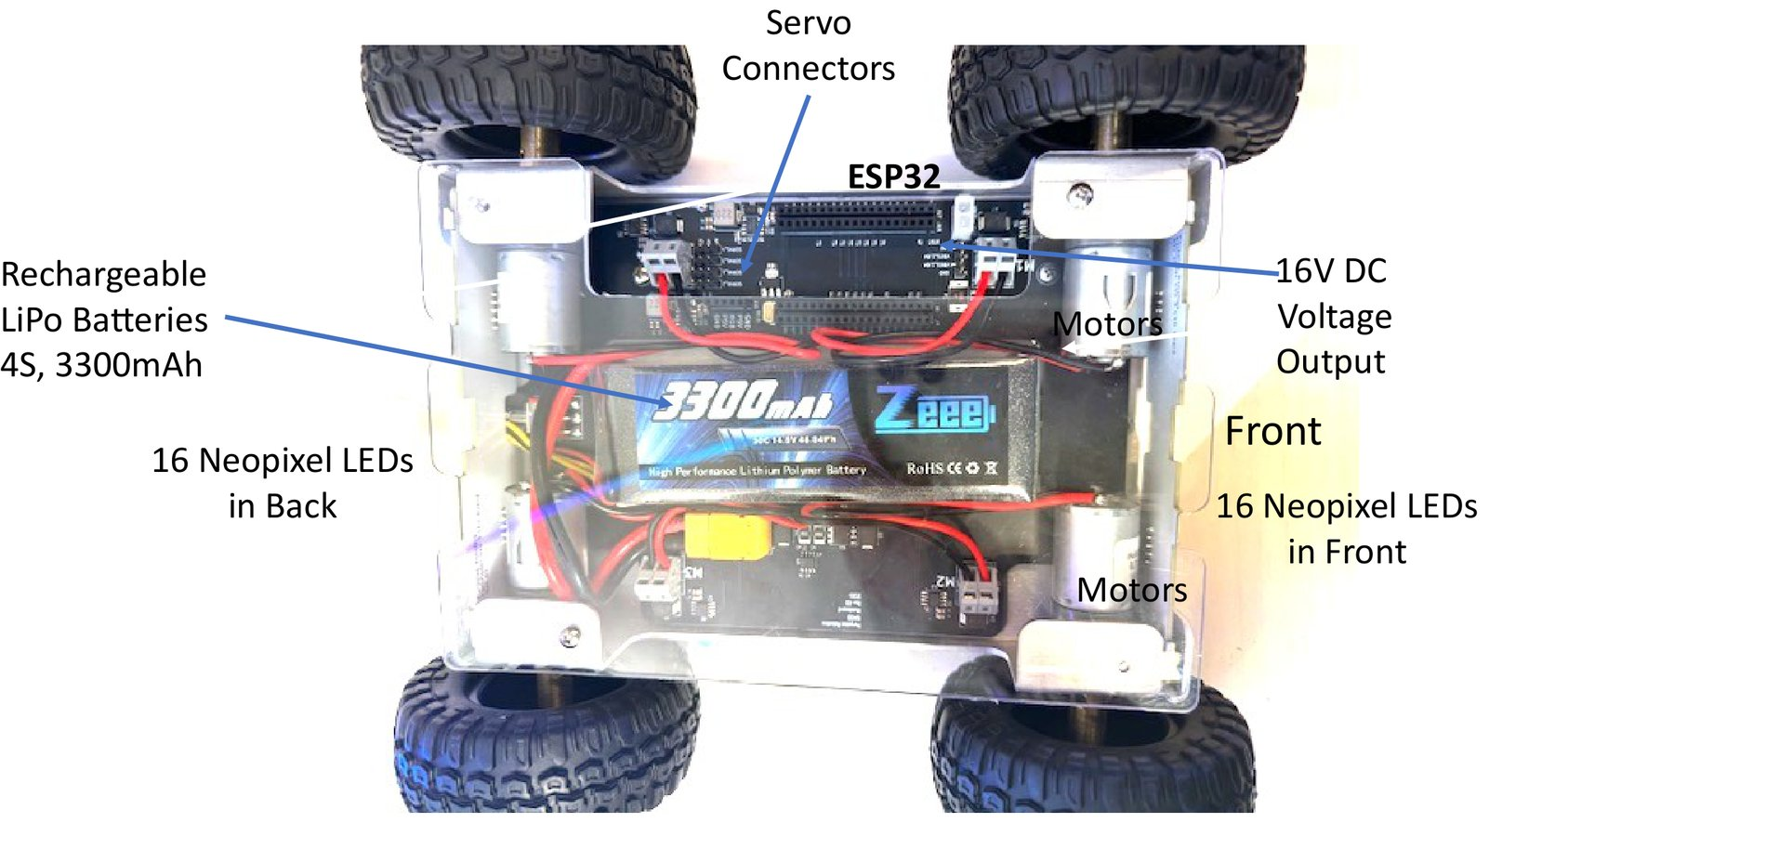
Every part, called out
Keep this page open for the rest of the lesson
Pathfinder Beginner - Nintendo Switch | Lesson 1
10
Notes:
Give them a minute to find each part on a real vehicle.
Worth pointing out the two LED bars are 16 each, front and rear - that becomes important in Lesson 4.

Slide 11
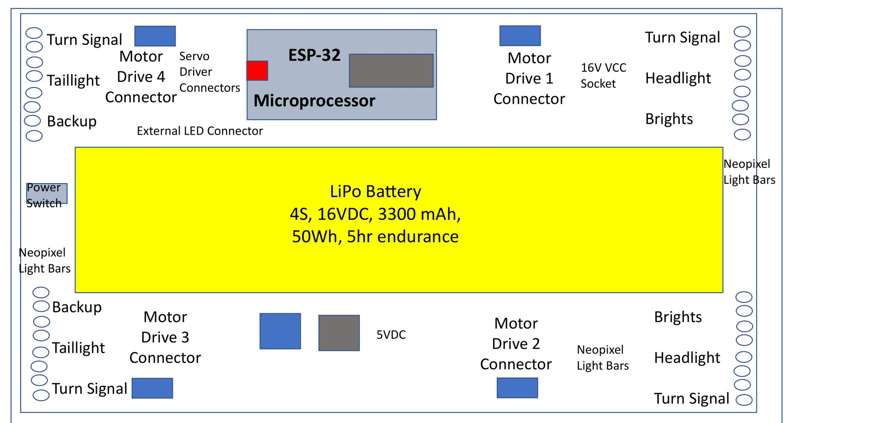
The board, from above
One board carries the computer, the four motor drivers, the servo outputs and the LED connectors. The battery sits in the middle of it.
Every connector, and which lights sit at which corner
Pathfinder Beginner - Nintendo Switch | Lesson 1
11
Notes:
This is the same vehicle as the photograph before it, drawn flat so you can see what is under the battery.
The four corners each carry a turn signal, a headlight or brights at the front, and a tail light and backup light at the rear. That naming comes back in Lesson 4 when they light them.
Get them to find the power switch and the 16 V socket on a real vehicle before moving on.
Note there are FOUR motor drive connectors, numbered 1 to 4, and the numbering is not the order you would guess. Lesson 2 has the pin table.

Slide 12
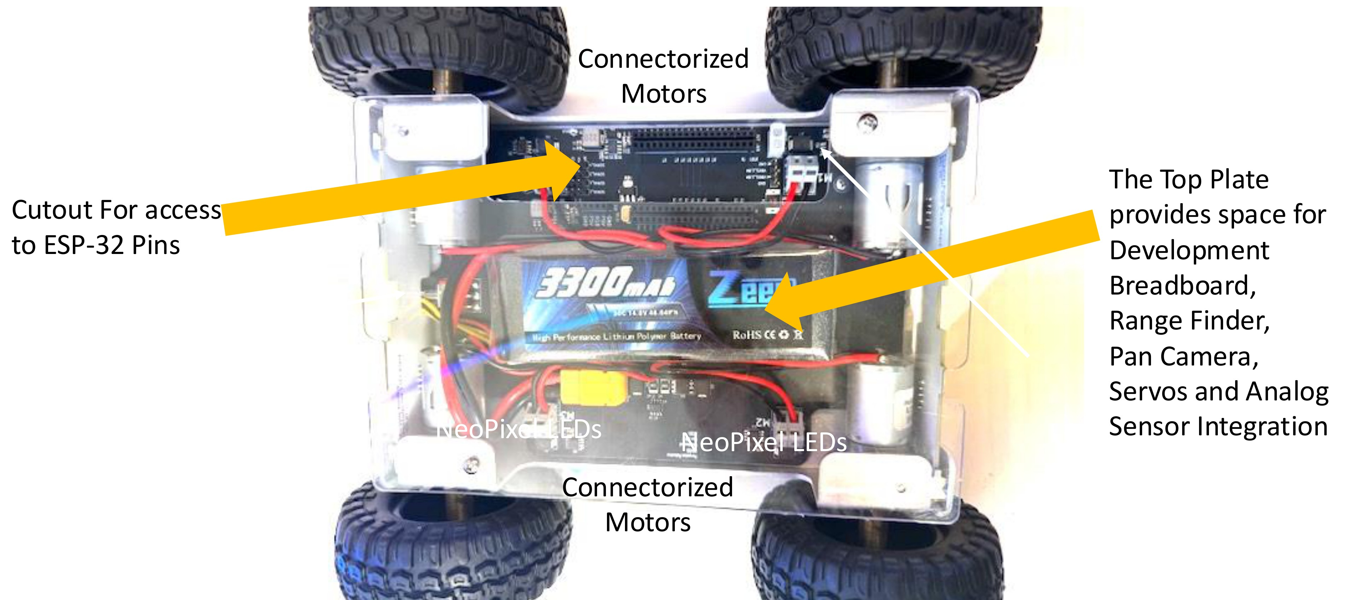
The top plate is where your own work goes
A cutout for the ESP32 pins, and clear space for a breadboard, sensors and servos
Pathfinder Beginner - Nintendo Switch | Lesson 1
12
Notes:
The top plate is not a lid. It is the development area, and it is why this vehicle can grow.
The cutout gives you access to the ESP32 pins without taking anything apart. That is where the breadboard circuit later in this lesson connects.
Everything in the advanced course - the range finder, the extra sensors - lands here.

Slide 13
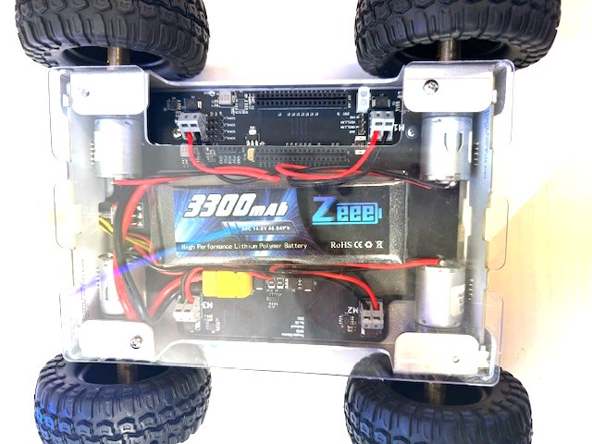
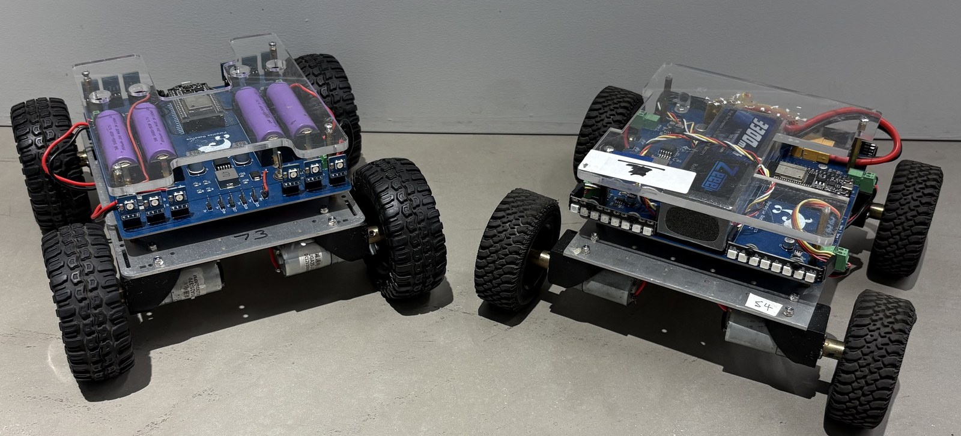
Three generations of Pathfinder
The vehicle has been through three designs. The program you write today runs on the last two.
Gen 1 and Gen 2 - an open chassis, board and battery on top
Gen 3 - one piece, everything inside, a clear top plate to build on
Pathfinder Beginner - Nintendo Switch | Lesson 1
13
Notes:
Thirty seconds of history, no more. The point is that the vehicle is a real product line that has been revised, not a kit somebody assembled once.
Gen 1 was the proof that the idea worked. Gen 2 is most of the fleet. Gen 3 is what new vehicles are built as.
Do not let this run long. The slide they actually need is the next one, which tells them which vehicle is in front of them.

Slide 14
Gen 2 and Gen 3 - which vehicle are you holding?
Gen 2
Gen 3
Most of the fleet.
ESP32, four DRV8871 H-bridges, 32 LEDs, four servo outputs.
No current sensor.
Everything in this course works on it.
A UNIBODY frame: one piece, with the board, battery and wiring inside it rather than on top.
Wheels at the vehicle's VERTICAL CENTER, so it drives just as well upside down.
A clear lexan TOP PLATE to mount sensors on.
An INA219 power monitor, so it can measure its own voltage and current - which is what makes a self-test possible.
KEY POINT The programs detect which one they are running on at boot, by looking for the sensor. One program, either vehicle - you do not have to know which you have before you upload.
Pathfinder Beginner - Nintendo Switch | Lesson 1
14
Notes:
Ask first: hands up who has the frame in one piece? Then let them work out which generation they are holding.
Nothing in these five lessons needs a Gen 3. Say so plainly, so nobody with a Gen 2 thinks they are missing out.
The upside-down point is worth demonstrating if you have a Gen 3 handy. Flip it over on the desk and let it drive.
The INA219 is only mentioned here. It comes back properly in the advanced course, so do not go down that road now.

Slide 15
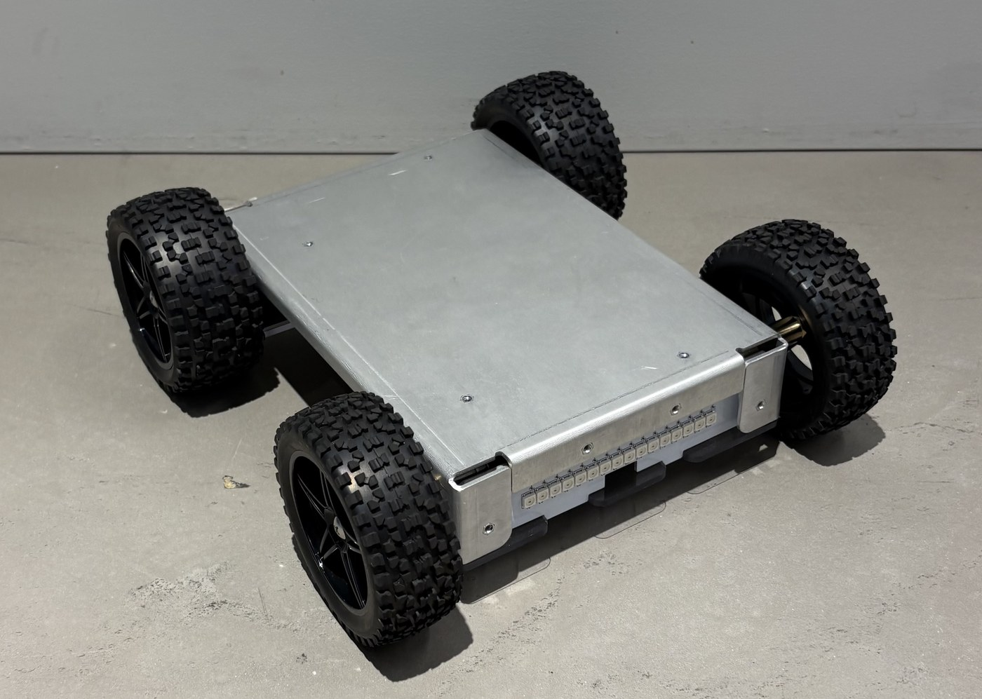
Gen 3, in two pictures
The two things that make a Gen 3 different are easiest to show rather than describe.
Looking down through the lexan top plate: board, battery, and the four motors inside the frame
Flip it over and it keeps going - the wheels reach past the frame on both sides
Pathfinder Beginner - Nintendo Switch | Lesson 1
15
Notes:
Pass a Gen 3 round if you have one. The unibody frame is obvious the moment somebody picks it up.
The upside-down trick is the one they will remember. If you have a Gen 3 to hand, do it live rather than showing a picture.
The photograph is the vehicle sitting on its back. What it shows is why it works: the wheels stand proud of the frame on both faces, so there is no wrong way up.

Slide 16
What a self-test looks like - a demonstration
What it does
What the current tells it
Fit the jumper on GPIO 34 and switch the vehicle on.
It measures what the electronics draw with the motors stopped. That is the BASELINE.
Then it drives each motor forward, then in reverse, watching the current against that baseline.
The LEDs blink GREEN if every motor passed, RED if any failed.
Press any button on the controller to clear it and drive.
A healthy motor spikes as it breaks away, then settles.
A disconnected motor draws almost nothing.
A jammed motor draws a lot, and keeps drawing it.
The Serial Monitor prints a line per motor with the numbers it measured, and PASS or FAIL beside each one.
KEY POINT This is the advanced program, not today's. But every idea in it is one of yours: a current is a number, a number can be compared, and a comparison can drive an LED.
Pathfinder Beginner - Nintendo Switch | Lesson 1
16
Notes:
DO THIS LIVE if you have a Gen 3 and the jumper. Two minutes of watching beats a slide, and it is the first time they see the vehicle check itself.
Put the Serial Monitor on the projector while it runs. The per-motor PASS and FAIL lines are the interesting part.
Unplug one motor first if you want a FAIL to show. It is worth doing - a test that only ever passes teaches nothing.
Head off the obvious question: no, they are not writing this today. It is the advanced course. Today it is a promise of where the five lessons lead.
A Gen 2 has no current sensor and will simply skip the test. Say so, so nobody thinks their vehicle is broken.

Slide 17
How a command gets from your thumb to a wheel
DRV8871 drivers
4 motors
Switch controller
Bluetooth
ESP32
12 13 16 17 18 19 22 23
WS2812B strip
32 LEDs
you move a stick
radio, 2.4 GHz
your program runs here
GPIO 5
Servo headers
up to 4 servos
25 26 27 14
KEY POINT Everything the vehicle can do happens on one of those three outputs. The rest of the program is deciding what to send.
Pathfinder Beginner - Nintendo Switch | Lesson 1
17
Notes:
Walk it left to right with a real vehicle in your hand, touching each box as you name it.
The point of the diagram is that nothing here is magic - every arrow is a wire or a radio link you can point at.
Ask where THEIR program sits. The answer is the ESP32 box, and everything either side of it is fixed hardware they inherit.
Come back to this slide whenever somebody is stuck: naming which box the fault is in is most of the debugging.

Slide 18
The ESP32 pins this vehicle actually uses
MOTORS
LIGHTS AND SERVOS
EVERYTHING ELSE
Front left
12 / 13
32 NeoPixels
5
I2C SDA / SCL
32 / 33
Rear left
18 / 19
Servo 1 / 2
25 / 26
BOOT button
0
Front right
22 / 23
Servo 3 / 4
27 / 14
Self-test jumper
34
Rear right
16 / 17
Blink LED, Lesson 1
2
one data wire drives all 32
LEDs, in one chain
two pins each: drive one for
34 to 39 are INPUT ONLY
forward, the other for reverse
and have no pull-ups
Pathfinder Beginner - Nintendo Switch | Lesson 1
18
Notes:
This is a reference page, not a teaching slide. Point at it and tell them where to find it again.
The full ESP32 has 38 pins. These are the ones wired to something on this board, which is the only list they need.
The motor pin numbers come straight out of the sketch, so the slide cannot disagree with the file.
The two facts worth saying out loud: GPIO 34 to 39 are INPUT ONLY and have no internal pull-up, and GPIO 0 is the BOOT button, so holding it down at reset does something special.

Slide 19
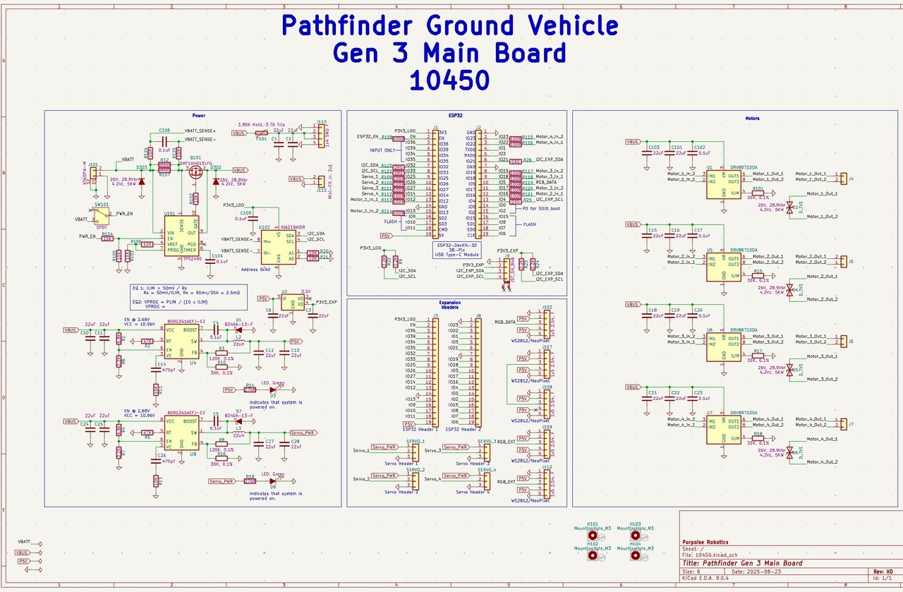
The Gen 3 control board, drawn out
You are not expected to read this today. It is here so you know it exists, and so you can come back to it.
Pathfinder Beginner - Nintendo Switch | Lesson 1
19
Notes:
Show it, say what it is, and move on. Fifteen seconds.
The reason it is in the deck is that somebody always asks what is actually on the board, and "there is a drawing, here it is" is a better answer than a description.
Point out that everything on the previous slide - the motor pins, the LED pin, the I2C pins - is somewhere on this sheet. That is the connection worth making.
Anybody who wants to follow it properly should be pointed at the advanced course.

Slide 20
What a microcontroller actually is
The ESP32
How that differs from your laptop
A whole computer on one chip: processor, memory, storage, and the hardware to drive pins.
240 MHz, dual core, with Wi-Fi and Bluetooth built in.
It runs ONE program. There is no desktop, no windows, no files.
It starts running the instant it has power, and stops when it does not.
We compile programs in C++ on a laptop and send them down the USB cable into its flash memory.
Your laptop runs hundreds of programs at once and shares its processor between them.
The ESP32 gives your program the whole machine. Nothing interrupts you, and nothing rescues you either.
If your program stops, the vehicle stops. If your program waits, the vehicle waits. You will meet that head-on in Lesson 5.
There is no error message on a screen unless you print one. That is why the Serial Monitor matters so much.
Pathfinder Beginner - Nintendo Switch | Lesson 1
20
Notes:
The contrast with a laptop is what makes this land. Most of them have never used a machine that runs exactly one program.
Nothing interrupts you, and nothing rescues you either. That sentence is the whole slide.
This sets up two later ideas: why the Serial Monitor matters (there is no error window) and why delay() is fatal (nothing else is running).
If somebody asks about the second core: yes, it has one, and no, we do not use it in this course.

Slide 21
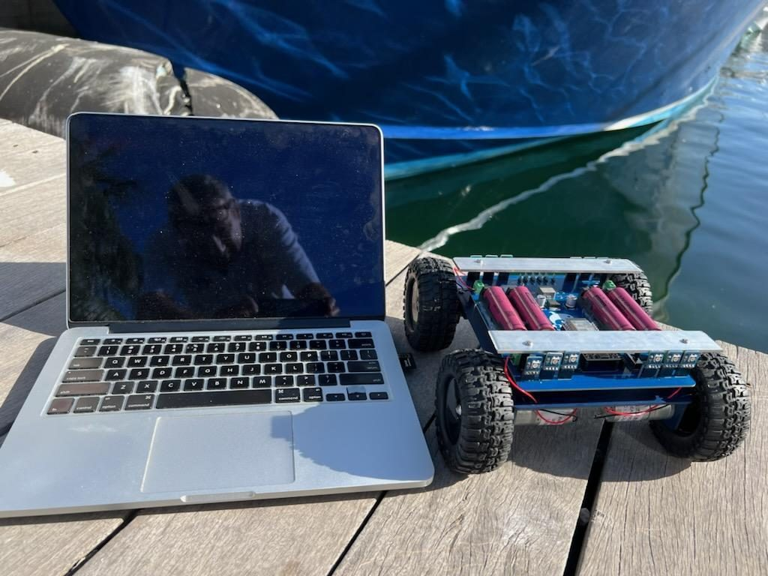
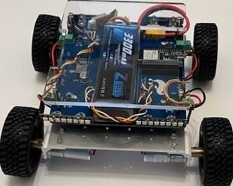
The development system is two machines
Your program is written and compiled on a laptop, then sent down a USB cable into the ESP32, where it runs on its own with the laptop unplugged.
The laptop compiles. The vehicle runs.
The ESP32 sits on the control board, under the top plate
KEY POINT That is the whole toolchain: edit here, compile here, upload there, run there. Everything in the next half hour is setting up the first two.
Pathfinder Beginner - Nintendo Switch | Lesson 1
21
Notes:
Make the two-machine point explicitly. A surprising number of students assume the laptop is still driving the vehicle.
Once a program is uploaded it stays in flash. Unplug the cable, switch the vehicle on tomorrow, and it runs the same program.
The left photograph is a vehicle being worked on in the field, which is where this kit is actually used.
Point at the ESP32 on a real vehicle before moving on. It is smaller than most people expect.

Slide 22
Setting up the Arduino IDE
About 35 minutes
done
NOW
The vehicle
Setting up the IDE
Your first circuit and program
Talking back
Your first light
Pathfinder Beginner - Nintendo Switch | Lesson 1
22
Notes:
The next thirty-five minutes are the least fun part of the whole course. Say so, and promise them something blinking at the end of it.
Get the fast finishers helping their neighbors rather than sitting idle.
Have a spare laptop set up and working, so a machine that will not cooperate never blocks a whole group.

Slide 23
Step 1 - install the Arduino IDE
Go to arduino.cc/en/software and download the Arduino IDE, version 2.3.10 or newer.
Windows: install it and sign in to your Microsoft account if it asks. You can ignore the donation and newsletter prompts.
Mac: open the downloaded .zip and drag Arduino.app into your Applications folder.
It needs about 500 MB of disk space.
The IDE is where you will write code, compile it, upload it to the vehicle, and read what the vehicle prints back.
"Compile" means turn your C++ into the machine language the ESP32 runs. "Upload" means send that down the USB cable.
KEY POINT If the install will not go through, pair up with a neighbor and carry on - you lose nothing today. Note down the error and we will sort the machine out afterwards.
Pathfinder Beginner - Nintendo Switch | Lesson 1
23
Notes:
Do this one step at a time with the room, not as a slide to read.
Anybody on a school-managed laptop may need an administrator. Find that out now rather than at the upload step.
The download is large. Start it, then talk over the top of it - do not watch a progress bar with thirty people.

Slide 24
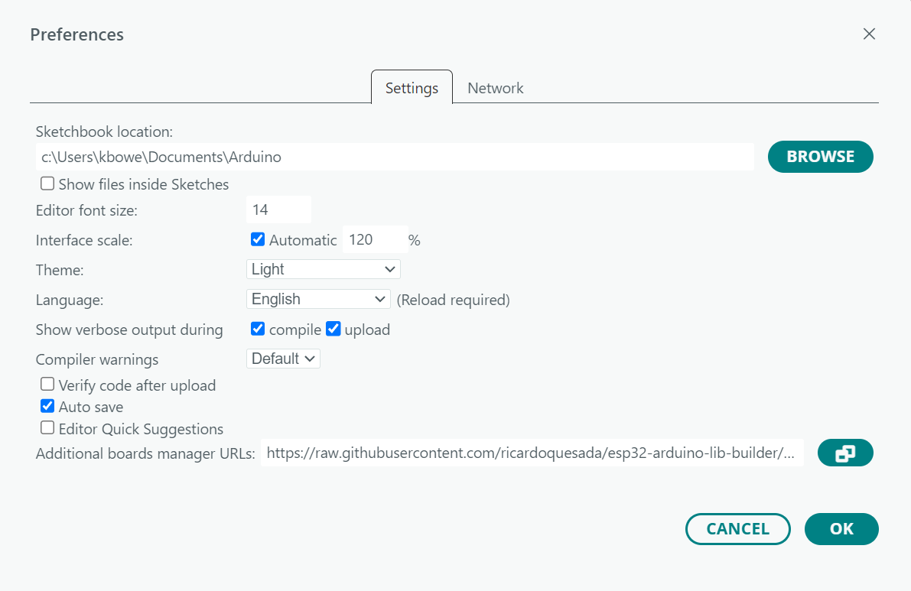
Step 2 - install the board package
The Arduino IDE does not know what an ESP32 is until you tell it.
1. File > Preferences.
2. Paste this into "Additional boards manager URLs":
https://raw.githubusercontent.com/ricardoquesada/esp32-arduino-lib-builder/master/bluepad32_files/package_esp32_bluepad32_index.json
3. Click OK.
4. Tools > Board > Boards Manager. Search "bluepad32".
The entry you want is esp32_bluepad32 by Ricardo Quesada, version 4.1.0
5. Choose version 4.1.0, NOT the latest. Install.
6. Tools > Board > esp32_bluepad32 > "ESP32 Dev Module"
"Additional board manager URLs" is the bottom row
WATCH OUT Two entries are now called "ESP32 Dev Module". This track needs the one under "esp32_bluepad32".
Pathfinder Beginner - Nintendo Switch | Lesson 1
24
Notes:
This is the step that goes wrong most often. Do it together, one line at a time, and do not let the fast groups run ahead.
The URL is the part everybody mistypes. Have it ready to paste into the chat, or written on the board, rather than reading it out.
The screenshot is the real dialog. Point at the bottom row - the box is easy to miss, and it is the one field on the page that matters today.
The board package is a large download. Start everybody off, then talk over it rather than watching a progress bar with thirty people.
If a download fails halfway, close the IDE completely and start it again before retrying.
Nobody moves on until Boards Manager shows the package as INSTALLED. Check screens rather than taking their word for it.
The version number matters more than they think. A different version is the cause of most compile errors that make no sense.
On the Switch track, warn them that Boards Manager now lists TWO entries called "ESP32 Dev Module", one under "esp32" and one under "esp32_bluepad32". A pile of errors that make no sense almost always means the wrong one is selected.

Slide 25
Step 3 - select the board and the port
BOARD: Tools > Board > esp32_bluepad32 > "ESP32 Dev Module"
Then set Upload Speed to 921600 and Flash Frequency to 80 MHz.
PORT: plug the vehicle into your computer with a micro USB cable FIRST, then choose Tools > Port.
Windows: the next available COM port, such as COM4.
Mac: something like /dev/cu.usbserial-0001.
If no port appears at all, the usual causes are: the vehicle is not switched on, or the cable is a charge-only cable with no data wires in it. Try a different cable before you try anything else.
WATCH OUT A charge-only USB cable looks identical to a real one and is the single most common reason a board "will not connect".
Pathfinder Beginner - Nintendo Switch | Lesson 1
25
Notes:
Two menus, and both are easy to get wrong. Walk round and check every screen before anybody tries to upload.
The charge-only cable is the single most common failure in this room. Have two known-good cables in your pocket.
If no port appears: is the vehicle switched on? Is it the right cable? In that order, every time.
On Windows a missing driver can also do it. That is a CP210x or CH340 install, and it is worth having the file on a memory stick.

Slide 26
Step 4 - install the libraries
Tools > Manage Libraries, then search the name and click Install.
"Adafruit NeoPixel" by Adafruit - drives the 32 LEDs.
none - Bluepad32 arrives with the board package
You still need "Adafruit NeoPixel" by Adafruit for the lighting lessons.
KEY POINT Without the NeoPixel library, nothing in Lesson 4 will compile.
Pathfinder Beginner - Nintendo Switch | Lesson 1
26
Notes:
Define LIBRARY properly here, out loud: code somebody else already wrote and tested, which your program can call instead of you writing it again. It is the first time the word has meant anything to most of the room, and it does not need to be on the slide.
Both libraries go in now, even though nothing needs them until Lesson 4. Doing it once saves a whole class of upload failures later.
Watch the search box. The display name is not always what you would guess, which is exactly what the note on the slide says.

Slide 27
Every program in this course, and what it needs
Install both libraries now and you are set for all five lessons.
Lesson | Sketch | Libraries beyond the board package
1 | l1a_blink / l1b_serial_monitor | none
1 | l1c_first_pixel | Adafruit NeoPixel
2 | l2a / l2b / l2c | none
3 | l3a / l3b / l3c | none (Bluepad32 ships with the board package)
4 | l4a / l4b / l4c | Adafruit NeoPixel
5 | l5a / l5b / l5c | Adafruit NeoPixel
5 | pathfinder_nintendoswitch | Adafruit NeoPixel
KEY POINT If a sketch will not compile, check this table before you change any code. A missing library is by far the most common cause.
Pathfinder Beginner - Nintendo Switch | Lesson 1
27
Notes:
This is the reference page. Tell students to photograph it.
The sketches are grouped by lesson because they need the same things. The one row worth pointing at is l1c_first_pixel: Lesson 1 is the only lesson where the three sketches do not all need the same library.
Worth saying out loud: the board package is not a library. The board package teaches the IDE what an ESP32 is; a library is code your program calls.

Slide 28
Getting the course files onto your computer
Thumb drive or email, into your Arduino folder
The thumb drive carries the SKETCHES - the programs for all five lessons. There are no libraries on it; you installed those from Library Manager in Step 4.
WINDOWS. Copy the sketch folders into
Documents\\Arduino\\
MAC. Copy the sketch folders into
Documents/Arduino/
If they arrived as a .zip, unzip it first.
Then restart the Arduino IDE. It only looks for sketches when it starts.
WATCH OUT One folder per sketch, and the folder name must match the .ino inside it. l1a_blink/l1a_blink.ino. The IDE will refuse to open a sketch whose folder is named differently.
Pathfinder Beginner - Nintendo Switch | Lesson 1
28
Notes:
Do this together. It is the single most common place a beginner gets stuck, and it costs ten minutes now against forty later.
Say plainly that the drive holds programs only. Anybody who did an earlier version of this course will remember copying libraries off it, and that is no longer how it works. Library Manager is the one route in, and it gets them the version we tested against.
Walk the room. Check File > Sketchbook actually lists the lessons before you move on.

Slide 29
Your first program
About 25 minutes
done
done
NOW
The vehicle
Setting up the IDE
Your first circuit and program
Talking back
Your first light
Pathfinder Beginner - Nintendo Switch | Lesson 1
29
Notes:
From here on they are building rather than installing. The energy in the room should go up.
Hand out the breadboards, LEDs, resistors and jumper wires now, one set per group, while you talk.

Slide 30
Every program has the same three parts
1. INITIALIZATION
2. SETUP
3. LOOP
Libraries, constants, variables.
The top of the file.
setup() runs ONCE, at power-up.
Get the hardware ready.
loop() runs OVER AND OVER,
until the power goes off.
#include <Adafruit_NeoPixel.h>
const int LED_PIN = 5;
void setup() {
pinMode(LED_PIN, OUTPUT);
}
void loop() {
digitalWrite(LED_PIN, HIGH);
delay(1000);
}
and round again, as fast as it can - unless you make it wait
KEY POINT delay(1000) is what makes this one blink once a second. Take the delay out and the same loop runs thousands of times a second, too fast to see.
Pathfinder Beginner - Nintendo Switch | Lesson 1
30
Notes:
Hold this shape up for the whole course. Every program they ever open has these three parts, and knowing which part a line lives in tells you WHEN it runs.
Ask before you explain: which of these three runs more than once? Let somebody get it wrong first - the answer sticks better.
The first part has no keyword in C++. It is just the top of the file. Naming it anyway gives them somewhere to file #includes and constants.
Common misunderstanding: students think setup() runs every time round. Say plainly that it runs once, at power-up, and never again until reset.

Slide 31
The ESP32 has no LED we can use, so you are going to give it one
Your first circuit
Some development boards have a little LED soldered on. The module on this vehicle does not have one free for us, so your first program will blink an LED you wire up yourself.
That is a better place to start anyway. Before you can make something blink, you have to make a circuit that works - and a circuit is the thing underneath everything else on this vehicle.
You need three things from the kit:
a breadboard
an LED
a 220 ohm resistor
two jumper wires
Pathfinder Beginner - Nintendo Switch | Lesson 1
31
Notes:
Hold up the three parts as you name them.
If anyone asks why the resistor: tell them to wait ninety seconds, it is the next slide but one.

Slide 32
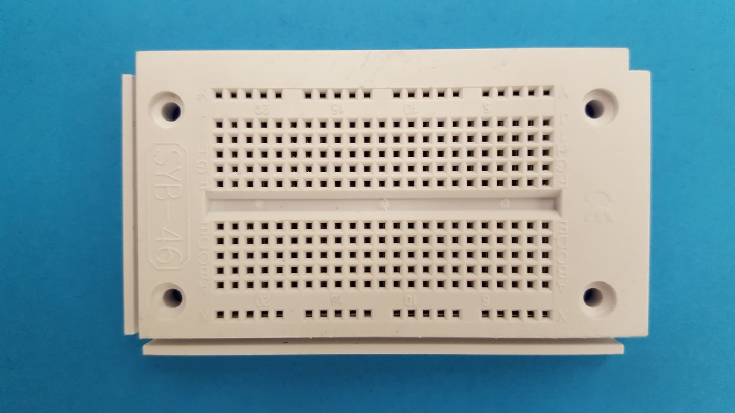
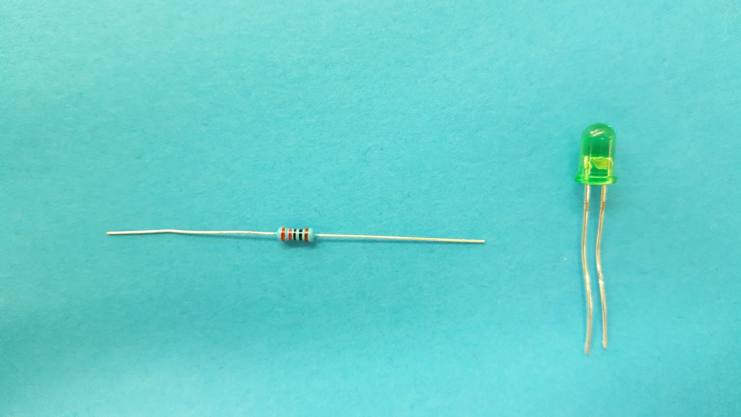
What a breadboard is
A breadboard lets you build a circuit without soldering, and take it apart again.
Terminal strips down the middle, power rails along the edges
A 220 ohm resistor and an LED. Note the LED has one leg longer.
KEY POINT The five holes in a row are joined to each other under the plastic. That is the whole trick: push two legs into the same row and they are connected.
Pathfinder Beginner - Nintendo Switch | Lesson 1
32
Notes:
Get them to look down into the holes. The metal clips are visible.
The row-of-five rule is the single fact that makes breadboards make sense. Say it twice.

Slide 33
The circuit you are about to build
ESP32 GPIO 2
R = 220 ohms
Why 220 ohms?
R = (supply - LED drop) / current
= (3.3 - 2.0) / 0.020
= 65 ohms
ANODE - the long leg, toward the pin
CATHODE - the short leg, toward ground
220 ohms is in the kit, and is a good choice:
(3.3 - 2.0) / 220 = about 6 mA
Dimmer than flat out, and easy to see.
ESP32 GND
Current leaves GPIO 2, crosses the resistor, passes through the LED from the triangle to the bar, and returns to ground.
WATCH OUT WHEN IN DOUBT, PICK THE BIGGER RESISTOR. Too big and the LED is dim. Too small and you get one bright flash, a dead LED, and possibly a damaged pin.
Pathfinder Beginner - Nintendo Switch | Lesson 1
33
Notes:
Trace the loop with a finger: out of the pin, through the resistor, through the LED, back to ground. A circuit that is not a loop does nothing.
Ask what the resistor is for BEFORE you say. The answer is that the LED will take as much current as you let it, and then stop being an LED.
The long leg is the anode and goes toward the pin. Backwards means no light and no damage, so let them find out.
This is a SCHEMATIC, and for most of the room it is the first one they have read. Name the two symbols out loud - a zigzag is a resistor, a triangle pointing at a bar is a diode - and say that the bar is the side current cannot come back through.
The three-bar symbol at the bottom is ground. They will see it on every circuit diagram for the rest of their lives.
Ground is not optional. Half the circuits that do not work are missing the return path.

Slide 34
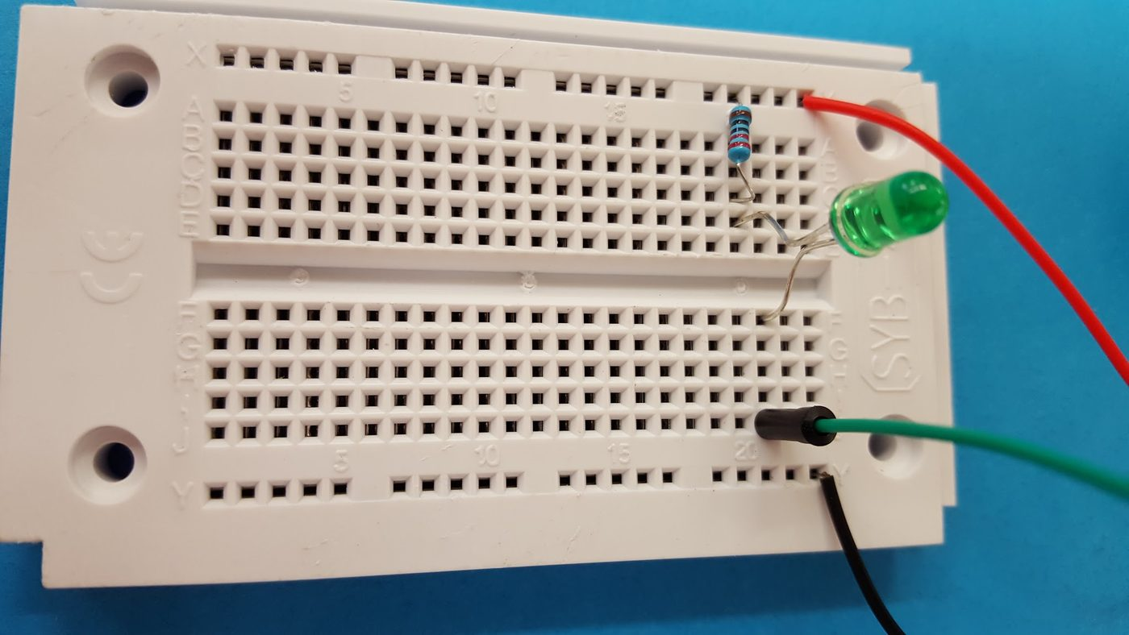
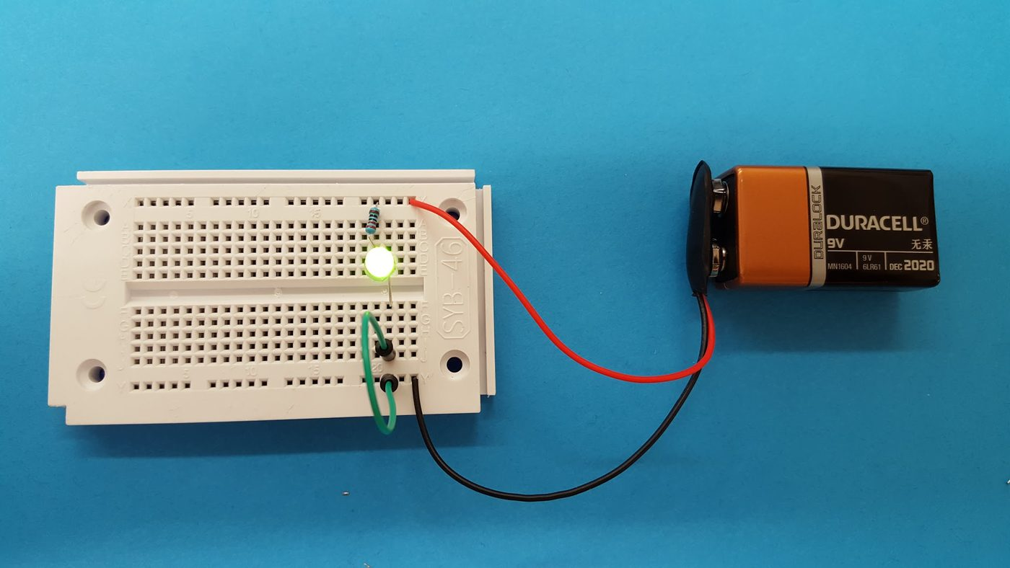
Building it
Bend the resistor legs, push everything into the board, and connect GPIO 2 and GND with the two jumper wires.
Both legs in the SAME row, so they are joined. Leads on, ready for power.
Lit. These photographs use a 9 V battery; yours runs from GPIO 2.
WATCH OUT Long leg of the LED toward the resistor and GPIO 2. Short leg toward ground. Backwards means no light, no damage - just turn it round.
Pathfinder Beginner - Nintendo Switch | Lesson 1
34
Notes:
Circulate. The two failures you will see are the LED in backwards and legs in different rows so nothing is connected.
Nobody uploads anything until their circuit is built and checked.

Slide 35
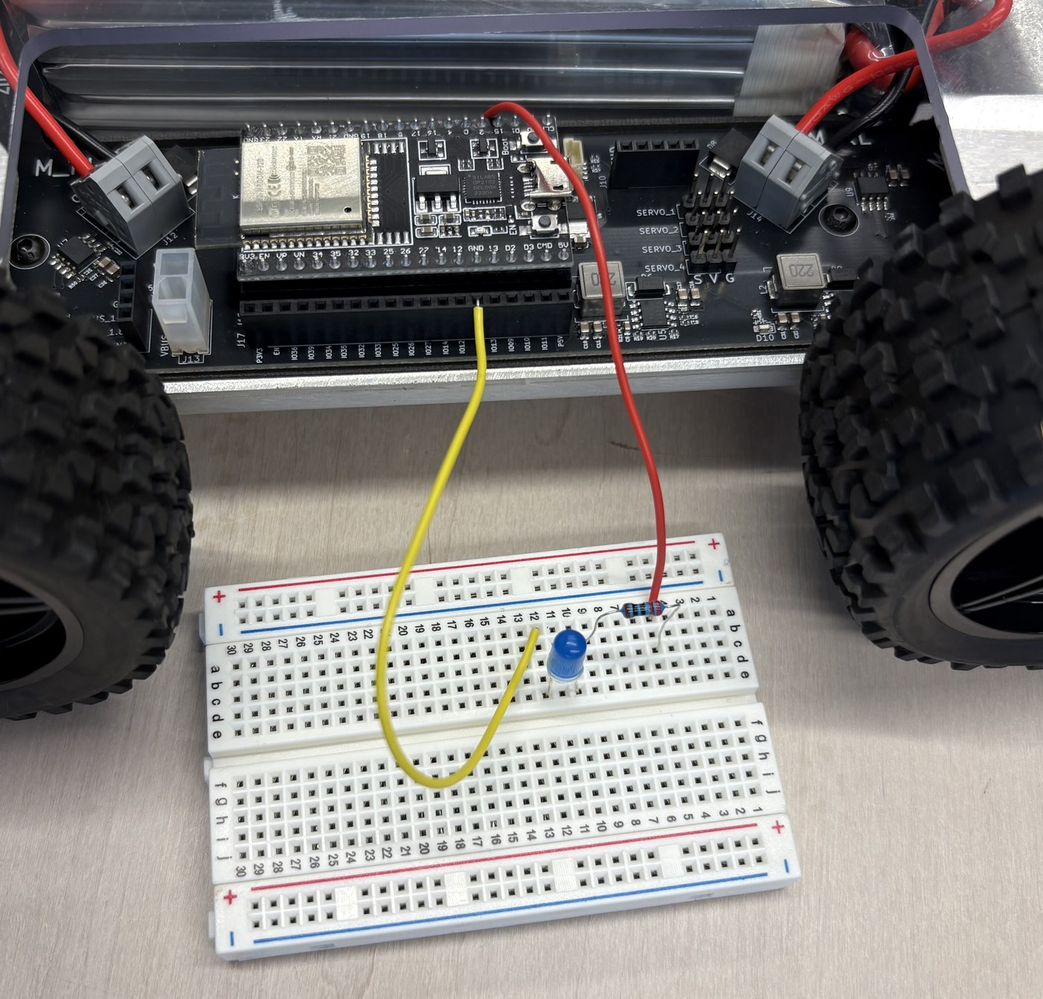
Powering it from the vehicle, not from a battery
A battery lights an LED. The ESP32 lets a PROGRAM light it.
Two jumper wires, through the top plate cutout:
GPIO 2 -> the resistor's row
GND -> the row with the LED's SHORT leg
A pin supplies about 12 mA safely. Plenty for one LED through 220 ohms, and the reason you never drive a motor off a pin.
What yours should look like
KEY POINT Any GND pin will do - there are several, and they are all the same wire inside the board.
Pathfinder Beginner - Nintendo Switch | Lesson 1
35
Notes:
This is the step that turns a circuit into a computer-controlled circuit. Make the distinction explicit.
Point at the top-plate cutout on a real vehicle and show them where the two wires go.
The 12 milliamp figure is worth saying: it is why an LED is fine straight off a pin and a motor never is. That is what the H-bridge in Lesson 2 is for.
Walk the photograph with them: red into pin 2 on the dev module, yellow into a GND socket on the expansion header. Two wires, and the breadboard is running off the vehicle.

Slide 36
l1a_blink - the whole program
l1a_blink.ino
const int LED_PIN = 2; // the pin your LED is wired to
const int BLINK_MS = 1000;
void setup() {
pinMode(LED_PIN, OUTPUT);
}
void loop() {
digitalWrite(LED_PIN, HIGH);
delay(BLINK_MS);
digitalWrite(LED_PIN, LOW);
delay(BLINK_MS);
}
const int says this is a whole number that never changes. Naming it means you change it in one place - move your LED to another pin and only this line changes.
pinMode(..., OUTPUT) tells the ESP32 we intend to WRITE to that pin. Without it, digitalWrite does nothing.
HIGH puts 3.3 volts on the pin. LOW puts 0 volts on it. That is the entire idea of digital output.
delay(1000) waits one second. Remember this line - in Lesson 5 we will throw it away.
Pathfinder Beginner - Nintendo Switch | Lesson 1
36
Notes:
Fourteen lines, and every one of them is worth a sentence. This is the first program they read, so read it properly.
Ask which lines are initialisation, which are setup, which are loop, and point back to the three-part diagram.
Ask what happens when loop() reaches the bottom. The answer - it starts again immediately - is not obvious to everybody.
Flag the two delay() calls. Tell them these come out in Lesson 5 and that there is a good reason.

Slide 37
Do it now - blink
UPLOAD AND RUN: l1a_blink (15 minutes)
1. File > Open, and find l1a_blink.ino.
2. Click the tick to VERIFY. It should compile with no errors.
3. Click the arrow to UPLOAD. Do not unplug during upload.
4. Wait for "Done uploading" and look at your LED.
Then change things:
5. Set BLINK_MS to 100. Upload. Then 2000. Upload.
6. Delete ONE of the two delay lines and upload.
What you should see
YOUR LED, on the breadboard, one second on and one second off.
Nothing at all means the LED is in backwards, or a leg is in the wrong row.
Answer these
Which makes it blink faster, a bigger number or a smaller one? Why?
With one delay deleted, the LED is still blinking. How fast, and why can you barely see it?
What resistor would a RED LED need? It drops about 1.8 V instead of 2.0 V.
Pathfinder Beginner - Nintendo Switch | Lesson 1
37
Notes:
Circuits checked before anybody uploads. Say it once, then enforce it.
Steps 1 to 4 are following instructions. Steps 5 and 6 are the actual lesson - do not let a group stop at step 4.
The deleted-delay question is the good one. It still blinks, at about half a second on and no time off, so it looks permanently lit.
The red-LED question needs Ohm's law, which they have not had yet. Take answers, do not resolve it, and promise it for Lesson 2.

Slide 38
Making the vehicle talk back
About 25 minutes
done
done
done
NOW
The vehicle
Setting up the IDE
Your first circuit and program
Talking back
Your first light
Pathfinder Beginner - Nintendo Switch | Lesson 1
38
Notes:
Frame this as giving the vehicle a voice. It is the only way it can tell them anything.
Twenty-five minutes, and most of it should be them typing.

Slide 39
The Serial Monitor
The ESP32 has no screen. If you want to know what it is thinking, it has to tell you - down the same USB cable you upload through.
Serial.begin(115200); opens the connection. Put it in setup().
Serial.print("text"); prints and stays on the same line.
Serial.println(x); prints and moves to a new line.
Open it with Tools > Serial Monitor, or the magnifying glass at the top right.
The baud rate box at the bottom MUST say 115200, because that is the number in Serial.begin(). Rows of nonsense characters mean the two numbers disagree.
When something does not work, print the numbers your program is working from. That will find the fault faster than staring at the code will.
KEY POINT Every program from here on prints something. Get in the habit of having the Serial Monitor open.
Pathfinder Beginner - Nintendo Switch | Lesson 1
39
Notes:
The baud rate mismatch is the thing that will happen to somebody in the next ten minutes. Show them the nonsense characters deliberately so they recognise it.
print versus println is worth ten seconds with a marker on the board.
The last bullet is the debugging habit the whole course rests on: print the numbers, do not stare at the code.

Slide 40
Variables: named boxes that hold a value
Type | Holds | Example | Used for
int | A whole number | int loopCount = 0; | Speeds, pin numbers, counts
float | A number with a decimal point | float volts = 16.8; | Voltages, measurements
bool | Only true or false | bool lightsOn = true; | Switches and flags
const int | A whole number that never changes | const int LED_PIN = 2; | Pins and settings
unsigned long | A big whole number, never negative | unsigned long now; | millis(), in Lesson 5
KEY POINT const means the compiler will stop you changing it by accident. Use it for anything that is a setting rather than a working value.
Pathfinder Beginner - Nintendo Switch | Lesson 1
40
Notes:
Do not lecture types. Read the table, then get them to tell you which type they would use for a battery voltage and which for a pin number.
unsigned long is on the table now purely so it is not a surprise in Lesson 5. Say that and move on.
The const point is worth making twice: it is not about the computer, it is about stopping YOU from changing a setting by accident.

Slide 41
One trap worth meeting on day one
from l1b_serial_monitor.ino
Serial.print("7 / 2 = ");
Serial.println(7 / 2); // prints 3, not 3.5
Serial.print("7.0 / 2 = ");
Serial.println(7.0 / 2); // prints 3.50
Serial.print("7 % 2 = ");
Serial.println(7 % 2); // prints 1
Both 7 and 2 are whole numbers, so the ESP32 does whole-number division and throws the remainder away.
It does NOT round. 7 / 2 is 3, and 9 / 10 is 0.
Writing one number with a decimal point asks for decimal division instead.
The % operator gives you the remainder that the first division discarded.
This bites everybody eventually, usually when a speed calculation quietly comes out as zero.
Pathfinder Beginner - Nintendo Switch | Lesson 1
41
Notes:
Make them predict all three answers before you reveal anything.
The 7 / 2 result is genuinely surprising, and being surprised is the point. It does not round - it throws the remainder away.
This exact trap turns up in Lesson 2 when a speed calculation comes out as zero. Tell them now, so they remember it then.
The % operator is new to most. One example is enough.

Slide 42
Do it now - make it talk
UPLOAD AND RUN: l1b_serial_monitor (15 minutes)
1. Open and upload l1b_serial_monitor.ino.
2. Open the Serial Monitor and set the baud rate to 115200.
3. Press the EN (reset) button on the ESP32. Watch it start again.
4. Change the greeting to your group's name and upload.
5. Change the two numbers in the math section. PREDICT the answers before you upload, then check.
6. Add a line of your own that prints every time round the loop.
What you should see
A greeting, some arithmetic, then one line per second counting up.
Answer these
What is 9 / 10 in this program? What did you expect?
What does millis() / 1000 give you, and why?
Pathfinder Beginner - Nintendo Switch | Lesson 1
42
Notes:
Step 5 is the one that matters: predict, then check. Do not let anybody upload before writing down what they expect.
The reset button is on the ESP32 itself and is marked EN. Show them where before they hunt for it.
millis() / 1000 gives seconds since power-up. That is the first time millis() appears, and it is deliberate groundwork for Lesson 5.

Slide 43
Your first light
About 15 minutes
done
done
done
done
NOW
The vehicle
Setting up the IDE
Your first circuit and program
Talking back
Your first light
Pathfinder Beginner - Nintendo Switch | Lesson 1
43
Notes:
Last twenty minutes. This is the one they will tell people about.
Have a vehicle switched on and connected to your laptop, ready to demonstrate if a group is stuck.

Slide 44
An addressable LED is a small computer of its own
An ordinary LED has two wires and is either on or off.
A NeoPixel has FOUR connections - power, ground, data in, data out - and a tiny controller chip inside it.
Send a color message into the first one and it keeps the first message, then passes everything after it down the chain to the next.
That is why all 32 LEDs on the vehicle need only ONE signal wire, on GPIO 5.
It is also why they are NUMBERED, 0 to 31, in the order the data flows. You will map that out properly in Lesson 4.
Each one holds three LEDs: red, green and blue. Every color you can make is a mixture of those three, each from 0 to 255.
WATCH OUT setPixelColor() only changes the ESP32's memory. Nothing happens on the vehicle until you call show(). This is the most common NeoPixel mistake there is.
Pathfinder Beginner - Nintendo Switch | Lesson 1
44
Notes:
The chain idea is the whole slide: each LED keeps the first message and passes the rest along.
That is why one wire drives thirty-two lights, and why they are numbered in the order the data flows rather than in any tidy order.
Say the show() rule now and say it again during the activity. It is the single most common NeoPixel mistake and it looks exactly like broken hardware.

Slide 45
l1c_first_pixel - the important lines
l1c_first_pixel.ino
#include <Adafruit_NeoPixel.h>
const int LED_PIN = 5; // all 32 LEDs are on GPIO 5
const int LED_COUNT = 32;
const int WHICH_LED = 0; // the one we light
const int BRIGHTNESS = 60; // master brightness, 0 to 255
Adafruit_NeoPixel strip(LED_COUNT, LED_PIN, NEO_GRB + NEO_KHZ800);
void setup() {
strip.begin();
strip.setBrightness(BRIGHTNESS);
strip.clear();
strip.show();
}
void loop() {
strip.setPixelColor(WHICH_LED, strip.Color(255, 0, 0));
strip.show();
delay(1000);
...
}
#include pulls in the library.
NEO_GRB says these LEDs want their color data green first. NEO_KHZ800 is the speed it is clocked out at. Both are correct for the WS2812B parts we use.
strip.begin() wakes the strip up. Always needed.
Color(red, green, blue), each 0 to 255.
show() is what actually sends it.
Pathfinder Beginner - Nintendo Switch | Lesson 1
45
Notes:
Do not read all twenty lines. Read the constants block, the strip declaration, and the two lines in loop() that actually do something.
NEO_GRB catches people out: these parts want green first. It is not a mistake on the slide.
setBrightness is a master dimmer for the whole strip and is set once. setPixelColor is per LED. Keep those two apart.
Point at strip.show() and say that nothing reaches the vehicle without it.

Slide 46
Do it now - light one pixel
UPLOAD AND RUN: l1c_first_pixel (15 minutes)
1. Upload it and find which physical LED comes on.
2. Change WHICH_LED to 15, then 16, then 31, uploading each time.
3. Draw the vehicle on paper and mark where LEDs 0, 8, 15, 16, 24 and 31 are. Keep that drawing - you need it in Lesson 4.
4. Invent a color with strip.Color(r, g, b). What do you get from (255, 255, 0)? From (128, 0, 128)?
5. Delete the strip.show() line and upload. What happens?
What you should see
One LED cycling red, green, blue, white, off.
Answer these
Where is LED 0 on the vehicle? Where is LED 31?
With show() deleted, why does nothing happen?
Pathfinder Beginner - Nintendo Switch | Lesson 1
46
Notes:
Step 3 - the paper drawing - is homework for Lesson 4. Make sure every group actually does it and keeps it.
Walk round with the LED numbers in your head: 0 to 15 is one bar, 16 to 31 is the other. Do not just tell them - let them find it.
(255, 255, 0) is yellow and (128, 0, 128) is a dim purple. Let them predict first.
Deleting show() is a deliberate failure. Make everybody do it, so the symptom is familiar before it happens by accident.

Slide 47
Safety, and looking after the vehicle
LITHIUM BATTERIES. 4S, 3300 mAh, about 16 volts and a lot of stored energy. Never puncture, crush or short one. If a pack is swollen, hot, or has been dropped hard, stop and tell an instructor.
Charge only on the bench, only supervised, and never leave a charging pack unattended.
WHEELS OFF THE GROUND when you upload a change for the first time. A vehicle on a block cannot drive off the desk.
Keep fingers, hair, sleeves and USB cables away from the wheels.
Know where your power switch is BEFORE you start a program that drives.
Do not stare into the LEDs at full brightness from close up.
Carry the vehicle by the base plate, not by the top plate or the wires.
SAFETY Everything in Lesson 2 onwards moves. This page stops being theoretical next lesson.
Pathfinder Beginner - Nintendo Switch | Lesson 1
47
Notes:
Slow down here. This is the page that stops somebody getting hurt next lesson.
Show them a real pack, and show them the swelling you are describing. Words alone do not do it.
Wheels off the ground is the rule they will be tempted to break in Lesson 2. Make it a habit today, while nothing moves.
Ask each group to find their power switch now and point at it.

Slide 48
Check yourself
Next lesson: motors. Bring the drawing you made of the LED numbers.
1. Name the three parts of an Arduino program, and say how many times each one runs.
2. What does pinMode(LED_PIN, OUTPUT) do, and what happens if you leave it out?
3. Your Serial Monitor shows rows of strange characters. What is almost certainly wrong?
4. What does 7 / 2 evaluate to in C++? What about 7.0 / 2?
5. All 32 LEDs share one data wire. How does LED number 20 know that a message is for it?
6. You call setPixelColor() and nothing lights up. What did you forget?
Pathfinder Beginner - Nintendo Switch | Lesson 1
48
Notes:
Run this as a conversation, not a test. Ask the room, take a wrong answer first, then get to the right one.
Answers, in order: initialisation once at the top / setup once at power-up / loop forever; pinMode makes the pin an output, and without it digitalWrite does nothing; the baud rate does not match Serial.begin; 7 / 2 is 3 and 7.0 / 2 is 3.5; the data is passed down the chain and each LED keeps the first message it sees; you forgot strip.show().
Remind them to bring the LED drawing next lesson.

