Slide 1

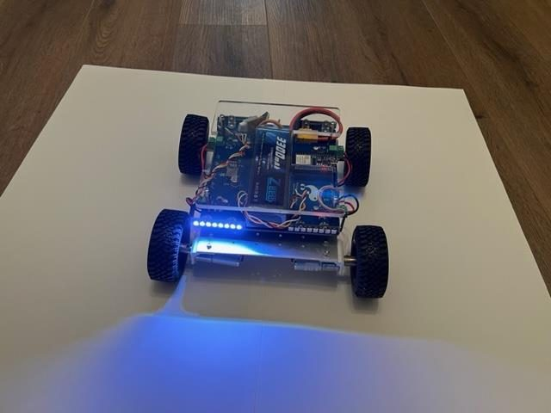
LESSON 3
Controller Programming
Bluetooth, thumbsticks, deadzones, and turning a number from your thumb into a speed for four wheels.
PORPOISE ROBOTICS - Precision Oceanographic Program On and In the Sea Environment
porpoiserobotics.org
Kevin Bowen, President - kbowen6@icloud.com
Malcom Graham, VP Education Louis Parker, VP Technology
Valen Farre, System Engineer Gary Howland, Animation
Eddie Revollo, Artificial Intelligence
Interns: Oscar Canazales, Krishnansh Vemulapalli, Soham Gangal, Erik Olsen
Three hours. Bring the Switch controller paired to your vehicle.
Porpoise Robotics - proprietary. For use with Porpoise Robotics lessons.
Notes:
Controllers charged and paired before the class starts. A flat pad costs you twenty minutes you do not have.
Today is the lesson they came for. Say so, then make them earn it - everything before the last hour is print-only.

Slide 2
What you will be able to do by the end
By the end of this lesson you will be able to:
1. Explain how a controller reaches one vehicle and not another
2. Say what a deadzone is for, and what goes wrong without one
3. Use map() to turn a stick reading into a motor speed
4. Mix a forward value and a turn value into two wheel speeds
5. Drive the vehicle under your own control
6. Write the failsafe that stops the motors when the controller drops
Pathfinder Beginner - Nintendo Switch | Lesson 3
2
Notes:
Objective six, the failsafe, is the one that matters beyond this course. Flag it now and come back to it at the end.

Slide 3
Where we got to last lesson
You know how an H-bridge reverses a motor, and how PWM sets its speed.
You watched duty and speed change together on the Serial Monitor.
You drove a square you calculated, and found out why it did not close.
Today you take the wheel.
KEY POINT Everything today until the last hour is print-only. Nothing moves until you have seen the numbers first.
Pathfinder Beginner - Nintendo Switch | Lesson 3
3
Notes:
Sixty seconds, then straight on.
The note is the discipline for the day: see the numbers first, drive second. It stops a room full of vehicles bolting during the first upload.

Slide 4
Today, in order
Time | What we do
0:00 | Recap. What Bluetooth is, and how a pad finds a vehicle
0:25 | One vehicle, one controller
0:50 | Upload l3a_controller_check. Find every button and axis
1:15 | BREAK (10 minutes)
1:25 | The deadzone problem, and map()
1:50 | Upload l3b_deadzone_and_map. Watch the arithmetic
2:10 | BREAK (10 minutes)
2:20 | Mixing forward and turn
2:35 | Upload l3c_tank_drive. Drive it
2:55 | Failsafe, and what happens when the link drops
Pathfinder Beginner - Nintendo Switch | Lesson 3
4
Notes:
Point out that the vehicle does not move until 2:35. Manage the disappointment early rather than fighting it all lesson.

Slide 5
What Bluetooth is doing
A radio link, and a phone number for each device
A short-range radio link in the 2.4 GHz band - the same band as Wi-Fi, microwave ovens and almost everything else.
It hops between 79 narrow channels many times a second, so a busy band does not stop it. That is why twenty vehicles in one room actually works.
Range is tens of meters, and it goes down sharply if somebody stands between the pad and the vehicle.
Every Bluetooth device has an ADDRESS - six bytes, written as six pairs of hexadecimal digits, like 02:02:03:04:05:08. It is the equivalent of a phone number.
The ESP32 has Bluetooth built into the chip. That is a large part of why we use it.
KEY POINT A Bluetooth sketch fills about 85% of the ESP32's program storage. That is the radio stack, not your code - but it does mean there is not much room left, so keep additions lean.
Pathfinder Beginner - Nintendo Switch | Lesson 3
5
Notes:
Keep the radio theory to two minutes. The one thing that must land is that every device has an address, and an address is like a phone number.
The channel-hopping detail answers the question they are about to ask: why twenty vehicles in one room actually works.
The 85% storage note is worth mentioning. It explains why a Bluetooth sketch takes so long to upload and why some boards run out of room.

Slide 6

Two pads, one room, and the problem that creates
A Switch pad in pairing mode connects to whichever vehicle answers first. With twenty vehicles in a classroom, that is a coin toss.
Identical to look at, and identical to a vehicle that is not told which one is its own
Pathfinder Beginner - Nintendo Switch | Lesson 3
6
Notes:
Hold up two pads. Ask the room how a vehicle is supposed to tell them apart.
The answer is that it cannot, unless somebody writes down which one it belongs to. That is the next slide.
This is worth ten seconds of real confusion before you give them the allowlist.

Slide 7
One vehicle, one controller - the allowlist
A Switch pad in pairing mode will happily connect to whichever vehicle answers first. In a room with twenty vehicles that means two students end up driving the same one.
So on this track, the VEHICLE is told which controller address it will accept.
Bluepad32 keeps an ALLOWLIST - a guest list checked BEFORE a connection is accepted. A pad that is not on the list is turned away before it is ever let in.
uni_bt_allowlist_remove_all();
uni_bt_allowlist_add_addr(myControllerAddress);
uni_bt_allowlist_set_enabled(true);
You find your pad's address with l3a_controller_check, which prints the address for you, then paste the line it prints into the top of every sketch for the rest of the day.
KEY POINT The list is rebuilt from scratch at every boot, so the sketch is always the single source of truth about who may drive. Write the address on a sticker on the vehicle AND the controller.
Pathfinder Beginner - Nintendo Switch | Lesson 3
7
Notes:
The Switch story is the opposite way round: the vehicle keeps a guest list and turns away anything not on it.
Allowlist is the right word to teach. It is checked before the connection is accepted, not after.
The list is rebuilt at every boot, so the sketch is always the truth. Nothing is remembered behind their backs.

Slide 8
How YOUR vehicle gets paired
pathfinder_nintendoswitch: the address lives in the sketch
In pathfinder_nintendoswitch - the program this whole course is about - the address is a CONSTANT IN THE PROGRAM, called MY_CONTROLLER.
1. Upload l3a_controller_check and connect your pad.
2. It prints a ready-made MY_CONTROLLER line.
3. Paste that line into the top of the sketch.
4. Upload. From now on the vehicle answers only to that pad.
To change controllers, you edit the sketch and upload again.
Nothing is hidden. The whole mechanism is visible in the file in front of you, which is exactly what you want while you are still learning what the pieces are.
KEY POINT Side note: the ADVANCED program, Pathfinder_Op_Program12, does this differently - it stores the address in EEPROM and you pair by typing 'pair' in the Serial Monitor, or pressing the BOOT button, then A and HOME on the pad. If somebody hands you a vehicle and tells you to type 'pair', it is running that program, not this one.
Pathfinder Beginner - Nintendo Switch | Lesson 3
8
Notes:
This is how THEIR program does it - a constant at the top of the file they can see and edit.
Four steps, and step 2 does the hard part for them: l3a_controller_check prints a ready-made line to paste.
The advanced program stores the address in EEPROM instead, which is better in the field and worse for learning. One sentence, then move on.

Slide 9
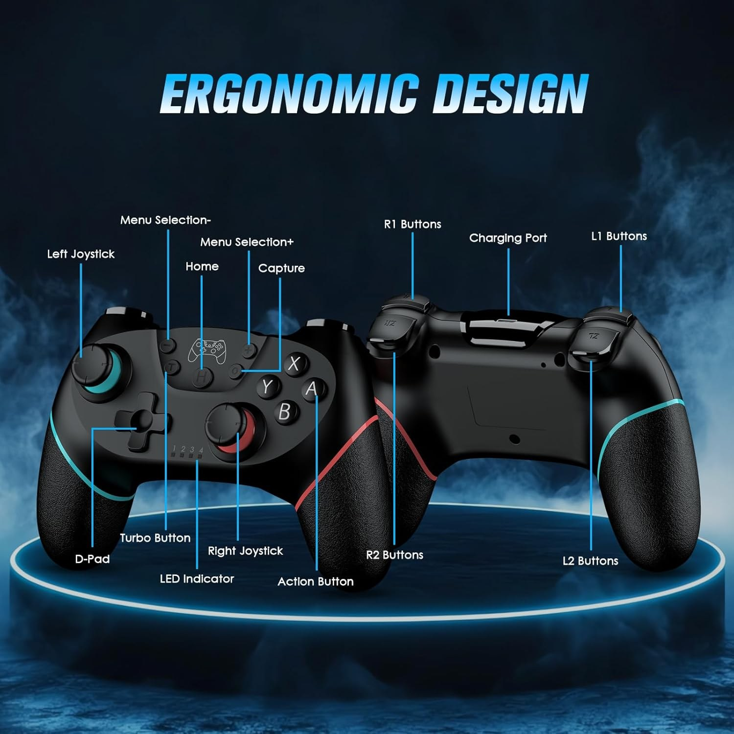
The Switch controller
Every one of those has a name in the program - but not always the name printed on it. The next slide is the table you will actually need.
Two analog sticks, a D-pad, four face buttons, shoulders and triggers, and the small ones in the middle
Pathfinder Beginner - Nintendo Switch | Lesson 3
9
Notes:
Hold a real controller up alongside the picture.
Warn them now that the names in the program are not always the letters printed on the pad. The next slide is the table that sorts it out.

Slide 10
The Switch controller, as Bluepad32 sees it
Bluepad32 names the face buttons by POSITION, Xbox style - not by the letter printed on your pad.
Printed on the pad | In the program | Where it is
B | myController->a() | bottom face button
A | myController->b() | right face button
Y | myController->x() | left face button
X | myController->y() | top face button
L / R | l1() / r1() | shoulders
ZL / ZR | l2() / r2() | triggers
stick click | thumbL() / thumbR() | press a stick in
D-pad | dpad() & DPAD_UP etc. | one number, one bit per direction
left stick | axisX() / axisY() | -512 to +511
right stick | axisRX() / axisRY() | -512 to +511
WATCH OUT So y() is the button MARKED X, because it is the top one. Third-party pads do not always agree. l3a_controller_check prints what you actually pressed, which settles it.
Pathfinder Beginner - Nintendo Switch | Lesson 3
10
Notes:
This table is the single most useful page in the Switch track. Print it.
Bluepad32 names the face buttons by POSITION, Xbox style. So y() is the button MARKED X, because it is the top one.
Third-party pads do not always agree with each other. That is exactly why l3a_controller_check exists - measure, do not assume.
Have them press each button and tick it off the table before moving on.

Slide 11
How the ESP32 controls the motors
YOUR PROGRAM
H-BRIDGE DRIVER
MOTOR
ledcWrite -> GPIO 12 / 13
DRV8871
Front left wheel
ledcWrite -> GPIO 18 / 19
DRV8871
Rear left wheel
ledcWrite -> GPIO 22 / 23
DRV8871
Front right wheel
ledcWrite -> GPIO 16 / 17
DRV8871
Rear right wheel
KEY POINT TWO pins per motor, and the driver is what makes it possible. An ESP32 pin gives you 3.3 volts and about 20 milliamps; a motor wants battery voltage and amps. The DRV8871 takes the small signal and switches the big one.
Pathfinder Beginner - Nintendo Switch | Lesson 3
11
Notes:
Read one row left to right and the whole thing is obvious: two pins, a driver chip, a motor.
The driver is the part worth naming. The ESP32 pin can supply about 20 milliamps at 3.3 volts. A motor wants amps at battery voltage. The DRV8871 is what stands between them.
Two pins per motor, not one. Which of the two you drive is what decides the direction - that is the H-bridge from Lesson 2.
Point out that the pin numbers on this slide are read out of the sketch when the deck is built, so if they look at the file they will find the same ones.
Worth pausing on the fact that all four rows are identical. Four motors is not four times the thinking - it is the same thinking, four times.

Slide 12
Two kinds of control, and the axes they move
Digital: pressed or not
Analog: how far
A digital reading is true or false, with nothing in between.
The D-pad, Select, Start and the PS button, and clicking either stick in.
Good for: on/off, mode changes, one-shot actions.
On this track:
myController->x()
An analog reading says HOW FAR, not just whether.
Both thumbsticks, on two axes each, reading -512 to +511.
The TRIGGERS are analog too. Bluepad32 reports them as brake() and throttle(), not as buttons.
Good for: speed, steering, aiming a servo.
myController->axisX() // left/right
myController->axisY() // up/down
WATCH OUT Push a stick UP and the number goes NEGATIVE. That catches everybody. It is why the driving code has a minus sign in front of the Y reading.
Pathfinder Beginner - Nintendo Switch | Lesson 3
12
Notes:
Digital and analog is a distinction they will use for the rest of their lives. Two minutes, properly.
The two triggers are ANALOG on this track as well. Bluepad32 gives them to you as brake() and throttle() with a range, not as pressed-or-not. The face buttons, unlike a PS3 pad, really are digital.
A press can read differently from a light one, and you can still treat any of them as a plain yes or no - which is mostly what we do, and why it is easy to get wrong.
If you have five spare minutes, have them squeeze a trigger slowly in l3a_controller_check and watch the number climb.
The warning panel is the one to read out. Push a stick up and the number goes negative - it catches everybody, and it is why there is a minus sign in the driving code.
Have a controller in your hand and press the things as you name them.

Slide 13
Six degrees of freedom
Any rigid object in space can move in six independent ways. Three are translations - sliding along an axis - and three are rotations.
TRANSLATION
Forward and back - surge
Side to side - sway
Up and down - heave
ROTATION
Roll - tipping left or right about the fore-aft axis
Pitch - nose up or nose down
Yaw - turning left or right, which is your steering
A ground vehicle on a flat floor really only controls surge and yaw. A submersible or an aircraft controls all six, which is why they need far more from the operator.
KEY POINT The PS3 controller was originally called the Sixaxis because it could sense all six. Spelled backwards, Sixaxis is still Sixaxis.
Pathfinder Beginner - Nintendo Switch | Lesson 3
13
Notes:
Six degrees of freedom is genuinely useful vocabulary and it costs three minutes.
Demonstrate with your hand: three slides, three twists.
A rover on a flat floor really only has surge and yaw. That is why one stick is enough here and why a submersible pilot needs two.
The Sixaxis palindrome is a cheap laugh and it makes the name stick.

Slide 14
Six degrees of freedom, and the two your rover has
TRANSLATION - sliding along an axis
ROTATION - turning about an axis
SURGE
forward and back
X axis
ROLL
tipping left or right
about X
your rover controls this one
SWAY
left and right
Y axis
PITCH
nose up or nose down
about Y
HEAVE
up and down
Z axis
YAW
turning left or right
about Z
your rover controls this one
LEFT STICK on the Switch controller -> surge and yaw
RIGHT STICK -> the four servos
KEY POINT A rover controls two of the six, so one stick drives it and the other is free to aim servos. A submersible controls all six, and an ROV pilot needs both sticks to fly it.
Pathfinder Beginner - Nintendo Switch | Lesson 3
14
Notes:
Six ways a rigid body can move. Three slides, three twists, and nothing else.
Demonstrate with your hand held flat before you show the diagram. Slide it forward, sideways, up. Then tip it, nose it down, spin it.
The two boxed in teal are the two a rover on a flat floor can actually control. That is why one stick with two axes is enough here.
A submersible or an aircraft controls all six, which is why an ROV pilot needs two sticks and far more practice.
Sway is the interesting one to ask about. A rover cannot slide sideways - it has to yaw and then surge. Ask them why.

Slide 15
What the pad sends
About 25 minutes
done
NOW
Bluetooth and pairing
What the pad sends
Deadzone and map
Driving it
Pathfinder Beginner - Nintendo Switch | Lesson 3
15
Notes:
Twenty seconds. First of three.

Slide 16
Do it now - what does the controller actually send?
UPLOAD AND RUN: l3a_controller_check (25 minutes)
1. Upload it and open the Serial Monitor.
2. Hold the SYNC button until the controller lights run.
3. Press every button in turn and match it to the printed name.
4. Push the left stick fully UP. Positive or negative?
5. Let go of the sticks and DO NOT touch the controller. Does it print exactly 0, or does it drift?
6. Push a stick diagonally. Watch x and y move together.
7. Copy the MY_CONTROLLER line it prints. You need it all day.
What you should see
A line for every press, every release, and every stick movement.
Answer these
Which way is negative on the Y axis?
How far does your stick drift when nobody is touching it?
Pathfinder Beginner - Nintendo Switch | Lesson 3
16
Notes:
This is a reading exercise, not a driving one. Nothing moves.
Step 5 is the one that sets up the whole deadzone section: hands off, and watch the number refuse to sit at zero.
On the Switch track, step 7 gives them the MY_CONTROLLER line they need for the rest of the day. Make sure it is written down or pasted immediately - it is easy to lose.
Walk round with a list of button names. Somebody will find a button that prints nothing, and that is usually a third-party pad rather than a fault.

Slide 17
Deadzone and map
About 45 minutes
done
done
NOW
Bluetooth and pairing
What the pad sends
Deadzone and map
Driving it
Pathfinder Beginner - Nintendo Switch | Lesson 3
17
Notes:
Twenty seconds. Two of three.

Slide 18
The problem with believing the stick
Deadzone
A thumbstick that has been thumbed by a hundred students does not come back to exactly zero.
You just measured it. Yours probably reads a few counts either side of center when nobody is touching it.
If we fed that straight to the motors, the vehicle would creep across the room on its own while the controller sat on the desk. In a classroom with twenty vehicles, that is not a minor annoyance.
The answer is a DEADZONE: any reading smaller than a threshold is treated as a firm, deliberate zero.
On this track the deadzone is 60, which is about 12% of the stick travel.
Too small and the vehicle creeps. Too big and you waste the stick.
Pathfinder Beginner - Nintendo Switch | Lesson 3
18
Notes:
They measured the drift ten minutes ago. Ask for numbers before you explain anything.
Paint the picture: twenty vehicles creeping across a classroom floor with nobody touching a controller.
The deadzone value and percentage on this slide are read out of the sketch at build time, so they match the file they are about to edit.
The trade-off is the point: too small and it creeps, too big and you waste the stick. They will feel both in the next activity.

Slide 19
From thumbstick to motor speed
DEADZONE answer is 0
stickToSpeed()
motor
speed
0 to 255
map() stretches what is left across the whole speed range
if (abs(v) < DEADZONE)
return 0;
size = map(abs(v),
DEADZONE, 511,
MOTOR_MIN, maxSpeed);
return (v > 0) ? size
: -size;
Why a deadzone at all?
A worn stick does not return
to exactly zero. Without this
the vehicle creeps away on
its own.
stick reading 0 to 511
60
Pathfinder Beginner - Nintendo Switch | Lesson 3
19
Notes:
The two numbers that matter are the deadzone and the top of the stick range. Everything else on the slide follows from those.
Ask why the line does not start at zero. The answer - a stick at rest is never exactly centered - is worth getting from the room rather than telling them.
The jump at the deadzone edge is deliberate: below the minimum duty the motor buzzes instead of turning, so the map skips straight past it.
Come back to this diagram when somebody's vehicle creeps on its own.

Slide 20
map() - the most useful function in the course
the idea, and how the program uses it
map(value, fromLow, fromHigh, toLow, toHigh)
// "value sits somewhere between fromLow and fromHigh.
// Where does it sit between toLow and toHigh?"
map(0, 0, 511, 0, 255) -> 0
map(255, 0, 255, 0, 255) -> 127
map(511, 0, 511, 0, 255) -> 255
// In stickToSpeed the low end is the DEADZONE, not zero,
// so the leftover travel is stretched across the whole
// speed range. Without that you could never reach 255.
size = map(abs(v), 60, 511, MOTOR_MIN, maxSpeed);
map() is just proportion. Nothing more.
It does NOT clamp. Feed it something outside the input range and you get something outside the output range, which is why the program calls constrain() straight afterwards.
abs() throws away the sign, so we map the SIZE of the push and put the direction back at the end.
Pathfinder Beginner - Nintendo Switch | Lesson 3
20
Notes:
map() is just proportion. Say that first, then show the three worked examples.
The important subtlety is on the last line: the low end is the DEADZONE, not zero. Without that, the leftover travel could never reach full speed.
map() does not clamp. Feed it something outside the range and you get something outside the range - which is exactly why constrain() exists.
Get them to work out one example on paper before the activity.

Slide 21
Do it now - watch the arithmetic
UPLOAD AND RUN: l3b_deadzone_and_map (20 minutes)
1. Upload it. Nothing moves - this is print only.
2. Push the stick VERY slowly from center to full forward. Watch both columns. Where does the speed stop being 0?
3. Set STICK_DEADZONE to 0. Upload. Put the controller down and do not touch it. Does the speed stay at 0?
4. Set it to 408. How much of the stick is now wasted?
5. Put it back. Now set MOTOR_MIN to 60 and watch what happens the instant you leave the deadzone.
What you should see
Two columns: the raw number from the controller, and the motor speed it turns into.
Answer these
With the deadzone at 0, what does the vehicle do when nobody is holding the controller?
What does MOTOR_MIN = 60 change, and when would you want it?
Pathfinder Beginner - Nintendo Switch | Lesson 3
21
Notes:
Print only. Nothing moves, so nobody needs a block.
Step 3 is the demonstration of the whole idea: deadzone at zero, hands off, and the numbers will not sit still.
Step 4 makes the opposite mistake on purpose. Ask them how much of the stick is left.
Step 5 previews MOTOR_MIN, which they met in Lesson 2. The jump the instant they leave the deadzone is what a raised minimum feels like.

Slide 22
Driving it
About 35 minutes
done
done
done
NOW
Bluetooth and pairing
What the pad sends
Deadzone and map
Driving it
Pathfinder Beginner - Nintendo Switch | Lesson 3
22
Notes:
Twenty seconds, then clear the floor.

Slide 23
Mixing, and why steering has its own limit
Full speed forwards, 75% steering
left = forward + turn right = forward - turn
Driving gets the full MOTOR_MAX of 255.
Steering gets turnMax, which is 75% of that by default - 191.
Why? Because at full power a small nudge sideways spins the vehicle faster than anybody can correct for. Holding steering to 75% makes it controllable without making it slow.
The full program lets you switch between the two with clicking the left stick in. Sharp mode is for spinning on the spot deliberately; normal mode is for actually getting somewhere.
constrain() catches the overflow. forward 200 plus turn 60 is 260, which is more than a motor can take.
Pathfinder Beginner - Nintendo Switch | Lesson 3
23
Notes:
Two lines of arithmetic. Write them on the board and work an example with the room before you show the slide.
The half-power steering choice is a design decision, not a limitation. Explain the reasoning: full-power steering spins faster than anybody can correct for.
constrain() is what catches forward 200 plus turn 60. Ask what would happen without it - the number wraps past what the motor can take and the vehicle turns the wrong way.

Slide 24
l3c_tank_drive - the whole of loop()
l3c_tank_drive.ino
void loop() {
if (myController == nullptr || !myController->isConnected()) {
drive(0, 0); // never drive without a controller
return;
}
int leftStickX = myController->axisX();
int leftStickY = myController->axisY();
int forward = stickToSpeed(-leftStickY, MOTOR_MAX);
int turn = stickToSpeed(leftStickX, turnMax);
int leftSpeed = constrain(forward + turn, -MOTOR_MAX, MOTOR_MAX);
int rightSpeed = constrain(forward - turn, -MOTOR_MAX, MOTOR_MAX);
drive(leftSpeed, rightSpeed);
}
Read the first four lines again. If there is no controller, the motors stop and we go round again. That is the FAILSAFE, and it is the most important part of the program.
Note the minus sign on leftStickY. Up is negative.
Driving gets MOTOR_MAX; steering gets turnMax.
Everything else you have already seen.
Pathfinder Beginner - Nintendo Switch | Lesson 3
24
Notes:
Read the first four lines twice. That is the failsafe, and it is the most important thing in the file.
The minus sign in front of leftStickY is the up-is-negative fix from earlier. Point back at it.
Ask which line sets speed and which sets steering, then which one limits steering to 75%.
This is the first program in the course they could plausibly have written themselves. Say so.

Slide 25
Do it now - drive it
UPLOAD AND RUN: l3c_tank_drive (30 minutes)
1. Wheels off the ground. Upload. Check that up is forward and right is right BEFORE you put it down.
2. Put it on the floor in a clear space and drive.
What you should see
A vehicle that goes where you point it.
Answer these
What happened when the pad went out of range, and which four lines made that happen?
Pathfinder Beginner - Nintendo Switch | Lesson 3
25
Notes:
Step 1 is not optional. Wheels off the ground, check up is forward and right is right, every single upload.
Step 3 is the failsafe demonstration, and it needs setting up. Kevin caught this in the 2026-09-08 review: the slide used to say switch the pad off, and neither of these controllers CAN be switched off by hand. Walking out of range is the demonstration that actually works.
Send one person down the corridor with the pad while the rest of the group watches the wheels. Thirty feet, or one wall, is usually enough. If the room is small, power-cycle the vehicle instead and push the stick while it is disconnected - same guard, seen from the other side.
Steps 5 and 6 are deliberate breakages, and the line numbers on the slide are read out of the sketch when the deck is built, so they are right for the track in front of you.
Swapped signs give a vehicle that steers backwards. Dropping the turn term from the right side only gives something that swings wide one way and barely turns the other - the left wheels still get forward + turn while the right ones get forward alone.
Make them put both back before they leave.
Give this the full thirty minutes. It is the payoff for three lessons of groundwork.

Slide 26
Do it now - drive it (continued)
UPLOAD AND RUN: l3c_tank_drive
3. Wheels off the ground, motors running. Carry the pad out of range - round a corner, or thirty feet down the corridor - and watch the wheels stop. Walk back and it picks up again.
Neither of these pads has an off switch, so out of range is how you prove the failsafe. Power-cycling the VEHICLE shows the same guard from the other side: the pad is on, the sticks work, and nothing moves until it reconnects.
Pathfinder Beginner - Nintendo Switch | Lesson 3
26
Notes:
(Continued from the previous slide - the same notes apply.)
Step 1 is not optional. Wheels off the ground, check up is forward and right is right, every single upload.
Step 3 is the failsafe demonstration, and it needs setting up. Kevin caught this in the 2026-09-08 review: the slide used to say switch the pad off, and neither of these controllers CAN be switched off by hand. Walking out of range is the demonstration that actually works.
Send one person down the corridor with the pad while the rest of the group watches the wheels. Thirty feet, or one wall, is usually enough. If the room is small, power-cycle the vehicle instead and push the stick while it is disconnected - same guard, seen from the other side.
Steps 5 and 6 are deliberate breakages, and the line numbers on the slide are read out of the sketch when the deck is built, so they are right for the track in front of you.
Swapped signs give a vehicle that steers backwards. Dropping the turn term from the right side only gives something that swings wide one way and barely turns the other - the left wheels still get forward + turn while the right ones get forward alone.
Make them put both back before they leave.
Give this the full thirty minutes. It is the payoff for three lessons of groundwork.

Slide 27
Do it now - drive it (continued)
UPLOAD AND RUN: l3c_tank_drive
4. Set turnMax to MOTOR_MAX. Which is easier to aim?
5. Lines 224 and 225: swap the + and the - and drive. What is wrong now?
6. Line 225: make it rightSpeed = forward; with no turn term. Why is that worse steering?
SAFETY Check the controls with the wheels off the ground first. Every time you upload a change.
Pathfinder Beginner - Nintendo Switch | Lesson 3
27
Notes:
(Continued from the previous slide - the same notes apply.)
Step 1 is not optional. Wheels off the ground, check up is forward and right is right, every single upload.
Step 3 is the failsafe demonstration, and it needs setting up. Kevin caught this in the 2026-09-08 review: the slide used to say switch the pad off, and neither of these controllers CAN be switched off by hand. Walking out of range is the demonstration that actually works.
Send one person down the corridor with the pad while the rest of the group watches the wheels. Thirty feet, or one wall, is usually enough. If the room is small, power-cycle the vehicle instead and push the stick while it is disconnected - same guard, seen from the other side.
Steps 5 and 6 are deliberate breakages, and the line numbers on the slide are read out of the sketch when the deck is built, so they are right for the track in front of you.
Swapped signs give a vehicle that steers backwards. Dropping the turn term from the right side only gives something that swings wide one way and barely turns the other - the left wheels still get forward + turn while the right ones get forward alone.
Make them put both back before they leave.
Give this the full thirty minutes. It is the payoff for three lessons of groundwork.

Slide 28
Failsafe: what a robot does when it stops hearing you
A radio link is not reliable. Batteries go flat, people walk between the pad and the vehicle, and an operator walks further than the radio reaches.
The only safe behavior is to STOP. Not carry on with the last command, and not do something clever.
Three lines at the top of loop() do it:
if (!connected) { drive(0, 0); return; }
This is not a Pathfinder detail. Every unmanned vehicle has a failsafe, and what it should do when the link drops is a real engineering decision. A drone hovers, or returns home. A submersible surfaces. A ground vehicle stops.
Ask yourself, on any system you build: what happens when the operator disappears?
SAFETY If you take one habit away from this course, take this one.
Pathfinder Beginner - Nintendo Switch | Lesson 3
28
Notes:
Slow down. This is the most transferable idea in the whole course.
The only safe behavior is to stop. Not to carry on with the last command, and not to be clever.
Go round the examples: a drone hovers or returns home, a submersible surfaces, a ground vehicle stops. Ask why each is right for that vehicle.
End with the question on the slide and let it sit: on anything you ever build, what happens when the operator disappears?

Slide 29
When it will not connect
Symptom | Most likely cause | What to do
Nothing connects at all | Address mismatch | Check the address in the sketch matches the pad
Connects, then drops | Flat controller battery | Charge it over USB for a few minutes
Somebody else's vehicle moves | Two vehicles on one address | Give every vehicle a different address
Wheels spin the wrong way | Motor pins swapped | Swap that motor's two pin numbers in the sketch
It creeps with the stick centered | Deadzone too small | Raise STICK_DEADZONE
Nothing at all, no serial output | Wrong board selected | Check the board menu - see Lesson 1
Pathfinder Beginner - Nintendo Switch | Lesson 3
29
Notes:
Do not read this table out. Point at it and tell them to use it during the activity.
Worth printing and taping to the wall for the rest of the course.
Row three - somebody else's vehicle moving - is the funny one and the one that will actually happen.

Slide 30
Check yourself
Next lesson: the 32 LEDs, and what color actually is.
1. What is a Bluetooth address, and why must every vehicle in the room have a different one?
2. Push the left stick fully forward. Is the number positive or negative? Why does the program put a minus sign in front of it?
3. What is a deadzone for? What goes wrong if it is 0? What goes wrong if it is far too big?
4. In your own words, what does map() do?
5. forward is 180 and turn is 100. What speed does each side get, before and after constrain()?
6. Why is steering limited to 75% of full power by default?
7. Write the three lines that stop the vehicle when the controller disconnects.
Pathfinder Beginner - Nintendo Switch | Lesson 3
30
Notes:
Conversation, not a test.
Answers, in order: an address is the device's phone number and duplicates mean one pad drives two vehicles; the number is negative, hence the minus sign; a deadzone stops phantom creep, zero means it creeps and too big wastes the stick; map() is proportion.
For question 5: left gets 280 and right gets 80 before constrain, then 255 and 80 after.
For question 6: full-power steering is faster than a person can correct for.
The answer to question 7, in full: if (!Ps3.isConnected()) { drive(0, 0); return; } - four lines if you count the closing brace, and they go at the very top of loop().
Question 7 should be written out, not said. Check a few notebooks.

