Slide 1

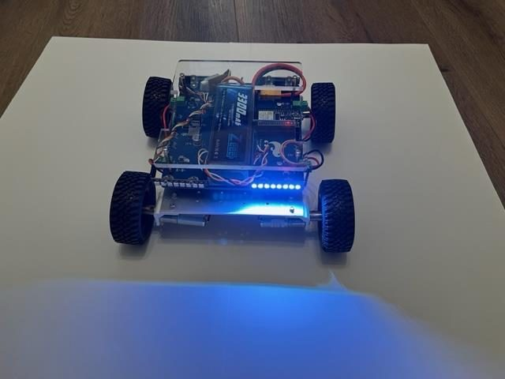
LESSON 5
Maneuvers with Lights
Non-blocking timing, edge detection, and the full pathfinder_nintendoswitch program.
PORPOISE ROBOTICS - Precision Oceanographic Program On and In the Sea Environment
porpoiserobotics.org
Kevin Bowen, President - kbowen6@icloud.com
Malcom Graham, VP Education Louis Parker, VP Technology
Valen Farre, System Engineer Gary Howland, Animation
Eddie Revollo, Artificial Intelligence
Interns: Oscar Canazales, Krishnansh Vemulapalli, Soham Gangal, Erik Olsen
Three hours. Bring a charged battery.
Porpoise Robotics - proprietary. For use with Porpoise Robotics lessons.
Notes:
Charged batteries and a cleared floor. Today has the most driving of any lesson in the course.
Tell them at the start that by the end they will be running the same program that leaves the factory on a finished vehicle. It changes how they read it.
If you are racing at the end, tape the course out before the class starts.

Slide 2
What you will be able to do by the end
By the end of this lesson you will be able to:
1. Explain why delay() breaks a program that has to do two things at once
2. Write the millis() pattern from memory
3. Detect the edge of a button press, and say what happens without it
4. Explain what a dirty flag saves
5. Drive the vehicle with its full lighting behavior running
6. Calibrate your vehicle's speed and race it
Pathfinder Beginner - Nintendo Switch | Lesson 5
2
Notes:
Objective two - write the millis() pattern from memory - is a genuine test. Come back to it in the quiz.
The last objective ties the whole term together: they calculated a speed in Lesson 2, and today they find out whether they were right.

Slide 3
Everything so far
Lesson 1 - the toolchain, the three parts of a program, digital output, the Serial Monitor.
Lesson 2 - H-bridges, PWM and duty cycle, tank drive, dead reckoning, and the math that predicts where the vehicle ends up.
Lesson 3 - Bluetooth, one vehicle per controller, deadzones, map(), mixing, and the failsafe.
Lesson 4 - addressable LEDs, color and perception, the power budget, the LED map, and four patterns.
Today: two more ideas, and then all of it at once.
KEY POINT By the end of today you will be driving the same program that leaves the factory on a finished vehicle.
Pathfinder Beginner - Nintendo Switch | Lesson 5
3
Notes:
Two minutes. Point at each lesson and get one sentence from the room rather than reading it yourself.
The note is the promise for today. Say it and then deliver it.

Slide 4
Today, in order
Time | What we do
0:00 | Recap. Why delay() has to go
0:25 | Upload l5a_millis_not_delay
0:45 | Edge detection. Upload l5b_button_toggle
1:10 | BREAK (10 minutes)
1:20 | Driving lights from driving state. Upload l5c_drive_with_lights
1:50 | A tour of the full program
2:10 | BREAK (10 minutes)
2:20 | Servos, the scanner, and sharp steering
2:35 | Calibrate, then race
2:57 | Where this course goes next
Pathfinder Beginner - Nintendo Switch | Lesson 5
4
Notes:
Two breaks. The racing is at 2:35, and it will overrun if you let it - protect the last five minutes for where the course goes next.

Slide 5
The problem with delay()
It does not wait. It stops.
delay(1000) does not mean "come back in a second". It means "stand here and do nothing for a second".
Inside a delay() the ESP32 is not reading the controller, not checking anything, not updating any other light.
In Lesson 2 that was fine. Now we need a turn signal every 300 ms, a scanner every 40 ms, and the motors as fast as possible - and those three cannot all be delays.
The old System Test program did exactly this: press a button and the vehicle froze for two seconds, still holding the last motor command. That is why it was replaced.
WATCH OUT This is the single biggest difference between a program that works on the bench and one that works on a vehicle.
Pathfinder Beginner - Nintendo Switch | Lesson 5
5
Notes:
The distinction on the lead line is the whole lesson: delay() does not wait, it stops.
Give the concrete numbers: a turn signal every 300 ms, a scanner every 40 ms, the motors as fast as possible. Ask them to write those as delays and watch it fall apart.
The old System Test story is worth telling. A real program, a real freeze, and a real reason it was replaced.
This is the difference between something that works on the bench and something that works on a vehicle.

Slide 6
Why the vehicle programs never call delay()
with delay() - one job, and nothing else runs
blink
frozen - delay(1000)
blink
frozen - delay(1000)
while it is frozen it is not reading the controller, not checking the battery, and not updating any other light
with millis() - many jobs, none of them waiting
drive motors
scanner frame
turn signal
battery check
each job fires on its own schedule, and loop() never stops running
if (millis() - lastTime >= INTERVAL) { lastTime = millis(); ...do the thing... }
Pathfinder Beginner - Nintendo Switch | Lesson 5
6
Notes:
This is the slide that explains the whole of Lesson 5. Do not rush it.
Two jobs at different rates cannot both be done with delay(). Draw the two timelines on the board and let them see the collision.
millis() is not a timer you start. It is a clock that has been running since power-up, and all you ever do is subtract.
Subtracting rather than comparing is what survives the wrap at 49 days. Mention it, do not dwell on it.

Slide 7
The pattern, in four lines
millis() instead of delay()
unsigned long lastBlink = 0;
const unsigned long INTERVAL = 1000;
void loop() {
if (millis() - lastBlink >= INTERVAL) {
lastBlink = millis();
// ...do the thing...
}
// ...and everything else keeps running...
}
millis() returns how many milliseconds the board has been switched on. Reading it costs nothing.
Each job needs its OWN "when did I last run" variable.
unsigned long, because millis() counts past what an int can hold in under an hour.
Subtracting like this also survives the moment millis() wraps back to zero, which happens after 49 days.
This exact pattern appears five times in the full vehicle program.
Pathfinder Beginner - Nintendo Switch | Lesson 5
7
Notes:
Four lines. Get them to copy it into a notebook, because they will write it from memory in the quiz.
millis() is not a timer you start - it has been running since power-up, and all you ever do is subtract.
Each job needs its OWN lastRun variable. That is the bit people get wrong when they first try it.
unsigned long matters: an int overflows in under an hour. Subtracting rather than comparing is also what survives the wrap at 49 days.

Slide 8
Two speeds at once
About 20 minutes
done
NOW
Why delay() has to go
Two speeds at once
Edge detection
Lights from state
The full program
Pathfinder Beginner - Nintendo Switch | Lesson 5
8
Notes:
Twenty seconds. First of four.

Slide 9
Do it now - two speeds at once
UPLOAD AND RUN: l5a_millis_not_delay (20 minutes)
1. Upload it. Two LEDs blink at different rates, and the Serial Monitor counts how many times loop() runs per second.
2. Write down that number. It is enormous.
3. Uncomment the delay(1000) at the bottom of loop(). Upload.
4. Watch both lights break, and watch the loop counter fall to 1.
5. Comment it back out.
6. Add a THIRD light on its own timer without touching the other two.
What you should see
LED 0 blinking once a second, LED 15 blinking about seven times a second, and a very large loop count.
Answer these
How many times per second does loop() run?
With the delay in place, what is the loop count, and what does that tell you about how much attention the vehicle has left over?
Pathfinder Beginner - Nintendo Switch | Lesson 5
9
Notes:
The loop counter is the star of this activity. Get the number written down before step 3, or the comparison means nothing.
Step 4 is the demonstration: one delay, and a counter in the tens of thousands falls to 1.
Step 6 - a third light on its own timer without touching the other two - is the proof they have understood the pattern.
Nothing moves in this one, so no blocks needed.

Slide 10
Edge detection: one press, one action
The level is not the event
loop() runs tens of thousands of times a second. A finger holds a button for about 100 milliseconds - thousands of trips round the loop.
So this is wrong:
if (myController->x()) lightsOn = !lightsOn;
It flips the lights thousands of times during ONE press. Whether they end up on or off is pure luck.
What we want is the MOMENT the button goes down - the edge, not the level. To find an edge you have to remember what it was doing last time round:
bool isNewPress = isDown && !wasDown;
wasDown = isDown;
That is justPressed(), and the full program uses it for every single button.
Pathfinder Beginner - Nintendo Switch | Lesson 5
10
Notes:
Do the arithmetic out loud: loop() runs tens of thousands of times a second, a finger holds a button for about a tenth of a second.
So one press is thousands of trips round the loop, and the naive version flips the lights thousands of times. Whether they end up on or off is luck.
The level is not the event. That sentence is worth writing on the board.
To find an edge you must remember what it was doing last time. That is the whole of justPressed().

Slide 11
Edge detection
About 25 minutes
done
done
NOW
Why delay() has to go
Two speeds at once
Edge detection
Lights from state
The full program
Pathfinder Beginner - Nintendo Switch | Lesson 5
11
Notes:
Twenty seconds. Two of four.

Slide 12
Do it now - see the bug, then the fix
UPLOAD AND RUN: l5b_button_toggle (25 minutes)
1. Upload it.
2. Press the LEFT face button (marked Y on most Switch pads) a few times. One press, one change, every time.
3. Now press the TOP face button (marked X on most Switch pads) ONCE and read the Serial Monitor.
4. How many times did one press register?
5. Hold the good button down for five seconds. Does anything extra happen? Should it?
6. Change justPressed so it fires on RELEASE instead. Which feels better to use?
What you should see
The good button toggles the headlights cleanly. The broken one reports flipping the value hundreds or thousands of times.
Answer these
Why does the broken version sometimes appear to work?
What does the & mean in bool &wasDown?
Pathfinder Beginner - Nintendo Switch | Lesson 5
12
Notes:
This sketch ships with a deliberately broken button next to a correct one. That is on purpose - do not let anybody fix it.
Step 4 is the moment: one press, hundreds of reported changes.
The broken version sometimes appears to work because an odd number of flips lands on the answer you wanted. Pure luck.
The & in bool &wasDown is a reference, so the function can update the caller's variable. Worth two minutes - it is their first reference.

Slide 13
State: what the vehicle remembers
Variables that live between passes
A variable that survives from one pass of loop() to the next is STATE. It is what makes a program feel like it has a mind rather than just reflexes.
The vehicle remembers:
lightsOn - are the running lights on at all
headlightLevel - dim or bright
lightPattern - stopped, forward, reverse, left or right
lightsChanged - does the strip need redrawing
turnMax - normal or sharp steering
scannerOn - is the KITT scanner running
That last flag is worth a slide of its own.
Pathfinder Beginner - Nintendo Switch | Lesson 5
13
Notes:
State is the word for it. A variable that survives from one pass to the next is what makes a program feel like it has a mind.
Read the six down. Ask which ones a driver can change and which the program works out for itself.
lightsChanged is the odd one out and gets its own slide next. Flag that.

Slide 14
Draw only when something changed
The dirty flag
Pushing 32 LEDs out to the strip takes about a millisecond. loop() runs tens of thousands of times a second.
Redrawing every pass would waste most of the vehicle's attention and make the lights flicker.
So the program keeps a flag: lightsChanged.
Anything that would alter the picture sets it to true.
The drawing code at the bottom of loop() runs only when it is set, and then clears it.
if (lightsChanged) { lightsChanged = false; showDrivingLights(); }
This is called a DIRTY FLAG, and you will find the same idea in graphics engines, spreadsheets and web browsers. Anywhere redrawing is expensive, something is keeping track of what actually changed.
Pathfinder Beginner - Nintendo Switch | Lesson 5
14
Notes:
Do the arithmetic: about a millisecond to push 32 LEDs out, tens of thousands of loops a second. Redrawing every pass wastes almost everything.
The dirty flag idea is worth naming properly, because it turns up in graphics engines, spreadsheets and web browsers.
Anywhere redrawing is expensive, something is keeping track of what actually changed. That is a genuinely transferable idea.

Slide 15
Choosing the lighting picture from what the vehicle is doing
from l5c_drive_with_lights.ino
LightPattern newPattern = LIGHTS_STOPPED;
if (forward > 0) newPattern = LIGHTS_FORWARD;
else if (forward < 0) newPattern = LIGHTS_REVERSE;
else if (turn > 0) newPattern = LIGHTS_RIGHT;
else if (turn < 0) newPattern = LIGHTS_LEFT;
if (newPattern != lightPattern) {
lightPattern = newPattern;
lightsChanged = true;
}
The lights are not controlled by a button. They follow what the vehicle is ALREADY doing, which is how a real car works.
An enum is a named list of the states something can be in. Better than 1, 2, 3, 4, 5, because the compiler can check it and you can read it.
The else-if chain means exactly one pattern is chosen. Driving forward wins over turning.
Only if it CHANGED do we set the dirty flag.
Pathfinder Beginner - Nintendo Switch | Lesson 5
15
Notes:
The lights are not on a button. They follow what the vehicle is already doing, which is how a real car works.
Introduce enum properly. A named list of the states something can be in, which the compiler can check and a human can read.
The else-if chain means exactly one pattern wins, and driving forward beats turning. Ask whether they agree with that priority.
The last two lines are the dirty flag again - only set it if something actually changed.

Slide 16
Lights from state
About 30 minutes
done
done
done
NOW
Why delay() has to go
Two speeds at once
Edge detection
Lights from state
The full program
Pathfinder Beginner - Nintendo Switch | Lesson 5
16
Notes:
Twenty seconds. Three of four.

Slide 17
Do it now - drive with lights
UPLOAD AND RUN: l5c_drive_with_lights (30 minutes)
1. Wheels off the ground. Upload. Check the controls.
2. Put it down and drive. Watch the lights follow the stick: headlights, tail lights, brake lights when you stop, white in reverse, amber on the side you are turning toward.
3. Press the LEFT face button (marked Y on most Switch pads) to toggle the lights.
4. D-pad up and down for bright and dim headlights.
5. Make the turn signals BLINK rather than stay on. Use millis(), not delay(), or the vehicle will stutter.
What you should see
A vehicle that drives and lights itself correctly at the same time, with no stuttering.
Answer these
Which lines make the brake lights come on?
Why does the amber only appear on one side?
SAFETY Check the controls with the wheels off the ground first.
Pathfinder Beginner - Nintendo Switch | Lesson 5
17
Notes:
Blocks first, every time. Then the floor.
Step 2 is the payoff for the whole term. Let them drive for a few minutes before you push them on to step 5.
Step 5 - blinking turn signals - is the exercise that proves they can use millis(). Anybody who reaches for delay() will feel the vehicle stutter immediately, which is the best possible feedback.
The amber only appears on one side because the pattern picks a side from the sign of the turn value.

Slide 18
The full program
About 55 minutes
done
done
done
done
NOW
Why delay() has to go
Two speeds at once
Edge detection
Lights from state
The full program
Pathfinder Beginner - Nintendo Switch | Lesson 5
18
Notes:
Forty-five minutes on the real program. Have it open on the projector.
Frame it honestly: they already wrote most of this. Today is about the last few pieces and about reading the whole thing.

Slide 19
pathfinder_nintendoswitch - what it adds
You have already written most of it. Here is what is left.
Feature | Where you have seen it
Tank drive with mixing | Lesson 3 - l3c_tank_drive
Deadzone and map | Lesson 3 - l3b_deadzone_and_map
Failsafe on disconnect | Lesson 3 - the top of loop()
Headlights, tail, brake, reverse, signals | Lesson 5 - l5c
The dirty flag | Lesson 5 - l5c
Edge-detected buttons | Lesson 5 - l5b
Two servos on the right stick | New today
The KITT scanner, non-blocking | Lesson 4 - l4c, made non-blocking
Sharp steering toggle | New today
A startup light show | New today - it proves every LED works
Pathfinder Beginner - Nintendo Switch | Lesson 5
19
Notes:
Go down the right-hand column and let them realise how much of it they recognise. That is the point of the table.
Only four rows say New today. Everything else is theirs already.

Slide 20
A servo listens to the LENGTH of a pulse
1.0 ms
one end of the travel
1.5 ms
centered
2.0 ms
the other end
the whole cycle is 20 ms, repeated 50 times a second
The ESP32 counts duty, not microseconds. At 16-bit resolution one 20 ms cycle is 65536 counts:
duty = microseconds * 65536 / 20000
Pathfinder Beginner - Nintendo Switch | Lesson 5
20
Notes:
A servo does not listen to voltage, or to duty in the way a motor does. It listens to how LONG the pulse is, and it wants one every 20 ms.
1.0 ms is one end, 1.5 ms is center, 2.0 ms is the other end. Those three numbers are the whole protocol.
The ESP32 counts duty, not microseconds, so the program has to convert. Walk the arithmetic once, slowly.
Continuous-rotation servos read the same pulse as a SPEED rather than a position. Worth flagging before somebody buys the wrong one.

Slide 21
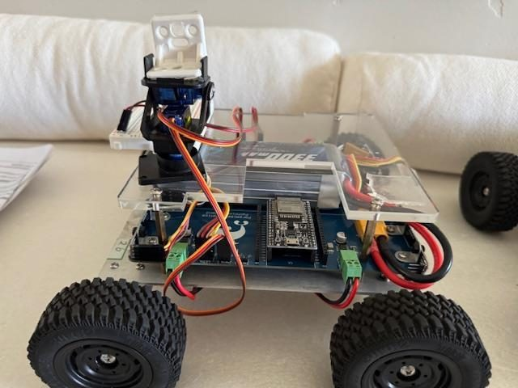
What the servo outputs are for
There are four servo headers on the MAIN CONTROL BOARD, under the top plate, and the full program drives them from the RIGHT stick. What you bolt on goes on the top plate; its leads come down to the board through the cutout.
Each servo owns one direction of the stick, so one stick aims four independent things and each sits centered when the stick is not pushed its way.
A pan and tilt mount is the obvious first use: two servos, one for left and right and one for up and down, with a camera or a range finder on top.
Watch out for which kind you have. A standard servo takes a position, plus or minus 180 degrees. A CONTINUOUS ROTATION servo reads the same pulse as a SPEED and will just keep turning.
Two servos, driven from opposite sides of the vehicle
Pathfinder Beginner - Nintendo Switch | Lesson 5
21
Notes:
Have the pan and tilt unit on the desk if you have one. It is much more convincing in the hand.
Point at the headers on a real board before you say anything else. Kevin caught this in the 2026-09-08 review: the slide used to put them on the top plate, and a student hunting for them up there will not find them.
The one-direction-per-servo scheme surprises people. Draw the stick on the board and mark which servo owns which push.
The continuous-rotation warning is the practical one. Somebody will buy the wrong kind and wonder why it never stops.
This is where the range finder goes in the projects list a few slides from now.

Slide 22
The last three additions
THE KITT SCANNER, done properly.
Lesson 4 used delay(), so the vehicle froze while it swept. The full program moves the dot every 40 ms off millis(), so you can drive with it running.
Toggled with the TOP face button (marked X on most Switch pads).
SHARP STEERING.
turnMax is normally 75% of MOTOR_MAX - 191 of 255 - which makes it easy to aim. clicking the left stick in flips it to full power, for spinning on the spot.
The bottom of the range is the same either way, so a gentle turn still breaks the wheels loose.
THE STARTUP LIGHT SHOW.
One scanner sweep at power-up. delay() is fine THERE, because nothing else needs to happen yet, and it proves every LED works before you drive off.
KEY POINT Read the top of the file. Every setting you might want to change is in the SETTINGS block, with a comment saying what it does.
Pathfinder Beginner - Nintendo Switch | Lesson 5
22
Notes:
The scanner is the same idea as Lesson 4 with delay() taken out. Ask them what had to change - the answer is a lastMove variable and a millis() test.
Sharp steering is a design choice they can now evaluate rather than just accept. Ask which mode they would want by default.
The startup light show is the one place delay() is still fine, because nothing else needs to happen yet. Say why explicitly, or it looks like an inconsistency.
The SETTINGS block at the top of the file is where everything tunable lives. Show it on the projector.

Slide 23
Putting it all together - read pathfinder_nintendoswitch in six sections
Six sections, ten minutes, in your groups. Do not start at line one and read to the end - it is the slowest way in.
Section | What you are reading | Ask yourself
1 | The header comment and the #includes | What does each library bring in, and which lesson met it?
2 | The SETTINGS block | Which numbers here did you change in an earlier lesson?
3 | The state variables and the LightPattern enum | Which of these survive between passes of loop(), and why?
4 | stickToSpeed(), drive() and setMotor() | Where does the deadzone go, and where does map() stretch what is left?
5 | setup() | Why are the motors set up before the LEDs, and the radio last?
6 | loop(), top to bottom | Find the failsafe, the button edges, the mixing, and the one place the lights are drawn.
KEY POINT This is the same order you would use on any program you did not write: what it depends on, what it can be tuned to do, what it remembers, then how it works.
Pathfinder Beginner - Nintendo Switch | Lesson 5
23
Notes:
Give them the full ten minutes and stay quiet for most of it.
The order matters. Vocabulary first, then the skeleton, then the detail - the same habit the advanced course opens with.
Section 2 is the confidence builder. They will recognise STICK_DEADZONE, MOTOR_MAX and the LED count as numbers they have already changed with their own hands.
Section 6 is the assessment. Walk round and ask groups to point at the failsafe. Anybody who can find it has understood Lesson 3.
Collect answers out loud before moving on, one section per group.

Slide 24
Six things to be able to explain before you upload it
You have written or read every one of these in an earlier lesson. This is the point where they are all in one file.
1. Why does the program #include a NeoPixel library but not a motor library?
2. strip(LED_COUNT, LED_PIN, NEO_GRB + NEO_KHZ800) - what is each of those four things telling the library?
3. What is STICK_DEADZONE for, and what would the vehicle do if it were 0?
4. enum LightPattern lists five values. Why an enum rather than the numbers 1 to 5?
5. drive() calls setMotor() four times. Why four, and why do two of them get the same number?
6. Find the four lines that stop the motors when the controller drops. What happens to the rest of loop() when they run?
Pathfinder Beginner - Nintendo Switch | Lesson 5
24
Notes:
Run this straight after the six sections, as a conversation.
Answers: the NeoPixel protocol is fussy enough to be worth a library, whereas a motor is two pins and a duty value - ledcWrite is already in the core.
The four arguments are how many pixels, which pin, the color order these parts want, and the speed they are clocked at.
The deadzone stops a stick that never quite centers from driving the vehicle. At 0 it creeps across the room on its own.
An enum because the compiler can check it and a person can read it. LIGHTS_REVERSE says what it means; 3 does not.
Four motors, and the two on a side always get the same number - that IS tank steering.
The failsafe calls drive(0, 0) and then return, which skips the whole of the rest of loop() and starts it again.

Slide 25
Do it now - the real thing
UPLOAD AND RUN: pathfinder_nintendoswitch (30 minutes)
1. Open pathfinder_nintendoswitch.ino.
2. READ IT FIRST. You will recognise almost all of it.
3. Paste your MY_CONTROLLER line into the top.
4. Wheels off the ground. Upload. Check every control.
5. Put it down and drive properly.
6. Find three things in the file you have NOT seen before, and work out what they do.
What you should see
A startup sweep, then a green blink while it waits, then full driving with lights, servos and the scanner.
Answer these
What does the green blink mean?
What are the three things you found?
SAFETY Wheels off the ground until every control is checked.
Pathfinder Beginner - Nintendo Switch | Lesson 5
25
Notes:
Step 2 is not optional. Read it before uploading it - that is the habit the whole course has been building.
Step 6 is the assessment: three things they have not seen, and what they do. Collect the answers, they are a good measure of the term.
The green blink means it is waiting for a controller. They saw showWaitingLights() in the code.
Give this the full thirty minutes and circulate. This is the last time they get help before the race.

Slide 26
Calibrate, then race
Measure first. Then argue about who is fastest.
CALIBRATE FIRST.
Mark a start and a finish line with tape. Measure the distance.
Drive it flat out and time it. Speed = distance / time.
Compare with the number you calculated in Lesson 2. Were you right?
DRAG RACE.
Two or three vehicles side by side. First across the line INSIDE the lane wins - leaving the lane does not count.
DRAG RACE (cont.)
Straight-line speed is not the whole problem. Keeping it straight is, because only one command runs at a time.
You can only brake by reversing. Half power for a short time is usually right.
COURSE RACE.
Tape out a course with corners. Now sharp steering earns its keep.
Fastest clean lap. Touching a cone costs you two seconds.
Pathfinder Beginner - Nintendo Switch | Lesson 5
26
Notes:
Calibrate before racing. If you let them race first you will never get them back to the measurement.
The comparison with their Lesson 2 calculation is the whole point. Ask each group how close they were before you start the racing.
Braking by reversing is the detail that decides the drag race. Half power for a short time is usually right.
Keeping it straight is harder than going fast, because only one command runs at a time. Let them discover that.
For the course race, two seconds per cone touched keeps it honest.

Slide 27
Take it further - projects that fit on this vehicle
Each is a real addition to the program you now understand. Pick one and build it.
LOW BATTERY WARNING. Flash yellow below 12 volts and red below 10. A 4S pack should never be run flat, and the vehicle notices sooner than you do.
COLLISION WARNING. An ultrasonic range finder on the top plate. Closer than 20 inches: stop, flash red, wait three seconds, carry on.
AUTOMATIC LIGHTS. Reversing beeps, hazard lights, or headlights that come on only when the vehicle is moving.
WAYPOINT NAVIGATION. Give the program a LIST of moves - distance and heading - instead of one hard-coded square.
SERVO PAN AND TILT. Two servos and a bracket, aimed with the right stick. The headers are already on the board.
KEY POINT All five are within reach of what you learned in five lessons. Two of them need nothing bought at all: the list of moves needs no new parts, and the servo headers are already on the board.
Pathfinder Beginner - Nintendo Switch | Lesson 5
27
Notes:
These are real projects, not filler. Each one is a genuine addition to the program they now understand.
The waypoint list and the servos are the two that need nothing bought. Point that out - it is the difference between an idea and a plan.
FOR YOU, NOT FOR THEM: all five of these are written out in full in src/projects/, one folder each, for both tracks. Each one is l5c_drive_with_lights plus the one thing, so you can put the two files side by side and the difference IS the project. Kevin asked for these in the 2026-09-08 review, and the reason was blunt: an instructor who cannot help a stuck student is not acceptable.
Do not hand them out. Read the one a student has picked before the session they start it in, and the questions they get stuck on will be the ones you have already met. The header of each file has a section called THE IDEA, which is the part worth understanding rather than the feature.
If anybody is staying on after the course, get them to pick one today while the enthusiasm is high.

Slide 28
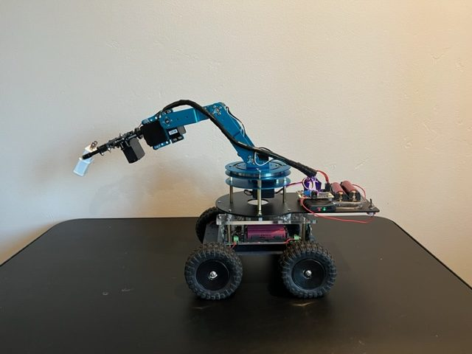
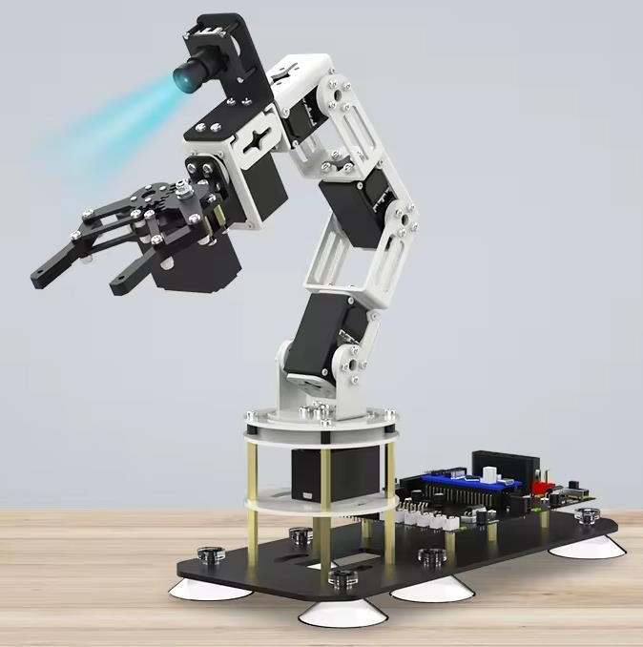
Two of those, already built
Both of these are the same vehicle you have been driving, with something bolted to the top plate and a few hundred lines added to the program.
A gripper arm on the top plate, driven from the servo headers on the board below it
The same idea taken further: six joints, six servos, one program
Pathfinder Beginner - Nintendo Switch | Lesson 5
28
Notes:
Show these AFTER the projects list, not before. The point is that the list is not hypothetical.
The arm is servo outputs, which they met earlier today. The range finder is one new sensor and a threshold.
Neither needed a different vehicle. That is the message.
If either is in the room, get it out and let people handle it.

Slide 29
Where this goes next
Straight on from here
The advanced program
SENSORS - a range finder that stops the vehicle before it hits something, line followers, light and temperature. Once it can sense the world, dead reckoning stops being the only way it knows where it is.
VEHICLE TO VEHICLE - ESP-NOW lets ESP32s talk directly to each other, with no router in between.
CAMERAS AND AI - object recognition, and a 6-DOF arm that picks things up.
Pathfinder_Op_Program12 is the same vehicle with:
eight files, split by subsystem
10-bit PWM and hybrid drive at low speed
speed ramping, so it does not lurch
a serial console for tuning without recompiling
settings saved to EEPROM
a current sensor and a powered self-test
A five-lesson course of its own.
KEY POINT Everything you learned this term transfers directly. The advanced course starts by taking this program apart.
Pathfinder Beginner - Nintendo Switch | Lesson 5
29
Notes:
Left column is where robotics goes. Right column is the advanced course, which is the same vehicle taken apart properly.
Everything they learned this term transfers directly. Say so - the advanced course opens by dismantling this program.

Slide 30
Why this is worth your time
Robotics and STEM, and where they lead
At Oceanology International Americas in San Diego, we asked a panel what the transition opportunities are:
Dr Rick Spinrad, NOAA Administrator, said a knowledge of robotics and STEM is a competitive advantage for entry-level positions.
Rear Admiral Ron Piret, USN, said they are looking for students with robotics and STEM education for operational careers.
Kendra MacDonald, CEO of Canada's Ocean Supercluster, said that whether you become a doctor, a lawyer or a scientist, STEM will help you.
What you have actually practiced this term: reading somebody else's code, changing one thing at a time, measuring instead of guessing, and working out whether a fault is mechanical, electrical or software.
Those four habits are the job. The vehicle was just the excuse.
Pathfinder Beginner - Nintendo Switch | Lesson 5
30
Notes:
These are real quotes from a real panel. Say who the people are, briefly, so the names mean something.
The paragraph that matters is the last one: reading someone else's code, changing one thing at a time, measuring instead of guessing, and locating a fault. Those four habits are the job.
Finish on the line about the vehicle being the excuse. It is true, and it is the right note to end on.

Slide 31
Check yourself
Thank you. Go and break something interesting.
1. Why can a program not use delay() if it has to do two things at different rates?
2. Write the four-line millis() pattern from memory.
3. Why does unsigned long matter for millis()?
4. What is edge detection, and what goes wrong without it?
5. What is a dirty flag, and what does it save?
6. A servo is centered by a pulse of what length? How often is it sent?
7. Name three things the full program does that l5c does not.
8. Your vehicle drifts left on the drag strip. Give one mechanical cause and one software fix.
Pathfinder Beginner - Nintendo Switch | Lesson 5
31
Notes:
Run it as a conversation, and take your time - this is the last thing they do.
Answers, in order: delay stops everything, so two different rates cannot both be served; the four-line pattern should be written out and checked; unsigned long because an int overflows in under an hour.
Edge detection catches the moment a button goes down; without it one press registers thousands of times. A dirty flag saves redrawing the strip when nothing changed.
A servo centers on a 1.5 ms pulse, sent every 20 ms.
For question 8: mechanically, one motor weaker or a wheel dragging; in software, a small turn correction added to the straight-line command.
Thank them properly, and mean the last line.

