Slide 1

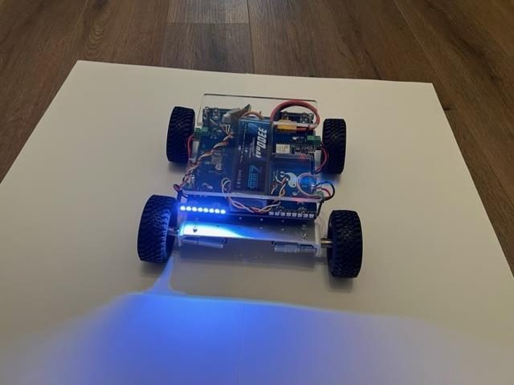
LESSON 1
Meet Pathfinder
What a robot is, the vehicle your team will program for twelve lessons, how we stay safe - and your very first drive.
PORPOISE ROBOTICS - Precision Oceanographic Program On and In the Sea Environment
porpoiserobotics.org
Kevin Bowen, President - kbowen6@icloud.com
Malcom Graham, VP Education Louis Parker, VP Technology
Valen Farre, System Engineer Gary Howland, Animation
Eddie Revollo, Artificial Intelligence
Interns: Oscar Canazales, Krishnansh Vemulapalli, Soham Gangal, Erik Olsen
One hour. Teams of three, one vehicle per team.
Porpoise Robotics - proprietary. For use with Porpoise Robotics lessons.
Notes:
BEFORE CLASS: every vehicle charged, on its stand, switched off, with e01a_learner_drive already uploaded and its controller claimed with e00_claim_controller. The arena is taped on the floor. The README has the full checklist.
Introduce yourself, then go round the room for names. Ask who has built or programmed anything before - a LEGO kit, Scratch, Minecraft redstone all count. It tells you who can help their team, and makes beginners feel normal.
Promise them one thing right now: everybody drives a robot before this hour is up.

Slide 2
Today's mission
By the end of today, you can:
1. Say the three things every robot does
2. Find the computer, motors, lights and battery on a Pathfinder
3. Explain the Explorer Code, and why each rule is there
4. Drive a Pathfinder through the course and park it in the garage
Pathfinder Explorers | Lesson 1
2
Notes:
Read these out. Come back to this slide in the last five minutes and ask for a thumbs-up, sideways or down on each one.
The fourth one is the one they care about. Say so, and say that the first three are how they earn it.

Slide 3
Welcome, Explorers!
For the next twelve lessons, your team gets its own robot vehicle.
You will make it light up, move, drive itself, and listen to your controller.
By the last lesson, YOU will have written the program that drives it.
Mistakes are part of the job. Every engineer breaks things. The good ones find out why.
KEY POINT Questions are always welcome here. "I don't know - let's find out" is a great answer.
Pathfinder Explorers | Lesson 1
3
Notes:
Set the tone in the next two minutes: this is a room where being wrong is normal and asking is good.
The last bullet matters most. A nine-year-old whose vehicle does something strange needs to hear that this is the job, not a sign they're bad at it. Say it slowly.
If you have a few older students, ask them now to be the people who help, not the people who grab the keyboard. Most rise to it.

Slide 4
Where we're going
Lesson | What you'll do
1 | Meet Pathfinder, and drive it
2 | Write your first program, and hunt bugs
3 | Mix colors with light, and map every light
4 | Loops, and a light show you design
5 | Make the wheels move
6 | Autopilot: drive a square by code
7 | Mission to Mars: plan a route
8 | Make the controller's buttons do your bidding
9 | Joystick driving, and your driving test
10 | Smart lights that signal, like a car
11 | Design your own upgrade
12 | Mission Day!
Pathfinder Explorers | Lesson 1
4
Notes:
One line each - this is a map, not a lesson.
Point at Lesson 12 and tell them families are invited to watch, if they are. Having somebody to show is a strong motivator all term.

Slide 5
Today, in order
Time | What we do
0:00 | Welcome, and the Starting Line questionnaire
0:06 | The game 'Robot or not?'
0:14 | Meet Pathfinder: every part, and what it does
0:21 | Team jobs and the Explorer Code
0:30 | First drive in the arena
0:50 | Mission Log, Learner Permits, and pack up
Pathfinder Explorers | Lesson 1
5
Notes:
Put the agenda on the board as well, with the driving or uploading block circled. Students settle when they can see when the hands-on part starts.
The timings are a guide for a one-hour session. If the hands-on block runs long, take the time out of the check yourself questions, never out of the pack-up - a rushed pack-up is how cables and controllers go missing.

Slide 6
Starting Line - questionnaire 1 of 3
CHECK-IN: Starting Line questionnaire (6 minutes)
Your teacher gives you a questionnaire, and your EXPLORER CODE. Write the code at the top - not your name.
This is NOT a test. Nobody gets a grade.
Your teacher reads each question out loud. Answer on your own - no peeking!
Not sure? Tick "I don't know yet". Today that's the RIGHT answer for most of Part 2!
Done? Turn it over and wait quietly.
What you should see
You won't know most of Part 2 yet. That's the point: in twelve lessons, you will.
Pathfinder Explorers | Lesson 1
6
Notes:
Hand this out before ANYTHING is taught, so the answers show where students start rather than what the first ten minutes taught them.
Give every student an Explorer code: team number plus a letter (3A, 3B, 3C). Write it on a sticky note on their desk; they copy it onto the questionnaire and the Mission Log cover. Keep the list of codes and names yourself. The questionnaires never carry names, which is what lets students be honest.
Read every question aloud, at a steady pace, for the whole room. Nine-year-olds read at very different speeds, and you are measuring what they know, not how fast they read.
Don't explain or hint at Part 2. If somebody asks, the answer is always: if you're not sure, tick I don't know yet.
Collect them straight away, and don't read them in front of the class. The README says how to type them into questionnaire_tracker.xlsx. A student who misses today does it at the start of Lesson 2, with the real date on it.

Slide 7
What is a robot?
About 10 minutes
NOW
What is a robot?
Meet Pathfinder
The Explorer Code
First drive
Pathfinder Explorers | Lesson 1
7
Notes:
A breath between parts of the lesson. Read the title out and point at where it sits on the strip.

Slide 8
Robot or not?
UNPLUGGED: Thumbs up, thumbs down (8 minutes)
Your teacher names something. You decide: is it a ROBOT?
Thumbs UP for robot. Thumbs DOWN for not a robot.
  A robot vacuum. A TV remote. An automatic door.
  A Mars rover. A remote-control car. A calculator.
Pick one and explain your vote to the person next to you.
What you should see
Lots of arguing. That's the point!
Answer these
What does a machine need to do to count as a robot?
Pathfinder Explorers | Lesson 1
8
Notes:
Do these one at a time and make them commit before anyone explains. Then ask a thumbs-up and a thumbs-down to defend their vote.
There are no perfect answers, and that is the fun. Where most rooms land: robot vacuum YES (it senses bumps and decides where to go). TV remote NO (it does what your thumb says). Automatic door - arguable, it senses and acts but hardly thinks. Mars rover YES. Remote-control car NO - a person does the thinking. Calculator - it thinks, but doesn't sense the world or move anything.
Steer the discussion toward the three verbs on the next slide: does it SENSE, THINK and ACT by itself?

Slide 9
Every robot does three things
SENSE
THINK
ACT
the rover's ears
the rover's brain
the rover's muscles
Your controller:
buttons and sticks
The ESP32 computer
runs YOUR program
4 motors turn the wheels
32 lights light up
KEY POINT A ROBOT is a machine that can sense, think and act by itself. A remote-control car can act - but YOU do all its thinking.
Pathfinder Explorers | Lesson 1
9
Notes:
Point at each box on a real vehicle as you say it: the controller is how it senses you today, the computer under the top plate thinks, the wheels and lights act.
Ask: does a TV remote sense, think and act? (It senses your thumb, but it doesn't decide anything - you do.) Does a robot vacuum? (Yes - it bumps, decides, and turns.) Let them argue. Arguing about the edges is how the idea sticks.
Say plainly that the 'think' box is where THEIR programs will live. Everything they write in this course goes in the middle box.

Slide 10
Robots go where people can't
In 1997, NASA landed a mission called Mars Pathfinder.
It carried Sojourner - the first rover ever to drive on Mars. It was about the size of a microwave oven.
Its top speed was about 1 centimeter per second. Your vehicle is MUCH faster.
Here in San Diego, scientists send robots deep into the ocean too.
PLACEHOLDER
IMAGE: NASA's Sojourner rover on Mars, 1997
NASA images are generally free to use in teaching. Search 'Sojourner' at photojournal.jpl.nasa.gov and save one as sojourner-on-mars.jpg
Sojourner, on Mars
KEY POINT Robots explore where it is too far, too deep, or too dangerous for people to go.
Pathfinder Explorers | Lesson 1
10
Notes:
Your vehicle shares its name with that mission. It's a good story to tell: a robot the size of a microwave, driving very slowly across another planet, run by a team in Pasadena, California, a couple of hours north of here.
Sojourner landed on July 4, 1997. One centimeter a second is about the width of a fingernail every second.
The ocean line is the local hook. Porpoise Robotics builds robots for the sea, and Scripps Institution of Oceanography in La Jolla sends robot floats and gliders all over the world's oceans. Ask who has been to the Birch Aquarium or the tide pools.

Slide 11
Meet Pathfinder
About 5 minutes
done
NOW
What is a robot?
Meet Pathfinder
The Explorer Code
First drive
Pathfinder Explorers | Lesson 1
11
Notes:
A breath between parts of the lesson. Read the title out and point at where it sits on the strip.

Slide 12
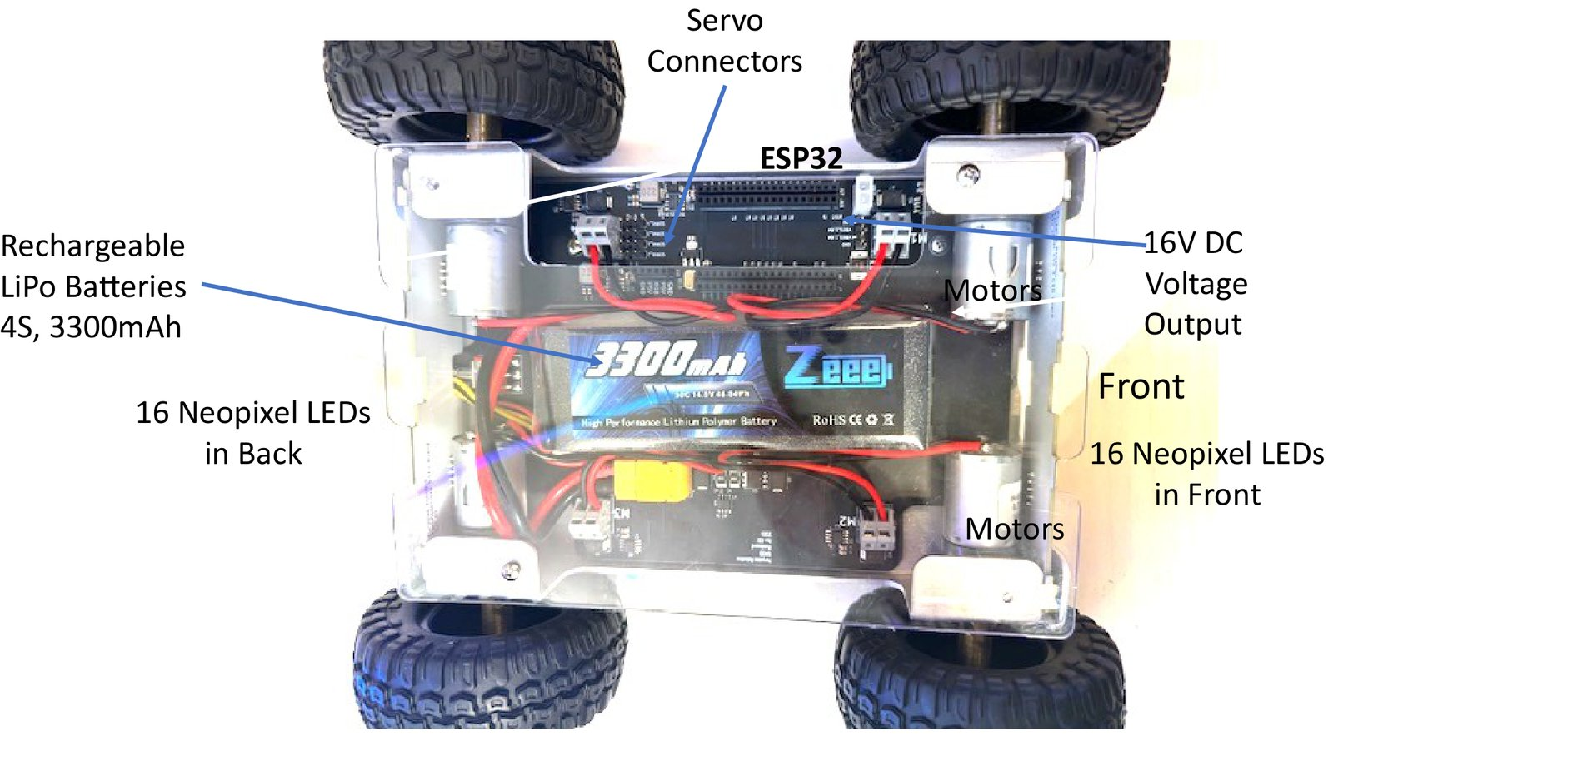
Meet Pathfinder
Every part, labeled. Find each one on your team's vehicle.
Pathfinder Explorers | Lesson 1
12
Notes:
Give each team two minutes to find every labeled part on their own vehicle. Hands on is fine; power stays OFF.
Make sure every team finds the POWER SWITCH. Ask every Crew Chief to put a finger on it. You will ask for it again in the safety section.
Don't explain the battery voltage or the motor drivers - that comes later. Names and jobs only.

Slide 13
A robot is a bit like a body
Part | What it does | Like your...
ESP32 computer | Runs your program. Makes every decision. | brain
4 motors | Turn the wheels | muscles
32 lights | Show what the robot is doing | face
Controller and radio | Bring your commands in | ears
Battery | Stores energy for everything | food
Frame and wheels | Hold it together, and roll | skeleton and feet
Pathfinder Explorers | Lesson 1
13
Notes:
Ask the room to fill in the last column before you show it - cover it with your hand, or read the middle column and let them shout.
The comparison is loose and that's fine. If a student argues that the lights are more like a voice than a face, they have understood it perfectly.

Slide 14

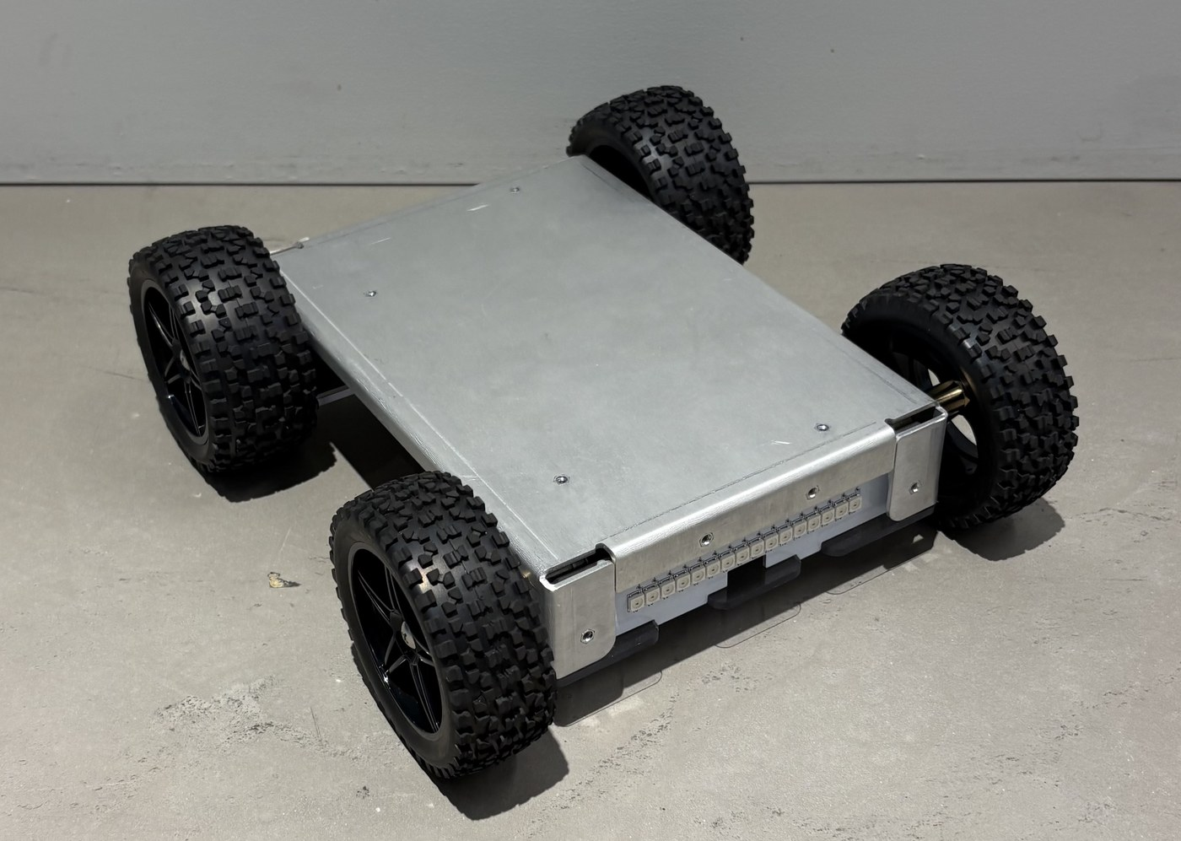
Built for exploring
Flipped over: the wheels stick out past the frame on BOTH sides.
Your controller. Its radio talks to ONE vehicle only.
Pathfinder Explorers | Lesson 1
14
Notes:
Left: a Pathfinder on its back. The wheels are bigger than the frame on the top and the bottom, so it still touches the ground with its wheels. Ask why an explorer robot might need that. (Bumps, rocks, flips.)
Right: the controllers. Each one is locked to one vehicle, which is the next slide.

Slide 15
One vehicle, one controller
Every vehicle has a number sticker.
Its controller has the SAME number.
The vehicle ignores every other controller in the room.
Lights blinking GREEN: it's looking for its controller. Press a button on it.
Lights blinking RED: tell your teacher.
PLACEHOLDER
PHOTO: a vehicle and its controller with matching number stickers
Both stickers in the same shot, close enough to read the number
Matching numbers
Pathfinder Explorers | Lesson 1
15
Notes:
Without this, twelve controllers in one room would grab whichever vehicle answered first. The stickers are how students keep the pairs together.
Blinking RED means the vehicle has never been told which controller is its own. That is an instructor job: run e00_claim_controller on it (the README walks you through it). It takes two minutes.
If a controller seems dead: check it's charged, and that it isn't the neighbor's. Swapped controllers are the most common 'broken vehicle' of the whole course.

Slide 16
The Explorer Code
About 10 minutes
done
done
NOW
What is a robot?
Meet Pathfinder
The Explorer Code
First drive
Pathfinder Explorers | Lesson 1
16
Notes:
A breath between parts of the lesson. Read the title out and point at where it sits on the strip.

Slide 17
Your team, and your jobs
Job | What you do
Pilot | Holds the controller and drives. Runs the tests.
Coder | Sits at the laptop. Types the changes and uploads.
Crew Chief | In charge of the vehicle: the stand, the power switch, the cable. Reads the mission steps out loud. Calls STOP if anything looks unsafe.
KEY POINT Switch jobs EVERY lesson. Everybody does every job.
Pathfinder Explorers | Lesson 1
17
Notes:
Assign today's jobs now, out loud, team by team. Write them on the board so you can rotate them fairly next lesson.
Teams of two: one person is Crew Chief AND Pilot. Teams of four: add a Navigator who reads the steps and keeps the Mission Log.
Crew Chief is the most important job, not the least. Give it to your most careful student first, so the others see how it's done.

Slide 18
The Explorer Code
1. WHEELS UP whenever the cable is plugged in. The vehicle sits on its stand.
2. Hands, hair and sleeves away from the wheels while the power is on.
3. Power OFF before you pick it up. Carry it by the bottom plate, never by the wires.
4. Drive on the floor, inside the arena. Never on a table.
5. Batteries and chargers are for grown-ups only.
6. A puffy, hot or damaged battery - or a burning smell? Power OFF, step back, tell a grown-up.
7. Don't stare into the lights.
SAFETY The Crew Chief can call STOP at any time, and everybody stops. No arguing.
Pathfinder Explorers | Lesson 1
18
Notes:
Slow down. This is the slide that keeps everybody safe for twelve weeks.
Ask WHY for at least three rules and let students answer. Rules they can explain are rules they keep. (1: a vehicle on a table can drive itself off it. 3: the wires are the weakest part. 5: the battery is a 16-volt lithium pack with a lot of energy in it.)
Rule 5 is absolute. Students never charge, unplug, or swap a battery. If you have a puffy pack, show it - kids remember what they've seen far better than what they've heard.
Have every student sign the Explorer Code page in the Mission Log before anyone drives.

Slide 19
Wheels up, and the power switch
PLACEHOLDER
PHOTO: a vehicle on its wheels-up stand
A block or small box under the frame, all four wheels clear of the table. Shoot it from the side so the gap under the wheels shows
PLACEHOLDER
PHOTO: the vehicle's power switch, close up
Show which way is ON. Add an arrow if the switch is not marked
Wheels up = all four wheels in the air
Crew Chiefs: know where this is
Pathfinder Explorers | Lesson 1
19
Notes:
Show a real vehicle on a real stand. Anything works: a wooden block, a small sturdy box, a stack of books. All four wheels must be clear.
Crew Chiefs point at their power switch. Every one of them, before you move on.

Slide 20
First drive
About 20 minutes
done
done
done
NOW
What is a robot?
Meet Pathfinder
The Explorer Code
First drive
Pathfinder Explorers | Lesson 1
20
Notes:
A breath between parts of the lesson. Read the title out and point at where it sits on the strip.

Slide 21
Today's driving course
How to pass
1. Weave through the cups
2. Park in the garage - all four wheels inside
3. Back out and drive home to START
Knock over a cup? Go back to START and try again.
GARAGE
START
Pathfinder Explorers | Lesson 1
21
Notes:
Build this on the floor before the lesson with masking tape and four plastic cups. About 10 feet by 12 feet is plenty.
Walk the course on foot first, slowly, with the class watching. Nine-year-olds learn a route far better by seeing a person do it than by looking at a map.
The garage is the hard part. Parking slowly and precisely is a far better test of control than speed, and it is what the license rewards.

Slide 22
The arena
PLACEHOLDER
PHOTO: the driving arena on the classroom floor
Masking-tape rectangle, four cups, the START box and the GARAGE, taken from a chair so the whole course is in the frame
Drive inside the tape. Wait your turn behind the line.
Pathfinder Explorers | Lesson 1
22
Notes:
If your room is small, run the arena in shifts: two or three vehicles at a time, and the waiting teams label the parts page in their Mission Log. Everybody gets a turn.
Tell them where to stand while they wait - behind the tape, not in the arena. Feet in the arena are the main hazard.

Slide 23
First drive
MISSION: e01a_learner_drive (20 minutes)
Crew Chief: vehicle on the floor at START. Power ON. The lights blink GREEN.
Pilot: press any button on YOUR controller. The blinking stops - you're connected!
Weave through the cups. Park in the garage. Back out. Drive home.
Switch jobs. Everybody drives at least twice.
LEVEL 2: hold A. Tap Y. Tap X. What happens?
What you should see
White headlights at the front
Red brake lights when you stop
Orange blinking on the side you turn toward
Answer these
Which way do you push to turn right?
What do the back lights do when you back up?
SAFETY If anything goes wrong, LET GO of the stick. The vehicle stops.
Pathfinder Explorers | Lesson 1
23
Notes:
Your teacher has already uploaded e01a_learner_drive to every vehicle, so there's no laptop in this activity.
Watch the first lap of every team closely. Kids push the stick all the way at first. The learner speed limit keeps it manageable; praise smooth driving loudly.
Answers: the stick goes right to turn right, and the vehicle turns on the spot if you aren't also pushing forward. The back lights turn white when reversing - like a car's backup lights. A flashes the headlights, Y switches the lights off and on, X is party mode.
If a vehicle won't connect: is it the right controller? Is the controller charged? Is the vehicle blinking green (good) or red (needs e00)?

Slide 24
The one line to look at today
e01a_learner_drive.ino, line 28
// ===== SETTINGS =====
const int SPEED_LIMIT = 50; // LEARNER 50 - LICENSED 75 - EXPERT 100
const int WOBBLE_ZONE = 10; // Stick numbers smaller than this count as zero
Pathfinder Explorers | Lesson 1
24
Notes:
Say it plainly: this number is why your vehicle drives gently today. It's a percent - at 50 a full push on the stick gives half power. Pass the driving test, and you get to raise it.
Open e01a_learner_drive on your own laptop and project it. Don't let anybody change it yet - today is look, don't touch.
This is the hook for the whole course: there's a number in the program, and changing it changes the robot. By Lesson 9 they'll change it themselves.

Slide 25
Your driver's license
License | SPEED_LIMIT | How you earn it
Learner Permit | 50 | Lesson 1: know the Explorer Code and finish the driving course
Driver's License | 75 | Lesson 9: pass the driving test - no cups knocked over
Expert License | 100 | Lesson 10 or later: the test course at 75, signaling every turn
KEY POINT Speed is something you EARN, and your teacher decides. 100 means full power - it is FAST.
Pathfinder Explorers | Lesson 1
25
Notes:
This is the reward system for the whole course, so make it feel like a real license. Stamp it. Make a little ceremony of the upgrade.
SPEED_LIMIT is a percent of full power. At the Learner level a full stick gives half power; at Expert it gives everything the motors have.
It is entirely your call when a team goes up a level. A team that drives carelessly at 75 can be asked to go back to 50 - say so now, before anyone has earned anything.

Slide 26
Check yourself
Talk it over with your team, then we'll share.
1. What are the three things every robot does?
2. Which part of Pathfinder is its brain?
3. When must the vehicle be WHEELS UP?
4. Who is allowed to touch the batteries?
5. Something smells hot. What do you do?
Pathfinder Explorers | Lesson 1
26
Notes:
Answers: 1 sense, think, act. 2 the ESP32 computer. 3 whenever the cable is plugged in. 4 grown-ups only. 5 power OFF, step back, tell a grown-up.
Questions 3 to 5 are the ones that matter. Anybody who can't answer them doesn't get a Learner Permit stamp yet - say that kindly and go over it again.

Slide 27
Mission Log, then pack up
In your Mission Log
Pack up
Write your team name and draw your vehicle
Label the parts
Sign the Explorer Code
Stamp: Learner Permit
Crew Chief: vehicle power OFF.
Unplug the cable and coil it up.
Vehicle and controller back in their spot, stickers matching.
Close the laptop. Push your chairs in.
KEY POINT Last job: every team member says one thing they learned today.
Pathfinder Explorers | Lesson 1
27
Notes:
Stamp the Learner Permit for every student who answered the safety questions. It's the first page they'll show their families.
Next lesson they upload their first program, so laptops need the board package and the course sketches by then. See the README.
Do not let anyone leave until their Crew Chief has shown you a switched-off vehicle.

