Slide 1

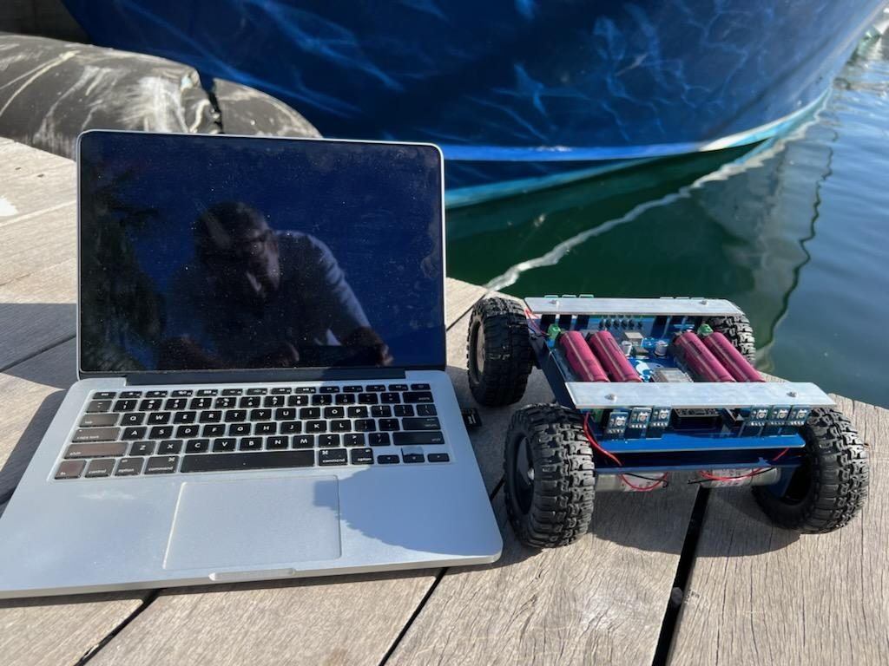
LESSON 2
Talking to Robots
A program is a list of instructions. Today you write your first one, send it to your vehicle, and hunt down three bugs.
PORPOISE ROBOTICS - Precision Oceanographic Program On and In the Sea Environment
porpoiserobotics.org
Kevin Bowen, President - kbowen6@icloud.com
Malcom Graham, VP Education Louis Parker, VP Technology
Valen Farre, System Engineer Gary Howland, Animation
Eddie Revollo, Artificial Intelligence
Interns: Oscar Canazales, Krishnansh Vemulapalli, Soham Gangal, Erik Olsen
One hour. Teams of three, one vehicle per team.
Porpoise Robotics - proprietary. For use with Porpoise Robotics lessons.
Notes:
BEFORE CLASS: every laptop has the Arduino IDE, the esp32_bluepad32 board package, Adafruit NeoPixel, and the explorers sketch folder in its sketchbook. The board is already set to ESP32 Dev Module. Students should not be installing anything today.
Have one good USB data cable per team, plus two spares in your pocket. A charge-only cable looks identical and is the number one reason an upload 'doesn't work'.

Slide 2
Today's mission
By the end of today, you can:
1. Give instructions so exact that a robot can follow them
2. Name the two parts of every program, and say when each one runs
3. Upload a program to your vehicle, and change it
4. Read an error message and fix the bug it points to
Pathfinder Explorers | Lesson 2
2
Notes:
Read them out. The third one is the big moment - their first upload. Build it up.

Slide 3
Last time
You met Pathfinder and drove it.
A robot SENSES, THINKS and ACTS.
Today: the THINK part. Who tells the robot what to think?
  You do.
Switch jobs! Last lesson's Pilot is today's Coder.
Pathfinder Explorers | Lesson 2
3
Notes:
Ask for the three robot verbs before you show the slide.
Rotate the jobs now, before anybody sits down at a laptop. Whoever was Pilot last time is the Coder today.

Slide 4
Today, in order
Time | What we do
0:00 | Warm-up: what did the rover do last time?
0:05 | Program a Human Robot
0:17 | The Arduino IDE, setup() and loop()
0:25 | Upload e02a_hello_rover and change it
0:40 | Bug hunt: e02b_bug_hunt
0:52 | Mission Log and pack up
Pathfinder Explorers | Lesson 2
4
Notes:
Put the agenda on the board as well, with the driving or uploading block circled. Students settle when they can see when the hands-on part starts.
The timings are a guide for a one-hour session. If the hands-on block runs long, take the time out of the check yourself questions, never out of the pack-up - a rushed pack-up is how cables and controllers go missing.

Slide 5
Instructions
About 10 minutes
NOW
Instructions
Your first upload
Bug hunt
Pathfinder Explorers | Lesson 2
5
Notes:
A breath between parts of the lesson. Read the title out and point at where it sits on the strip.

Slide 6
Program a Human Robot
UNPLUGGED: Instructions on a card (12 minutes)
One person is the ROBOT. Everybody else on the team is a PROGRAMMER.
Mission: walk the robot from the door to the teacher's desk, and PICK UP the marker.
Write the program on a card using ONLY these words:
  STEP FORWARD (number) TURN LEFT TURN RIGHT PICK UP
The robot does EXACTLY what the card says. Even if it's wrong!
Didn't work? Fix the card and run it again.
What you should see
The robot walks into a chair, turns the wrong way, or stops short
Answer these
What went wrong the first time?
Why can't the robot just figure it out?
SAFETY Robots WALK, slowly. Programmers: no instructions that walk your robot into anything.
Pathfinder Explorers | Lesson 2
6
Notes:
Play the robot yourself for the first team, and be ruthlessly literal. 'Step forward' with no number? Stand still and say 'how many?' 'Turn' without left or right? Freeze. Kids love catching you out, and it lands the point.
Then let teams run it with a student robot. Two runs each is plenty.
Answers: computers can't guess what you meant - they only have what you wrote. That's both the frustrating part and the reliable part.

Slide 7
What the human robot taught us
A PROGRAM is a list of instructions.
The computer follows them in order, from top to bottom.
It does EXACTLY what you said - not what you meant.
A mistake in a program is called a BUG. Finding and fixing it is called DEBUGGING.
KEY POINT In 1947, engineers working with Grace Hopper found a real moth stuck inside their computer - and taped it into their notebook.
Pathfinder Explorers | Lesson 2
7
Notes:
Pull the lessons out of the game in their own words before you show the bullets.
The moth story is true: September 9, 1947, on a computer called the Harvard Mark II. The notebook page is in the Smithsonian. People had called machine faults 'bugs' before that, but the moth made the word famous. Grace Hopper went on to become a rear admiral in the Navy and a computing pioneer.

Slide 8
Your first upload
About 25 minutes
done
NOW
Instructions
Your first upload
Bug hunt
Pathfinder Explorers | Lesson 2
8
Notes:
A breath between parts of the lesson. Read the title out and point at where it sits on the strip.

Slide 9
The Arduino IDE
See the second tab called explorer.h? That's the ENGINE ROOM. It does the hard work. You don't need to change it.
PLACEHOLDER
SCREENSHOT: the Arduino IDE with e02a_hello_rover open
Circle Verify (check mark), Upload (arrow), Serial Monitor (magnifying glass), and the explorer.h tab
Where you write programs, and send them to the vehicle
Pathfinder Explorers | Lesson 2
9
Notes:
Project your own screen and point at each button as you name it on the next slide.
IDE stands for Integrated Development Environment - a long name for 'the program you write programs in'. Only tell the older ones; nobody needs it.
The explorer.h tab is in every Explorers sketch. It holds the code that talks to the motors, lights and controller, so the students' own programs stay short. Curious students are welcome to read it.

Slide 10
The buttons you'll use
Button | What it does
Check mark: Verify | Checks your program for mistakes. Sends nothing.
Arrow: Upload | Checks it, then sends it down the cable.
Magnifying glass: Serial Monitor | A window where the vehicle types messages to you.
The explorer.h tab | The engine room. Read it. Don't change it.
Pathfinder Explorers | Lesson 2
10
Notes:
If your IDE is set up with the toolbar at the top-left (the default in Arduino IDE 2), Verify and Upload are the first two round buttons, and the Serial Monitor is the magnifying glass at the top right.

Slide 11
Every program has two parts
setup()
loop()
runs ONCE, when the rover wakes up
runs OVER and OVER, forever
Like getting ready in the morning:
wake up, get dressed, pack.
Like walking: left foot, right foot,
left foot, right foot...
void setup() {
startRover();
setLight(0, RED);
}
void loop() {
Serial.println("Hello! I am a Pathfinder rover.");
delay(2000);
}
KEY POINT The rover reads your program from top to bottom, one line at a time - and it does EXACTLY what each line says.
Pathfinder Explorers | Lesson 2
11
Notes:
This is the most important idea of the whole lesson. Slow down.
Act it out. For setup(), mime getting ready once - stretch, put on a backpack. For loop(), start walking on the spot and DON'T STOP while you keep talking. Keep walking until somebody laughs.
Ask: if I put the hello message in setup(), how many times will it print? (Once.) And in loop()? (Forever, or until the power goes off.)
Common mix-up: kids think loop() runs once and stops. The walking is what fixes it.

Slide 12
Your first program
e02a_hello_rover.ino
#include "explorer.h"
void setup() {
// This happens ONCE
startRover();
setLight(0, RED);
}
void loop() {
// This happens OVER AND OVER
Serial.println("Hello! I am a Pathfinder rover.");
delay(2000); // Wait 2 seconds
}
#include brings in the engine room.
setLight(0, RED) turns light 0 red.
Serial.println() types a message to your screen.
delay(2000) waits 2 seconds.
Every instruction ends with a semicolon ;
Pathfinder Explorers | Lesson 2
12
Notes:
Read it top to bottom like a story, the way the robot does.
Lines starting with // are COMMENTS - notes for people. The computer skips them. Ask somebody to find one.
Point out the semicolons now. They'll meet a missing one in twenty minutes.

Slide 13
How to upload
1. Crew Chief: vehicle on its stand, WHEELS UP.
2. Plug the cable into the vehicle and the laptop.
3. Crew Chief: vehicle power ON.
4. Coder: File > Sketchbook > explorers > e02a_hello_rover.
5. Click the arrow (Upload). Wait for "Done uploading".
WATCH OUT Stuck on "Connecting..."? Ask your teacher. It's usually the cable.
Pathfinder Explorers | Lesson 2
13
Notes:
The board and port should already be chosen on every laptop. If a laptop shows no port, check in this order: is the vehicle switched on? Is it a data cable, not a charge-only one? Then try another USB socket.
If an upload sits on 'Connecting.....' and times out, hold the ESP32's BOOT button until the percentage starts climbing. Some boards need it every time; most never do.
A first upload takes the better part of a minute because it compiles the Bluetooth library. Warn them, or they'll click Upload three more times.

Slide 14
Your first upload
MISSION: e02a_hello_rover (15 minutes)
Upload it. Light 0 turns RED.
Open the Serial Monitor. Choose 115200 baud. Read the message.
LEVEL 1: change 0 to 5 in setLight(0, RED) (line 24). Upload. Which light is it now?
LEVEL 2: change RED to BLUE, GREEN, PURPLE or PINK. Make the message say your team's name.
LEVEL 3: make the light BLINK.
What you should see
A red light at the front left
"Hello! I am a Pathfinder rover." every 2 seconds
Answer these
Why does the message keep coming, but the light only turns on once?
SAFETY Wheels up for every upload - even when you're only changing a light.
Pathfinder Explorers | Lesson 2
14
Notes:
Walk the room during the first upload. Expect at least one port problem and one cable problem.
Answer: setLight is in setup(), which runs once. Serial.println is in loop(), which runs forever.
Level 3 answer, for you: move setLight into loop() and add the off half - setLight(0, RED); delay(500); setLight(0, OFF); delay(500); - inside loop(). Let them struggle a little first. A good hint is: 'what four things happen in a blink?'
Typos are fine. They're about to learn how to fix them.

Slide 15
What the Serial Monitor shows
PLACEHOLDER
SCREENSHOT: the Serial Monitor showing the hello message
115200 baud selected, three or four 'Hello! I am a Pathfinder rover.' lines visible
Set the speed in the corner to 115200 baud, or you'll see nonsense
Pathfinder Explorers | Lesson 2
15
Notes:
If students see gibberish, the baud rate is wrong - it has to match the 115200 in the engine room.
If they see nothing at all, they may have opened the monitor on the wrong port, or the program isn't running - press the reset (EN) button or switch the vehicle off and on.

Slide 16
Bug hunt
About 10 minutes
done
done
NOW
Instructions
Your first upload
Bug hunt
Pathfinder Explorers | Lesson 2
16
Notes:
A breath between parts of the lesson. Read the title out and point at where it sits on the strip.

Slide 17
Bugs are clues
Everybody's programs have bugs. Even NASA's.
Click Verify and the computer checks your program.
Something wrong? A message appears at the bottom of the window.
It tells you the LINE NUMBER. Go there first.
It often guesses what you meant!
PLACEHOLDER
SCREENSHOT: the IDE after clicking Verify on e02b_bug_hunt
The first error message showing at the bottom of the window, with its line number
An error message, and its line number
KEY POINT Fix the FIRST message first. Then click Verify again.
Pathfinder Explorers | Lesson 2
17
Notes:
The real skill here is not panicking at a wall of orange text. Model it: read the first line out loud, slowly, find the line number, go there.
An error often points at the line AFTER the real mistake - especially a missing semicolon, which the computer only notices when the next line starts. Tell them to look at the line it names AND the line above.

Slide 18
Three bugs. Can you spot them?
e02b_bug_hunt.ino
void setup() {
startRover();
setLight(0, GREEN)
setlight(1, YELLOW);
setLight(2, BLEU);
}
This program will not upload until all three are fixed.
Find them by eye first.
Then let Verify find them for you.
Pathfinder Explorers | Lesson 2
18
Notes:
Give them thirty seconds of silent spotting, then ask for hands. Don't confirm or deny yet - the IDE is about to.
The bugs: a missing semicolon after setLight(0, GREEN); setlight with a small L; BLEU spelled wrong.

Slide 19
Decoding the messages
The message says... | It means...
expected ';' before 'setlight' | A semicolon is missing just BEFORE this word - at the end of the line above
'setlight' was not declared in this scope | The computer doesn't know this word. The next line guesses: suggested alternative: 'setLight'
'BLEU' was not declared in this scope | It doesn't know this word either. It suggests 'BLUE'.
KEY POINT One bug can hide another. Fix the semicolon, and the setlight bug appears.
Pathfinder Explorers | Lesson 2
19
Notes:
These are the real messages from the compiler, word for word. On the first Verify only two appear - the missing semicolon confuses the computer so much that it doesn't notice setlight until the semicolon is fixed.
'Not declared in this scope' sounds scary. Translate it every time: 'I don't know that word.'

Slide 20
Bug hunt
MISSION: e02b_bug_hunt (12 minutes)
Open e02b_bug_hunt.
Click Verify (the check mark). Read the FIRST message.
Go to the line it names. Fix that ONE bug.
Verify again. Repeat until it says "Done compiling".
Upload it. Lights 0, 1 and 2 come on.
What you should see
Green, yellow and blue lights at the front left
Answer these
Which bug was hardest to find?
Why did one bug hide until you fixed another?
Pathfinder Explorers | Lesson 2
20
Notes:
Resist fixing it for them. Ask: 'what line does it say? What's on that line? What's on the line above?'
Fast teams: have them break e02a on purpose - delete a semicolon, misspell a color - and swap laptops with another team to fix each other's bugs. Kids love this.

Slide 21
New words
Word | What it means
Program | A list of instructions for a computer
Upload | Send your program down the cable to the vehicle
setup() | The part of a program that runs ONCE
loop() | The part that runs OVER AND OVER
Bug | A mistake in a program
Debugging | Finding and fixing bugs
Comment | A note for people, after //. The computer skips it.
Pathfinder Explorers | Lesson 2
21
Notes:
Read each word out and have the room say it back. Saying a word out loud is half of owning it.
These are also in the glossary at the back of the Mission Log.

Slide 22
Check yourself
1. Your instructions have a mistake. What does the robot do?
2. How many times does setup() run? And loop()?
3. What does delay(1000) do?
4. What's a bug? What's debugging?
5. The message says expected ';'. What do you check?
Pathfinder Explorers | Lesson 2
22
Notes:
Answers: 1 exactly what you wrote, mistake and all. 2 once; forever. 3 waits one second. 4 a mistake; finding and fixing it. 5 the end of the line it names, and the line above.

Slide 23
Mission Log, then pack up
In your Mission Log
Pack up
Write the three bugs you found, and how you fixed each one
Fill in the two parts of every program
Stamp: Bug Hunter
Crew Chief: vehicle power OFF.
Unplug the cable and coil it up.
Vehicle and controller back in their spot, stickers matching.
Close the laptop. Push your chairs in.
KEY POINT Last job: every team member says one thing they learned today.
Pathfinder Explorers | Lesson 2
23
Notes:
Have each team read one bug and its fix out loud. It rehearses the vocabulary.
Remind Coders that the program on the vehicle stays there when it's switched off. Next lesson's program replaces it.

