Slide 1

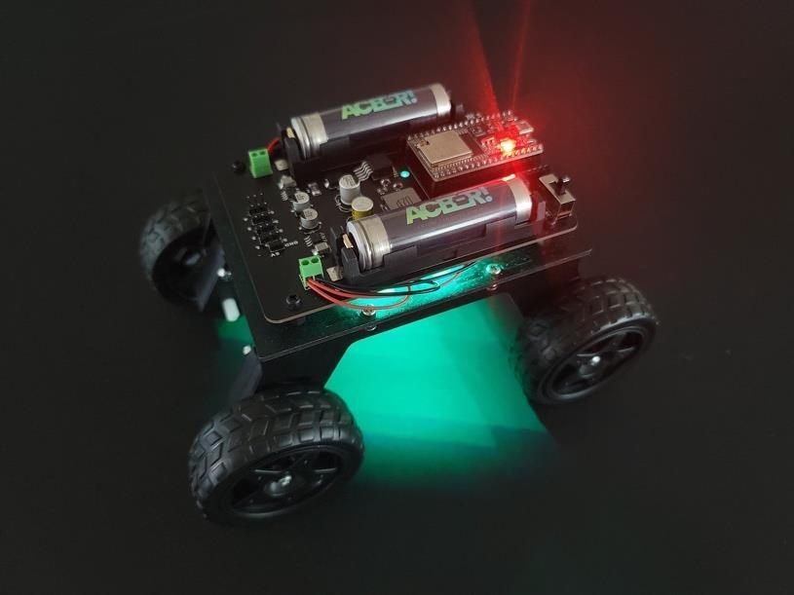
LESSON 3
Color Lab
Every color on a screen is made from just three: red, green and blue. Today you mix your own, and map every light on the vehicle.
PORPOISE ROBOTICS - Precision Oceanographic Program On and In the Sea Environment
porpoiserobotics.org
Kevin Bowen, President - kbowen6@icloud.com
Malcom Graham, VP Education Louis Parker, VP Technology
Valen Farre, System Engineer Gary Howland, Animation
Eddie Revollo, Artificial Intelligence
Interns: Oscar Canazales, Krishnansh Vemulapalli, Soham Gangal, Erik Olsen
One hour. Teams of three, one vehicle per team.
Porpoise Robotics - proprietary. For use with Porpoise Robotics lessons.
Notes:
A dim room helps today. If you can, turn off half the lights for the color lab - colors on the LEDs are much easier to judge.
Have the color prediction page of the Mission Log ready to go. Predicting BEFORE uploading is the whole point of the first activity.

Slide 2
Today's mission
By the end of today, you can:
1. Predict the color you get when red, green and blue light mix
2. Mix any color you like with three numbers from 0 to 255
3. Paint your team color on your vehicle
4. Find any light on the vehicle by its number
Pathfinder Explorers | Lesson 3
2
Notes:
Read them out. Ask who already knows what red and green light make together. Don't tell them yet.

Slide 3
Last time
You uploaded your first program, and fixed three bugs.
setLight(0, RED) turned light 0 red.
But what IS red, to a computer? It's a number. Three numbers, actually.
Switch jobs!
Pathfinder Explorers | Lesson 3
3
Notes:
Ask a Coder from last lesson to explain what setup() and loop() do. Then rotate the jobs.

Slide 4
Today, in order
Time | What we do
0:00 | Warm-up: what IS red, to a computer?
0:05 | Mixing light is not like mixing paint
0:15 | Predict, then upload e03a_color_lab
0:35 | Find every light with e03b_light_map
0:50 | Check yourself, Mission Log, and pack up
Pathfinder Explorers | Lesson 3
4
Notes:
Put the agenda on the board as well, with the driving or uploading block circled. Students settle when they can see when the hands-on part starts.
The timings are a guide for a one-hour session. If the hands-on block runs long, take the time out of the check yourself questions, never out of the pack-up - a rushed pack-up is how cables and controllers go missing.

Slide 5
Mixing light
About 10 minutes
NOW
Mixing light
The color lab
The light map
Pathfinder Explorers | Lesson 3
5
Notes:
A breath between parts of the lesson. Read the title out and point at where it sits on the strip.

Slide 6
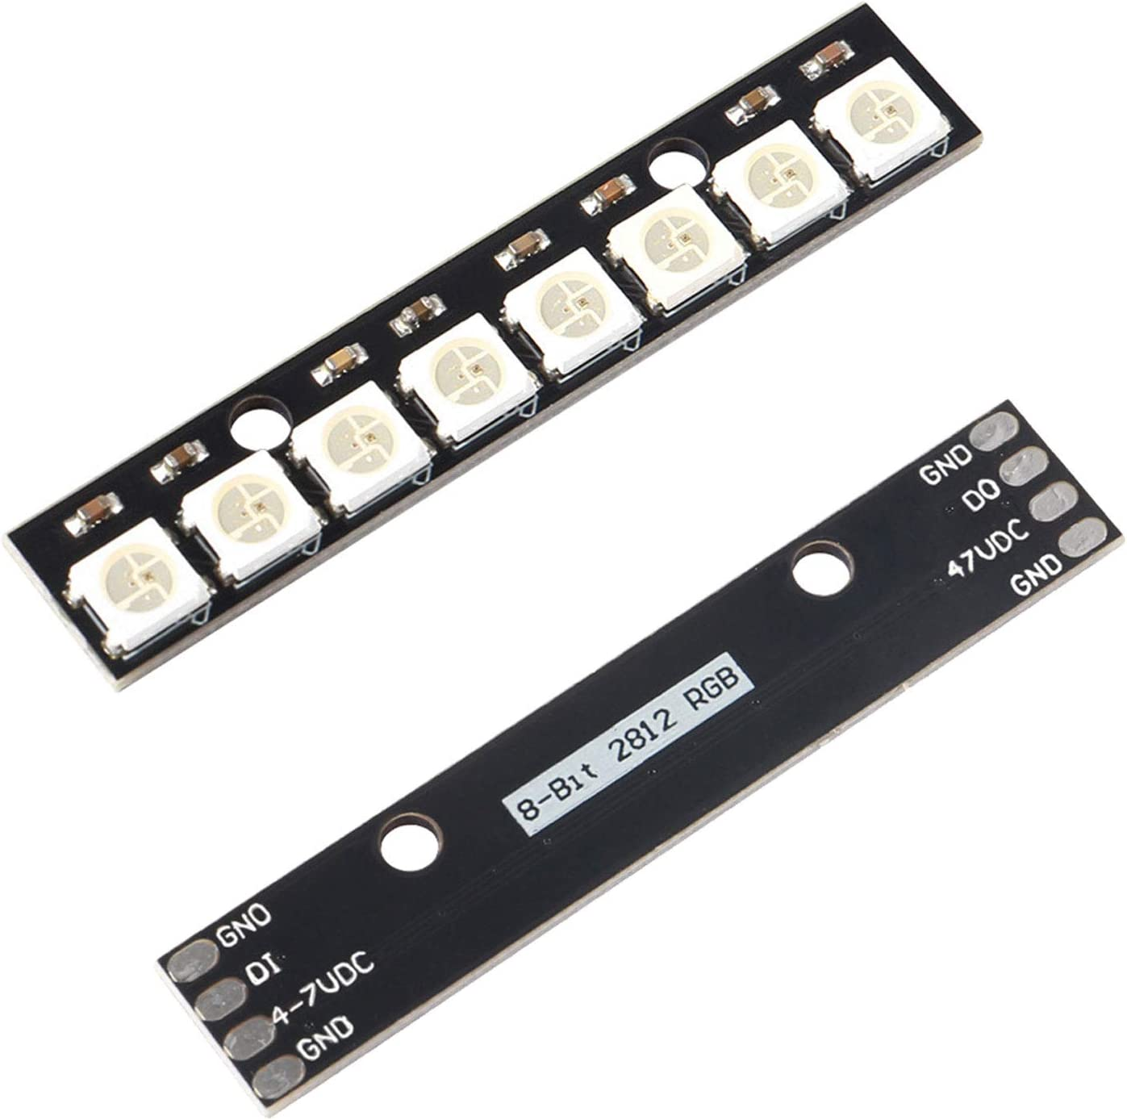
Each light is really THREE lights
Look closely at a light on your vehicle while it's OFF.
Inside are three tiny lights: one red, one green, one blue.
Turn them up and down, and your eye blends them into one color.
Your TV, tablet and phone screens work the same way, with millions of tiny red, green and blue dots.
Eight of these lights on a strip. Yours has 32.
Pathfinder Explorers | Lesson 3
6
Notes:
If you have a magnifying glass, pass it round with a vehicle - switched off - so they can see the three tiny chips inside one light.
A magnifying glass on a phone or tablet screen showing white is an even better demo: they'll see the red, green and blue dots. Kids are amazed by this every time.

Slide 7
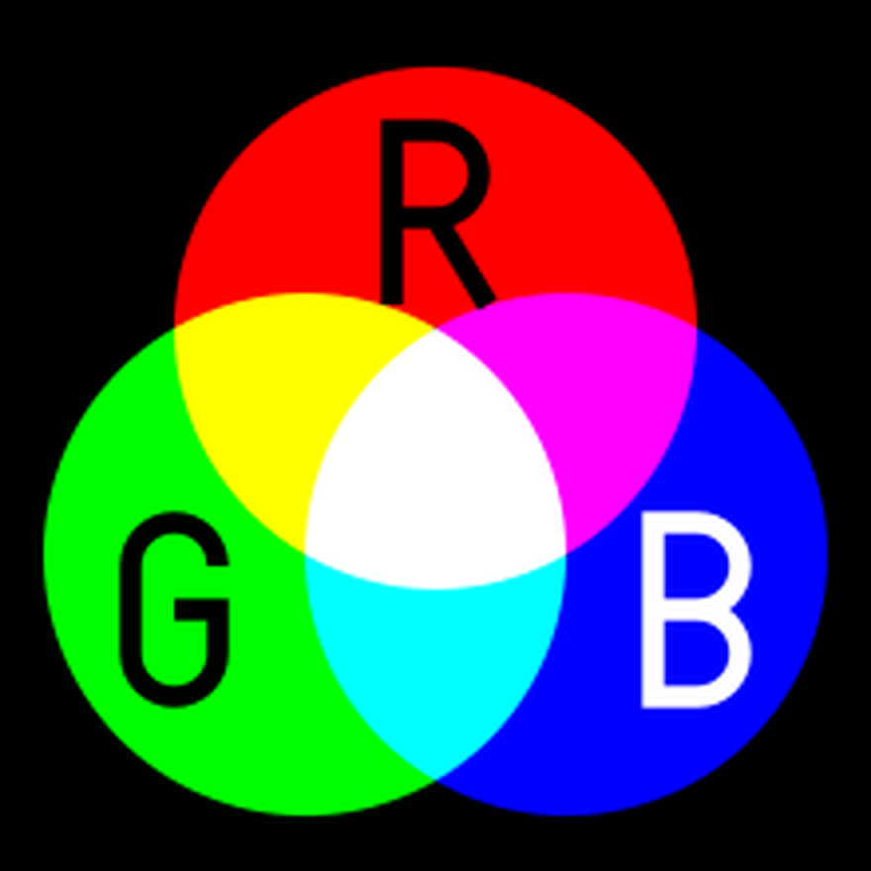
Light doesn't mix like paint
Mix red and green PAINT: you get a muddy brown.
Mix red and green LIGHT: you get YELLOW!
All three lights together make WHITE.
Light ADDS together. That's why it gets brighter as you mix.
Red, green and blue light, overlapping
Pathfinder Explorers | Lesson 3
7
Notes:
Red plus green making yellow is the moment of surprise. Let it land before you explain.
Why it happens, for the curious: your eye has three kinds of color sensor, roughly tuned to red, green and blue. Light that tickles the red and green sensors together looks yellow to your brain, even with no yellow light in it at all.
Paint works the opposite way: each paint SOAKS UP some colors, so mixing paints takes more colors away and gets darker.

Slide 8
mixColor(red, green, blue) - predict!
Each number goes from 0 (none of that color) to 255 (all of it). Write your guesses in your Mission Log.
Red | Green | Blue | You get...
255 | 0 | 0 | red
0 | 0 | 255 | blue
255 | 255 | 0 | ?
0 | 255 | 255 | ?
255 | 0 | 255 | ?
255 | 255 | 255 | ?
Pathfinder Explorers | Lesson 3
8
Notes:
Don't reveal the question marks. They test them on the vehicle in a few minutes.
Answers, for you: yellow, cyan (a light blue-green), magenta (a hot pink-purple), white.
Why 255? Each number is stored in eight bits, which can count from 0 to 255 - that's 256 steps. Only worth saying to older students who ask.

Slide 9
The numbers are volume knobs
Each number turns ONE color up or down.
0 means that color is off. 255 means all the way up.
mixColor(255, 100, 0) = lots of red, a little green, no blue = ORANGE.
Three knobs with 256 steps each makes over 16 million colors!
KEY POINT RED, ORANGE, PURPLE and the other names are just mixes the engine room made for you.
Pathfinder Explorers | Lesson 3
9
Notes:
16 million: 256 x 256 x 256 = 16,777,216. Older students may enjoy checking it on a calculator.
The next slide shows the actual lines in explorer.h where the named colors are mixed.

Slide 10
The named colors are just mixes
explorer.h - the engine room
const Color RED = mixColor(255, 0, 0);
const Color ORANGE = mixColor(255, 90, 0);
const Color YELLOW = mixColor(255, 190, 0);
const Color GREEN = mixColor( 0, 255, 0);
const Color CYAN = mixColor( 0, 255, 255);
const Color BLUE = mixColor( 0, 0, 255);
const Color PURPLE = mixColor(140, 0, 255);
const Color PINK = mixColor(255, 30, 120);
const Color WHITE = mixColor(255, 255, 255);
const Color OFF = mixColor( 0, 0, 0);
These lines are in the explorer.h tab.
Every name is three numbers.
YELLOW isn't (255, 255, 0). On these lights, a bit less green looks MORE yellow.
Pathfinder Explorers | Lesson 3
10
Notes:
Have them click the explorer.h tab and find these lines. It demystifies the engine room a little.
The yellow point is real engineering: the green chip in these lights is very bright, so full green swamps the red and looks lime. Somebody tuned that number by eye.
Remind them: look, but don't change explorer.h.

Slide 11
The color lab
About 20 minutes
done
NOW
Mixing light
The color lab
The light map
Pathfinder Explorers | Lesson 3
11
Notes:
A breath between parts of the lesson. Read the title out and point at where it sits on the strip.

Slide 12
The color lab
e03a_color_lab.ino
Color myColor = mixColor(255, 0, 255); // Red + blue = ?
Color teamColor = mixColor(0, 0, 0); // LEVEL 2
void setup() {
startRover();
setLight(0, mixColor(255, 0, 0)); // Red only
setLight(1, mixColor(0, 255, 0)); // Green only
setLight(2, mixColor(0, 0, 255)); // Blue only
setLight(3, mixColor(255, 255, 0)); // Red + green = ?
setLight(4, mixColor(0, 255, 255)); // Green + blue = ?
setLight(5, mixColor(255, 255, 255)); // All three = ?
setLight(6, myColor);
// setBackLights(teamColor);
}
Pathfinder Explorers | Lesson 3
12
Notes:
Point out that myColor and teamColor are VARIABLES: names that hold a value. Make a color once, give it a name, use the name anywhere.
The // in front of setBackLights turns that line into a comment, so the computer skips it. Removing the // brings it to life. That's how they'll switch things on all course.

Slide 13
The color lab
MISSION: e03a_color_lab (20 minutes)
BEFORE you upload: write your guesses for lights 3, 4, 5 and 6 in your Mission Log.
Upload. Check your guesses. Were you right?
LEVEL 2: mix your TEAM COLOR in teamColor (line 27). Remove the // in front of setBackLights. Upload.
LEVEL 3: paint a flag or a rainbow across the front, lights 0 to 15. Try setLights(0, 4, RED);
What you should see
Seven colors, on lights 0 to 6
Answer these
What did red + green make?
What three numbers make your team color?
SAFETY Look at the lights from the side, not straight into them.
Pathfinder Explorers | Lesson 3
13
Notes:
Hold the line on predictions. A team that uploads first and 'predicts' afterwards has skipped the science.
Common snag: a team color that looks too dark. Light can't make dark colors - (100, 50, 0) just looks like dim orange, not brown. That's a great discovery, not a failure.
Level 3: setLights(first, last, color) paints a run of lights. Three stripes: setLights(0, 4, RED); setLights(5, 10, WHITE); setLights(11, 15, BLUE);

Slide 14
What it looks like
PLACEHOLDER
PHOTO: lights 0 to 6 running e03a_color_lab
Taken in a dim room from the front, so the seven colors are easy to tell apart
Lights 0 to 6, running e03a_color_lab
Pathfinder Explorers | Lesson 3
14
Notes:
Use this to settle arguments about what a color 'really' is - or skip it and let them judge their own vehicles.

Slide 15
Mixing tips
Orange: lots of red, a little green. (255, 90, 0)
Purple: red and blue, more blue. (140, 0, 255)
Pastels: add some of all three. Light pink is (255, 120, 150)
Brown and black are impossible! Lights can only ADD. Dark just looks dim.
Too bright? setBrightness(30) dims every light at once.
Pathfinder Explorers | Lesson 3
15
Notes:
Put this up while teams work, as a help sheet.
setBrightness takes a percent, 0 to 100. The engine room caps 100% well below what the LEDs can do, to protect eyes and the battery.

Slide 16
The light map
About 15 minutes
done
done
NOW
Mixing light
The color lab
The light map
Pathfinder Explorers | Lesson 3
16
Notes:
A breath between parts of the lesson. Read the title out and point at where it sits on the strip.

Slide 17
Every light has a number
FRONT of the vehicle
0
1
2
3
4
5
6
7
8
9
10
11
12
13
14
15
LEFT
One long loop: across the front, then back across the rear
RIGHT
31
30
29
28
27
26
25
24
23
22
21
20
19
18
17
16
BACK of the vehicle
KEY POINT Front: 0 to 15, left to right. Back: 16 to 31, right to left. So the light right behind front light 5 is back light 26.
Pathfinder Explorers | Lesson 3
17
Notes:
Put a vehicle on the desk the same way round as the drawing, front toward the screen, before you say a word.
Counting starts at ZERO. Ask why anybody would start at zero. (Computers do. It is strange the first time and normal by Lesson 4.)
Trace the loop with your finger on the real vehicle: across the front left to right, round the right-hand corner, and back across the rear right to left. It is one long string of lights.
So 0 and 31 are both on the LEFT, and 15 and 16 are both on the RIGHT. Get somebody to point at 31 before you move on.

Slide 18
Map every light
MISSION: e03b_light_map (15 minutes)
Upload e03b_light_map. Open the Serial Monitor.
Watch the vehicle AND the numbers on the screen.
Fill in the light map in your Mission Log.
Where are 0, 15, 16 and 31? Point to each on the vehicle.
Too fast? Make WAIT bigger (line 22).
What you should see
One white light at a time, going all the way round
Answer these
Which two lights are at the LEFT end?
Which back light is right behind front light 5?
Pathfinder Explorers | Lesson 3
18
Notes:
This program uses a for loop to count from 0 to 31. They don't need to understand it yet - it's next lesson's star. Tell them to notice it, and come back to it.
Answers: 0 and 31 are both at the left end. Behind front light 5 is back light 26 (31 minus 5).
The map they draw here gets used for the rest of the course. Check every team's before they pack up.

Slide 19
New words
Word | What it means
RGB | Red, green and blue: the three colors of light
mixColor() | Makes a color from three numbers, 0 to 255
Variable | A name that holds a value, like teamColor
Comment out | Put // in front of a line so the computer skips it
Light map | Where each light number is on the vehicle
Pathfinder Explorers | Lesson 3
19
Notes:
Read each word out and have the room say it back. Saying a word out loud is half of owning it.
These are also in the glossary at the back of the Mission Log.

Slide 20
Check yourself
1. What three colors of light make every color on a screen?
2. Red light + green light = ?
3. What does mixColor(0, 0, 255) make?
4. What number turns a color all the way up?
5. Where is light 16 on your vehicle?
Pathfinder Explorers | Lesson 3
20
Notes:
Answers: 1 red, green, blue. 2 yellow. 3 blue. 4 255. 5 the back, at the right-hand end - right behind light 15.

Slide 21
Mission Log, then pack up
In your Mission Log
Pack up
Check your color predictions - right or wrong?
Write your team color recipe: (red, green, blue)
Finish the light map
Stamp: Color Scientist
Crew Chief: vehicle power OFF.
Unplug the cable and coil it up.
Vehicle and controller back in their spot, stickers matching.
Close the laptop. Push your chairs in.
KEY POINT Last job: every team member says one thing they learned today.
Pathfinder Explorers | Lesson 3
21
Notes:
The light map has to be finished before they leave - Lesson 4 depends on it.
Teams who were wrong about yellow should write that down proudly. Being surprised by an experiment is what science is for.

