Slide 1

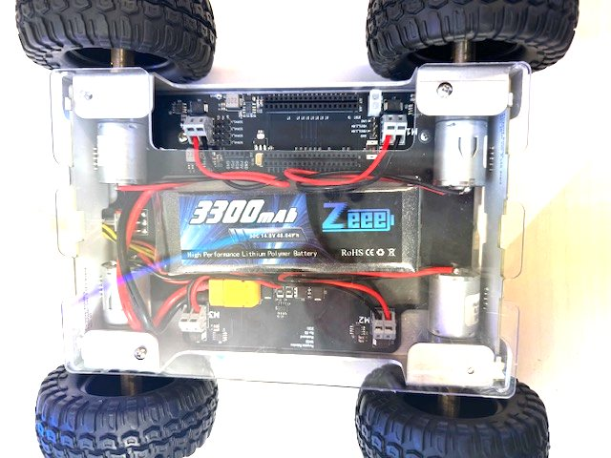
LESSON 5
Make It Move
Motors, magnets, and a vehicle with no steering wheel. Today the wheels turn - with the vehicle safely up on its stand.
PORPOISE ROBOTICS - Precision Oceanographic Program On and In the Sea Environment
porpoiserobotics.org
Kevin Bowen, President - kbowen6@icloud.com
Malcom Graham, VP Education Louis Parker, VP Technology
Valen Farre, System Engineer Gary Howland, Animation
Eddie Revollo, Artificial Intelligence
Interns: Oscar Canazales, Krishnansh Vemulapalli, Soham Gangal, Erik Olsen
One hour. Teams of three, one vehicle per team.
Porpoise Robotics - proprietary. For use with Porpoise Robotics lessons.
Notes:
Check every stand before class. Today is the first lesson where code moves the wheels, and a vehicle that walks off a block is the accident you're preventing.
For the Human Tank: a pool noodle or a meter stick per demonstration pair.

Slide 2
Today's mission
By the end of today, you can:
1. Say how an electric motor turns electricity into spinning
2. Explain how a motor goes forward, backward, and half speed
3. Explain how a vehicle with no steering wheel can turn
4. Make the wheels move from your own code - safely, wheels up
Pathfinder Explorers | Lesson 5
2
Notes:
Read them out, then go straight to the safety slide.

Slide 3
Today the wheels MOVE
WHEELS UP: the vehicle stays on its stand the whole lesson.
Crew Chief: keep a finger near the power switch.
Hair tied back. Sleeves pushed up. Cables away from the wheels.
Switch jobs! Make sure today's Crew Chief knows the power switch.
SAFETY Wheels moving when you didn't expect it? Crew Chief: power OFF. Then figure it out.
Pathfinder Explorers | Lesson 5
3
Notes:
Do a quick drill: 'Crew Chiefs, hands on power switches... now OFF... now hands in the air.' Twice. It's the reflex you want later.

Slide 4
Today, in order
Time | What we do
0:00 | Warm-up, and the wheels-up rule
0:05 | What is inside a motor
0:12 | Pedal and coast: how a motor goes half speed
0:20 | The Human Tank
0:30 | Upload e05a_motor_lab - wheels up!
0:52 | Mission Log and pack up
Pathfinder Explorers | Lesson 5
4
Notes:
Put the agenda on the board as well, with the driving or uploading block circled. Students settle when they can see when the hands-on part starts.
The timings are a guide for a one-hour session. If the hands-on block runs long, take the time out of the check yourself questions, never out of the pack-up - a rushed pack-up is how cables and controllers go missing.

Slide 5
How motors work
About 5 minutes
NOW
How motors work
Speed
Tank steering
Motor lab
Pathfinder Explorers | Lesson 5
5
Notes:
A breath between parts of the lesson. Read the title out and point at where it sits on the strip.

Slide 6
What's inside a motor
An electric motor is full of MAGNETS.
Electricity flowing through coils of wire turns them into magnets too.
Magnets push and pull on each other - and that push makes the motor spin.
Your vehicle has FOUR motors, one for each wheel.
KEY POINT The same idea spins fans, drills, electric cars, and the buzzer in your controller.
Pathfinder Explorers | Lesson 5
6
Notes:
If you have two fridge magnets, show push and pull. That's the whole idea of a motor.
The 'buzzer in your controller' is the rumble: a tiny motor spinning a lopsided weight. They'll use it in Lesson 8.

Slide 7
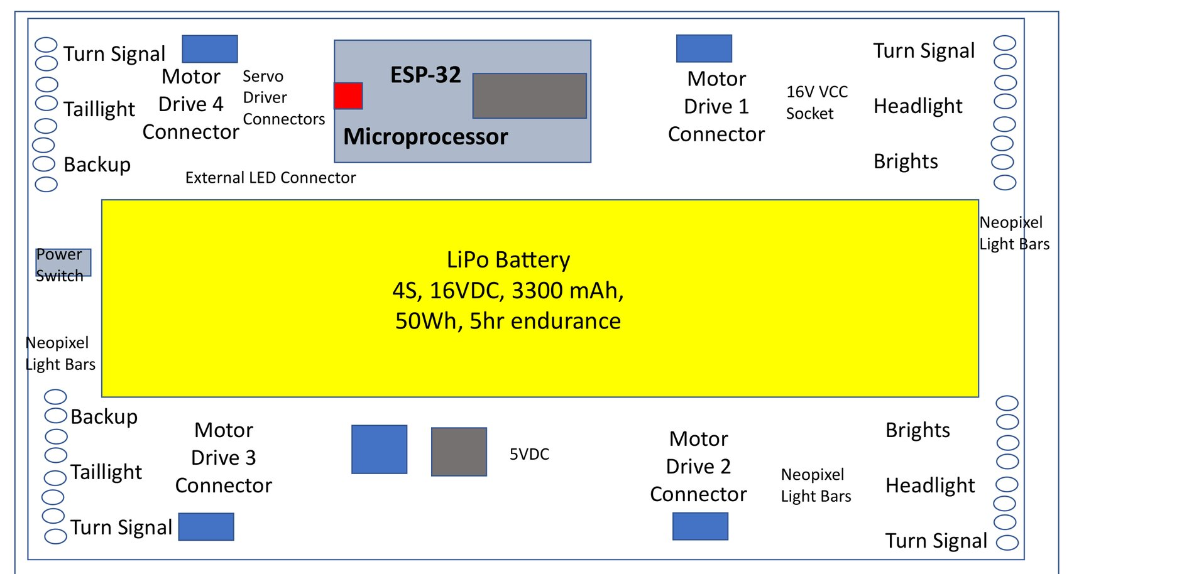
Forward and backward
Electricity one way: the motor spins forward. The OTHER way: backward.
A chip called the MOTOR DRIVER is the traffic cop that picks the way. Your program tells it what to do.
The control board from above. Each motor has its own driver.
Pathfinder Explorers | Lesson 5
7
Notes:
Don't go into how the driver works inside. 'It sends the electricity one way or the other, and your program tells it which' is the right depth for this age.
For any older student who wants more: the chip is called an H-bridge, because the four switches inside it are drawn in the shape of the letter H. The Beginner course covers it.

Slide 8
Speed
About 10 minutes
done
NOW
How motors work
Speed
Tank steering
Motor lab
Pathfinder Explorers | Lesson 5
8
Notes:
A breath between parts of the lesson. Read the title out and point at where it sits on the strip.

Slide 9
How a motor goes half speed
The motor driver flips the power ON and OFF 20,000 times every second.
ON = pedal
OFF = coast
25% slow
50% medium
100% fast
KEY POINT Your speed number picks how much of each flip is ON. More ON means faster wheels.
Pathfinder Explorers | Lesson 5
9
Notes:
The bike story: pedal hard for a moment, then coast, then pedal again. Pedal most of the time and you go fast. Pedal a little and you go slow.
The motor driver does the same thing with electricity, but thousands of times a second - far too fast to see or hear. That's why the motor just seems to run smoothly at a lower speed.
Ask: which row would make the wheels go fastest? Which would make them barely move? Then: what would 0% look like? (All coasting. Stopped.)
Older students may want the real name: Pulse Width Modulation, or PWM. Give it to them, but don't test on it.

Slide 10
Speeds in your programs
drive(leftSpeed, rightSpeed)
Speeds go from -100 to 100.
  100 is top speed forward. 50 is half. 0 is stop.
  -100 is top speed BACKWARD.
Minus means backward - like a temperature below zero.
SPEED_LIMIT decides how fast "top speed" really is.
Pathfinder Explorers | Lesson 5
10
Notes:
Negative numbers aren't taught in school until about sixth grade, so don't assume the younger ones know them. A thermometer, or a number line on the board with 0 in the middle, is all it takes.
With the Learner limit of 50, drive(100, 100) is half of the motors' full power, and drive(50, 50) is a quarter.

Slide 11
Tank steering
About 10 minutes
done
done
NOW
How motors work
Speed
Tank steering
Motor lab
Pathfinder Explorers | Lesson 5
11
Notes:
A breath between parts of the lesson. Read the title out and point at where it sits on the strip.

Slide 12
The Human Tank
UNPLUGGED: Two volunteers and a pool noodle (10 minutes)
Two volunteers stand side by side, holding a pool noodle between them.
The LEFT person is the left wheels. The RIGHT person is the right wheels.
Both step forward together: STRAIGHT.
Left steps forward, right stands still: which way do you turn?
Left steps forward, right steps BACKWARD: SPIN!
Class: shout out drive(left, right) for the tank to act out.
What you should see
Turning toward the side that moves less
Answer these
To turn RIGHT, which side has to go faster?
How do you spin on the spot?
SAFETY Small, slow steps. The tank never runs.
Pathfinder Explorers | Lesson 5
12
Notes:
Facing the class is confusing for left and right. Have the tank face the same way as the class, back to the room.
Answers: to turn right, the LEFT side goes faster. To spin, the two sides go opposite ways.
Good class shouts to try: drive(50, 50), drive(50, 0), drive(0, 50), drive(50, -50), drive(-50, -50).

Slide 13
No steering wheel: it turns like a tank
Straight
Curve right
Spin right
Backward
front
front
front
front
drive(50, 50)
drive(50, 20)
drive(50, -50)
drive(-50, -50)
goes straight
curves to the right
spins on the spot
backs up
KEY POINT drive(leftSpeed, rightSpeed). Make one side faster than the other and the vehicle turns toward the SLOWER side.
Pathfinder Explorers | Lesson 5
13
Notes:
Look under a vehicle together first: the front wheels can't turn left or right. So how does it steer?
Each arrow shows which way that SIDE'S wheels are pushing, and a longer arrow means faster.
Spin right is the one that surprises people: the left side goes forward and the right side goes BACKWARD, and the vehicle turns on the spot like a figure skater.
Tie it straight back to the Human Tank game they just played.

Slide 14
Motor lab
About 20 minutes
done
done
done
NOW
How motors work
Speed
Tank steering
Motor lab
Pathfinder Explorers | Lesson 5
14
Notes:
A breath between parts of the lesson. Read the title out and point at where it sits on the strip.

Slide 15
The motor lab
e05a_motor_lab.ino (the first three steps)
void loop() {
Serial.println("Left side forward");
drive(50, 0);
delay(2000);
Serial.println("Right side forward");
drive(0, 50);
delay(2000);
Serial.println("Both sides forward");
drive(50, 50);
delay(2000);
Each step: say what's happening, set the wheels, wait.
drive() keeps the wheels going until you change them.
PREDICT before each step!
Pathfinder Explorers | Lesson 5
15
Notes:
Important idea: drive() doesn't run the wheels FOR a time. It sets them and they keep going until the next drive(). The delay() is what decides how long each step lasts.

Slide 16
Motor lab
MISSION: e05a_motor_lab (22 minutes)
Crew Chief: vehicle on its stand, all four wheels in the air. Check!
Upload. Watch the countdown on the lights. Then the wheels move!
LEVEL 1: before each step, PREDICT which wheels turn, and which way.
LEVEL 2: find the WAKE-UP SPEED. Change drive(50, 0) (line 39) to 30, then 20, then 10.
LEVEL 3: write a WHEEL DANCE: change loop() into your own routine.
What you should see
Left wheels, right wheels, both, backward, a spin, then a rest
Answer these
Which step is a spin? Why?
What's your wake-up speed?
SAFETY WHEELS UP the whole lesson. If the vehicle creeps on its stand, Crew Chief: power OFF.
Pathfinder Explorers | Lesson 5
16
Notes:
Walk the room and look at stands, not screens. A wheel touching the table will walk the vehicle off the edge.
The wake-up speed varies by vehicle and battery charge. Collect every team's number on the board - the spread is a nice lead-in to 'no two vehicles are the same' next lesson.
Level 3 dances: encourage a wiggle (drive(40, -40) then drive(-40, 40), short delays) and a 'drum roll' (both sides forward and back quickly).

Slide 17
Why is there a wake-up speed?
A motor needs a big enough push to get started - like you getting out of bed!
Tiny speeds can't beat the friction in the gears and the wheels.
On the floor it's even higher: now the motor has to move the whole vehicle.
KEY POINT Engineers call this STARTING FRICTION. Every motor has it.
Pathfinder Explorers | Lesson 5
17
Notes:
Ask: once the wheel is turning, could it keep turning at an even lower speed? (Usually yes. Starting is harder than keeping going - a good thing to test if a team finishes early.)

Slide 18
New words
Word | What it means
Motor | Turns electricity into spinning
Magnet | Pushes or pulls on other magnets
Motor driver | The chip that sends electricity to the motor, one way or the other
Tank steering | Turning by running one side faster than the other
Negative number | Less than zero. Here, minus means backward.
Pathfinder Explorers | Lesson 5
18
Notes:
Read each word out and have the room say it back. Saying a word out loud is half of owning it.
These are also in the glossary at the back of the Mission Log.

Slide 19
Check yourself
1. What's inside a motor that makes it spin?
2. How do you make a motor spin backward?
3. What does drive(50, -50) do?
4. To curve RIGHT, which side goes faster?
5. Why must the wheels be up today?
Pathfinder Explorers | Lesson 5
19
Notes:
Answers: 1 magnets. 2 send the electricity the other way - in code, a minus speed. 3 spins right on the spot. 4 the left. 5 the program moves the wheels as soon as it starts, and a vehicle on a table can drive off it.

Slide 20
Mission Log, then pack up
In your Mission Log
Pack up
Write your wake-up speed
Draw or write your wheel dance
Stamp: Motor Mechanic
Crew Chief: vehicle power OFF.
Unplug the cable and coil it up.
Vehicle and controller back in their spot, stickers matching.
Close the laptop. Push your chairs in.
KEY POINT Last job: every team member says one thing they learned today.
Pathfinder Explorers | Lesson 5
20
Notes:
Next lesson is on the FLOOR. Check the floor space you'll use and tape the squares beforehand.

