Slide 1

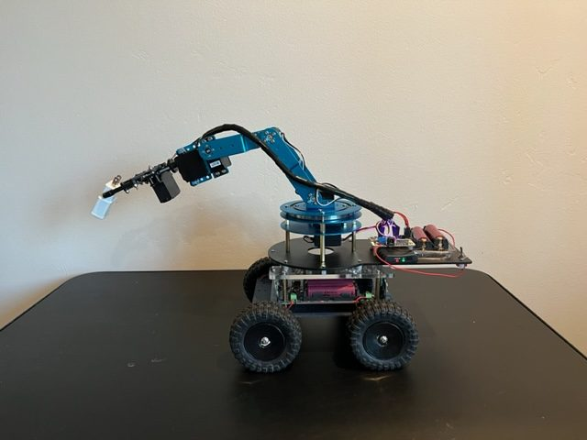
LESSON 11
Design Challenge
You can make it light up, move, listen and signal. Now upgrade it with your team's own idea, built the way engineers build things.
PORPOISE ROBOTICS - Precision Oceanographic Program On and In the Sea Environment
porpoiserobotics.org
Kevin Bowen, President - kbowen6@icloud.com
Malcom Graham, VP Education Louis Parker, VP Technology
Valen Farre, System Engineer Gary Howland, Animation
Eddie Revollo, Artificial Intelligence
Interns: Oscar Canazales, Krishnansh Vemulapalli, Soham Gangal, Erik Olsen
One hour. Teams of three, one vehicle per team.
Porpoise Robotics - proprietary. For use with Porpoise Robotics lessons.
Notes:
Today is the most open lesson of the course, and the noisiest. Spend your time on the teams that are stuck, not the ones that are flying.
Make sure every team saves its own copy of e11a with File > Save As, so Mission Day starts from their work, not from a fresh copy.

Slide 2
Today's mission
By the end of today, you can:
1. Use the engineering design process: ask, imagine, plan, create, test, improve
2. Plan a change to a program on paper, before typing it
3. Build and test an upgrade one small step at a time
4. Show your upgrade, and explain how it works
Pathfinder Explorers | Lesson 11
2
Notes:
Read them out, and say plainly that the upgrade working perfectly is NOT the goal - using the process is.

Slide 3
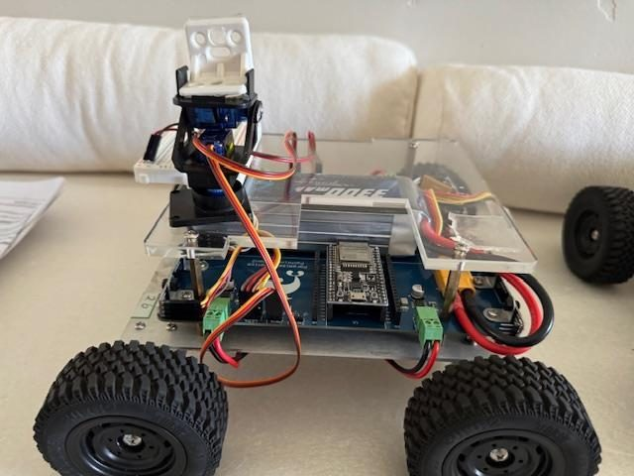
Engineers upgrade their rovers
These Pathfinders got new hardware. Today you upgrade the SOFTWARE - no new parts needed.
A robot arm, for picking things up
A mount that can point a camera around
Pathfinder Explorers | Lesson 11
3
Notes:
Both upgrades use the vehicle's servo outputs, which this course hasn't touched. Students who catch the bug can go on to the Beginner course, which does.

Slide 4
Today, in order
Time | What we do
0:00 | Warm-up: upgrades real engineers make
0:05 | The design process, and picking an upgrade
0:13 | Plan it on paper
0:20 | Build it, test it, improve it
0:48 | Show and tell, Mission Log, and pack up
Pathfinder Explorers | Lesson 11
4
Notes:
Put the agenda on the board as well, with the driving or uploading block circled. Students settle when they can see when the hands-on part starts.
The timings are a guide for a one-hour session. If the hands-on block runs long, take the time out of the check yourself questions, never out of the pack-up - a rushed pack-up is how cables and controllers go missing.

Slide 5
Ask and imagine
About 10 minutes
NOW
Ask and imagine
Plan
Create and test
Pathfinder Explorers | Lesson 11
5
Notes:
A breath between parts of the lesson. Read the title out and point at where it sits on the strip.

Slide 6
How engineers build things
1 ASK
What should it do?
6 IMPROVE
Fix ONE thing
2 IMAGINE
Lots of ideas
Go round as many
times as you need
5 TEST
Wheels up first!
3 PLAN
Draw it, write it
4 CREATE
Write the code
Pathfinder Explorers | Lesson 11
6
Notes:
This is the engineering design process. Different companies draw it with five, six or seven steps; the steps matter less than the shape. It's a CIRCLE.
Ask where most people want to jump straight to. (CREATE - typing the code.) Ask what goes wrong when you skip PLAN. (You build the wrong thing, fast.)
And the most important arrow is the one from IMPROVE back round to ASK. Nobody gets it right first time - not NASA, not you, not me.

Slide 7
Pick your upgrade
Upgrade | What it does | How hard?
Team light show | Your own pattern when the rover wakes up | Easy
Headlight flash | Hold A: headlights flash bright white | Easy
Party mode | Tap X: rainbow lights on and off | Medium
Hazard lights | Tap B: BOTH sides blink, like a stopped car | Medium
Crawl mode | Hold ZL: half speed, for careful parking | Medium
Victory dance | A button runs an autopilot dance | Hard
Your own idea | Check it with your teacher first | You decide!
Pathfinder Explorers | Lesson 11
7
Notes:
Steer younger or less confident teams toward Easy or Medium. A finished Easy upgrade beats a half-built Hard one.
Your own idea: say yes to almost anything that only changes lights, buttons and moves. Say no to anything that raises the speed limit past the team's license.

Slide 8
Plan
About 5 minutes
done
NOW
Ask and imagine
Plan
Create and test
Pathfinder Explorers | Lesson 11
8
Notes:
A breath between parts of the lesson. Read the title out and point at where it sits on the strip.

Slide 9
Plan before you type
In your Mission Log design sheet:
  Which button? Held, or tapped?
  What should happen? Draw it!
  Which UPGRADE ZONES will you change?
  How will you TEST that it works?
Show your plan to your teacher before you start typing.
KEY POINT Teams that plan finish faster. Really.
Pathfinder Explorers | Lesson 11
9
Notes:
Make the plan check a real gate: a team can't start typing until you've looked at their sheet for thirty seconds. It's the single best way to stop teams wandering.

Slide 10
Where to build
e11a_my_upgrade.ino
// ===== BUTTONS =====
if (tappedY()) {
headlightsOn = !headlightsOn;
}
// ===== UPGRADE ZONE 2 =====
// if (tappedX()) {
// partyMode = !partyMode;
// }
Zone 1, at the top: your true/false switches.
Zone 2, here: your buttons.
Zone 3, at the bottom: your lights.
The examples are already written. Remove the // to use them.
Pathfinder Explorers | Lesson 11
10
Notes:
Party mode is fully sketched in the comments across the three zones, so a team that wants a quick win can un-comment it and then make it their own.

Slide 11
Building blocks you already know
To remember ON or OFF
Handy tools
Zone 1: bool partyMode = false;
Zone 2: if (tappedX()) {
  partyMode = !partyMode;
}
Zone 3: if (partyMode) { ... }
blinkIsOn() - blinking
rainbowColor(number * 3) - a rainbow
randomColor() - surprise colors
rumble(200) - a buzz
forward(), spinLeft() - autopilot moves
Pathfinder Explorers | Lesson 11
11
Notes:
This is the pattern behind most upgrades: a true/false switch, a button that flips it, and an if that does something while it's on.

Slide 12
Create and test
About 30 minutes
done
done
NOW
Ask and imagine
Plan
Create and test
Pathfinder Explorers | Lesson 11
12
Notes:
A breath between parts of the lesson. Read the title out and point at where it sits on the strip.

Slide 13
Build your upgrade
MISSION: e11a_my_upgrade (28 minutes)
Open e11a_my_upgrade. File > Save As, with your team name.
Build ONE small piece. Upload. Test it, wheels up.
Works? Build the next piece. Doesn't? Fix it before adding more.
Write each test in your Mission Log.
Finished? Add a second upgrade, or help another team.
What you should see
Your upgrade working, one piece at a time
Answer these
What was the first thing that didn't work?
How did you find out why?
SAFETY Dances and autopilot moves: floor only, inside the arena, everybody behind the line.
Pathfinder Explorers | Lesson 11
13
Notes:
Hazard lights, for you: bool hazards = false; in Zone 1; if (tappedB()) { hazards = !hazards; } in Zone 2; in Zone 3: if (hazards && blinkIsOn()) { setLeftLights(ORANGE); setRightLights(ORANGE); }
Crawl mode: in the DRIVING section, after the wobble zone: if (buttonZL()) { forward = forward / 2; turn = turn / 2; } - e12a_mission_day has exactly this.
Victory dance: write a function at the bottom with spins and light flashes, and call it from if (tappedX()) in Zone 2. Holding B stops any autopilot move.

Slide 14
Stuck? Try these
Click Verify. Read the FIRST error message, and its line number.
Count your braces. Every { needs a }.
Is it running the program you think? Check the tab name.
Add Serial.println("got here"); to see if a part of your code runs.
Explain your code, line by line, to a teammate. Or to a rubber duck!
Pathfinder Explorers | Lesson 11
14
Notes:
Rubber duck debugging is a real thing professional programmers do: explaining your code out loud, even to a toy, very often makes the bug jump out. If you have a duck, put it on the desk.

Slide 15
Show and tell
Every team gets one minute:
  What does your upgrade do? Show it!
  What went wrong, and how did you fix it?
  What would you add next?
Pathfinder Explorers | Lesson 11
15
Notes:
Clap for every team, working upgrade or not. The second question is the one to praise most - fixing something is the skill.

Slide 16
Check yourself
1. Name the six steps of the design process.
2. Why test after every small change?
3. What does the ! do in partyMode = !partyMode; ?
4. Name one way to find a bug.
Pathfinder Explorers | Lesson 11
16
Notes:
Answers: 1 ask, imagine, plan, create, test, improve. 2 so when something breaks you know which change did it. 3 flips it to the opposite - true becomes false, false becomes true. 4 any of the 'stuck' slide.

Slide 17
Mission Log, then pack up
In your Mission Log
Pack up
Finish your design sheet and test log
Write one thing you'd improve next
Stamp: Design Engineer
Crew Chief: vehicle power OFF.
Unplug the cable and coil it up.
Vehicle and controller back in their spot, stickers matching.
Close the laptop. Push your chairs in.
KEY POINT Last job: every team member says one thing they learned today.
Pathfinder Explorers | Lesson 11
17
Notes:
Next lesson is Mission Day. Charge every battery, and check every team's upgrade still drives safely.

