Slide 1

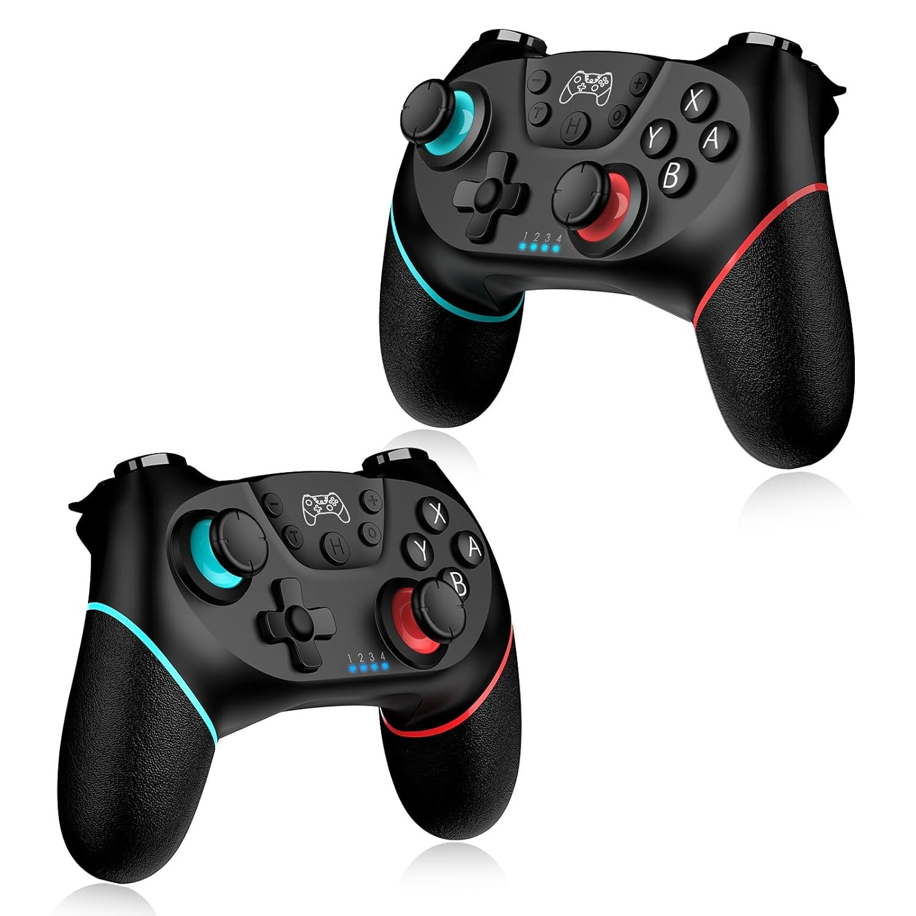
LESSON 8
Wireless Control
Your controller talks to the vehicle by radio. Today you decide what every button does.
PORPOISE ROBOTICS - Precision Oceanographic Program On and In the Sea Environment
porpoiserobotics.org
Kevin Bowen, President - kbowen6@icloud.com
Malcom Graham, VP Education Louis Parker, VP Technology
Valen Farre, System Engineer Gary Howland, Animation
Eddie Revollo, Artificial Intelligence
Interns: Oscar Canazales, Krishnansh Vemulapalli, Soham Gangal, Erik Olsen
One hour. Teams of three, one vehicle per team.
Porpoise Robotics - proprietary. For use with Porpoise Robotics lessons.
Notes:
Charge every controller before class. A flat controller looks exactly like a broken program.
Make sure each team has its OWN controller - check the stickers as they come in.

Slide 2
Today's mission
By the end of today, you can:
1. Explain how the controller talks to the vehicle
2. Use if and else to make the vehicle choose what to do
3. Tell the difference between HOLDING a button and TAPPING it
4. Make the controller's buttons do things you chose
Pathfinder Explorers | Lesson 8
2
Notes:
Read them out. Ask: which button on a game controller do you press the most?

Slide 3
Last time
Your rover followed a plan on autopilot.
It couldn't see the crater. It couldn't change its mind.
Today the human is back in control - with the controller.
But YOU decide what each button does.
Switch jobs!
Pathfinder Explorers | Lesson 8
3
Notes:
Quick show of hands: which team got home from the sample zone last lesson?

Slide 4
Today, in order
Time | What we do
0:00 | Warm-up: what was hard about autopilot?
0:05 | Radio, and one controller per vehicle
0:12 | Simon Says, if/else edition
0:20 | if and else, held and tapped
0:28 | Upload e08a_button_lab and make the buttons yours
0:52 | Mission Log and pack up
Pathfinder Explorers | Lesson 8
4
Notes:
Put the agenda on the board as well, with the driving or uploading block circled. Students settle when they can see when the hands-on part starts.
The timings are a guide for a one-hour session. If the hands-on block runs long, take the time out of the check yourself questions, never out of the pack-up - a rushed pack-up is how cables and controllers go missing.

Slide 5
Radio links
About 5 minutes
NOW
Radio links
Choices
Button lab
Pathfinder Explorers | Lesson 8
5
Notes:
A breath between parts of the lesson. Read the title out and point at where it sits on the strip.

Slide 6
An invisible link
The controller and the vehicle talk by RADIO - a kind called Bluetooth.
It's the same kind of radio that wireless earbuds use.
Every controller has its own address, like a house number.
Your vehicle only listens to ONE address: its own controller's. That's why the stickers match.
PLACEHOLDER
PHOTO: a vehicle and its controller with matching number stickers
Both stickers in the same shot, close enough to read the number
Same number, same team
Pathfinder Explorers | Lesson 8
6
Notes:
Radio is invisible light, more or less - it goes through walls and bodies, which is why the controller works from anywhere in the room.
Your teacher told each vehicle its controller's address before Lesson 1, and the vehicle stores it in its memory. Uploading new programs doesn't erase it. (For you: that was e00_claim_controller.)

Slide 7
Your controller, and the name of every button
L and ZL
buttonL() buttonZL()
R and ZR
buttonR() buttonZR()
ZL
ZR
L
R
LEFT STICK: drive
leftStickX()
leftStickY()
X
X Y A B
buttonA() tappedA()
...and the same for B, X, Y
Y
A
B
D-PAD
dpadUp() dpadDown()
dpadLeft() dpadRight()
RIGHT STICK
rightStickX()
rightStickY()
KEY POINT The letter PRINTED on the button is the letter in the code. Press A, and buttonA() is true.
Pathfinder Explorers | Lesson 8
7
Notes:
Hold up a real controller next to the screen and match the two, button by button.
The letter printed on the button is the letter in the code. Press A, and buttonA() is true. That's the whole rule.
B is the brake button in the autopilot programs later on - B for Brake. Worth saying now so it sticks.
If a controller from a different company has its letters in different places, trust the e00 test your teacher ran: it printed the name of each button as it was pressed.

Slide 8
Choices
About 15 minutes
done
NOW
Radio links
Choices
Button lab
Pathfinder Explorers | Lesson 8
8
Notes:
A breath between parts of the lesson. Read the title out and point at where it sits on the strip.

Slide 9
Simon Says, if/else edition
UNPLUGGED: Everybody stands up (8 minutes)
The teacher is the program. You are the robots.
RULE 1: IF the teacher's hand is UP, clap. ELSE, stay still.
RULE 2: the WHOLE TIME the teacher holds a hand up, keep waving.
RULE 3: when the teacher TAPS their head, jump ONCE - no matter how long the hand stays there.
Mix them up, and speed up!
What you should see
Clapping, waving and jumping at the right moments
Answer these
What's the difference between rule 2 and rule 3?
SAFETY Jump on the spot. Give your neighbors room.
Pathfinder Explorers | Lesson 8
9
Notes:
Rule 1 is if/else. Rule 2 is a HELD button: true the whole time. Rule 3 is a TAPPED button: true only at the moment it starts. Name them that way after the game.
The fun part of rule 3 is leaving your hand on your head for a long time. Anyone who jumps twice was reading it as 'held'.

Slide 10
if and else: the rover makes a choice
Is A held
down?
if (buttonA()) {
setFrontLights(GREEN);
} else {
setFrontLights(OFF);
}
YES
NO
front lights
GREEN
front lights
OFF
if means: when this is true...
else means: otherwise...
...then loop() starts again, and asks again.
Pathfinder Explorers | Lesson 8
10
Notes:
Trace one trip through with your finger: start at the diamond, answer the question, follow YES or NO, do the job.
Then say the important part: as soon as it finishes, loop() starts again and asks the question AGAIN - thousands of times every second. That's why the lights change the instant you let go.
Match the drawing to the code on the right, line by line. The diamond is the if, the YES box is the first pair of braces, and the NO box is the else.

Slide 11
Held, or tapped?
buttonA()
tappedA()
TRUE the whole time you hold A
Use it for:
  lights that stay on while you hold
  a horn, or a headlight flash
TRUE once, the moment you press A
Use it for:
  switching something ON and OFF
  counting presses
KEY POINT loop() runs thousands of times a second. Holding a button for one second is thousands of loops!
Pathfinder Explorers | Lesson 8
11
Notes:
That note is why tapped exists. A light switch that flipped on EVERY loop while you held it would flicker on and off thousands of times.
The engine room works out 'tapped' by remembering what the button was doing last time round loop(). If it's down now and was up last time, that's a tap.

Slide 12
The button lab
e08a_button_lab.ino
void loop() {
if (controllerReady() == false) {
return; // No controller yet
}
if (buttonA()) {
setFrontLights(GREEN); // A held
} else {
setFrontLights(OFF); // A not held
}
if (tappedX()) {
rumble(200); // One buzz
}
The first if: no controller yet? Stop here and try again next loop.
return means: skip the rest of loop() this time.
Then A, with an else. Then X, with no else.
Pathfinder Explorers | Lesson 8
12
Notes:
controllerReady() also stops the motors and blinks the lights green while it waits. Every driving program from now on starts with these three lines.
An if doesn't NEED an else. Ask why the X part has none. (There's nothing to do when X isn't tapped.)

Slide 13
Button lab
About 25 minutes
done
done
NOW
Radio links
Choices
Button lab
Pathfinder Explorers | Lesson 8
13
Notes:
A breath between parts of the lesson. Read the title out and point at where it sits on the strip.

Slide 14
Button lab
MISSION: e08a_button_lab (24 minutes)
Upload, wheels up. The lights blink GREEN until the controller connects.
Press a button on YOUR controller to connect.
LEVEL 1: try every button. Then change the colors.
LEVEL 2: change tappedY() to buttonY() (line 56). HOLD Y and watch the Serial Monitor. Change it back.
LEVEL 3: make dpadLeft() and dpadRight() light up one side. Then invent a SECRET COMBO.
What you should see
Green front while A is held, red back while B is held, a buzz for each X tap
Answer these
Why did holding Y with buttonY() print so many lines?
What's your secret combo?
Pathfinder Explorers | Lesson 8
14
Notes:
This program never moves the wheels, but wheels-up stays the rule - it's a habit, not a case-by-case decision.
Level 2 answer: buttonY() is true on every loop while Y is held, so it prints thousands of times. tappedY() prints once.
Level 3 for the D-pad: if (dpadLeft()) { setLeftLights(ORANGE); } - and the same for the right. Some third-party controllers don't rumble at all; if X does nothing, that's the controller, not the code.

Slide 15
Secret combos
Two ampersands && mean AND.
  if (buttonA() && buttonB()) { ... }
  Only TRUE when A AND B are BOTH held down.
Two lines || mean OR.
  if (dpadLeft() || dpadRight()) { ... }
  TRUE when either one is pressed.
Put your combo at the END of loop(). Whatever lights you set LAST are the ones that show.
Pathfinder Explorers | Lesson 8
15
Notes:
The || key is above Enter on most keyboards, with Shift. Expect to show several people.
Last-one-wins is a useful idea for the rest of the course: the lights shown are whatever the program set by the end of each loop.
Combo ideas: A+B = all lights white, L+R = rainbow party (setLight(number, randomColor()) in a for loop).

Slide 16
New words
Word | What it means
Radio | Invisible waves that carry messages through the air
Bluetooth | The kind of radio your controller uses
if / else | Do this if it's true... otherwise do that
Held | buttonA(): true the whole time it's down
Tapped | tappedA(): true once, the moment you press
&& and || | AND, and OR
Pathfinder Explorers | Lesson 8
16
Notes:
Read each word out and have the room say it back. Saying a word out loud is half of owning it.
These are also in the glossary at the back of the Mission Log.

Slide 17
Check yourself
1. How does the controller talk to the vehicle?
2. Why doesn't your vehicle obey another team's controller?
3. What does else mean?
4. To switch lights on and off with X, use buttonX() or tappedX()? Why?
5. What does && mean?
Pathfinder Explorers | Lesson 8
17
Notes:
Answers: 1 radio (Bluetooth). 2 it only listens to its own controller's address. 3 otherwise. 4 tappedX(), so it flips once per press instead of thousands of times. 5 AND.

Slide 18
Mission Log, then pack up
In your Mission Log
Pack up
Fill in the button plan: what does each button do?
Write your secret combo
Stamp: Radio Operator
Crew Chief: vehicle power OFF.
Unplug the cable and coil it up.
Vehicle and controller back in their spot, stickers matching.
Close the laptop. Push your chairs in.
KEY POINT Last job: every team member says one thing they learned today.
Pathfinder Explorers | Lesson 8
18
Notes:
Next lesson: the stick, and the driving test. Tell them to practice their best driving.

