Slide 1

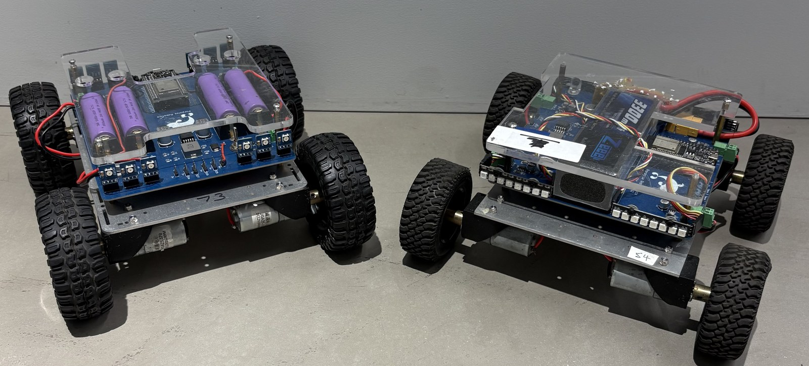
LESSON 9
Joystick Driving
The stick sends numbers. Today your code turns them into driving - and you take your driving test.
PORPOISE ROBOTICS - Precision Oceanographic Program On and In the Sea Environment
porpoiserobotics.org
Kevin Bowen, President - kbowen6@icloud.com
Malcom Graham, VP Education Louis Parker, VP Technology
Valen Farre, System Engineer Gary Howland, Animation
Eddie Revollo, Artificial Intelligence
Interns: Oscar Canazales, Krishnansh Vemulapalli, Soham Gangal, Erik Olsen
One hour. Teams of three, one vehicle per team.
Porpoise Robotics - proprietary. For use with Porpoise Robotics lessons.
Notes:
Set up the driving test course (the same one as Lesson 1) before class, and have the license stamps ready.
Fully charged batteries matter today - a flat battery makes for a sluggish, unfair test.

Slide 2
Today's mission
By the end of today, you can:
1. Read the numbers a joystick sends
2. Explain the wobble zone, and fix stick wobble with code
3. Turn forward and turn numbers into left and right wheel speeds
4. Pass the driving test and earn your Driver's License
Pathfinder Explorers | Lesson 9
2
Notes:
Read them out, and point at the last one. Today's the day.

Slide 3
Last time
You made the buttons do things.
buttonA() is true while held. tappedA() is true once.
Today: the STICK. It's not on or off. It sends NUMBERS.
Switch jobs!
Pathfinder Explorers | Lesson 9
3
Notes:
Ask for a held/tapped example from last lesson.

Slide 4
Today, in order
Time | What we do
0:00 | Warm-up: held or tapped?
0:05 | What the stick really sends
0:10 | Upload e09a_joystick_drive and watch the numbers
0:22 | Mixing forward and turn
0:30 | The driving test
0:52 | Mission Log and pack up
Pathfinder Explorers | Lesson 9
4
Notes:
Put the agenda on the board as well, with the driving or uploading block circled. Students settle when they can see when the hands-on part starts.
The timings are a guide for a one-hour session. If the hands-on block runs long, take the time out of the check yourself questions, never out of the pack-up - a rushed pack-up is how cables and controllers go missing.

Slide 5
Stick numbers
About 5 minutes
NOW
Stick numbers
The wobble zone
Tank mixing
License test
Pathfinder Explorers | Lesson 9
5
Notes:
A breath between parts of the lesson. Read the title out and point at where it sits on the strip.

Slide 6
What the stick really sends
UP +100
leftStickY()
up is plus, down is minus
leftStickX()
right is plus, left is minus
LEFT
-100
RIGHT
+100
Let go, and it SHOULD say 0...
...but a real stick often says 2, or -3!
The WOBBLE ZONE (orange circle):
small numbers count as zero.
DOWN -100
Pathfinder Explorers | Lesson 9
6
Notes:
The stick isn't an on/off button. It's two numbers at once: how far up or down, and how far left or right.
Minus just means the other direction - down instead of up, left instead of right. Younger students don't need negative numbers from math class to get this; a thermometer below zero is enough.
The wobble zone is the small circle in the middle. A stick you let go of springs back NEAR zero, not exactly to zero. They'll see that for themselves on the Serial Monitor in a minute.

Slide 7
The wobble zone
About 10 minutes
done
NOW
Stick numbers
The wobble zone
Tank mixing
License test
Pathfinder Explorers | Lesson 9
7
Notes:
A breath between parts of the lesson. Read the title out and point at where it sits on the strip.

Slide 8
Reading the stick
e09a_joystick_drive.ino
int forward = leftStickY(); // Up is +100
int turn = leftStickX(); // Right is +100
// The wobble zone
if (abs(forward) < WOBBLE_ZONE) {
forward = 0;
}
if (abs(turn) < WOBBLE_ZONE) {
turn = 0;
}
int makes a variable that holds a whole number.
abs() means: how big, ignoring the minus.
abs(-3) is 3. abs(3) is 3.
Smaller than WOBBLE_ZONE? Count it as 0.
Pathfinder Explorers | Lesson 9
8
Notes:
abs is short for absolute value. Younger students only need 'how far from zero, in either direction'.
The program starts with WOBBLE_ZONE = 0 on purpose, so they can see what goes wrong without one.

Slide 9
Watch the numbers
MISSION: e09a_joystick_drive (12 minutes)
Upload, wheels up. Open the Serial Monitor.
Push the stick all the way up, down, left and right. Write the numbers in your Mission Log.
Now LET GO. Is it exactly 0? Write what you see.
LEVEL 2: set WOBBLE_ZONE (line 27) to 10. Upload. Let go again.
Then try 60. Drive gently on the stand. What's wrong? Put it back to 10.
What you should see
100 at full up, -100 at full down
Numbers NEAR zero when you let go
Answer these
What did your stick say when you let go?
What went wrong at 60?
SAFETY Wheels up until the numbers make sense.
Pathfinder Explorers | Lesson 9
9
Notes:
Most sticks rest within a few counts of zero; an old or dropped controller can rest further out. Either way, the point is that it's not reliably exactly zero.
At 60, more than half the stick's travel does nothing, then the wheels suddenly jump in. It feels dead and then jumpy.

Slide 10
Too small, too big, just right
WOBBLE_ZONE = 0: a stick resting at 3 still asks the motors for a tiny bit of power.
WOBBLE_ZONE = 60: the first 60 of the stick does NOTHING. Then it jumps.
WOBBLE_ZONE = 10: tiny wobbles ignored. Everything else works.
KEY POINT Engineers call it a DEADZONE. Nearly every game controller uses one.
Pathfinder Explorers | Lesson 9
10
Notes:
This is a design trade-off, which is a big idea in engineering: there's no perfect number, just a good balance between two problems.

Slide 11
Tank mixing
About 10 minutes
done
done
NOW
Stick numbers
The wobble zone
Tank mixing
License test
Pathfinder Explorers | Lesson 9
11
Notes:
A breath between parts of the lesson. Read the title out and point at where it sits on the strip.

Slide 12
Two numbers in, two numbers out
e09a_joystick_drive.ino
// Tank steering
int leftSide = forward + turn;
int rightSide = forward - turn;
drive(leftSide, rightSide);
Turn RIGHT: turn is plus.
The left side gets MORE. The right side gets LESS.
That's the Human Tank, in two lines of math!
Pathfinder Explorers | Lesson 9
12
Notes:
Act it out again with two students if you can: forward 50, turn 20 - left person takes big steps, right person takes small ones.

Slide 13
Be the computer
Fill in the table in your Mission Log.
forward | turn | left = forward + turn | right = forward - turn | The vehicle...
50 | 0 | 50 | 50 | goes straight
50 | 20 | ? | ? | ?
0 | 50 | ? | ? | ?
-50 | 0 | ? | ? | ?
100 | 40 | ? | ? | ?
Pathfinder Explorers | Lesson 9
13
Notes:
Answers: (50, 20) gives 70 and 30, curving right. (0, 50) gives 50 and -50, spinning right. (-50, 0) gives -50 and -50, backing up. (100, 40) gives 140 and 60 - the engine room treats anything over 100 as 100, so it's 100 and 60, curving right at full speed.
Negative results are where the younger students wobble. Use the number line: 0 minus 50 is 50 steps the other way.

Slide 14
License test
About 20 minutes
done
done
done
NOW
Stick numbers
The wobble zone
Tank mixing
License test
Pathfinder Explorers | Lesson 9
14
Notes:
A breath between parts of the lesson. Read the title out and point at where it sits on the strip.

Slide 15
The driving test
How to pass
1. Weave through the cups
2. Park in the garage - all four wheels inside
3. Back out and drive home to START
Knock over a cup? Go back to START and try again.
GARAGE
START
Pathfinder Explorers | Lesson 9
15
Notes:
Build this on the floor before the lesson with masking tape and four plastic cups. About 10 feet by 12 feet is plenty.
Walk the course on foot first, slowly, with the class watching. Nine-year-olds learn a route far better by seeing a person do it than by looking at a map.
The garage is the hard part. Parking slowly and precisely is a far better test of control than speed, and it is what the license rewards.

Slide 16
Driver's License test
MISSION: e09a_joystick_drive (22 minutes)
WOBBLE_ZONE at 10. Upload. Unplug. Floor.
Practice the course once.
Then the TEST, with your teacher watching: weave, park, back out, home.
No cups knocked over, and all four wheels in the garage = PASS!
Passed? Your teacher lets you raise SPEED_LIMIT (line 26) to 75.
Too twitchy when you turn? Remove the // in front of turn = turn / 2;
What you should see
Smooth driving, and stopping exactly where you want
Answer these
Which part of the course was hardest?
SAFETY One vehicle on the test course at a time. Everybody else behind the line.
Pathfinder Explorers | Lesson 9
16
Notes:
Every team member takes the test, one at a time, and each earns their own license stamp. The SPEED_LIMIT change is a team decision once everyone on the team has passed - or your call if one person is still learning.
Retakes are fine and normal. A student who fails twice gets a practice lap with you walking beside them.
Watch the first lap at 75 closely. The vehicle is noticeably quicker.

Slide 17
Your driver's license
License | SPEED_LIMIT | How you earn it
Learner Permit | 50 | Lesson 1: know the Explorer Code and finish the driving course
Driver's License | 75 | Lesson 9: pass the driving test - no cups knocked over
Expert License | 100 | Lesson 10 or later: the test course at 75, signaling every turn
KEY POINT Speed is something you EARN, and your teacher decides. 100 means full power - it is FAST.
Pathfinder Explorers | Lesson 9
17
Notes:
Stamp the Driver's License for everyone who passed.
Point out the Expert level: it needs turn signals, which is next lesson.

Slide 18
New words
Word | What it means
Joystick | A stick that sends two numbers: up/down, and left/right
Wobble zone | Small stick numbers that count as zero. Also called a deadzone.
abs() | How big a number is, ignoring the minus
int | A variable that holds a whole number
Mixing | Turning forward and turn into left and right
Pathfinder Explorers | Lesson 9
18
Notes:
Read each word out and have the room say it back. Saying a word out loud is half of owning it.
These are also in the glossary at the back of the Mission Log.

Slide 19
Check yourself
1. Stick all the way up: what number? All the way down?
2. Why isn't the stick exactly 0 when you let go?
3. What does WOBBLE_ZONE do?
4. forward = 50, turn = 20. Left side? Right side?
5. To turn right, which side goes faster?
Pathfinder Explorers | Lesson 9
19
Notes:
Answers: 1 100 and -100. 2 the stick springs back NEAR the middle, not exactly to it. 3 counts small numbers as zero. 4 70 and 30. 5 the left.

Slide 20
Mission Log, then pack up
In your Mission Log
Pack up
Your stick numbers, and the be-the-computer table
Driver's License stamp, if you passed
Stamp: Licensed Driver
Crew Chief: vehicle power OFF.
Unplug the cable and coil it up.
Vehicle and controller back in their spot, stickers matching.
Close the laptop. Push your chairs in.
KEY POINT Last job: every team member says one thing they learned today.
Pathfinder Explorers | Lesson 9
20
Notes:
Next lesson adds the lights that make the vehicle look like a real car.

