Slide 1

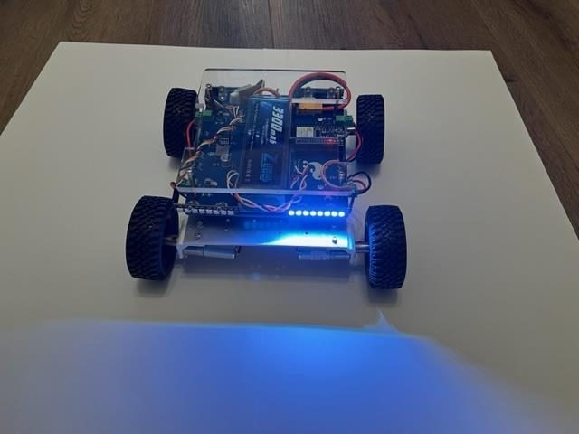
LESSON 10
Smart Lights
Lights that tell everybody what the vehicle is about to do - just like a real car.
PORPOISE ROBOTICS - Precision Oceanographic Program On and In the Sea Environment
porpoiserobotics.org
Kevin Bowen, President - kbowen6@icloud.com
Malcom Graham, VP Education Louis Parker, VP Technology
Valen Farre, System Engineer Gary Howland, Animation
Eddie Revollo, Artificial Intelligence
Interns: Oscar Canazales, Krishnansh Vemulapalli, Soham Gangal, Erik Olsen
One hour. Teams of three, one vehicle per team.
Porpoise Robotics - proprietary. For use with Porpoise Robotics lessons.
Notes:
A car-light homework idea for the lesson before: 'next time you're in a car, watch the lights of the car in front.' It makes the warm-up much livelier.

Slide 2
Today's mission
By the end of today, you can:
1. Say what headlights, brake lights, backup lights and turn signals tell other people
2. Make the lights change by themselves as you drive
3. Add turn signals that blink on the correct side
4. Explain why blinking with delay() would ruin your driving
Pathfinder Explorers | Lesson 10
2
Notes:
Read them out. The last one is the clever idea of the day - save some energy for it.

Slide 3
Car-light spotting
Picture a car on the road. When does it show...
  bright red at the back?
  white at the back?
  a blinking orange light?
Those lights are a LANGUAGE. Every driver knows it.
Today your vehicle learns to speak it. Switch jobs!
Pathfinder Explorers | Lesson 10
3
Notes:
Take answers for each one before moving on: braking, reversing, turning.

Slide 4
Today, in order
Time | What we do
0:00 | Warm-up: car-light spotting
0:05 | What car lights mean
0:12 | Upload e10a_smart_lights, then add turn signals
0:30 | The nap problem, and blinkIsOn()
0:37 | Make them blink, add a headlight switch
0:52 | Mission Log and pack up
Pathfinder Explorers | Lesson 10
4
Notes:
Put the agenda on the board as well, with the driving or uploading block circled. Students settle when they can see when the hands-on part starts.
The timings are a guide for a one-hour session. If the hands-on block runs long, take the time out of the check yourself questions, never out of the pack-up - a rushed pack-up is how cables and controllers go missing.

Slide 5
Lights that talk
About 5 minutes
NOW
Lights that talk
Lights from driving
Blinking
Pathfinder Explorers | Lesson 10
5
Notes:
A breath between parts of the lesson. Read the title out and point at where it sits on the strip.

Slide 6
The language of car lights
Light | Where, and what color | It says...
Headlights | Front, white | "I'm here, and I can see the road."
Tail lights | Back, dim red | "I'm here. This is my back."
Brake lights | Back, BRIGHT red | "I'm stopping!"
Backup lights | Back, white | "I'm backing up!"
Turn signal | Blinking orange, one side | "I'm about to turn THIS way."
Pathfinder Explorers | Lesson 10
6
Notes:
Lights are about OTHER people: drivers behind you, people crossing the street. Ask who the backup light is for. (Anybody behind the car - especially small people who are hard to see.)

Slide 7
What the lights say
Driving forward
Stopped
Reversing
Turning right
back: dim red
tail lights
back: bright red
brake lights
back: white
backup lights
right side: orange
turn signal
KEY POINT Headlights are white at the front in every picture. Only the BACK lights and the turn signals change.
Pathfinder Explorers | Lesson 10
7
Notes:
Each little vehicle is seen from above, front at the top. The strip across the top is the front lights, the strip across the bottom is the back lights.
Ask who has noticed a car's brake lights get BRIGHTER when it stops, or white lights come on at the back when it reverses. These are the same rules, and everybody on the road knows them.
Turning right: orange on the RIGHT side, front and back. Point out that on our vehicle the right side is two separate pieces of the light loop - it's why setRightLights() exists.

Slide 8
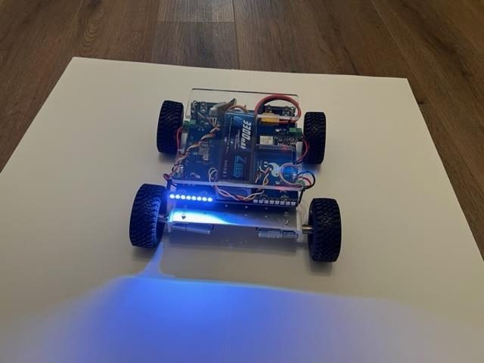
Pathfinder's turn signals
LEFT turn signal, seen from the front
RIGHT turn signal - same vehicle, same program
Pathfinder Explorers | Lesson 10
8
Notes:
Both photographs show the front of the vehicle, so you can only see the front lights. The back lights on the same side are blinking too, just like a car.

Slide 9
Lights from driving
About 20 minutes
done
NOW
Lights that talk
Lights from driving
Blinking
Pathfinder Explorers | Lesson 10
9
Notes:
A breath between parts of the lesson. Read the title out and point at where it sits on the strip.

Slide 10
Smart lights
e10a_smart_lights.ino
lightsOff(); // Fresh picture
setFrontLights(WHITE); // Headlights
if (forward > 0) {
setBackLights(mixColor(60, 0, 0));
} else if (forward < 0) {
setBackLights(WHITE); // Backup
} else {
setBackLights(RED); // Brakes
}
Every time round loop(), draw a whole new picture.
else if is a second question, asked only if the first answer was no.
Forward? Backward? Neither? Then we're stopped.
Pathfinder Explorers | Lesson 10
10
Notes:
The program reads the same stick numbers it drives with. forward bigger than zero means going forward.
'else if' makes a three-way choice. Exactly ONE of the three back-light lines runs each time round.
Why lightsOff() first? So that lights from last time - like a turn signal - don't stay stuck on. The engine room only sends the finished picture to the lights, so they don't flicker.

Slide 11
Smart lights
MISSION: e10a_smart_lights (18 minutes)
Upload, wheels up. Connect your controller.
Push the stick forward, let go, then pull back. Watch the BACK lights.
LEVEL 2: find the turn signal lines (line 68). Remove the // at the start of each one. Upload.
Steer left and right. Is the orange on the correct side?
Working? Unplug, and try it on the floor.
What you should see
Dim red going forward, bright red stopped, white in reverse
Orange on the side you steer toward
Answer these
Why does the program start with lightsOff() every time?
How does the program know you've stopped?
Pathfinder Explorers | Lesson 10
11
Notes:
Un-commenting is satisfying and quick, but watch for teams that remove the // from the LEVEL 2 heading too - that line isn't code and won't compile. The error message will point straight at it.
Answers: so old lights don't stay on; forward and turn are both 0.
The turn signals are solid, not blinking, at this stage. That's the next problem.

Slide 12
Blinking
About 20 minutes
done
done
NOW
Lights that talk
Lights from driving
Blinking
Pathfinder Explorers | Lesson 10
12
Notes:
A breath between parts of the lesson. Read the title out and point at where it sits on the strip.

Slide 13
Blinking: the obvious way is a trap
You might try: lights on, delay(400), lights off, delay(400).
But while delay() waits, loop() is STUCK. It can't read the stick.
Your steering would lag almost a second behind your thumb!
WATCH OUT Never put delay() inside a driving program's loop().
Pathfinder Explorers | Lesson 10
13
Notes:
If you want to prove it, add a delay(400) to loop() on your own vehicle and let a student try to drive it. It's horrible, and they'll never forget it. Take it out afterwards.

Slide 14
Why not just use delay() to blink?
delay(): the rover takes a NAP. It can't feel the stick while it sleeps.
Zzz... delay(400)
Zzz... delay(400)
Zzz... delay(400)
Zzz... delay(400)
notices here - too late!
blinkIsOn(): the rover GLANCES at the clock, and keeps checking.
you push the stick
KEY POINT Grey = asleep. Teal = awake and reading the stick. Driving programs need to stay awake.
Pathfinder Explorers | Lesson 10
14
Notes:
Top row: each grey block is a delay(). While the rover is inside it, it's asleep. It doesn't read the stick, so if you steer during a nap, nothing happens until it wakes up.
Bottom row: blinkIsOn() just glances at the clock and answers yes or no straight away, so loop() goes round thousands of times a second and catches your stick instantly.
Act it out: you're the rover. A student 'steers' by pointing left or right. Close your eyes and count to three before every look. Then do it with your eyes open, glancing at a clock. The class will feel the difference.

Slide 15
blinkIsOn(): glance at the clock
explorer.h - the engine room
// Looks at the clock instead of waiting
bool blinkIsOn() {
return (millis() / 400) % 2 == 0;
}
millis() is a clock: milliseconds since the rover woke up.
Divide by 400. Is the answer even, or odd?
Even: true. Odd: false. It flips every 0.4 seconds.
No waiting at all.
Pathfinder Explorers | Lesson 10
15
Notes:
% means 'the remainder after dividing'. Any number % 2 is 0 for even numbers and 1 for odd ones. That's for your older students; the younger ones need only 'it flips every 0.4 seconds, and answers instantly'.
Worked example: at 1000 ms, 1000 / 400 = 2 (computers drop the leftover), and 2 is even, so the light is on. At 1300 ms, 1300 / 400 = 3, odd, off.

Slide 16
Blinking signals, and a headlight switch
MISSION: e10a_smart_lights (15 minutes)
LEVEL 3: change if (turn > 0) to if (turn > 0 && blinkIsOn()). Do the same for the left.
Upload. Do the signals blink? Can you still steer smoothly?
HEADLIGHT SWITCH: add bool headlightsOn = true; above setup().
Flip it with tappedY(), and only light the front if headlightsOn is true.
Stuck? See how lightsOn works in e01a_learner_drive.
Then: drive the test course, signaling every turn.
What you should see
Orange that blinks on the side you're turning
Y switches the headlights off and on
Answer these
Why does && blinkIsOn() make it blink?
SAFETY Floor driving inside the arena only. Everybody behind the line.
Pathfinder Explorers | Lesson 10
16
Notes:
The headlight switch, for you: bool headlightsOn = true; at the top. In loop(): if (tappedY()) { headlightsOn = !headlightsOn; } and wrap setFrontLights(WHITE) in if (headlightsOn) { ... }. The ! means 'the opposite of'.
Answer: && means both must be true - turning right AND the clock says 'on'. Half the time the clock says off, so the light goes off.
Teams that finish can attempt the Expert License: the test course at 75, with a signal on every turn.

Slide 17
The Expert License
Drive the test course at SPEED_LIMIT 75.
Signal EVERY turn, on the correct side.
No cups knocked over. All four wheels in the garage.
Pass, and your teacher lets you raise SPEED_LIMIT to 100: FULL POWER.
SAFETY Full power is FAST. Arena only, and the Explorer Code still applies.
Pathfinder Explorers | Lesson 10
17
Notes:
This is the top of the license ladder, and it's earned, not given. A team that drives recklessly at full power goes back to 75. Say so before anyone takes the test.
At full power the vehicle is genuinely quick. Make the arena bigger, or run Expert drives one vehicle at a time.

Slide 18
New words
Word | What it means
Signal | A light that tells other people what you'll do next
else if | A second question, asked only if the first answer was no
millis() | A clock: milliseconds since the rover woke up
blinkIsOn() | Glances at the clock: on, off, on, off...
bool | A variable that holds true or false
Pathfinder Explorers | Lesson 10
18
Notes:
Read each word out and have the room say it back. Saying a word out loud is half of owning it.
These are also in the glossary at the back of the Mission Log.

Slide 19
Check yourself
1. Bright red at the back of a car. What does it mean?
2. Why does the light picture start with lightsOff()?
3. Why can't we blink with delay() while driving?
4. What does blinkIsOn() do?
5. The vehicle turns right. Which lights blink?
Pathfinder Explorers | Lesson 10
19
Notes:
Answers: 1 stopping. 2 so old lights don't stay on. 3 loop() stops reading the stick while it waits. 4 tells you on or off, flipping every 0.4 s, without waiting. 5 the right side, front and back.

Slide 20
Mission Log, then pack up
In your Mission Log
Pack up
Fill in the light rules table
Expert License stamp, if you passed
Stamp: Signal Expert
Crew Chief: vehicle power OFF.
Unplug the cable and coil it up.
Vehicle and controller back in their spot, stickers matching.
Close the laptop. Push your chairs in.
KEY POINT Last job: every team member says one thing they learned today.
Pathfinder Explorers | Lesson 10
20
Notes:
Next lesson is the design challenge. Ask teams to come with an upgrade idea in mind.

