Slide 1
Lesson 2
Number System I . Selection . Iteration

Slide 2
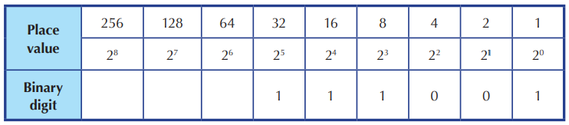

Binary → Denary
Base 2 to Base 10
Multiply by place value

Slide 3
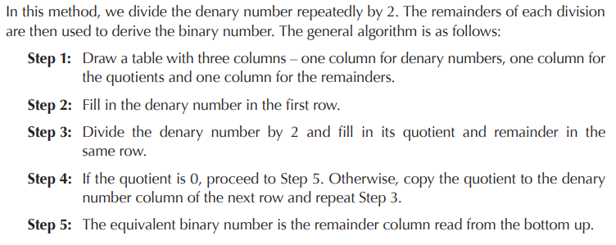
Denary → Binary
Base 10 to Base 2
Division by 2 method

Slide 4
Try now on a piece of paper (7 mins)
101010111 to denary
6543 to binary

Slide 5
print() VS return
Once you print, cannot use
output (return) of a function can be used as an input of another function

Slide 6
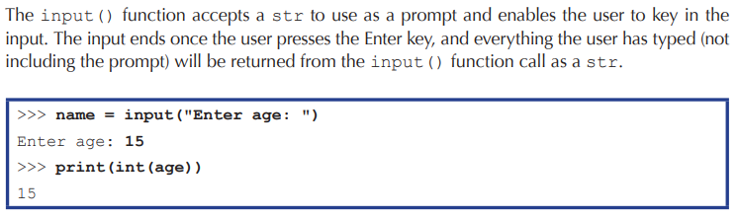
input()

Slide 7
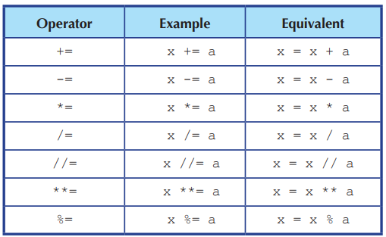
Useful operators

Slide 8
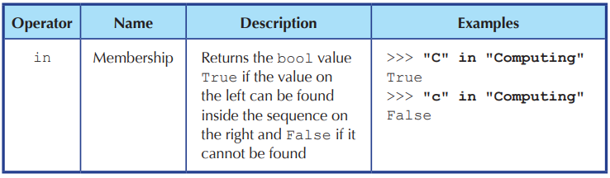
in , not , and , or

Slide 9
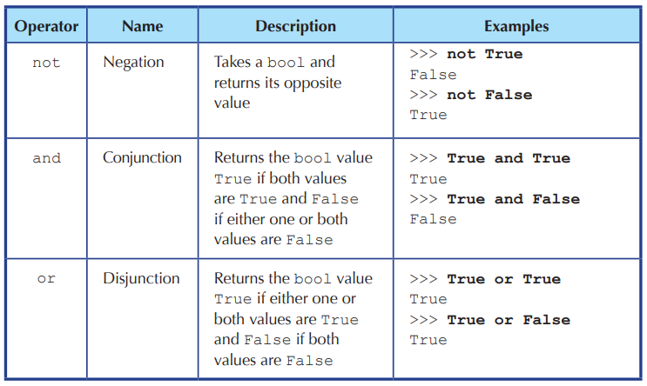

Slide 10
Selection
if – elif – else statements:
Indentation is important

Slide 11
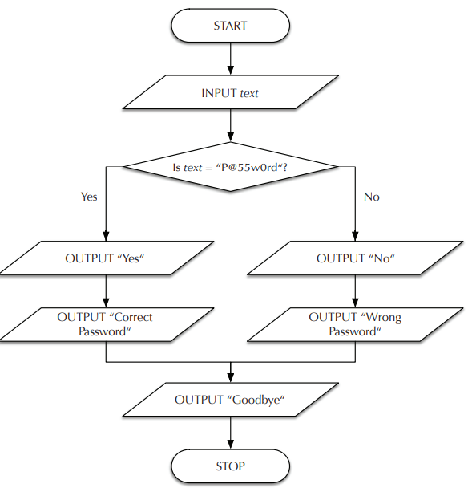
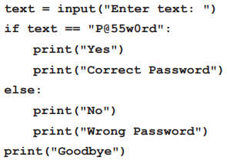
Why different indentation ?

Slide 12
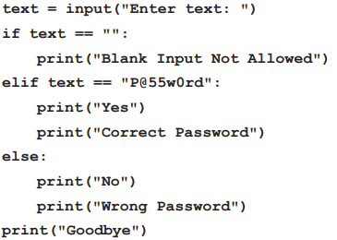
We might want to provide a separate error message if the text entered is blank.

Slide 13
Even / odd ? (demonstrate)
Using input() or define a function

Slide 14
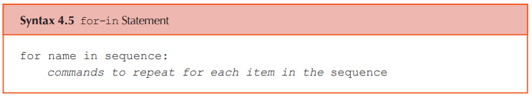
Iteration – for loop
for i in range(5):
print(4)
for i in range(5):
print(i)
for char in ‘abcdef’:
print(char)

Slide 15
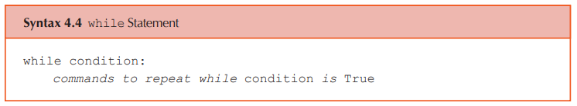
Iteration – while loop

Slide 16
for loop vs while loop (demonstrate)
Average example: find the average of 5 numbers
Max, min,

Slide 17
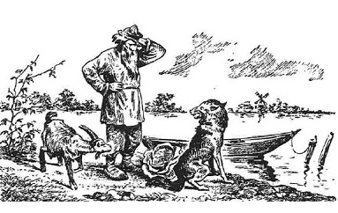
Problem Solving - Man, Cabbage, Goat, Wolf
A man lives on the east side of a river. He wishes to bring a cabbage, a goat and a wolf to a village on the west side of the river to sell. However, his boat is only big enough to hold himself, and either the cabbage, goat or wolf. In addition, the man cannot leave the goat alone with the cabbage because the goat will eat the cabbage, and he cannot leave the wolf alone with the goat because the wolf will eat the goat. How does the man solve his problem ?

Slide 18
Abstraction – a representation that leaves out details of what is represented
Colour of boat relevant? Width of river? Name of man?
Start state: man cabbage goat wolf
[E , E , E , E]
In this representation, the symbol E denotes that each corresponding object is on the east side of the river.
If the man were to row the goat across with him, the representation of the new state:
New state: man cabbage goat wolf
[W , E , W , E]
… … …
Goal state: man cabbage goat wolf
[W , W , W W]
Can you solve it ?

Slide 19
In order to computationally solve a problem, two things are needed:
a representation of the problem and an algorithm that solves it.

Slide 20
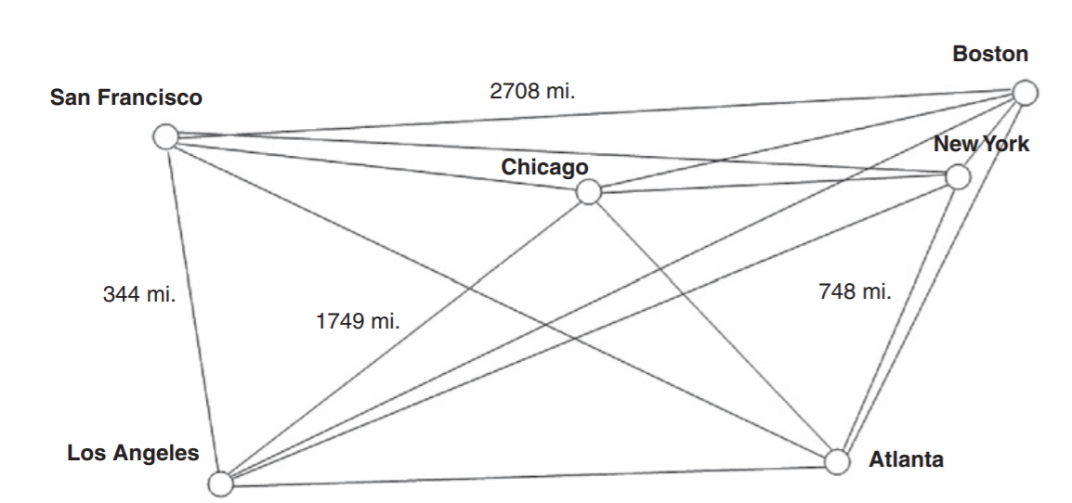
Limits of computational problem solving
Travelling salesman Problem
The problem is to find the shortest route of travel for a salesman needing to visit a given set of cities.

Slide 21
Travelling salesman Problem
Using a brute force approach, the lengths of all possible routes would be calculated and compared to find the shortest one.
For 3 cities, the number of possible routes is 3! = 1 x 2 x 3 = 6
For 10 cities, the number of possible routes is 10! = 1 x 2 x … x 10 = 3628800
For 20 cities, the number of possible routes is 20!
If we assume that a computer could compute the lengths of one million routes per second, .......
For 50 cities …

Slide 22
Any algorithm that correctly solves a given problem must solve the problem in a reasonable amount of time, otherwise it is of limited practical use.
An algorithm is a finite number of clearly described, unambiguous “doable” steps that can be systematically followed to produce a desired result for given input in a finite amount of time.

Slide 23
Algorithms and Computers: A Perfect Match
Because computers can execute instructions very quickly and reliably without error, algorithms and computers are a perfect match.
Example: determining the day of the week for any date between January 1, 1800 and December 31, 2099.

Slide 24
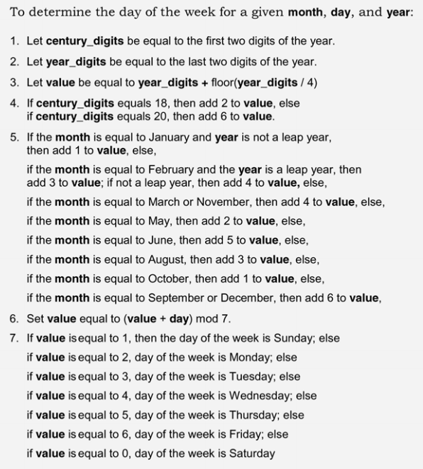
Given that the year 2016 is a leap year, what day of the week does April 15th of that year fall on?
Possible to write it as a function in Python?

