Slide 1
Lesson 3
Hexadecimal . Iterations . Array: list . Useful functions
Random Number Generator . Charles Babbage

Slide 2
Administrative
Lesson 6: Practical Test 1
Release of CA1 (Project) – Due Lesson 13

Slide 3
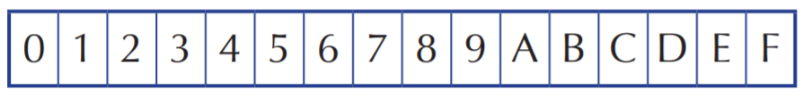
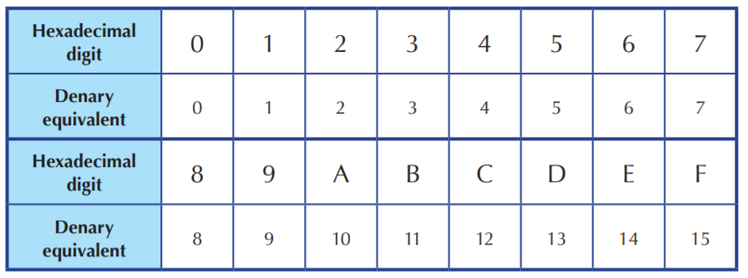
Hexadecimal – base 16

Slide 4
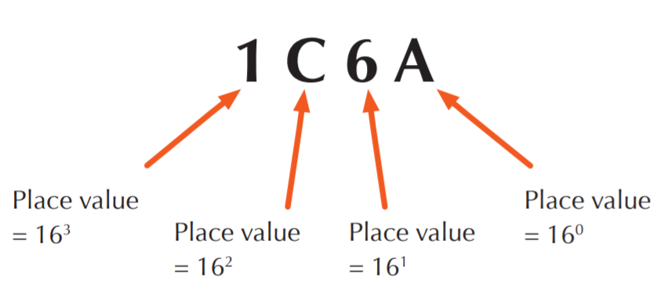
How to convert ? ( 16 → 10 )

Slide 5
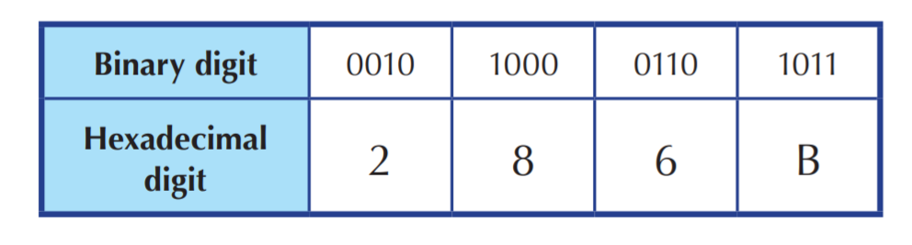
How to convert ? ( 2 → 16 )

Slide 6
Try . . .
(10101000111)₂ to hexadecimal.

Slide 7
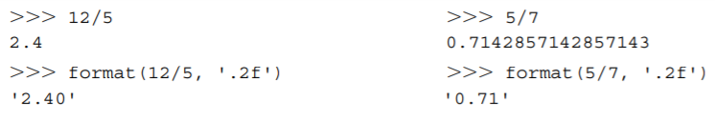
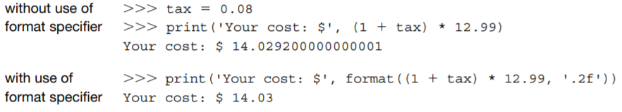
format()

Slide 8
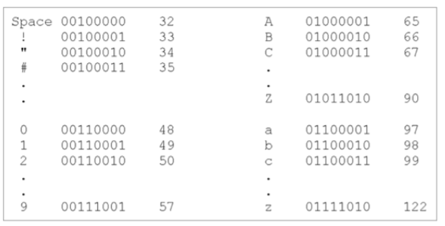
ord() , chr()
>>> ord(‘A’)
>>> 65

Slide 9
Let’s think . . .
if True or true:
print(‘true!’)
if true or True:
print(‘true!’)
What’s the difference ?

Slide 10
Short-Circuit (Lazy) Evaluation
For logical and, if the first operand evaluates to false, then regardless of the value of the second operand, the expression is false.
For logical or, if the first operand evaluates to true, regardless of the value of the second operand, the expression is true.
if n != 0 and 1/n < tolerance:
if n != 0:
if 1/n < tolerance
In the Python programming language, short-circuit evaluation is used.
What if n = 0 ?

Slide 11
List
Data type for storing multiple values in a sequence
list constructor [ ]
list() : takes in a sequence type and converts it into a list
common sequence operations: len() , max() , min()
mutation operations for list, lst:
lst.append(x) – adding an element x at the back
lst.extend(x) – adding a list
lst.reverse()
lst.insert(i,x)
lst.pop(i) – removes the element at index I and returns it
lst.remove(x) – removes the first occurrence of the element x
lst.clear() – empties the list

Slide 12
Loop examples
factorial
factorial(1) = 1
factorial(3) = 3! = 1 x 2 x 3
factorial(n) = n! = 1 x 2 x 3 x 4 x … x n
We can define a function factorial using loop.

Slide 13
factorial
using for loop
def factorial(n):
result = 1
for i in range(2,n+1):
result = result * i
return result
using while loop
def factorial(n):
result = 1
counter = 1
while counter <= n:
result = result * counter
counter = counter + 1
return result

Slide 14
random number generator
import random
random.randint(num1 , num2)

Slide 15
Guessing Number Game
Live demo

Slide 16
Coin Change Exercise Program
Write a program that implements an exercise for children to count change. It displays a random value between 1 and 99 cents and asks the user to enter a set of coins that sums exactly to the amount shown.
*change the coins denomination to 50 cents, 20 cents, 10 cents, 5 cents and 1 cent

Slide 17
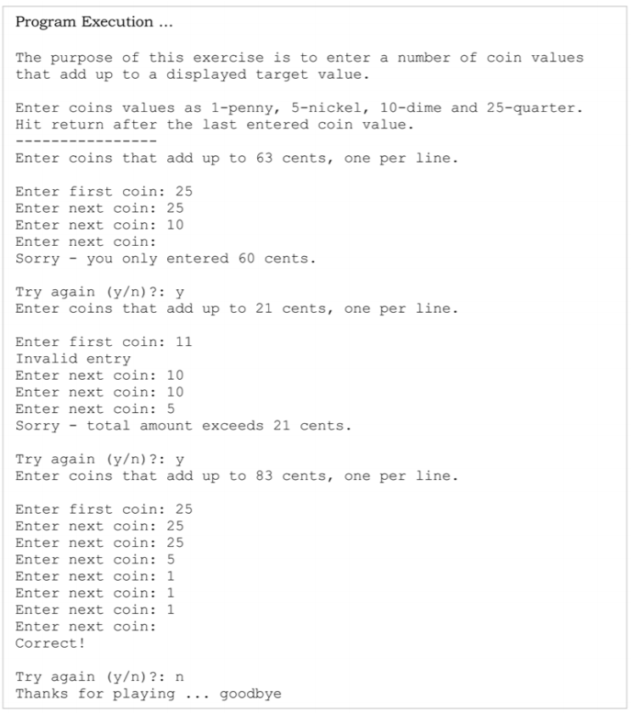

Slide 18
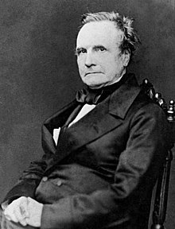
Who is Charles Babbage ?
Interesting facts or stories ?
What is his most significant work or contribution to this field ?
Contribute in the forum

