Slide 1
Automated VMAT Treatment Planning Using Sequential Convex Programming: Algorithm Development and Clinical Implementation
Masoud Zarepisheh
Department of Medical Physics, Memorial Sloan-Kettering Cancer Center, New York
Pinar Dursun, Linda Hong, Gourav Jhanwar, Qijie Huang, Ying Zhou, Jie Yang, Hai Pham, Laura Cervino, Jean M. Moran, Joseph O. Deasy

Slide 2
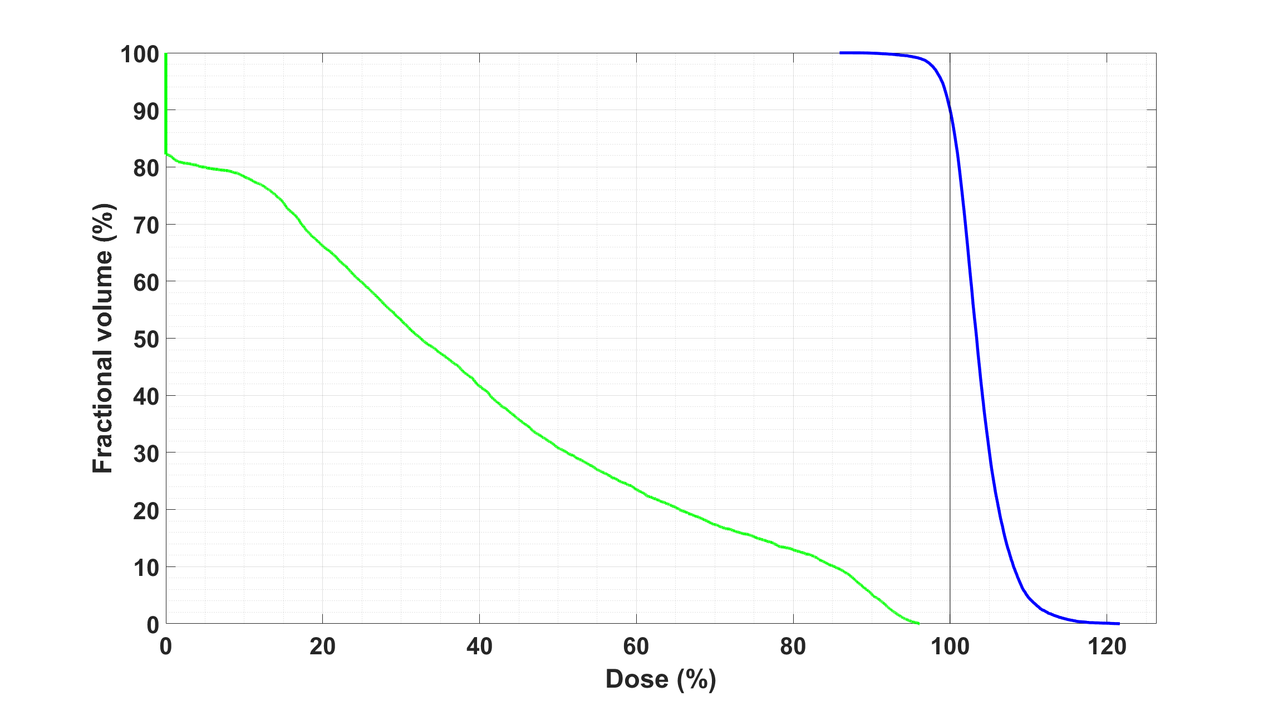



Automated Planning
ECHO: Expedited Constrained Hierarchical Optimization
Step-1: Best PTV coverage, given all max/mean/DVH hard constraints
Step-2: Relax PTV coverage to improve normal structure dose

Slide 3
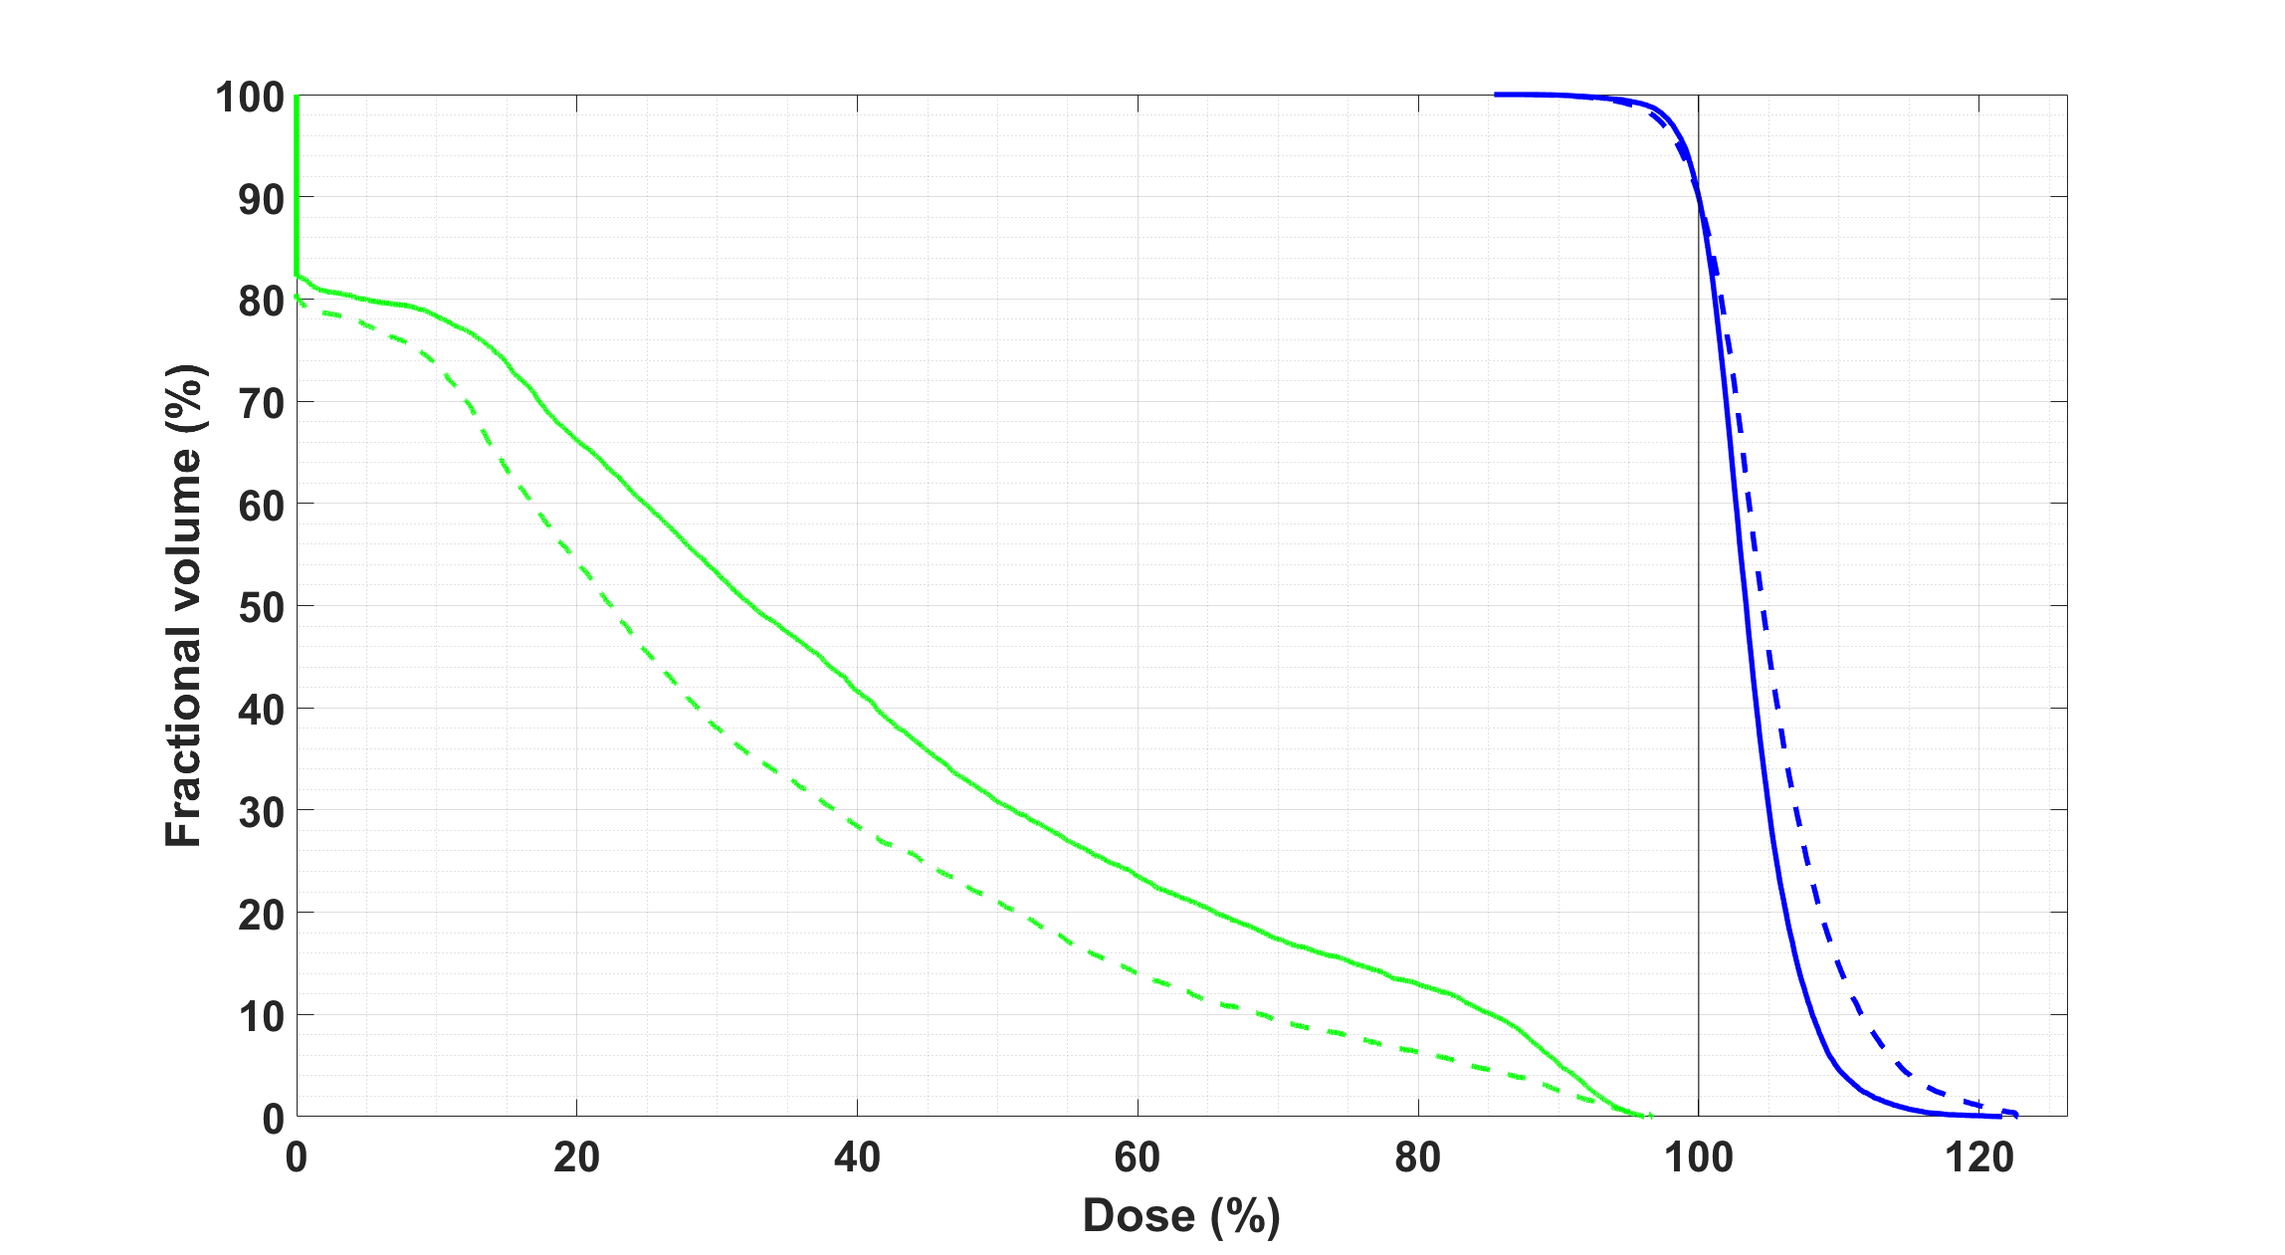
Automated Planning
ECHO: Expedited Constrained Hierarchical Optimization
Step-1: Best PTV coverage, given all max/mean/DVH hard constraints
Step-2: Relax PTV coverage to improve normal structure dose

Slide 4

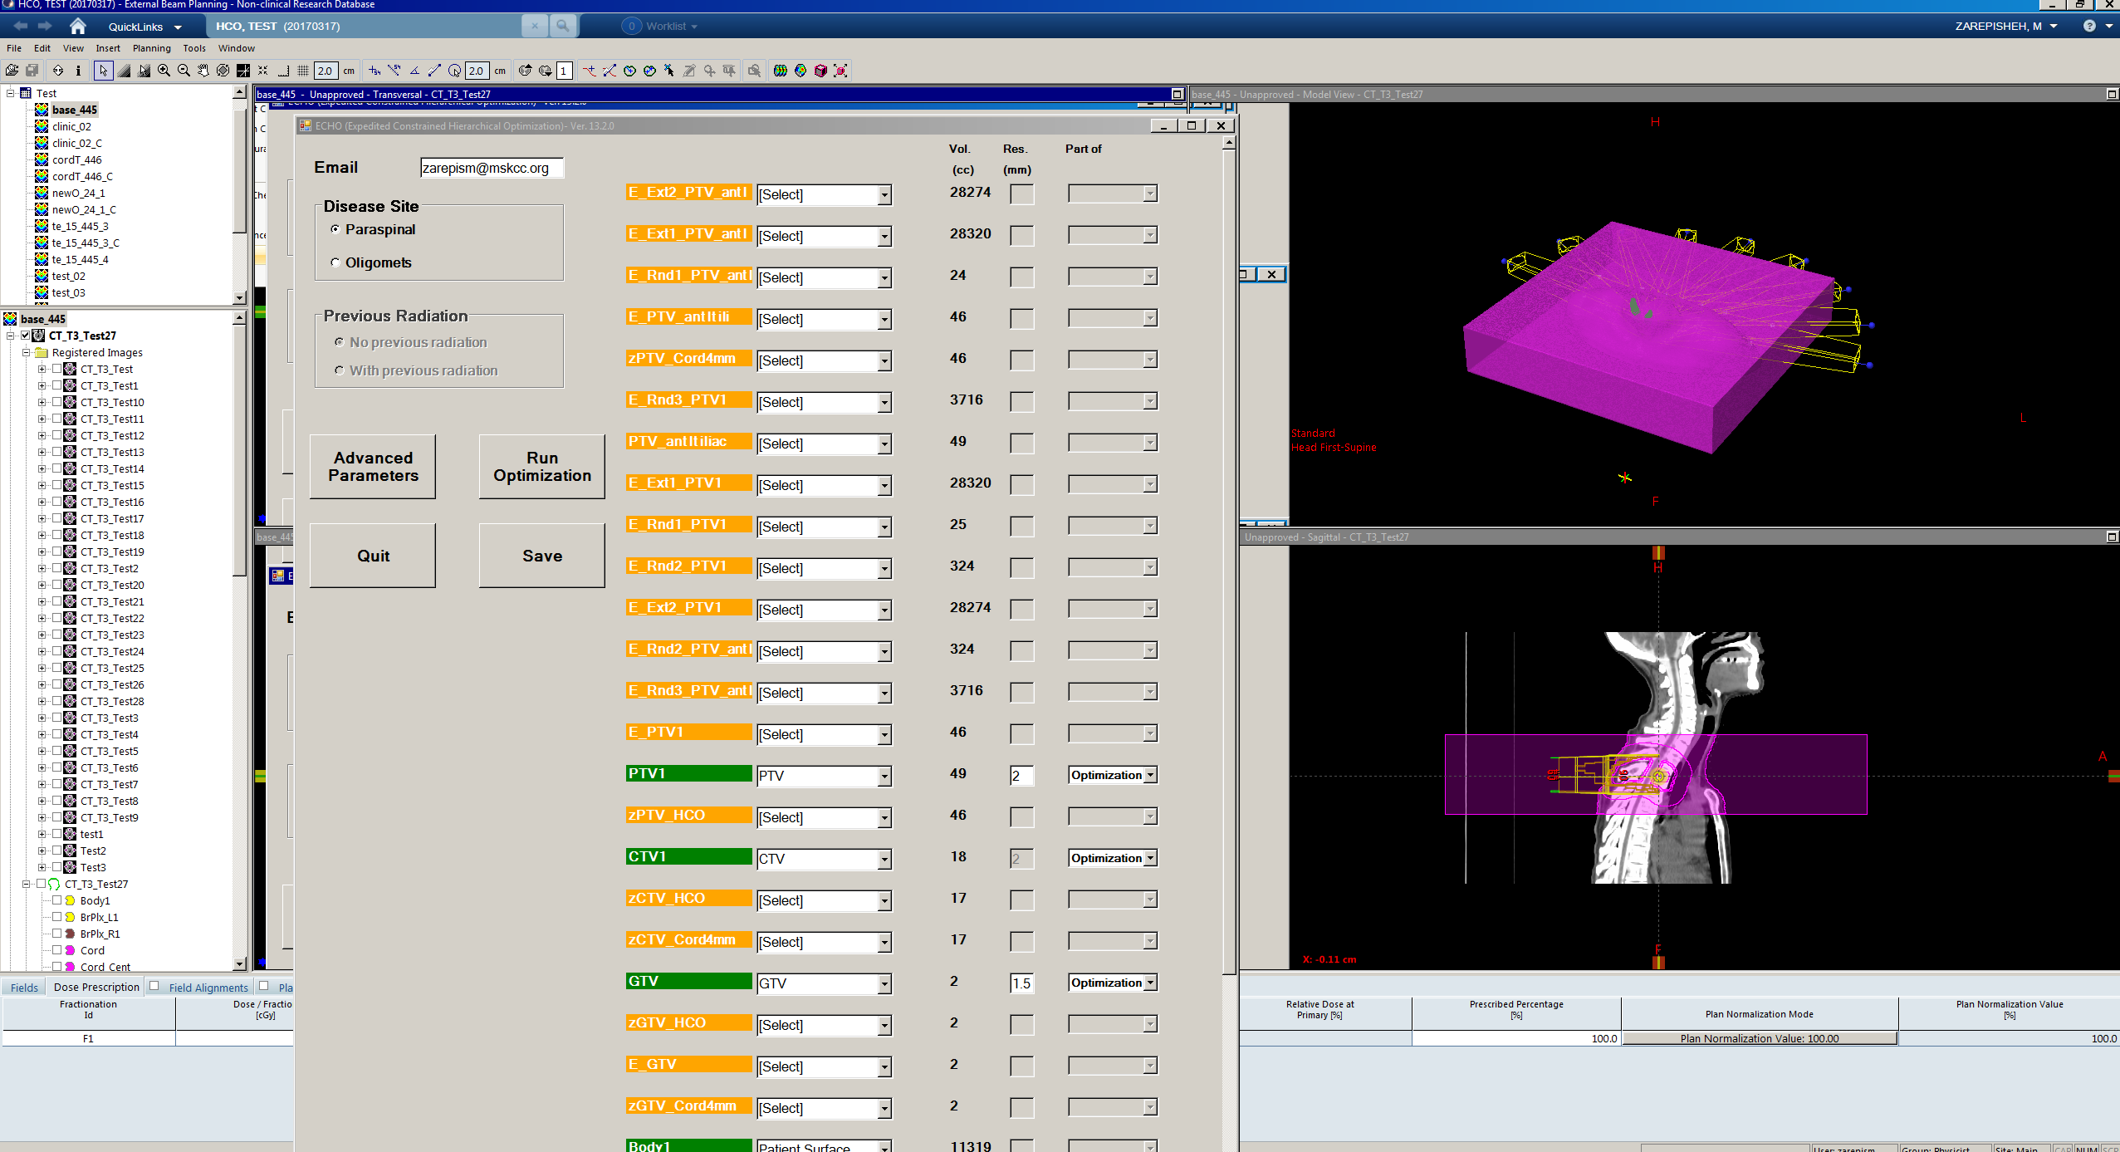




ECHO-Workflow
Planner runs ECHO plug-in
Planner notified, and
evaluates the plan
~30 min
MSK ECHO
Correction
Step
API
API
Extract patient data
Output optimal
setting
ECHO Optimization
Final calculation
(FDA-approved system)

Slide 5
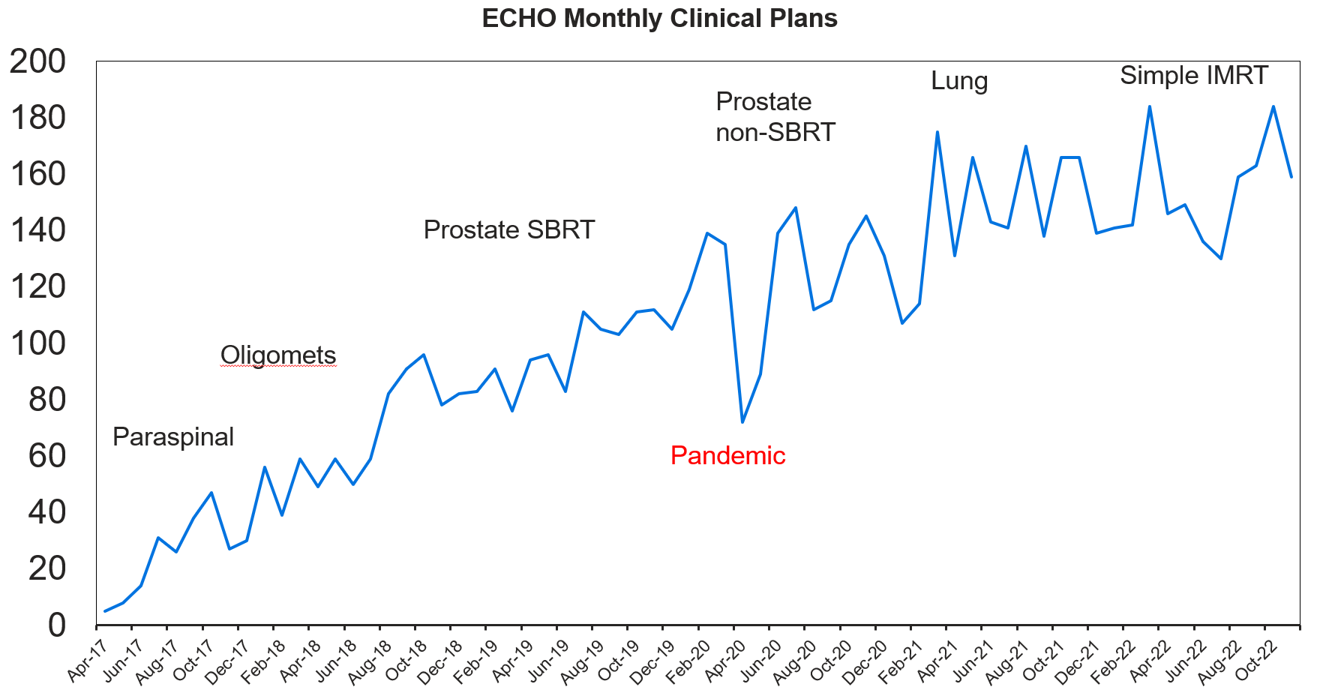
ECHO in Clinic
> 8000 plans to-date (2017-2023)
~ 200 plans per month

Slide 6
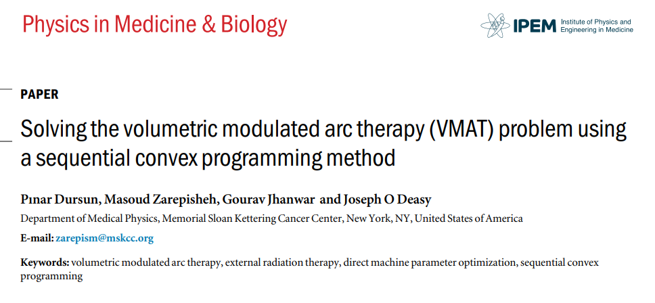
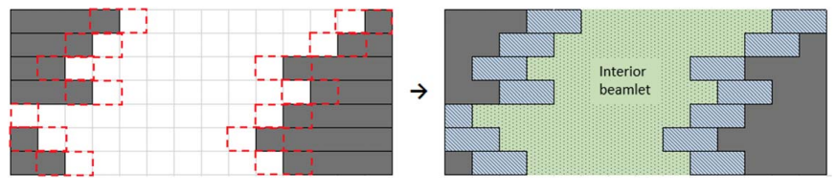
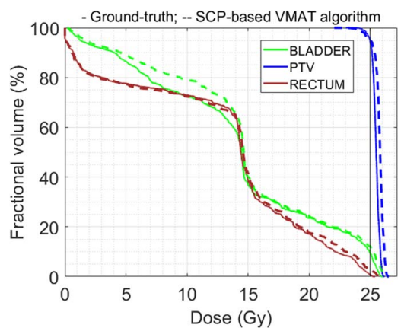
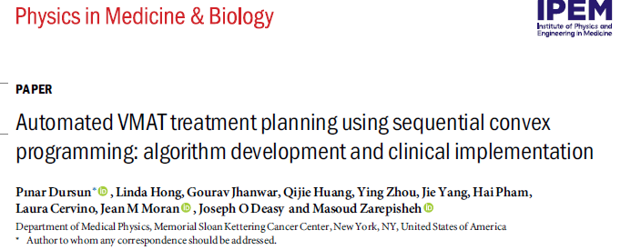
ECHO VMAT: Key Idea

Slide 7
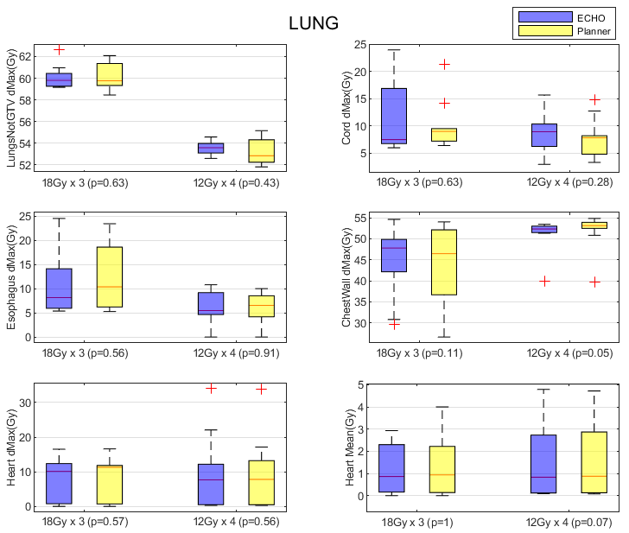
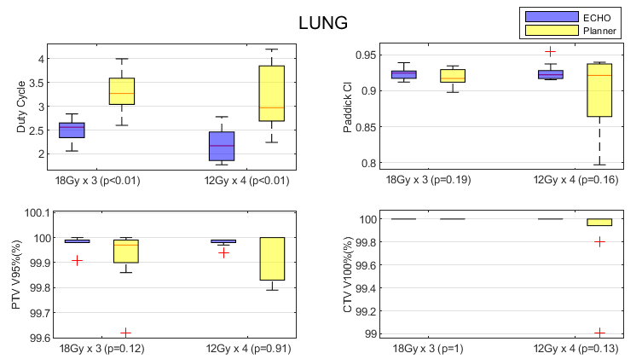
ECHO VMAT: Results
OAR Sparing
Coverage

Slide 8
ECHO
12 Publications (10 in PMB/Medical Physics)
INFORMS Edelman award finalist (2022)
Implementation Status | Challenge | Technique | Publication
Clinically Deployed | Multi-Criteria Challenge | Hierarchical Constrained Nonlinear Optimization | Zarepisheh et al. (2019) (Medical Physics) Zarepisheh et al. (2021) (INFORMS) Hong et al. (2020) (Advances in RO)
Deployed | Dose Discrepancy | Lagrangian Methods | Zarepisheh et al. (2019) (Medical Physics)
Deployed | Hard constrained DVH | Mixed Integer Programming, Convex Relaxation | Mukherjee et al. (2020) (Medical Physics)
Deployed | Non-convexity in Machine Parameters (VMAT) | Sequential Convex Programming | Dursun et al. (2021) (PMB) Dursun et al. (2023) (PMB)
Research & Development | Proton: Beam Angle Selection | Bayesian Optimization | Taasti et al. (2020) (Medical Physics)
R&D | Proton: Uncertainty Management | Robust Optimization (P-Norm Function) | Taasti et al. (2020) (Medical Physics)
R&D | Multi-Criteria Challenge | Deep Learning Predictions (Moment-Based Loss Functions) | Jhanwar et al. (2022) (PMB)
R&D | Proton: Increasing Computational Complexity With Uncertainty Managements | Distributed Optimization (ADMM) | Fu et al. (2022) (Medical Physics)
R&D | Reducing IMRT plan complexity | Wavelet-induced smoothness | Tefagh, Zarepisheh (2023) (PMB)

Slide 9
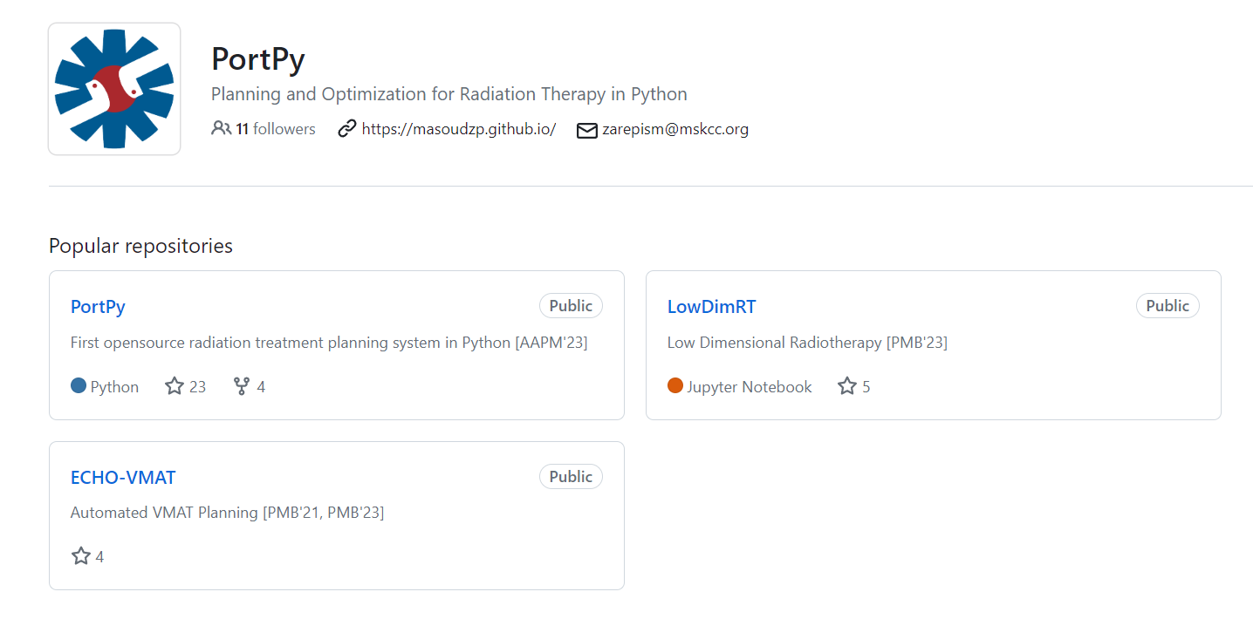

PortPy: Planning and Optimization for Radiation Therapy in Python
Benchmark Data (e.g., 100 lung patients, planner beams, ECHO plan)
Benchmark algorithms (e.g., VMAT, DVH, Beam selection)
Interfaces to:
Eclipse (final evaluation)
3D-Slicer (enhanced visualization)
CVXPy (high-level optimization)

Slide 10
Summary
Developed an in-house automated planning system (ECHO)
ECHO is clinically deployed and integrated with Eclipse via API
Treated > 8000 patients
Can handle complex re-treat Spine cases
ECHO-VMAT developed and clinically deployed
Code would be shared in Python open-source PortPy

