Slide 1
DevOps Q4 KY Maksim Ivanov
CI-CD pipline.
Deploy of index.html file to the Virtual Machine HTTP Server

Slide 2
Hi, my name is Maksim Ivanov
Short Summary:
System administrator with 20+ years of experience including programming, LAN administration, hardware management, users support willing to develop professional skills and knowledge, to learn new direction at information technologies
Skills:
Knowledge of programming languages: C, Visual Basic, Delphi, 1C Enterprise, JSON.
Basic knowledge of HTML, CSS, bat scripting.
LAN administration based on Windows family OS.
Network Technologies: TCP/IP, HTTP, RDP, VPN
Hardware Management.
Education:
1996 - 2001. Kiev, International Solomon University, Bachelor of Computer Science, Programming of Automated Systems.

Slide 3
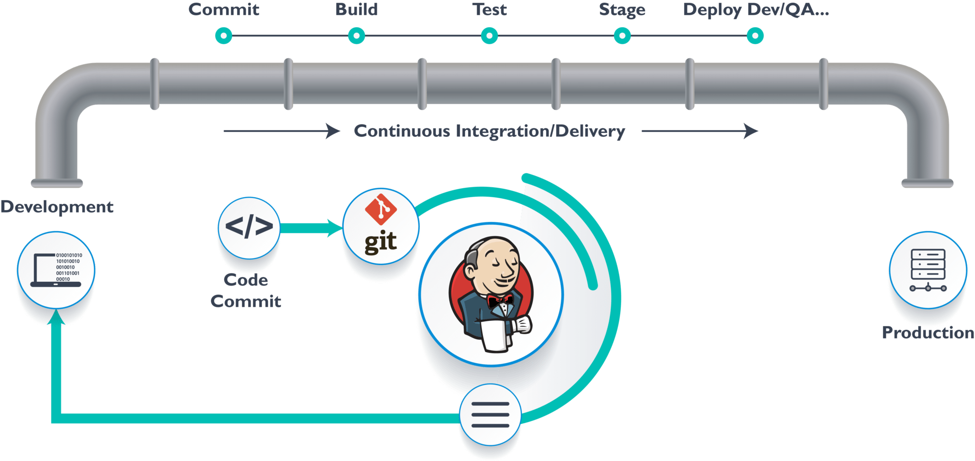
Pipeline scheme

Slide 4
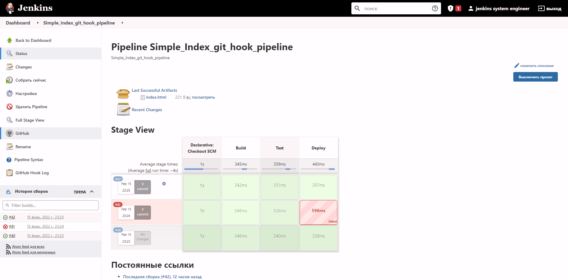
Jenkins

Slide 5
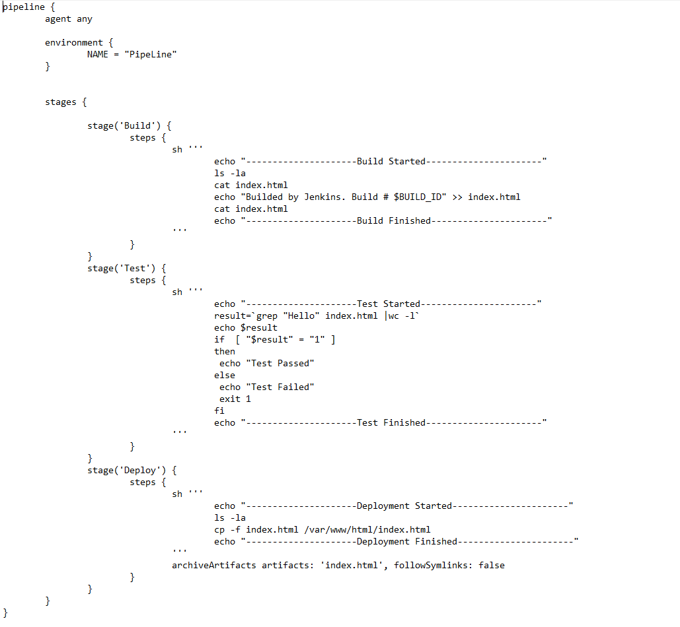
Pipeline code

