Slide 1
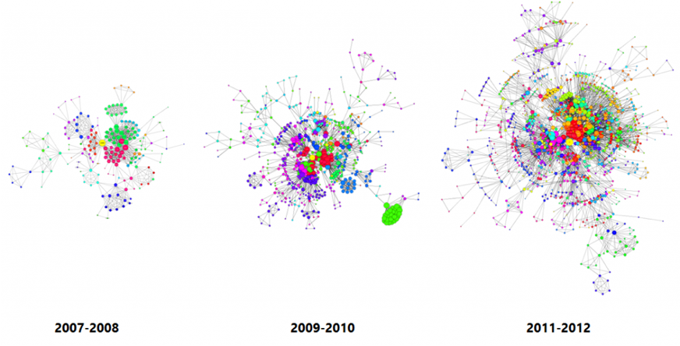
Towards Sequenced Semantics for Evolving Graphs
Vera Zaychik Moffitt Julia Stoyanovich
MOTIVATION
Systematic support for exploratory analysis of evolving graphs
Which network nodes are showing an increasing popularity trend?
Have any changes in network connectivity been observed?
At what time scale can interesting trends be observed?
How can multiple data sources be used jointly to complement or corroborate information about network evolution?
Usable and efficient
PROBLEM
Evolving graph model and algebra should be
Unambiguous
Expressive
Varied rates of evolution
Heterogeneous structure
Multigraphs
Support wide range of analyses.
Compare
Snapshot Sequence (Snaps)
relational model with intervals and point semantics (PS)
relational model with intervals and sequence semantics (SS)
v1
name = Alice
school= Drexel
v1
name = Alice
school= Drexel
v1
name = Alice
school= Drexel
v1
name = Alice
school= Drexel
e1
e1
name = Bob
v2
name = Bob
school = CMU
v2
name = Bob
school = CMU
v2
name = Cathy
school= Drexel
name = Cathy
school= Drexel
e2
e2
v3
v3
v3
name = Cathy
school= Drexel
v3
name = Cathy
school= Drexel
t1
t2
t3
t4
*Cathy was promoted at t3 **Cathy and Bob had 2 conversations
Q1. Subgraph limited to those nodes that persisted unchanged for at least 3 time periods.
Snaps: not supported.
PS: Alice [t1,t5) and Cathy [t1, t5). SS: Alice only [t1, t5).
Q2. Aggregate temporally by 2 time periods with edge aggregate count.
Snaps: e2, count 2
PS: e2, v3, v2, [t3,t4), 1 (coalesced)
SS: e2, v3, v2, [t3,t4), 2
APPROACH
Temporal relations V (v, p, a) & E (e, v1, v2, p, a)
Model soundness requirements:
R1: Unique vertices/edges
R2: Unique attribute values
R3: Referential integrity
Properties of sequenced semantics and distributed implementation:
Snapshot reducibility – result of temporal operator is equivalent to applying it to each time instant
Split tuples such that each snapshot computation is local to a partition and partitions are balanced. Use optimal splitters [2].
Extended snapshot reducibility – references to timestamps supported in predicates
During partitioning, place split tuples with their full unsplit periods.
Change preservation – results are coalesced only when they share the same lineage
Normalize and align primitives [1] are not sufficient to ensure correctness when tuples span partitions.
v | p | a
v1 | [t1, t5) | name=Alice school=Drexel
v2 | [t2, t3) | name=Bob
v2 | [t3, t5) | name=Bob school=CMU
v3 | [t1, t3) | name=Cathy school=Drexel
v3 | [t3, t5) | name=Cathy school=Drexel
e | v1 | v2 | p | a
e1 | v1 | v2 | [t2, t4) | ∅
e2 | v3 | v2 | [t3, t4) | ∅
e2 | v3 | v2 | [t4, t5) | ∅
Operations defined in [4]:
slice
subgraph
map
node creation
edge creation
union
intersection
difference
REFERENCES
1. A. Dignös et al. Temporal alignment. SIGMOD, 2012.
2. W. Le et al. Optimal splitters for temporal and multi-version databases. SIGMOD, 2013.
3. V. Z. Moffitt and J. Stoyanovich. Towards sequenced semantics for evolving graphs. EDBT 2017.
4. V. Z. Moffitt and J. Stoyanovich. Querying evolving graphs with Portal. Dec. 2016. arXiv:1602.00773.
5. V. Z. Moffitt and J. Stoyanovich. Towards a distributed infrastructure for evolving graph analytics. In TempWeb, 2016.
ACKNOWLEDGEMENTS
This work was supported in part by NSF Grants No.
1464327 and 1539856, and BSF Grant No. 2014391.

