Slide 1
PRO322 · M3P1 · WEEK 3
OUTLIER
Findings with my models
Porter Johnson · Experiment Review & Model Selection
July 17, 2026
Notes:
Open with the tempting number, spoken: 'My best turning-point model scores 41% — baseline 25%. A 60% jump. This talk is how I found out that gap isn't real, why that's the most useful thing I did this week, and my plan to turn it into real findings.' Eight slides; the rest is backup for your questions.

Slide 2
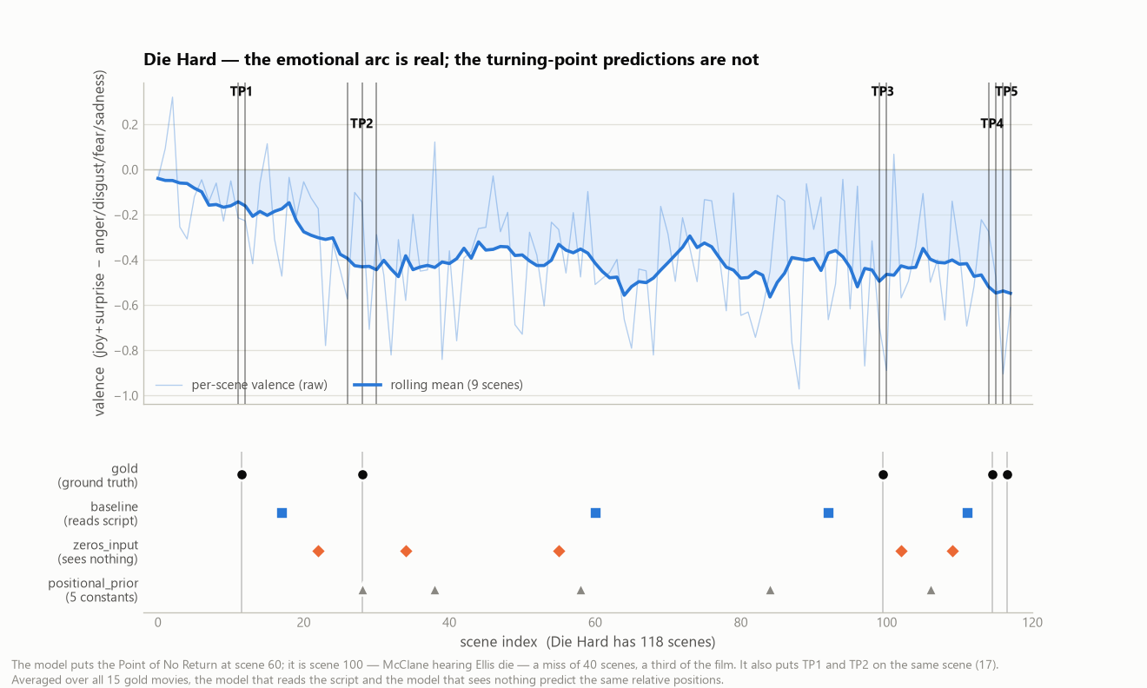
STARTING WITH DIE HARD
Everyone knows where Die Hard turns. The model doesn't.
Model puts the Point of No Return at scene 60. It's scene 100 — McClane hears Ellis die.
Notes:
The familiar example the instructor keeps asking for. TOP panel is the WIN: the emotional arc across all 118 scenes reads like Die Hard actually feels — positive setup, long negative Act 2. That branch works, and it's where the business value lives (I'll come back to it in the plan). BOTTOM panel is the problem: black dots = real turning points, blue = my model. Point of No Return 40 scenes off, a third of the film. The number said 41%; the movie everyone knows says otherwise. Why? Next slide.

Slide 3
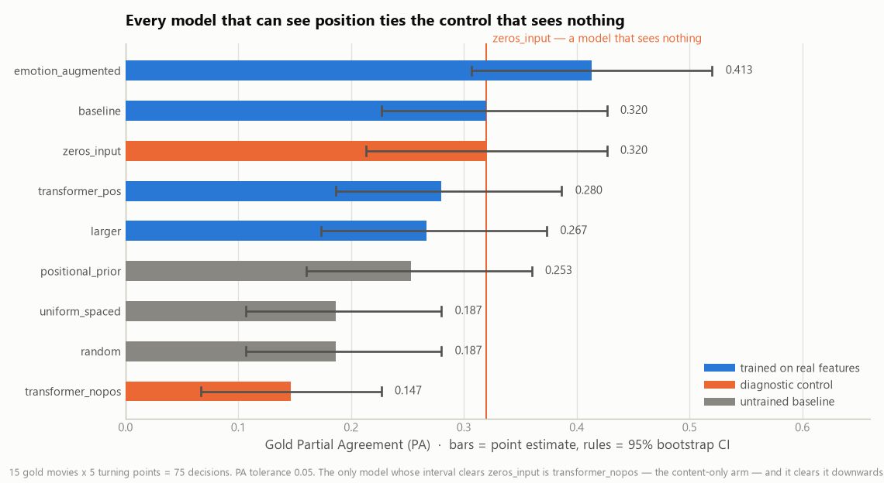
WHAT I TRIED — 9 EXPERIMENTS
Every model that sees position ties a model that sees nothing
Nothing clears the orange control by more than its confidence interval.
Notes:
This is the 'what did you try' answer: six trained models and three baselines, all on one axis. The orange line is zeros_input — a model with its input vectors zeroed, so it knows nothing about the script except its length. Every trained model that sees position ties it. emotion_augmented's 0.413 LOOKS like a win, but its CI [0.307, 0.520] entirely contains the control's 0.320. The only model that measurably separates is transformer_nopos — and it goes DOWN, below random. So the score isn't coming from the content. The next slide proves that cleanly.

Slide 4
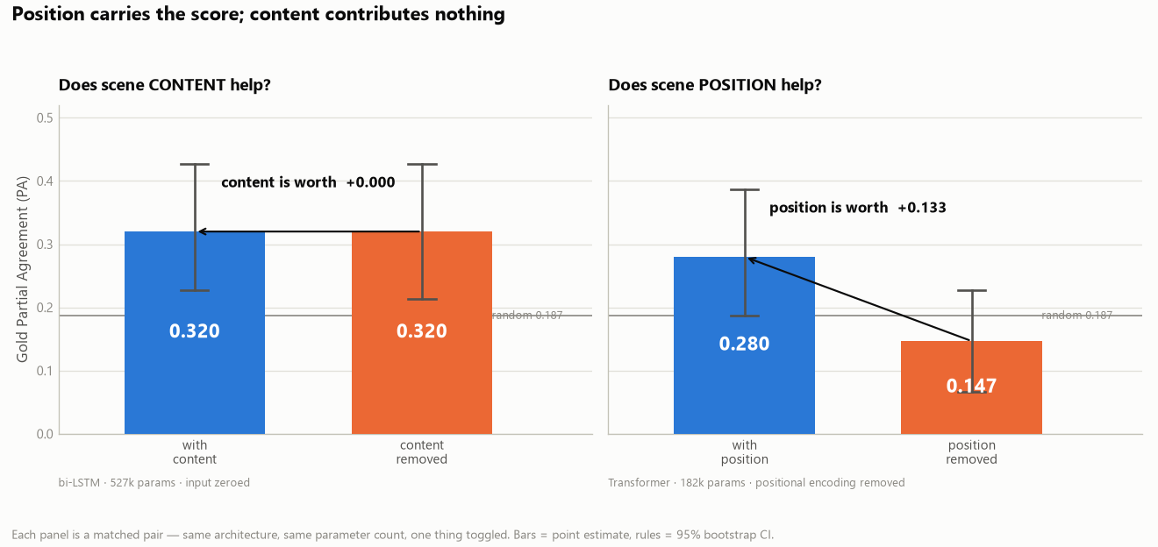
WHY — TWO CONTROLLED ABLATIONS
Position carries the score. Content contributes nothing.
Content is worth +0.000 · Position is worth +0.133
Notes:
The load-bearing figure. LEFT pair: same bi-LSTM, same 527k params — zero the input and the score doesn't move, 0.320 → 0.320. RIGHT pair: same Transformer, same 182k params — remove its sense of scene order and it collapses below random. Each pair holds architecture and parameters fixed and toggles one thing. If asked 'why not one 2×2': a bi-LSTM can't ignore order, so the content-only arm has to be a Transformer — two honest matched pairs beat a grid that crosses architectures.

Slide 5
MODEL SELECTION
Shipping the model that scores lower
 | positional_prior | emotion_augmented
Gold PA | 0.253 | 0.413 (top)
Gold D (lower = better) | 0.122 ✓ best | 0.125
Beats a model that sees nothing? | — | no · CI crosses it
Params · interpretable | 0 · fully | 539k · no
The one-sentence version
It built a very accurate stopwatch. It knows the climax is at the end. It doesn't know what a climax looks like, and I found that out in Week 3, instead of after building a product on it.
Not the top metric. The honest one. On D, and on 'beats a blank model,' the prior wins.
Notes:
Trap question: 'you picked the lower PA?' Answer: I'm not claiming the prior is a better model — I'm reporting that NO trained model beat a model with its input zeroed, so per my Week-2 plan I fall back to the prior as an anchor and spend the compute on the branch that works. It also wins on D (the metric that matters for pointing at a scene), with zero params and full interpretability. Read the navy box aloud if a non-technical stakeholder asks 'can I trust it.'

Slide 6
WHERE I STAND vs THE PLAN
The failure was in my Week-3 plan
plan.md line 99 · pre-declared fallback trigger
“the trained bi-LSTM can't beat the positional-prior baseline” ← it fired
plan.md line 113 · pre-planned response
“Use the positional priors as the anchor for the McKee layer. A smaller working thing beats an aspirational broken thing.”
Disclosure: that same plan line told me to build the prior from the 15 gold (test) movies — leakage. My code already uses the silver split; flagging it to show I caught it.
Notes:
Plan Transparency, backward-looking half: I anticipated this exact outcome in Week 2 and wrote the response down. 'On plan, on the fallback branch.' The leakage disclosure shows I audit my own work. Next slide is the forward-looking half — the action plan.

Slide 7
HOW I GET TO REAL FINDINGS
A negative result this week — here's the plan to turn it positive.
1
Reformulate — don't retune. Synopsis → scene retrieval.
Match a sentence that describes the turning point to the scene it fits. Semantic similarity — what a frozen encoder is already good at. Content enters at inference, not just training.
2
Fix the ruler first. A powered evaluation before I trust any gain.
75 gold decisions = ±0.10. I build cross-validation + more labeled scenes so a real improvement is distinguishable from noise — so I don't repeat this week's false positive.
3
Mine the emotion branch — one concrete test first. Does the emotional charge flip at each turning point?
Measure the valence delta — mean of the 3 scenes after each TP minus the 3 before — and test it against random scenes. A significant gap is both an ML signal and a business pattern.
Notes:
Plan Transparency, forward-looking half — and where the professor's 1-on-1 feedback shows up. Item 1 is the ML fix (semantic retrieval, TRIPOD's actual method). Item 2 is the rigor lesson — I can't measure a sub-0.10 gain on 75 decisions, so I fix the measurement before chasing the number. Item 3 is now a concrete first experiment, straight from our 1-on-1: measure the valence delta — mean valence of the 3 scenes after each turning point minus the 3 before — and test whether it's significantly larger at real TPs than at random scenes. A yes is both an ML signal AND a business pattern: 'turning points are where the emotional charge flips.' If they want to go deep on any one item, this is the conversation I want. || FIRST LOOK (already ran it on the 15 gold movies, run_valence_shift_probe.py): the shift IS 1.27x bigger at turning points than at random scenes — |delta| 0.196 vs 0.154, permutation p = 0.004. Signed, it darkens most at the Change of Plans (-0.16) and lifts at the Climax (+0.07). Exploratory on 15 movies; Week 4 extends to the full corpus and to per-emotion deltas. So if asked 'have you looked at the emotions yet?' — yes, and there's already a significant signal.

Slide 8
My models learned
WHERE turning points sit — not WHAT they look like.
Thank you. Q&A
Notes:
Bookend to the reframe. Deliver the anchor line slowly. Then invite questions — backup slides cover the overfitting proof, per-TP breakdown, label collapse, feature decisions, and the full statistics. That's the 80%: ready if they ask, no wasted time if they don't.

Slide 9
Additional
Other information
feature decisions · overfitting proof · per-TP · label quality · the statistics
Notes:
Divider. Everything past here is Q&A ammunition, not part of the flow.

Slide 10
BACKUP · THE RECEIPTS
Why I trust the negative result
Question | Answer
How big is the test set? | 15 movies × 5 TPs = 75 decisions · 95% CI ≈ ±0.10
Does content help? (bi-LSTM) | ΔPA = +0.000 [−0.107, +0.107]
Powered version (230 decisions) | ΔPA = −0.093 [−0.132, −0.052] — significant, negative
Did you tune on the test set? | No — silver∩gold = 0; gold touched once; dev picks the epoch
Is the PA tolerance confirmed? | No — 0.05 unverified; baseline 0.13→0.61 across 0.02→0.10
Every number reproduces: run_experiments.py · run_label_quality_cv.py · make_week3_figures.py
Notes:
The 'prove it' slide. If challenged on rigor, this is the whole defense on one screen — and it all reruns from the repo.

Slide 11
BACKUP · FEATURE DECISIONS
Two engineering calls worth defending
Standardized the emotion features
Fixed the truncation, then kept it
6× scale mismatch
50.5% of tokens silently dropped
Raw emotion dims averaged |0.246| vs MiniLM's |0.041| — 2.8% of the width, ~17% of the mass. Standardized on the train split only, so emotion_augmented could fail for the right reason, not an arithmetic one.
MiniLM caps at 256 tokens; 36% of scenes exceed it. I built the chunk-pool fix, re-ran, and it changed nothing (PA 0.291 → 0.291). Kept truncation, documented the limit. The null result is the finding.
Notes:
Only if asked about features. One removed a confound; one reported a fix that honestly didn't help.

Slide 12
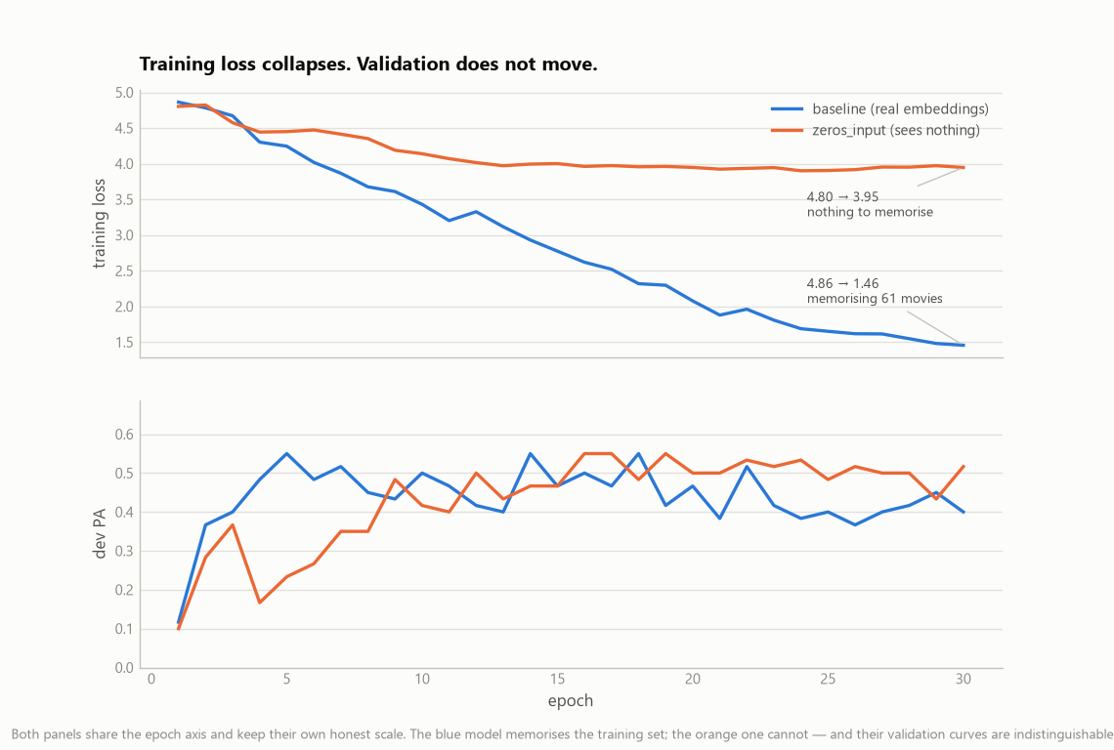
BACKUP · OVERFITTING
The falling training loss is memorization, not learning
Two panels share the epoch axis — no dual-axis scaling.
Notes:
Train loss collapses 4.86 → 1.46 while dev PA stays flat. The clincher is orange — zeros_input can't memorize (loss stalls at 3.95) yet its dev curve is indistinguishable. Can't regularize your way to signal that isn't there (weight_decay=1e-2 just drives loss to log(n_scenes)).

Slide 13
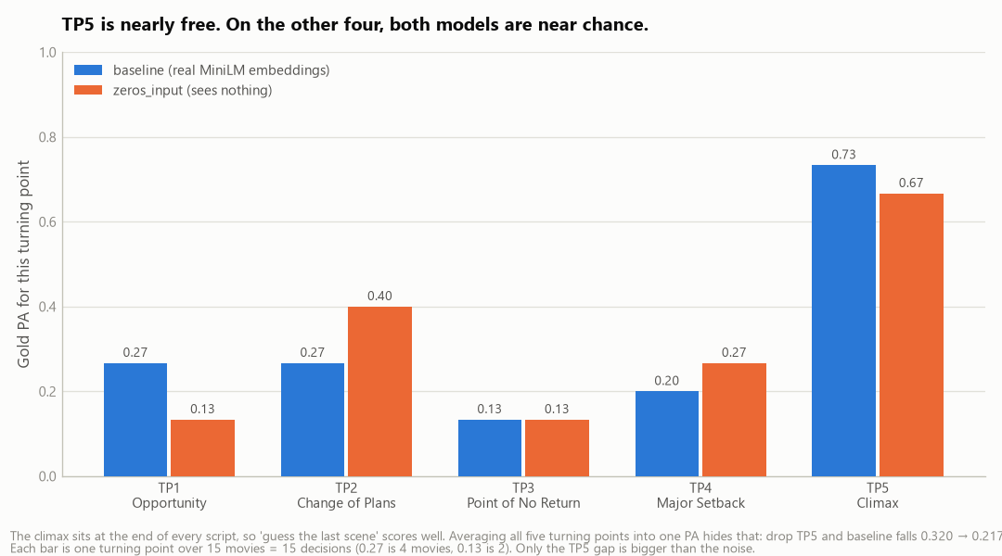
BACKUP · PER TURNING POINT
TP5 is nearly free — it inflates the headline
Each bar is 15 decisions — only the TP5 gap clears the noise.
Notes:
The climax is at the end of every script, so 'guess the last scene' scores 0.67–0.73. Drop TP5 and both models fall toward random. About a fifth of the headline PA is a freebie.

Slide 14
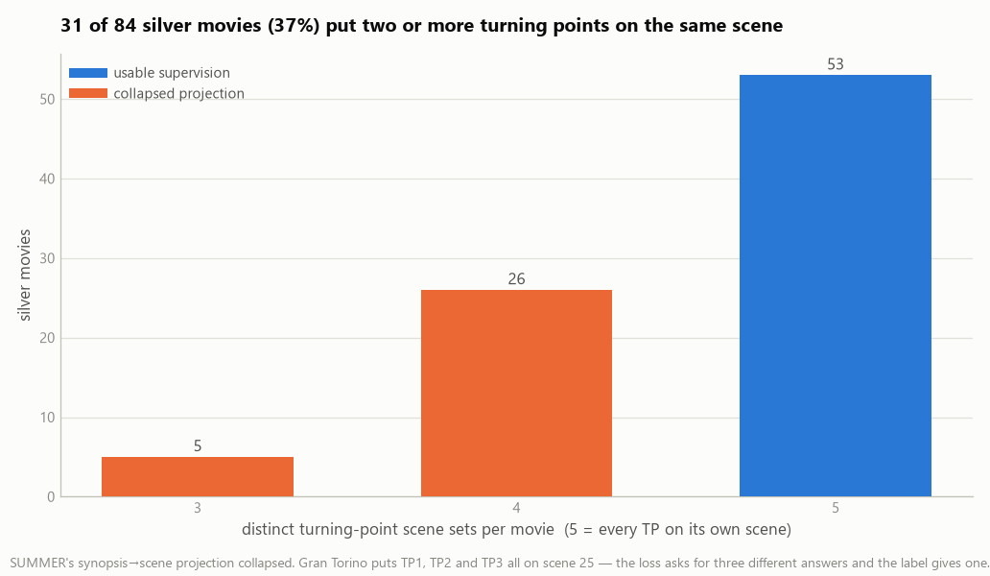
BACKUP · LABEL QUALITY
37% of the training labels are collapsed
Filtering to clean labels: ΔPA −0.093 on 230 decisions — content still hurt.
Notes:
SUMMER's synopsis→scene projection put 2+ turning points on the same scene for 37% of movies (Gran Torino: TP1=TP2=TP3=scene 25). I filtered to the clean ones and it did NOT help — so labels weren't the blocker either. That's part of why Week 4 reformulates instead of cleaning labels.

Slide 15
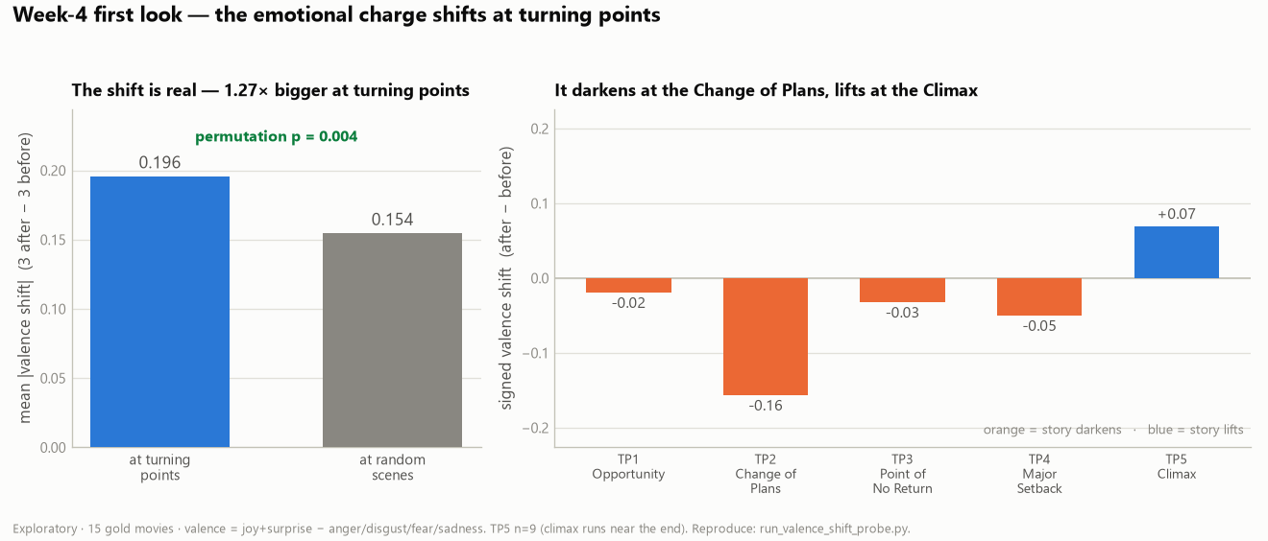
BACKUP · WEEK-4 FIRST LOOK
The emotional charge already shows a signal at turning points
1.27× bigger shift at TPs than random (p = 0.004) · darkens at the Change of Plans, lifts at the Climax.
Notes:
This is action-plan item 3, already run on the 15 gold movies (run_valence_shift_probe.py). LEFT: the valence shift — mean of the 3 scenes after each turning point minus the 3 before — is 1.27× bigger at real TPs than at random scenes, permutation p = 0.004. RIGHT: signed, it darkens most at the Change of Plans (−0.16) and is the only one that lifts at the Climax (+0.07). Exploratory — 15 movies, and TP5's n is small because the climax sits near the end. But it's a real first pattern, and it's both an ML signal and a business story. Show this only if the emotion/business-value conversation goes deep.

