Slide 1
CS186 Discussion #6
(ER Diagrams, Advanced SQL)

Slide 2
Announcements
Midterm in class: Thursday 3/5, 2-3:30pm
Review session: Sunday 3/1, 2-4pm @ 2050 VLSB

Slide 3
ER Diagrams

Slide 4
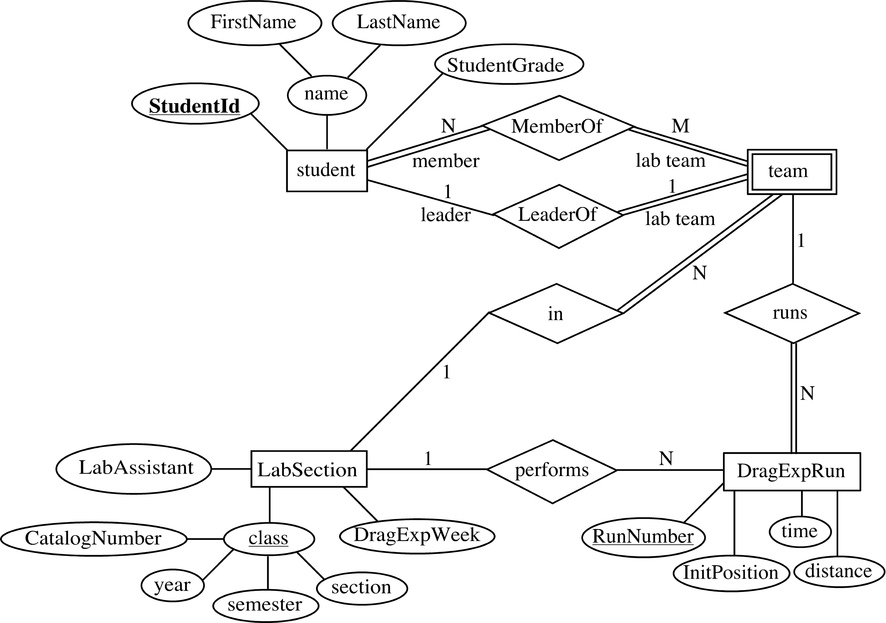
Motivation
Visualize data schema

Slide 5
Entities
Entity: “thing”
Attribute: Property of the entity
Primary key underlined
artist_id
artist_name
first_year_active
Artist

Slide 6
Relationships
How two entities interact
artist_id
artist_name
first_year_active
album_id
album_name
genre
Artist
Released
Album
Artist 4 released album 2.

Slide 7
Relationships
How two entities interact
Interactions can have attributes
date
artist_id
artist_name
first_year_active
album_id
album_name
genre
Artist
Released
Album
Artist 4 released album 2 on February 27, 2015.

Slide 8
Constraints
Make relationship lines meaningful
Participation constraint (Partial/Total)
Total participation: participates at least once
Key/Non-key constraint
Key: Participates at most once
 | Partial Participation | Total Participation
Non-Key | 0 or More | 1 or More
Key | 0 or 1 | Exactly 1

Slide 9
Constraints
date
artist_id
artist_name
first_year_active
album_id
album_name
genre
Artist
Released
Album
Non-Key constraint with partial participation

Slide 10
Constraints
date
artist_id
artist_name
first_year_active
album_id
album_name
genre
Artist
Released
Album
Non-Key constraint with partial participation
An artist can release an album zero or more times.

Slide 11
Constraints
date
artist_id
artist_name
first_year_active
album_id
album_name
genre
Artist
Released
Album
Non-Key constraint with total participation

Slide 12
Constraints
date
artist_id
artist_name
first_year_active
album_id
album_name
genre
Artist
Released
Album
Non-Key constraint with total participation
An artist can release an album one or more times.

Slide 13
Constraints
date
artist_id
artist_name
first_year_active
album_id
album_name
genre
Artist
Released
Album
Key constraint with partial participation

Slide 14
Constraints
date
artist_id
artist_name
first_year_active
album_id
album_name
genre
Artist
Released
Album
Key constraint with partial participation
An artist can release an album zero or one times.

Slide 15
Constraints
date
artist_id
artist_name
first_year_active
album_id
album_name
genre
Artist
Released
Album
Key constraint with total participation

Slide 16
Constraints
date
artist_id
artist_name
first_year_active
album_id
album_name
genre
Artist
Released
Album
Key constraint with total participation
An artist can release exactly one album.

Slide 17
We want…
date
artist_id
artist_name
first_year_active
album_id
album_name
genre
Artist
Released
Album
Non-Key constraint with partial participation
An artist can release an album zero or more times.

Slide 18
What constraint do we want from Album?
date
artist_id
artist_name
first_year_active
album_id
album_name
genre
Artist
Released
Album
An album can be released 0 or more times.
An album can be released 1 or more times.
An album can be released 0 or 1 times.
An album is released exactly once.

Slide 19
What constraint do we want from Album?
date
artist_id
artist_name
first_year_active
album_id
album_name
genre
Artist
Released
Album
An album can be released 0 or more times.
An album can be released 1 or more times.
An album can be released 0 or 1 times.
An album is released exactly once.

Slide 20
date
artist_id
artist_name
first_year_active
album_id
album_name
genre
Artist
Released
Album
An artist may release zero or more albums.
An album may be released or unreleased.

Slide 21
Ternary Relations
artist_id
artist_name
first_year_active
album_id
album_name
genre
Artist
Released
Album
?
date
Day
isFriday
An artist may release zero or more albums.
An album may be released or unreleased.
Releasing an album can occur ??? times a day.

Slide 22
Ternary Relations
artist_id
artist_name
first_year_active
album_id
album_name
genre
Artist
Released
Album
date
Day
isFriday
An artist may release zero or more albums.
An album may be released or unreleased.
Releasing an album can occur 0 or more times a day.

Slide 23
Weak Entities
Weak entity can only be identified only when considering primary key of another (owner) entity.
artist_id
artist_name
first_year_active
song_name
Artist
Writes
Song
Song’s key is actually (Artist.artist_id, Song.song_name)
Can there be two songs with the same name?
How about by the same artist?
Can a song exist without an artist?

Slide 24
Worksheet #7, 8, 9

Slide 25
Every Team in our database will have a team_id, a team_name and a stadium where they play their games. Each Player will have a player_id, name and their average score (This can be used for any sport!). Finally our database will contain who Plays_For which team and also the “position” that the player plays in.
Assume that a player can play in more than one team (Yes, our league has different rules!) and that a team needs at least one player.

Slide 26
Every Team in our database will have a team_id, a team_name and a stadium where they play their games. Each Player will have a player_id, name and their average score (This can be used for any sport!). Finally our database will contain who Plays_For which team and also the “position” that the player plays in.
Assume that a player can play in more than one team (Yes, our league has different rules!) and that a team needs at least one player.
position
team_name
stadium
player_id
name
avg_score
Team
Plays_For
Player

Slide 27
Every Team in our database will have a team_id, a team_name and a stadium where they play their games. Each Player will have a player_id, name and their average score (This can be used for any sport!). Finally our database will contain who Plays_For which team and also the “position” that the player plays in.
Now let’s say we want to also track who is the captain of every team. How will the ER diagram change from the previous case? Note: Every team needs exactly one captain!

Slide 28
Every Team in our database will have a team_id, a team_name and a stadium where they play their games. Each Player will have a player_id, name and their average score (This can be used for any sport!). Finally our database will contain who Plays_For which team and also the “position” that the player plays in.
Now let’s say we want to also track who is the captain of every team. How will the ER diagram change from the previous case? Note: Every team needs exactly one captain!
position
team_name
stadium
player_id
name
avg_score
Team
Plays_For
Player
Captains

Slide 29
Every Team in our database will have a team_id, a team_name and a stadium where they play their games. Each Player will have a player_id, name and their average score (This can be used for any sport!). Finally our database will contain who Plays_For which team and also the “position” that the player plays in.
Are there are any weak-entity relationships in either of our ER diagrams?

Slide 30
Every Team in our database will have a team_id, a team_name and a stadium where they play their games. Each Player will have a player_id, name and their average score (This can be used for any sport!). Finally our database will contain who Plays_For which team and also the “position” that the player plays in.
Are there are any weak-entity relationships in either of our ER diagrams?
No. A weak entity can be identified uniquely only by considering the primary key of another (owner) entity.
Example of possible weak entity: Coaches
team_name
stadium
name
age
Team
Coaches
Coach
A team can have many coaches, but each coach exactly coaches one team.

Slide 31
Advanced SQL

Slide 32
SELECT [DISTINCT] <column list>
FROM <table name>
[WHERE <predicate>]
[GROUP BY <column list> [HAVING <predicate>]]
[ORDER BY <column list>]
[LIMIT <#>];
SELECT standing, gpa, COUNT(*)
FROM Students
WHERE sname STARTS_WITH ‘A’
GROUP BY standing, gpa
HAVING COUNT(*) > 3;

Slide 33
SELECT [DISTINCT] <column list>
FROM <table name> [INNER | {LEFT | RIGHT| FULL} {OUTER}] JOIN <table name> ON <qualification list>
[WHERE <predicate>]…

Slide 34
Inner Join
SELECT s.sid, s.name, g.gpa
FROM Students s INNER JOIN Grades g
ON s.sid = g.sid;
Students
Grades
name
sid
sid
gpa
Bob
1
1
3.7
Sue
3
2
2.9
Ron
2

Slide 35
Inner Join
SELECT s.sid, s.name, g.gpa
FROM Students s INNER JOIN Grades g
ON s.sid = g.sid;
s.sid
s.name
g.gpa
1
Bob
3.7
2
Ron
2.9

Slide 36
Left Outer Join
SELECT s.sid, s.name, g.gpa
FROM Students s LEFT OUTER JOIN Grades g
ON s.sid = g.sid;
Students
Grades
name
sid
sid
gpa
Bob
1
1
3.7
Sue
3
2
2.9
Ron
2

Slide 37
Left Outer Join
SELECT s.sid, s.name, g.gpa
FROM Students s LEFT OUTER JOIN Grades g
ON s.sid = g.sid;
s.sid
s.name
g.gpa
1
Bob
3.7
2
Ron
2.9
3
Sue

Slide 38
Right Outer Join
SELECT s.name, g.sid, g.gpa
FROM Students s RIGHT OUTER JOIN Grades g
ON s.sid = g.sid;
Students
Grades
name
sid
sid
gpa
Bob
1
1
3.7
Sue
3
2
2.9
Ron
2
5
4.0

Slide 39
Right Outer Join
SELECT s.name, g.sid, g.gpa
FROM Students s RIGHT OUTER JOIN Grades g
ON s.sid = g.sid;
s.name
g.sid
g.gpa
Bob
1
3.7
Ron
2
2.9
5
4.0

Slide 40
Full Outer Join
SELECT s.name, s.sid, g.sid, g.gpa
FROM Students s FULL OUTER JOIN Grades g
ON s.sid = g.sid;
Students
Grades
name
sid
sid
gpa
Bob
1
1
3.7
Sue
3
2
2.9
Ron
2
5
4.0

Slide 41
Full Outer Join
SELECT s.name, s.sid, g.sid, g.gpa
FROM Students s FULL OUTER JOIN Grades g
ON s.sid = g.sid;
s.name
s.sid
g.sid
g.gpa
Bob
1
1
3.7
Sue
3
Ron
2
2
2.9
5
4.0

Slide 42
Worksheet #1-6

Slide 43
Songs(song_id, song_name,album_id, weeks_in_top_40)
Artists(artist_id, artist_name, first_year_active)
Albums (album_id, album_name, artist_id, year_released, genre)
Find all album id’s and names for every artist active since 2000 or later. If an artist does not have any albums, you should still include the artist's information in your output.

Slide 44
Songs(song_id, song_name,album_id, weeks_in_top_40)
Artists(artist_id, artist_name, first_year_active)
Albums (album_id, album_name, artist_id, year_released, genre)
Find all album id’s and names for every artist active since 2000 or later. If an artist does not have any albums, you should still include the artist's information in your output.
SELECT Ar.artist_id, Ar.artist_name, Al.album_id, Al.album_name
FROM Artists Ar
LEFT OUTER JOIN Albums Al
ON Ar.artist_id=Al.artist_id
WHERE Ar.first_year_active >= 2000;

Slide 45
Songs(song_id, song_name,album_id, weeks_in_top_40)
Artists(artist_id, artist_name, first_year_active)
Albums (album_id, album_name, artist_id, year_released, genre)
Find the id and name for each song released in the first year that the artist for the album was active.

Slide 46
Songs(song_id, song_name,album_id, weeks_in_top_40)
Artists(artist_id, artist_name, first_year_active)
Albums (album_id, album_name, artist_id, year_released, genre)
Find the id and name for each song released in the first year that the artist for the album was active.
SELECT S.song_id, S.song_name, Ar.artist_id, Ar.artist_name
FROM Songs S
INNER JOIN Albums Al
ON S.album_id=Al.album_id
INNER JOIN Artists Ar
ON Al.artist_id=Ar.artist_id
AND Al.year_released=Ar.first_year_active;

Slide 47
Songs(song_id, song_name,album_id, weeks_in_top_40)
Artists(artist_id, artist_name, first_year_active)
Albums (album_id, album_name, artist_id, year_released, genre)
Find the id and name for each artist who has albums of genre “pop” and “rock”.

Slide 48
Songs(song_id, song_name,album_id, weeks_in_top_40)
Artists(artist_id, artist_name, first_year_active)
Albums (album_id, album_name, artist_id, year_released, genre)
Find the id and name for each artist who has albums of genre “pop” and “rock”.
SELECT Ar.artist_id, Ar.artist_name
FROM Albums Al1
INNER JOIN Albums Al2 ON
Al1.artist_id=Al2.artist_id
INNER JOIN Artists Ar ON
Al2.artist_id=Ar.artist_id;
WHERE Al1.genre="pop"
AND Al2.genre="rock"

Slide 49
What is the difference between INNER JOIN and an implicit join (writing the join predicate as part of the WHERE statement)?

Slide 50
What is the difference between INNER JOIN and an implicit join (writing the join predicate as part of the WHERE statement)?
Semantically, no difference.
INNER JOIN makes the join more readable, especially if you have a lot of predicates in the WHERE statement.
Since INNER JOIN requires an ON predicate, it is more difficult to forget a join condition

Slide 51
Songs(song_id, song_name,album_id, weeks_in_top_40)
Artists(artist_id, artist_name, first_year_active)
Albums (album_id, album_name, artist_id, year_released, genre)
Find all artists who released more songs in 2014 than Taylor Swift. Include the number of songs that each artist released.

Slide 52
Songs(song_id, song_name,album_id, weeks_in_top_40)
Artists(artist_id, artist_name, first_year_active)
Albums (album_id, album_name, artist_id, year_released, genre)
Find all artists who released more songs in 2014 than Taylor Swift. Include the number of songs that each artist released.
WITH Taylor2014(cnt) AS
(SELECT COUNT(*)
FROM Songs S
INNER JOIN Albums Al ON S.album_id=Al.album_id
INNER JOIN Artists Ar ON Al.artist_id=Ar.artist_id
WHERE Al.year_released=2014
AND Ar.artist_name="Taylor Swift")
SELECT Ar.artist_id, Ar.artist_name, COUNT(*)
FROM Songs S, Taylor2014 T
INNER JOIN Albums Al ON S.album_id=Al.album_id
INNER JOIN Artists Ar ON Al.artist_id=Ar.artist_id
WHERE Al.year_released=2014
GROUP BY Ar.artist_id
HAVING COUNT(*) > T.cnt;

Slide 53
Songs(song_id, song_name,album_id, weeks_in_top_40)
Artists(artist_id, artist_name, first_year_active)
Albums (album_id, album_name, artist_id, year_released, genre)
Find all artists who released songs in 2014 or released songs that spent more than 10 weeks in the top 40.

Slide 54
Songs(song_id, song_name,album_id, weeks_in_top_40)
Artists(artist_id, artist_name, first_year_active)
Albums (album_id, album_name, artist_id, year_released, genre)
Find all artists who released songs in 2014 or released songs that spent more than 10 weeks in the top 40.
WITH Temp(artist_id) AS
(SELECT Al.artist_id
FROM Albums Al
WHERE Al.year_released=2014
UNION
SELECT Al.artist_id
FROM Albums Al
INNER JOIN Songs S ON Al.album_id=S.album_id
WHERE S.weeks_in_top_40>10)
SELECT Ar.artist_id, Ar.artist_name
FROM Artists Ar
INNER JOIN Temp T ON Ar.artist_id=T.artist_id;

