Slide 1
CS186 Discussion #14
(Logging & Recovery)

Slide 2
ACID
Atomicity: either none or all instructions committed
Consistency: database remains in consistent state
Isolation: runs as if it is only transaction
Durability: committed changes are never lost

Slide 3
Buffer Policies
NO STEAL: Don’t let system “steal” pages with uncommitted updates from buffer pool and write them to disk
STEAL:
Allow uncommitted data in disk
Requires UNDO to preserve atomicity

Slide 4
Buffer Policies
FORCE: “Force” buffer manager to write dirty pages to disk before committing
NO FORCE:
Allow commits before updates are written to disk
Requires REDO to preserve durability

Slide 5
Buffer Policies
NO STEAL/FORCE
Guarantees atomicity and durability
Slow at commit time
STEAL/NO FORCE
No guarantees about atomicity and durability
Much faster
Use write ahead logging!

Slide 6
Write-Ahead Logging
Log everything:
Starts
Updates
Commits
Aborts
Force log record for updates before updated data written to disk
Transaction not committed until all logs on disk
LSN
Log
prevLSN
10
T1 Start
null
20
T1 writes P5
10
30
T1 writes P1
20
40
T1 Commit
30
50
T1 End
40

Slide 7
Log Record
LSN (“Log Sequence Number”): globally increasing ID for log records
prevLSN: LSN of the last operation for this xact
<LSN, pageID, offset, old data, new data, prevLSN>
20
T1 writes P5
10

Slide 8
Transaction Table
Tells which xacts are currently running
Contains:
XID: Transaction ID
Status: Running/Committing/Aborting
lastLSN: most recent LSN written by xact

Slide 9
…
50
T1 writes P5
40
60
T2 Commit
30
70
T3 Abort
20
80
T4 Commit
10
90
T4 End
80

Slide 10
…
50
T1 writes P5
40
60
T2 Commit
30
70
T3 Abort
20
80
T4 Commit
10
90
T4 End
80
Transaction Table
XID
State
LastLSN

Slide 11
…
50
T1 writes P5
40
60
T2 Commit
30
70
T3 Abort
20
80
T4 Commit
10
90
T4 End
80
Transaction Table
XID
State
LastLSN
1
Running
50

Slide 12
…
50
T1 writes P5
40
60
T2 Commit
30
70
T3 Abort
20
80
T4 Commit
10
90
T4 End
80
Transaction Table
XID
State
LastLSN
1
Running
50
2
Committing
60

Slide 13
…
50
T1 writes P5
40
60
T2 Commit
30
70
T3 Abort
20
80
T4 Commit
10
90
T4 End
80
Transaction Table
XID
State
LastLSN
1
Running
50
2
Committing
60
3
Aborting
70

Slide 14
Dirty Page Table
Tells which buffer pages are dirty
Contains:
PageID
recLSN: LSN of first update that dirtied this page

Slide 15
Checkpoints
begin_checkpoint: Indicates when checkpt began
end_checkpoint:
Record contains current xact table and dirty page table
Accurate only as of time of begin_checkpoint
Store LSN of most recent checkpoint

Slide 16
Normal Execution of Xact
Series of reads and writes followed by commit or abort
Commit: Flush logs to disk
Abort: Undo all of xact’s changes
Get lastLSN of xact and follow chain of prevLSNs
Write a CLR (“compensation log record”) for each UNDO

Slide 17
Example Abort
LSN
Log
prevLSN
20
T1 writes P5
null
30
T1 writes P6
20
40
T1 Abort
30
50
CLR: Undo T1 LSN=30, undoNextLSN=20
40
60
CLR: Undo T1 LSN=20, undoNextLSN=null
50
70
T1 End
60

Slide 18
ARIES
Find failed and committed xacts since checkpoint
Re-apply changes made by committed xacts
Undo changes made by failed xacts

Slide 19
Analyze - DPT
Rebuilding dirty page table:
Start from checkpoint DPT
Add new entry for every dirtied page
recLSN = LSN
Create conservative approximation of DPT
Entries may have already been flushed

Slide 20
LSN
Log
prevLSN
30
T1 writes P5
10
40
T1 writes P6
30
50
T2 writes P1
20
Dirty Page Table @ Checkpoint
Page ID
recLSN
1
10

Slide 21
LSN
Log
prevLSN
30
T1 writes P5
10
40
T1 writes P6
30
50
T2 writes P1
20
Dirty Page Table
Page ID
recLSN
1
10
5
30

Slide 22
LSN
Log
prevLSN
30
T1 writes P5
10
40
T1 writes P6
30
50
T2 writes P1
20
Dirty Page Table
Page ID
recLSN
1
10
5
30
6
40

Slide 23
Analyze - Xact Table
Rebuilding xact table:
Remove xacts when you see END
Add/change xact states and lastLSNs as you go
Table will be precisely correct to last log flush before crash

Slide 24
30
T1 writes P6
20
40
T1 Abort
30
50
CLR: Undo T1 LSN=30, undoNextLSN=20
40
60
CLR: Undo T1 LSN=20, undoNextLSN=null
50
70
T2 End
10
Transaction Table @ Checkpoint
XID
State
LastLSN
1
Running
20
2
Running
10

Slide 25
30
T1 writes P6
20
40
T1 Abort
30
50
CLR: Undo T1 LSN=30, undoNextLSN=20
40
60
CLR: Undo T1 LSN=20, undoNextLSN=null
50
70
T2 End
10
Transaction Table
XID
State
LastLSN
1
Running
30
2
Running
10

Slide 26
30
T1 writes P6
20
40
T1 Abort
30
50
CLR: Undo T1 LSN=30, undoNextLSN=20
40
60
CLR: Undo T1 LSN=20, undoNextLSN=null
50
70
T2 End
10
Transaction Table
XID
State
LastLSN
1
Aborting
40
2
Running
10

Slide 27
30
T1 writes P6
20
40
T1 Abort
30
50
CLR: Undo T1 LSN=30, undoNextLSN=20
40
60
CLR: Undo T1 LSN=20, undoNextLSN=null
50
70
T2 End
10
Transaction Table
XID
State
LastLSN
1
Aborting
50
2
Running
10

Slide 28
30
T1 writes P6
20
40
T1 Abort
30
50
CLR: Undo T1 LSN=30, undoNextLSN=20
40
60
CLR: Undo T1 LSN=20, undoNextLSN=null
50
70
T2 End
10
Transaction Table
XID
State
LastLSN
1
Aborting
60
2
Running
10

Slide 29
30
T1 writes P6
20
40
T1 Abort
30
50
CLR: Undo T1 LSN=30, undoNextLSN=20
40
60
CLR: Undo T1 LSN=20, undoNextLSN=null
50
70
T2 End
10
Transaction Table
XID
State
LastLSN
1
Aborting
60

Slide 30
Worksheet #1a,b

Slide 31
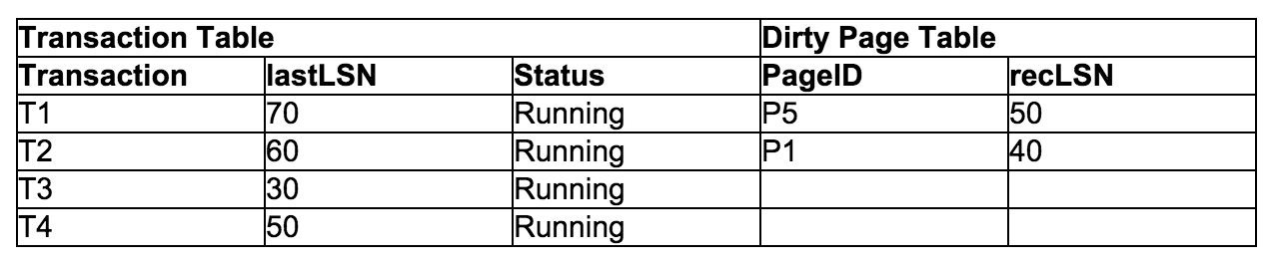
The log record at LSN 60 says that transaction 2 updated page 5. Was this update to page 5 successfully written to disk?

Slide 32
The log record at LSN 60 says that transaction 2 updated page 5. Was this update to page 5 successfully written to disk?
Update at LSN 60 MAY have been written to disk. The page was not yet flushed at the time of the checkpoint, but may have flushed later, because of the NO FORCE policy.

Slide 33
The log record at LSN 70 says that transaction 1 updated page 2. Was this update to page 2 successfully written to disk?

Slide 34
The log record at LSN 70 says that transaction 1 updated page 2. Was this update to page 2 successfully written to disk?
Update at LSN 70 was flushed to disk because P2 was not in the dirty page table at the time of the checkpoint.

Slide 35
Transaction Table
XID
LastLSN
Status
T1
70
Running
T2
60
Running
T3
30
Running
T4
50
Running
Dirty Page Table
Page ID
recLSN
P5
50
P1
40

Slide 36
Transaction Table
XID
LastLSN
Status
T1
90
Running
T2
60
Running
T3
30
Running
T4
50
Running
Dirty Page Table
Page ID
recLSN
P5
50
P1
40
P3
90

Slide 37
Transaction Table
XID
LastLSN
Status
T1
90
Running
T2
110
Running
T3
30
Running
T4
50
Running
Dirty Page Table
Page ID
recLSN
P5
50
P1
40
P3
90

Slide 38
Transaction Table
XID
LastLSN
Status
T1
90
Running
T2
120
Committing
T3
30
Running
T4
50
Running
Dirty Page Table
Page ID
recLSN
P5
50
P1
40
P3
90

Slide 39
Transaction Table
XID
LastLSN
Status
T1
90
Running
T2
120
Committing
T3
30
Running
T4
130
Running
Dirty Page Table
Page ID
recLSN
P5
50
P1
40
P3
90

Slide 40
Transaction Table
XID
LastLSN
Status
T1
90
Running
T3
30
Running
T4
130
Running
Dirty Page Table
Page ID
recLSN
P5
50
P1
40
P3
90

Slide 41
Transaction Table
XID
LastLSN
Status
T1
90
Running
T3
30
Running
T4
150
Aborting
Dirty Page Table
Page ID
recLSN
P5
50
P1
40
P3
90

Slide 42
Transaction Table
XID
LastLSN
Status
T1
90
Running
T3
30
Running
T4
150
Aborting
T5
160
Running
Dirty Page Table
Page ID
recLSN
P5
50
P1
40
P3
90
P2
160

Slide 43
Transaction Table
XID
LastLSN
Status
T1
90
Running
T3
30
Running
T4
180
Aborting
T5
160
Running
Dirty Page Table
Page ID
recLSN
P5
50
P1
40
P3
90
P2
160

Slide 44
REDO
Start at the smallest recLSN in DPT
Redo each log record or CLR except if:
Affected page is not in DPT
Affected page is in DPT, but:
recLSN > LSN, or
pageLSN (in DB) ≥ LSN

Slide 45
LSN
Log
prevLSN
30
T1 writes P5
10
40
T1 writes P6
30
50
T2 writes P1
20
60
T1 writes P1
40
Dirty Page Table
Page ID
recLSN
1
60
6
40

Slide 46
LSN
Log
prevLSN
30
T1 writes P5
10
40
T1 writes P6
30
50
T2 writes P1
20
60
T1 writes P1
40
Dirty Page Table
Page ID
recLSN
1
60
6
40
REDO: 40, 60

Slide 47
Worksheet #1c

Slide 48
At which LSN in the log should redo begin? Which log records will be redone (list their LSNs)? All other log records will be skipped.

Slide 49
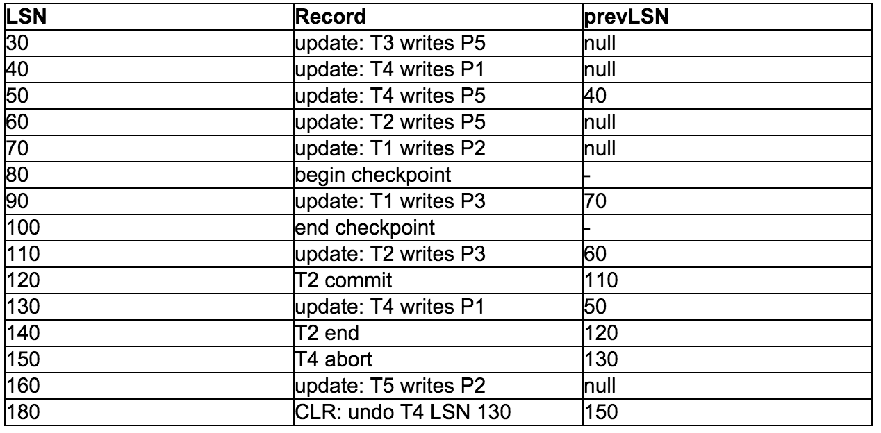
Start at the smallest recLSN in DPT: 40
Dirty Page Table
Page ID
recLSN
P5
50
P1
40
P3
90
P2
160
REDO:

Slide 50
Start at the smallest recLSN in DPT: 40
Dirty Page Table
Page ID
recLSN
P5
50
P1
40
P3
90
P2
160
REDO: 40

Slide 51
Start at the smallest recLSN in DPT: 40
Dirty Page Table
Page ID
recLSN
P5
50
P1
40
P3
90
P2
160
REDO: 40, 50

Slide 52
Start at the smallest recLSN in DPT: 40
Dirty Page Table
Page ID
recLSN
P5
50
P1
40
P3
90
P2
160
REDO: 40, 50, 60

Slide 53
Start at the smallest recLSN in DPT: 40
recLSN > LSN
Dirty Page Table
Page ID
recLSN
P5
50
P1
40
P3
90
P2
160
REDO: 40, 50, 60

Slide 54
Start at the smallest recLSN in DPT: 40
Dirty Page Table
Page ID
recLSN
P5
50
P1
40
P3
90
P2
160
REDO: 40, 50, 60, 90

Slide 55
Start at the smallest recLSN in DPT: 40
Dirty Page Table
Page ID
recLSN
P5
50
P1
40
P3
90
P2
160
REDO: 40, 50, 60, 90, 110

Slide 56
Start at the smallest recLSN in DPT: 40
Dirty Page Table
Page ID
recLSN
P5
50
P1
40
P3
90
P2
160
REDO: 40, 50, 60, 90, 110, 130

Slide 57
Start at the smallest recLSN in DPT: 40
Dirty Page Table
Page ID
recLSN
P5
50
P1
40
P3
90
P2
160
REDO: 40, 50, 60, 90, 110, 130, 160

Slide 58
Start at the smallest recLSN in DPT: 40
Dirty Page Table
Page ID
recLSN
P5
50
P1
40
P3
90
P2
160
REDO: 40, 50, 60, 90, 110, 130, 160, 180

Slide 59
UNDO
ToUndo = {lastLSN of all Xacts in Xact Table}
while ToUndo not empty:
Choose largest LSN in ToUndo (most recent)
If LSN is an update record:
UNDO, write CLR, and add prevLSN to ToUndo.
If LSN is a CLR and undoNextLSN != null:
Add undoNextLSN to ToUndo
If LSN is a CLR and undoNextLSN == null:
Write END

Slide 60
Worksheet #2

Slide 61
During Analysis, what log records are read? What are the contents of the transaction table and the dirty page table at the end of the analysis stage?

Slide 62
During Analysis, what log records are read? What are the contents of the transaction table and the dirty page table at the end of the analysis stage?
All records since last checkpoint are read.

Slide 63
Transaction Table
XID
LastLSN
Status
Dirty Page Table
Page ID
recLSN

Slide 64
Transaction Table
XID
LastLSN
Status
T1
10
Running
Dirty Page Table
Page ID
recLSN
P1
10

Slide 65
Transaction Table
XID
LastLSN
Status
T1
10
Running
T2
20
Running
Dirty Page Table
Page ID
recLSN
P1
10
P3
20

Slide 66
Transaction Table
XID
LastLSN
Status
T1
30
Committing
T2
20
Running
Dirty Page Table
Page ID
recLSN
P1
10
P3
20

Slide 67
Transaction Table
XID
LastLSN
Status
T1
30
Committing
T2
20
Running
T3
40
Running
Dirty Page Table
Page ID
recLSN
P1
10
P3
20
P4
40

Slide 68
Transaction Table
XID
LastLSN
Status
T1
30
Committing
T2
50
Running
T3
40
Running
Dirty Page Table
Page ID
recLSN
P1
10
P3
20
P4
40

Slide 69
Transaction Table
XID
LastLSN
Status
T2
50
Running
T3
40
Running
Dirty Page Table
Page ID
recLSN
P1
10
P3
20
P4
40

Slide 70
Transaction Table
XID
LastLSN
Status
T2
50
Running
T3
70
Running
Dirty Page Table
Page ID
recLSN
P1
10
P3
20
P4
40
P2
70

Slide 71
Transaction Table
XID
LastLSN
Status
T2
80
Aborting
T3
70
Running
Dirty Page Table
Page ID
recLSN
P1
10
P3
20
P4
40
P2
70

Slide 72
During Redo, what log records are read? What data pages are read? What operations are redone (assuming no updates made it out to disk before the crash)?

Slide 73
During Redo, what log records are read? What data pages are read? What operations are redone (assuming no updates made it out to disk before the crash)?
Read all log records after 10 (smallest recLSN in DPT)
Read all pages in DPT
Assuming no updates made it to disk, all updates and CLR’s are redone.
LSN’s: 10, 20, 40, 50, 70.

Slide 74
During Undo, what log records are read? What operations are undone? Show any new log records that are written for CLR’s. Start at LSN 100.

Slide 75
During Undo, what log records are read? What operations are undone? Show any new log records that are written for CLR’s. Start at LSN 100.
ToUndo: 80, 70

Slide 76
During Undo, what log records are read? What operations are undone? Show any new log records that are written for CLR’s. Start at LSN 100.
ToUndo: 70, 50
Read: 80

Slide 77
During Undo, what log records are read? What operations are undone? Show any new log records that are written for CLR’s. Start at LSN 100.
ToUndo: 50, 40
LSN
Log Record
100
CLR T3 LSN = 70; undoNextLSN = 40
Read: 80, 70
Undone: 70

Slide 78
During Undo, what log records are read? What operations are undone? Show any new log records that are written for CLR’s. Start at LSN 100.
ToUndo: 40, 20
LSN
Log Record
100
CLR T3 LSN = 70; undoNextLSN = 40
110
CLR T2 LSN = 50; undoNextLSN = 20
Read: 80, 70, 50
Undone: 70, 50

Slide 79
During Undo, what log records are read? What operations are undone? Show any new log records that are written for CLR’s. Start at LSN 100.
ToUndo: 20
LSN
Log Record
100
CLR T3 LSN = 70; undoNextLSN = 40
110
CLR T2 LSN = 50; undoNextLSN = 20
120
CLR T3 LSN = 40; undoNextLSN = null
130
T3 End
Read: 80, 70, 50, 40
Undone: 70, 50, 40

Slide 80
During Undo, what log records are read? What operations are undone? Show any new log records that are written for CLR’s. Start at LSN 100.
ToUndo:
LSN
Log Record
100
CLR T3 LSN = 70; undoNextLSN = 40
110
CLR T2 LSN = 50; undoNextLSN = 20
120
CLR T3 LSN = 40; undoNextLSN = null
130
T3 End
140
CLR T2 LSN = 20; undoNextLSN = null
150
T2 End
Read: 80, 70, 50, 40, 20
Undone: 70, 50, 40, 20

Slide 81
Thank you!

