Slide 1
CS186 Discussion #13
(Advanced Concurrency)

Slide 2
Lock Granularity
sid
points
grade
Bob
43
C
Joe
99
C
Alice
87
C
Suzy
50
C
Ted
73
C
Tim
12
C
T1: UPDATE students SET grade=‘A’ WHERE points >= 70;
T2: UPDATE students SET grade=‘F’ WHERE points < 70;

Slide 3
Lock Granularity
sid
points
grade
T1(X)
Bob
43
C
Joe
99
C
Alice
87
C
Suzy
50
C
Ted
73
C
Tim
12
C
T1: UPDATE students SET grade=‘A’ WHERE points >= 70;
T2: UPDATE students SET grade=‘F’ WHERE points < 70;

Slide 4
Lock Granularity
sid
points
grade
T1(X)
Bob
43
C
Joe
99
A
Alice
87
A
Suzy
50
C
Ted
73
A
Tim
12
C
T1: UPDATE students SET grade=‘A’ WHERE points >= 70;
T2: UPDATE students SET grade=‘F’ WHERE points < 70;

Slide 5
Lock Granularity
sid
points
grade
T2(X)
Bob
43
C
Joe
99
A
Alice
87
A
Suzy
50
C
Ted
73
A
Tim
12
C
T1: UPDATE students SET grade=‘A’ WHERE points >= 70;
T2: UPDATE students SET grade=‘F’ WHERE points < 70;

Slide 6
Lock Granularity
sid
points
grade
T2(X)
Bob
43
F
Joe
99
A
Alice
87
A
Suzy
50
F
Ted
73
A
Tim
12
F
T1: UPDATE students SET grade=‘A’ WHERE points >= 70;
T2: UPDATE students SET grade=‘F’ WHERE points < 70;

Slide 7
Lock Granularity
T1(IX)
sid
points
grade
Bob
43
C
T2(IX)
Joe
99
C
Alice
87
C
Suzy
50
C
Ted
73
C
Tim
12
C
T1: UPDATE students SET grade=‘A’ WHERE points >= 70;
T2: UPDATE students SET grade=‘F’ WHERE points < 70;

Slide 8
Lock Granularity
T1(IX)
sid
points
grade
Bob
43
F
T2(IX)
Joe
99
A
Alice
87
A
Suzy
50
F
Ted
73
A
Tim
12
F
Lock granularity maximizes concurrency and minimizes overhead.

Slide 9
Lock Hierarchy
Each Xact starts at root of hierarchy
Gets locks in top-down order
Releases locks in bottom-up order
Database
Tables
Pages
Tuples

Slide 10
Locks
IS: intent to get S lock(s) at finer granularity
IX: intent to get X lock(s) at finer granularity
SIX: shared lock, with intent to get X lock(s) at finer granularity

Slide 11
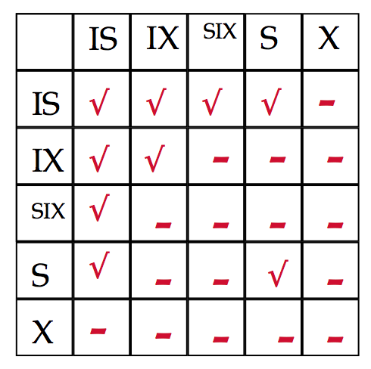
Lock Compatibility Matrix

Slide 12
Lock Granularity
T1(IX)
sid
points
grade
Bob
43
F
T2(X)
T2(IX)
Joe
99
A
T1(X)
Alice
87
A
T1(X)
Suzy
50
F
T2(X)
Ted
73
A
T1(X)
Tim
12
F
T2(X)

Slide 13
Worksheet - Lock Granularity

Slide 14
Suppose a transaction, T1, wants to scan a table R and update a few of its tuples. What kind of locks should T1 have on R, its pages, and the tuples that are updated?

Slide 15
Suppose a transaction, T1, wants to scan a table R and update a few of its tuples. What kind of locks should T1 have on R, its pages, and the tuples that are updated?
SIX lock on R
SIX lock on pages
X lock on updated tuples

Slide 16
Is an S lock compatible with an IX lock? Explain why or why not. Make your description as simple as possible.

Slide 17
Is an S lock compatible with an IX lock? Explain why or why not. Make your description as simple as possible.
Incompatible:
T1 has S lock on Students table to calculate average grade
T2 wants IX lock to change some grades

Slide 18
Index Concurrency
34
6
21
50
2
3
11
24
43
72
2PL on B+ tree is a bad idea!
Upper levels just to direct traffic.

Slide 19
B+ Tree
34
6
21
50
2
3
11
24
43
72

Slide 20
B-Link Tree
34
6
21
24
50
2
3
11
24
43
72

Slide 21
B-Link Tree
34
6
21
24
50
2
3
11
24
43
72
Each node has
right-link

Slide 22
B-Link Tree
Each node stores
“high key”
34
6
21
24
50
2
3
11
24
43
72
Each node has
right-link

Slide 23
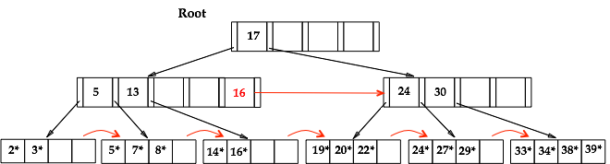
Search with Move Right
T1 searching for 39

Slide 24

Search with Move Right
T1 searching for 39
Reads:

Slide 25
Search with Move Right
T1 searching for 39
Reads:
T2, inserting 38, splits rightmost leaf

Slide 26

Search with Move Right
T1 searching for 39
Reads:
T2, inserting 38, splits rightmost leaf
T1 arrives at leaf that looks like:

Slide 27
Search with Move Right
T1 searching for 39
Reads:
T2, inserting 38, splits rightmost leaf
T1 arrives at leaf that looks like:
T1 moves right until it arrives at:

Slide 28
Latches
Unlatches almost immediately
Fast
In-memory next to data structure
Only DBMS engineers have access to APIs

Slide 29
Insertion
While traversing to leaf, keep stack of parents
If splits leaf, latch on parent
If high key on parent < key to insert, move right while latching and unlatching
Else insert key

Slide 30

doInsertion: split
parent
4
25
60
100
105
26
30
41
55
60
61
79
88
Insert 35

Slide 31
doInsertion: split
parent
4
25
60
100
105
26
30
60
61
79
88
35
41
55
Insert 35

Slide 32
doInsertion: split
parent
25
2
4
20
60
100
105
26
30
60
61
79
88
35
41
55
Insert 35

Slide 33
doInsertion: split
parent
25
2
4
20
60
100
105
26
30
60
61
79
88
35
41
55
Insert 35

Slide 34
doInsertion: split
parent
25
2
4
20
60
100
105
26
30
60
61
79
88
35
41
55
Insert 35

Slide 35
doInsertion: split
parent
25
2
4
20
60
100
105
26
30
60
61
79
88
35
41
55
Insert 35

Slide 36
doInsertion: split
parent
25
2
4
20
60
100
105
26
30
60
61
79
88
35
41
55
Insert 35

Slide 37
doInsertion: split
parent
25
2
4
20
35
60
100
105
26
30
60
61
79
88
35
41
55
Insert 35

Slide 38
Worksheet - B-Link Trees

Slide 39
What is the difference between a lock and a latch?

Slide 40
What is the difference between a lock and a latch?
Latches:
Internal to DBMS
Provide memory consistency
Unlatched almost immediately
Locks:
Often held for entire transaction duration
Provide logical transactional consistency

Slide 41
How many pages will be read to find 24? How many latches did T1 have to make?
25
10
16
63
100
3*
5*
11*
12*
18*
24*
32*
33*
81*
82*
101*
T1 has pointer to leaf page to read

Slide 42
How many pages will be read to find 24? How many latches did T1 have to make?
3*
5*
11*
12*
18*
24*
32*
33*
81*
82*
101*
T1 has pointer to leaf page to read

Slide 43
How many pages will be read to find 24? How many latches did T1 have to make?
Insert 17
17*
3*
5*
11*
12*
18*
24*
32*
33*
81*
82*
101*
T1 has pointer to leaf page to read

Slide 44
How many pages will be read to find 24? How many latches did T1 have to make?
Insert 17
3*
5*
11*
12*
17*
18*
24*
32*
33*
81*
82*
101*
T1 has pointer to leaf page to read

Slide 45
How many pages will be read to find 24? How many latches did T1 have to make?
Insert 20
20
3*
5*
11*
12*
17*
18*
24*
32*
33*
81*
82*
101*
T1 has pointer to leaf page to read

Slide 46
How many pages will be read to find 24? How many latches did T1 have to make?
Insert 20
3*
5*
11*
12*
17*
18*
20*
24*
32*
33*
81*
82*
101*
T1 has pointer to leaf page to read

Slide 47
How many pages will be read to find 24? How many latches did T1 have to make?
Insert 23
23
3*
5*
11*
12*
17*
18*
20*
24*
32*
33*
81*
82*
101*
T1 has pointer to leaf page to read

Slide 48
How many pages will be read to find 24? How many latches did T1 have to make?
Insert 23
5*
11*
…
3*
12*
17*
18*
20*
23*
24*
32*
33*
81*
82*
T1 has pointer to leaf page to read

Slide 49
How many pages will be read to find 24? How many latches did T1 have to make?
5*
11*
…
3*
12*
17*
18*
20*
23*
24*
32*
33*
81*
82*
T1 has pointer to leaf page to read

Slide 50
How many pages will be read to find 24? How many latches did T1 have to make?
4 pages read
0 latches
5*
11*
…
3*
12*
17*
18*
20*
23*
24*
32*
33*
81*
82*

Slide 51
How many latches made when inserting 99?
25
T1 has pointer to parent
10
16
63
100
3*
5*
11*
12*
18*
24*
32*
33*
81*
82*
101*

Slide 52
How many latches made when inserting 99?
34
T1 has pointer to parent
25
63
10
16
33
35
100
3*
5*
11*
12*
18*
24*
32*
33*
34*
35*
36*
81*
82*
101*

Slide 53
How many latches made when inserting 99?
34
T1 has pointer to parent
25
63
10
16
33
35
100
3*
5*
11*
12*
18*
24*
32*
33*
34*
35*
36*
81*
101*
82*
99*

Slide 54
How many latches made when inserting 99?
34
T1 has pointer to parent
25
63
10
16
33
35
100
3*
5*
11*
12*
18*
24*
32*
33*
34*
35*
36*
81*
101*
82*
99*

Slide 55
How many latches made when inserting 99?
34
T1 has pointer to parent
25
63
10
16
33
35
100
3*
5*
11*
12*
18*
24*
32*
33*
34*
35*
36*
81*
101*
82*
99*

Slide 56
How many latches made when inserting 99?
34
T1 has pointer to parent
25
63
10
16
33
35
100
3*
5*
11*
12*
18*
24*
32*
33*
34*
35*
36*
81*
101*
82*
99*

Slide 57
How many latches made when inserting 99?
34
T1 has pointer to parent
25
63
10
16
33
35
100
3*
5*
11*
12*
18*
24*
32*
33*
34*
35*
36*
81*
101*
82*
99*

Slide 58
How many latches made when inserting 99?
34
T1 has pointer to parent
25
63
10
16
33
35
100
3*
5*
11*
12*
18*
24*
32*
33*
34*
35*
36*
81*
101*
82*
99*

Slide 59
How many latches made when inserting 99?
34
T1 has pointer to parent
25
63
10
16
33
35
82
100
3*
5*
11*
12*
18*
24*
32*
33*
34*
35*
36*
81*
101*
82*
99*
3 latches

Slide 60
Multiversion Concurrency Control
Alternative to 2PL
Less waiting, but more aborts
Timestamp Ordered MVCC:
Each transaction gets timestamp upon entry
Keep timeline of read timestamps and versions

Slide 61
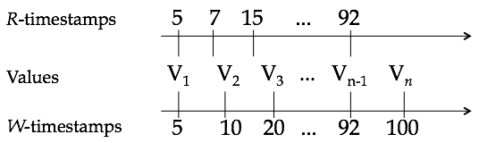
TO-MVCC

Slide 62
TO-MVCC
Reads: Read version with biggest timestamp smaller than
given timestamp

Slide 63
TO-MVCC
93
Reads: Read version with biggest timestamp smaller than
current timestamp
R(X) @ 93 will read V_{n-1}

Slide 64
TO-MVCC
Writes: Find interval from given timestamp X to smallest timestamp bigger than X
If there a read is in the interval, abort!

Slide 65
TO-MVCC
Writes: Find interval from given timestamp X to smallest timestamp bigger than X
If there a read is in the interval, abort!
W(X) @ 11

Slide 66
TO-MVCC
15 in interval,
abort!
Writes: Find interval from given timestamp X to smallest timestamp bigger than X
If there a read is in the interval, abort!
W(X) @ 11

Slide 67
TO-MVCC
Writes: Find interval from given timestamp X to smallest timestamp bigger than X
If there a read is in the interval, abort!
W(X) @ 8

Slide 68
TO-MVCC
V
8
Writes: Find interval from given timestamp X to smallest timestamp bigger than X
If there a read is in the interval, abort!
W(X) @ 8

Slide 69
Worksheet - MVCC

Slide 70
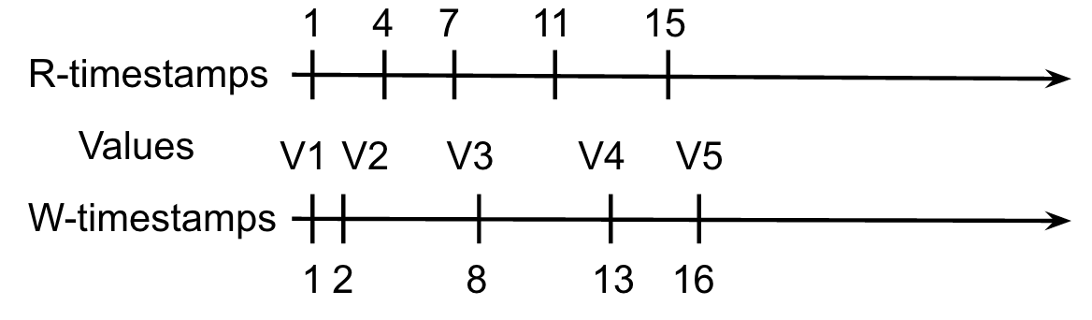
R(X)@17, W(X)@18, W(X)@14, W(X)@12, R(X)@20, R(X)@19, R(X)@23, W(X)@26, W(X)@24

Slide 71
R(X)@17, W(X)@18, W(X)@14, W(X)@12, R(X)@20, R(X)@19, R(X)@23, W(X)@26, W(X)@24
17

Slide 72
R(X)@17, W(X)@18, W(X)@14, W(X)@12, R(X)@20, R(X)@19, R(X)@23, W(X)@26, W(X)@24
17
V6
18

Slide 73
R(X)@17, W(X)@18, W(X)@14, W(X)@12, R(X)@20, R(X)@19, R(X)@23, W(X)@26, W(X)@24
17
V6
18

Slide 74
R(X)@17, W(X)@18, W(X)@14, W(X)@12, R(X)@20, R(X)@19, R(X)@23, W(X)@26, W(X)@24
17
V7
V6
12
18

Slide 75
R(X)@17, W(X)@18, W(X)@14, W(X)@12, R(X)@20, R(X)@19, R(X)@23, W(X)@26, W(X)@24
17
19
20
23
V7
V6
V9
V8
12
18
24
26

Slide 76
Weak Isolation
Transactions too restrictive
Allow changes to table while reading table?
Transactions too expensive
Lots of waiting

Slide 77
Isolation Levels
Read Uncommitted:
Can read dirty data
No locks on read
Read Committed:
Only read committed data
Can unlock immediately after read

Slide 78
Isolation Levels
Repeatable Read:
If value read twice in Xact, should see same committed version
Hold read locks until end of Xact
Serializable

Slide 79
Snapshot Isolation
Get snapshot of database when Xact starts
When Xact commits items, those items must not have changed since snapshot
If T1 and T2 start with the same snapshot and both modify same tuples, only one can commit.

Slide 80
Worksheet - Weak Isolation

Slide 81
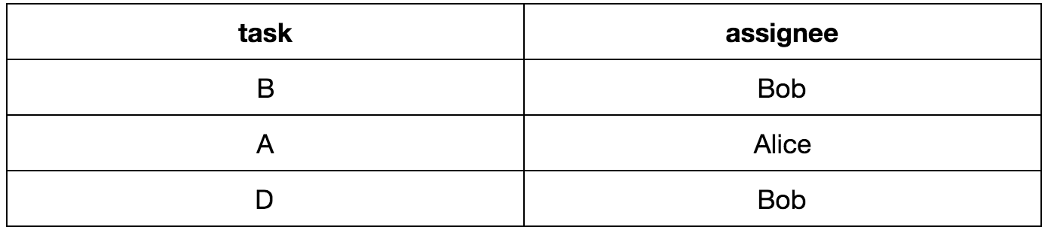
Outcome possible with serializable isolation?

Slide 82
Outcome possible with serializable isolation?
Yes. Serializable schedule is equivalent to serial execution.
Run T2 first, then abort T1 and T3.

Slide 83
Outcome possible with snapshot isolation?

Slide 84
Outcome possible with snapshot isolation?
Yes. Same reason as serializable. T2 can run first, commit,
then T1 and T3 abort.

Slide 85
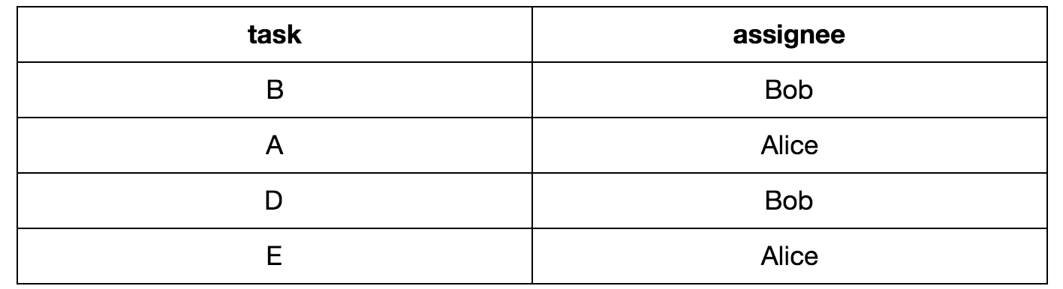
Outcome possible with serializable isolation?

Slide 86
Outcome possible with serializable isolation?
No. No way to run Xacts serially and have two Xacts commit.

Slide 87
Outcome possible with snapshot isolation?
Yes! T2 and T3 get same snapshot of initial db, and insert
their tasks. Their modified snapshots appear consistent, so both commit. T1 aborts.

Slide 88
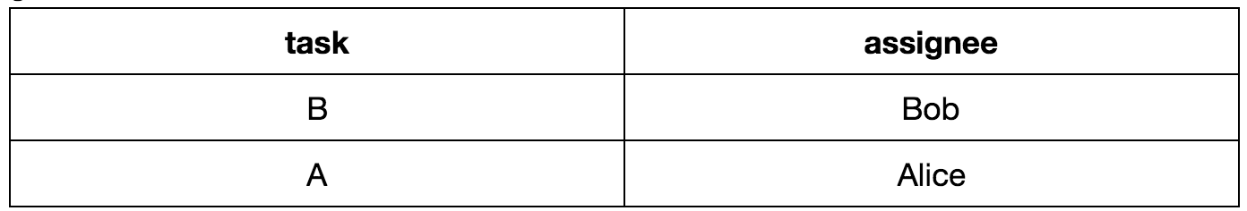
Outcome possible with serializable isolation?

Slide 89
Outcome possible with serializable isolation?
No. No way to run Xacts serially and no Xacts commit.

Slide 90
Outcome possible with read uncommitted isolation?
Yes. All three requests insert tasks at same time, and count
number of rows. Sees 5 rows, so aborts.

