Slide 1

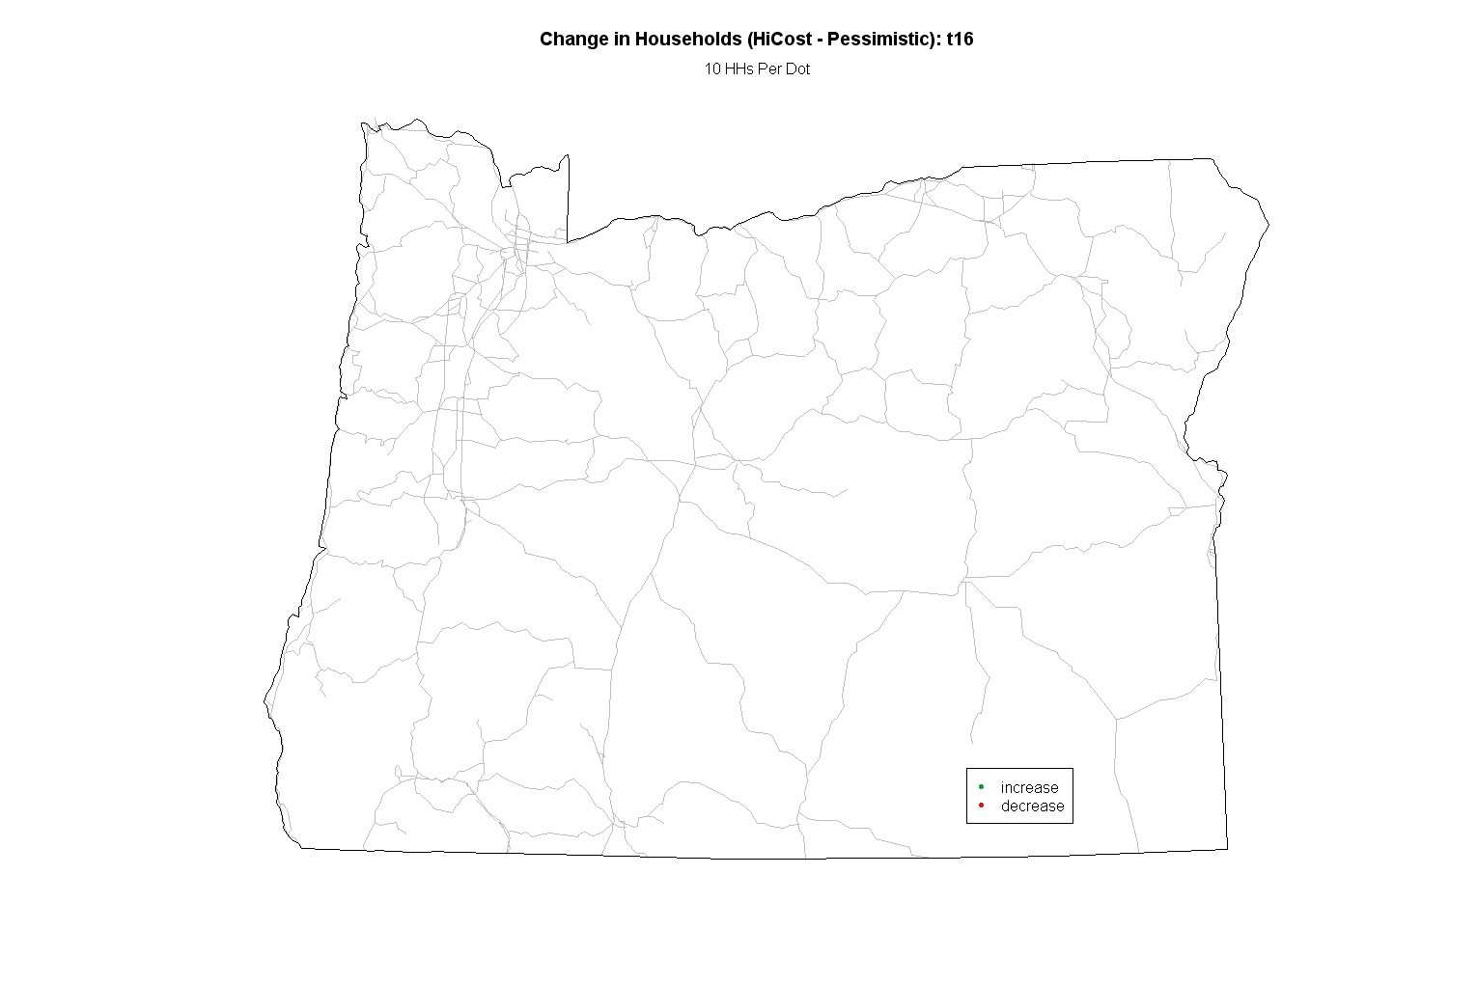
Spatial Data Visualization with R
Ben Stabler, Portland R Users Group, October 21, 2010

Slide 2
Agenda
  Goal: Get you going on generating map with R
  Visualization Problem
  Required Libraries
  Importing Shapefiles
  Joining Data
  Generating Maps
  Animating Maps
  Raster Data
  Where to Find More Info

Slide 3
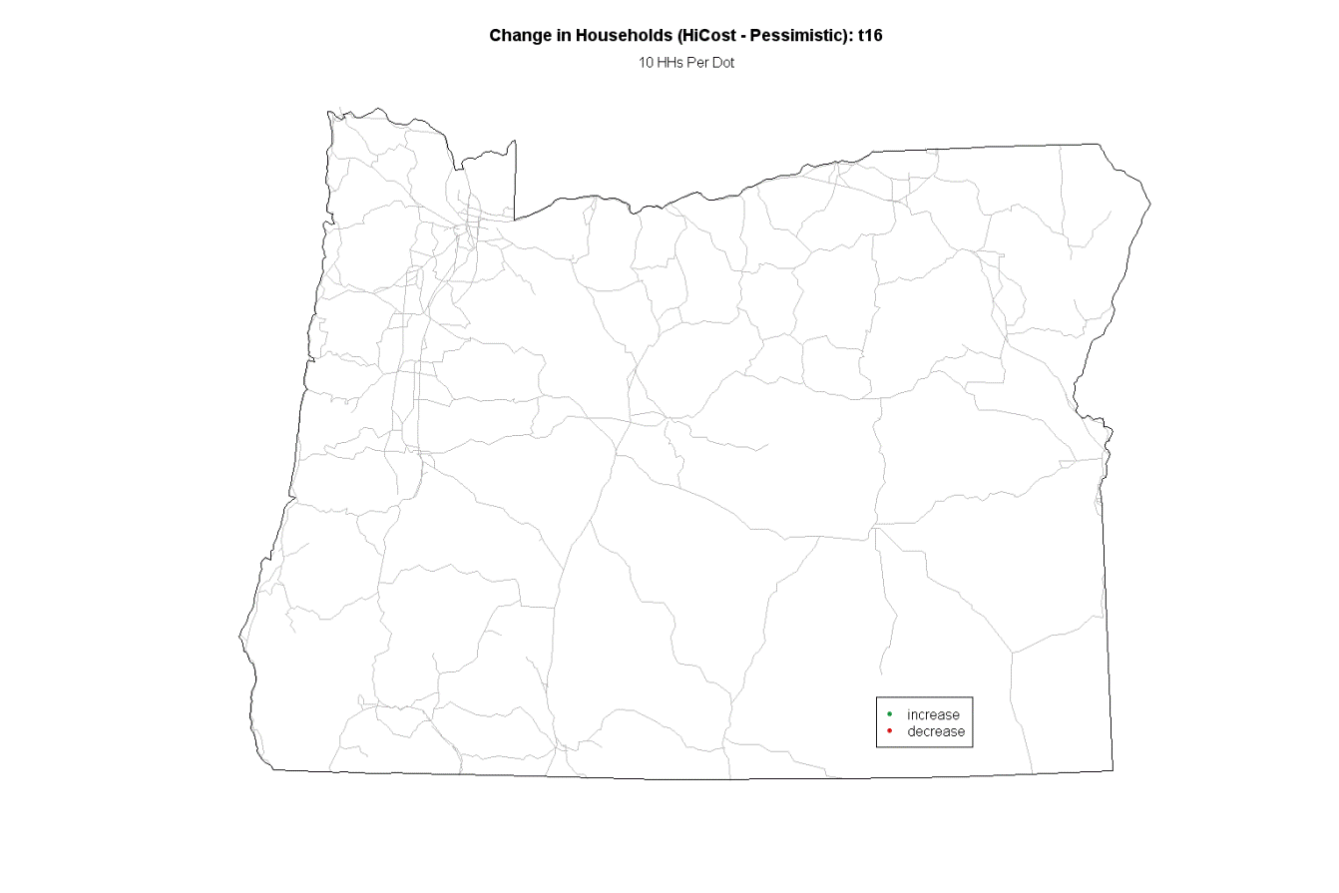
Visualization Problem
Create dot density map of Oregon using custom areas of dots
Color dots by an attribute (+/- growth)
Animate map to show change over time

Slide 4
Required Libraries
  The core libraries for mapping in R:
  maptools - set of tools for manipulating and reading geographic data, in particular ESRI shapefiles
  sp - a package that provides classes and methods for spatial data…Utility functions are provided, e.g. for plotting data as maps, spatial selection, as well as methods for retrieving coordinates, for subsetting…
  Optional
  RColorBrewer - the package provides palettes for drawing nice maps shaded according to a variable - see ?brewer.pal (http://colorbrewer2.org)

Slide 5
Importing Shapefiles
  #load libraries
  library(maptools)
  library(sp)
  library(RColorBrewer)
  #get polyline shapes
  orborder = readShapeLines("StateOR_lines.shp")
  clarkcolinks = readShapeLines("clackRd.shp")
  links = readShapeLines("MajorLinks.shp")
  #get polygon shapes
  zones = readShapePoly("bzones_OR.shp")
  inclusionZones = readShapePoly("urbanareas_2milebuffer_Inter.shp")
Creates objects in memory that are not saved to disk when R is closed

Slide 6
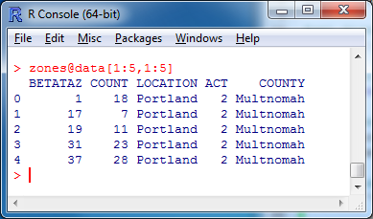
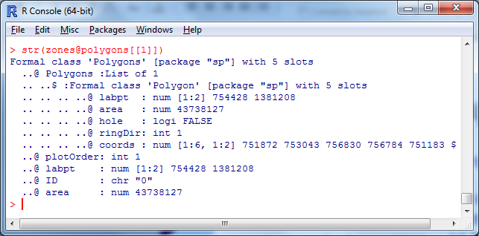
Importing Shapefiles
  str(zones) - returns description of SpatialPolygonsDataFrame object with 5 slots (fields)
  zones@data - access zones object’s data (dbf) slot with “@”
  zones@polygons – access list of polygons
  zones@polygons[[1]] – 1st Polygon object
  zones@polygons[[1]]@Polygons[[1]]@coords – 1st polygon, 1st shape coordinates

Slide 7
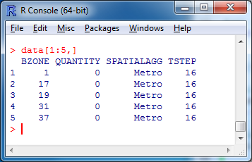
Joining Data
  #get data
  data = read.csv("hhDiff.csv")
  #get year data
  yearI = 17
  data2 = data[data$TSTEP == yearI,]
  #quantity per dot
  quantPerDot = 10
  #join data to zones
  zones@data$QUANTITY = data2$QUANTITY[match(zones@data$BETATAZ, data2$BZONE)]
  zones@data$DOTS = round(zones@data$QUANTITY/quantPerDot)
  #match inclusion zones to zones
  zones@data$INDEX = match(zones@data$BETATAZ, inclusionZones@data$BETATAZ)

Slide 8
Generating Maps
#plot data
windows(1500,1000) #1500 by 1000 pixel plot window
plot(zones, border="white") #draw zones polygons as new plot
#add polylines
lines(links, col="grey")
lines(clarkcolinks, col="grey")
lines(orborder, col="black")
#set plot title
label = "Households"
pTitle = paste("Change in ", label, " t", yearI, sep="")
title(main=pTitle)
mtext(paste(quantPerDot, label, "Per Dot")) #add subtitle

Slide 9
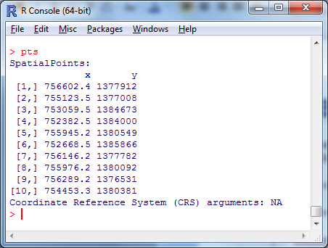
Generating Maps
#loop through zones and draw points
zones@data$DOTSGEN = 0
k = 0
for(i in 1:nrow(zones@data)) {
#sample dots
k = k + 1
j = zones@data$INDEX[i]
dots = zones@data$DOTS[i]
if(dots != 0) {
pts = spsample(inclusionZones@polygons[[j]], n=abs(dots), type="random", iter=100)
if(!is.null(pts)) {
zones@data$DOTSGEN[i] = nrow(pts@coords) #number of pts drawn
pCol = ifelse(dots > 0, "#1A9641", "#D7191C")
points(pts, pch=20, cex=0.001, col=pCol) #add points
} else {
print(paste(k, ":", zones@data$BETATAZ[i], ": skip")) #sampling not guaranteed
}
}
}
points() – add points to the plot
spsample() – sample points in a polygon

Slide 10

Generating Maps
#add legend to plot
legend(x=1707698, y=281631.7, legend=c("increase","decrease"), col=c("#1A9641", "#D7191C"), pch=20, cex=1, bg="white")
#save plot
savePlot(“map.png”, type="png")
#close plot
dev.off()

Slide 11
Animating Maps
Create a series of static images and stitch them together with the open source ImageMagick library
(http://www.imagemagick.org)
Install ImageMagick and add installation folder to the system PATH
ImageMagick is a collection of executables related to image processing
Use convert to convert a series of images to animated gif
convert -delay 100 out-*.png out.gif
converts all images named out-*.png in the folder to an animated gif named out.gif with a 1 second interval for each image

Slide 12
Animating Maps
#loop by year and create a static png image
years = unique(data$TSTEP)
counter = 0
for(yearI in years) {
#previous plotting code omitted
#save plot
savePlot(paste("out-", sprintf("%05i",counter), ".png", sep=""), type="png")
dev.off()
#iterate counter
counter = counter + 1
}
#at the end, convert pngs to an animated gif
unlink("out.gif") #delete file if it exists
shell("convert -delay 100 out-*.png out.gif", intern=T)

Slide 13
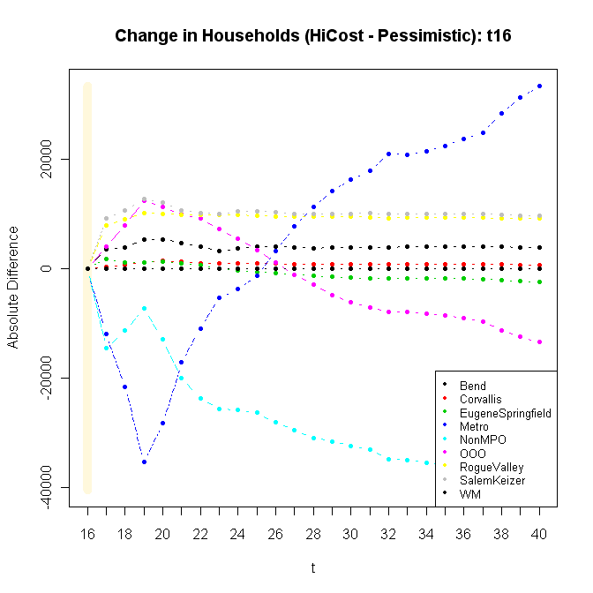
Final Product
*Chart added in the original final product

Slide 14
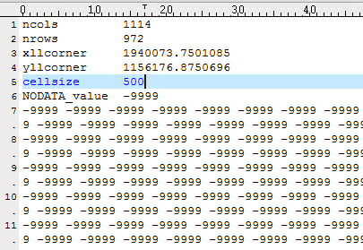
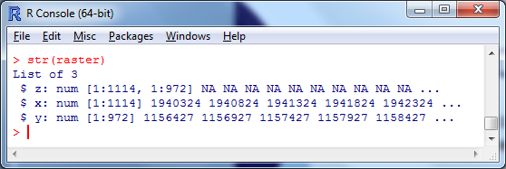
Raster Data
#Read ESRI ASCII grid file (as a simple matrix with as.image=T)
raster = read.asciigrid(file.choose(), as.image=T)
str(raster)

Slide 15
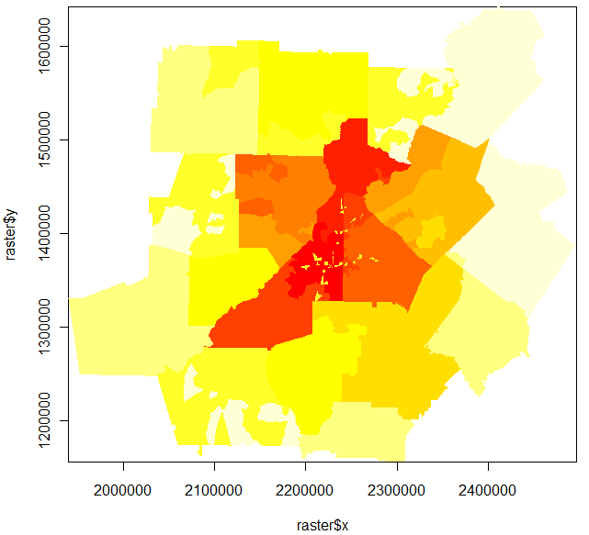
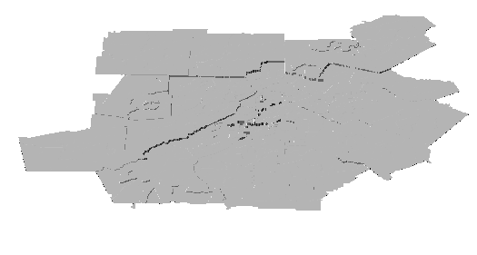
Raster Data
#2D plot
image(raster$x, raster$y, raster$z)
#3D plot
persp(raster$x, raster$y, raster$z, phi=30, d=10, scale=F, ltheta=-135, lphi=0, shade=0.5, border=NA, box=F, expand=2)
See ?persp for all the perspective arguments

Slide 16
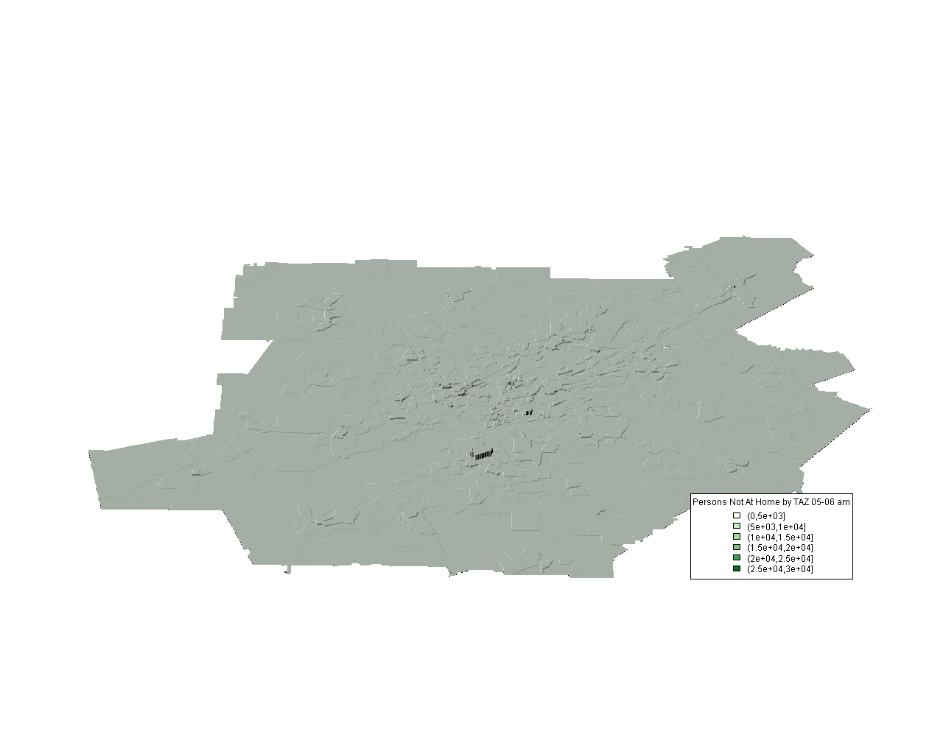
Raster Data
See ?persp for all the perspective arguments

Slide 17
Where to Find More Info
R Spatial Task View
http://cran.r-project.org/web/views/Spatial.html
UO Geographic Data Analysis with R Course
http://geography.uoregon.edu/geogr
ASU R Spatial Projects
http://geodacenter.asu.edu/r-spatial-projects
R Sig Geo mailing list
https://www.stat.math.ethz.ch/mailman/listinfo/r-sig-geo

Slide 18
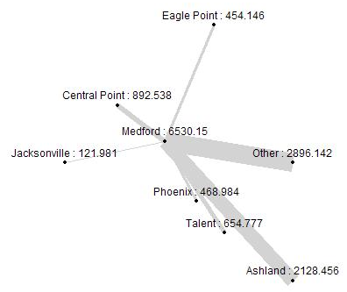
Thanks!
This is just the beginning of spatial data visualization with R. There are a host of spatial data analysis and visualization features in R, including spatial statistics (see geoR, gstat, spatial packages), point pattern analysis (see spatial package), raster analysis (see raster package), sampling (see spsample), point in polygon (see point.in.polygon), projections (see rgdal), etc
Ben Stabler, benstabler@yahoo.com

