Slide 1
第一章 Linux程式設計
Notes:
課程第一章

Slide 2
hello.c (ex01)
#include <stdio.h>
int main()
{
printf("This is the first Linux C program.\n"); return 0;
}

Slide 3
Program Execution Step
Compiler
  gcc –o hello hello.c
Execution
  ./hello
Result
  This is the first Linux C program.

Slide 4
score.c (ex01)
#include <stdio.h>
int main()
{
int score;
printf("輸入成績: ");
scanf("%d",&score);
if (score >= 90)
printf("甲\n");
else if (score >= 80)
printf("乙\n");
else if (score >= 70)
printf("丙\n");
else if (score >= 60)
printf("丁\n");
else
printf("不及格\n");
}
Compiler
  gcc –o score score.c
Execution
  ./score
Result
  ...…

Slide 5
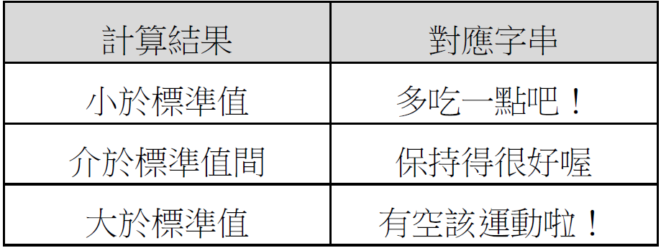
Hw#01 BMI
男性標準：20~25
女性標準：18~22
程式設計要求：
  要能選擇男性或女性
  直接輸入BMI判斷結果

Slide 6
Min. Value Demo Program
#include <stdio.h>
int min(int x, int y);
int main()
{
int n1, n2, n3;
printf(“Input 1st num:”);
scanf(“%d”,&n1);
printf(“Input 2nd num:”);
scanf(“%d”,&n2);
n3=min(n1, n2);
printf(“ minimum num is%d\n”,n3);
return 0;
}
int min(int x, int y)
{
if (x <y)
return x;
else
return y;
}

Slide 7
Program Spilt
mymin.h
int min(int x, int y);
mymin.c
int min(int x, int y)
{
if (x <y)
return x;
else
return y;
}
ex_min.c
#include <stdio.h>
#include “mymin.h’
int main()
{
int n1, n2, n3;
printf(“Input 1st num:”);
scanf(“%d”,&n1);
printf(“Input 2nd num:”);
scanf(“%d”,&n2);
n3=min(n1, n2);
printf(“ minimum num is%d\n”,n3);
return 0;
}
編譯程式 gcc ex_min.c mymin.c –o ex_main

Slide 8
Separate Linux Program (ex02)
answer.c
#include <stdio.h>
#include "msg.h"
int main()
{
printf("Where are you going to stay?\n");
msg1();
printf("How long are you going to stay?\n");
msg2();
return 0;
}
msg.h
void msg1();
void msg2();
msg1.c
#include <stdio.h>
void msg1()
{
char *p="I am going to stay at my friend's home.";
printf("%s\n",p);
}
msg2.c
#include <stdio.h>
void msg2()
{
char *p="For ten days.";
printf("%s\n",p);
}
編譯程式 gcc answer.c msg1.c msg2.c –o answer

Slide 9
Random Value Demo Program (ex03)
/* mymath.c */
#include <stdio.h>
#include <stdlib.h>
#include <time.h>
#include "mymath.h"
int main()
{
int a,b;
srand(time(NULL));
printf("輸入一個整數: ");
scanf("%d",&a);
printf("整數 %d 的平方為 %d\n",a,fun2(a));
b=fun3();
printf("隨機數產生器得到的數為 %d\n",b);
return 0;
}
/* mymath.h */
int fun2(int);
int fun3();
/* two.c */
int fun2(int a)
{
int ret;
ret=a*a;
return (ret);
}
/* three.c */
int fun3()
{
int a;
a=(rand()%6)+1;
return a;
}

Slide 10
rand()、srand()
#include <stdlib.h>
int rand(void)
  return a random value, range from 0 to RAND_MAX
void srand(unsigned int seed)
  Setting the seed of random value. To avoid to get the same value if using the same seed. The function time(0) can be used to be the seed value.

Slide 11
makefile01
mymath: mymath.o two.o three.o
gcc -o mymath mymath.o two.o three.o
mymath.o: mymath.c mymath.h
gcc -c mymath.c
two.o: two.c
gcc -c two.c
three.o: three.c
gcc -c three.c
[root@localhost ex03]# make -f makefile01

Slide 12
makefile01修正版Makefile
mymath: mymath.o two.o three.o
gcc -o mymath mymath.o two.o three.o
%.o : %.c
gcc -c $< -o $@
Automatic Variables
  $@ 擴展為目前規則的目標(target)檔案名稱
  $< 擴展為目前規則相依(prerequisite)檔案列表中的第一個相依文件
  $^ 擴展為整個相依(prerequisite)檔案的列表(刪除了所有重覆檔案名稱)
[root@localhost ex03]# make

Slide 13
Array Demo Program (ex04)
/* myarray.c */
#include <stdio.h>
#include "myarray.h“
int main()
{
  int i, ans1, score[5];
  double ans2;
  printf("請輸入五個人的成績:\n");
  for (i=0; i<5; i++) {
    scanf("%d",&score[i]);
  }
  ans1=mysum(score);
  printf("五個人的成績總和為: %d 分\n",ans1);
  ans2=myavg(score);
  printf("五個人的平均成績為 %.2lf 分\n",ans2);
  return 0;
}
/* myarray.h */
int mysum(int t[]);
double myavg(int *p);
/* mysum.c */
int mysum(int t[])
{
int i, sum; sum=0;
for (i=0; i<5; i++) {
sum += t[i];
}
return sum;
}
/* myavg.c */
double myavg(int *p)
{
int i; double sum; sum=0.0;
for (i=0; i<5; i++){
sum += *(p+i);
}
return sum/5;
}

Slide 14
Variable in makefile02
all: myapp
CC= gcc
INCLUDE= .
CFLAGS= -g -Wall -ansi
objects= myarray.o mysum.o myavg.o
myapp: $(objects)
$(CC) -o myapp $(objects)
myarray.o: myarray.c myarray.h
$(CC) -I$(INCLUDE) $(CFLAGS) -c myarray.c
mysum.o: mysum.c
$(CC) -I$(INCLUDE) $(CFLAGS) -c mysum.c
myavg.o: myavg.c
$(CC) -I$(INCLUDE) $(CFLAGS) -c myavg.c
clean:
rm myapp $(objects)
[root@localhost ex04]# make -f makefile02

Slide 15
makefile02修正版Makefile
all: myapp
CC= gcc
INCLUDE= .
CFLAGS= -g -Wall -ansi
objects= myarray.o mysum.o myavg.o
myapp: $(objects)
$(CC) -o myapp $(objects)
%.o : %.c
$(CC) -I$(INCLUDE) $(CFLAGS) -c $^ -o $@
clean:
rm myapp $(objects)
[root@localhost ex04]# make

Slide 16
Array & Pointer
int score[5];
  array name and size
ans1=mysum(score);
  array name can be an parameter to pass into function
int mysum(int t[])
double myavg(int *p)
  *p represents the first element in array
  *(p+1) represents the second element in array
Pointer Operation
  for(i=0;i<5;i++){ sum+=*(p+i); }

Slide 17
Hw#02 BMI
BMI 公式：體重(kg) / 身高²(m²)。
男性標準：20~25
女性標準：18~22
程式設計要求：
  結合hw#01程式功能
  具備體重與身高輸入功能
  將BMI計算函式另存檔案
  撰寫Makefile
  主程式檔名main.c，副程式檔名bmi.c，
  執行檔檔名exe，#include檔名bmi.h
  副程式檔案bmi.c 內部函數名稱cal()

Slide 18
Hw#03 找出最大最小值
根據ex04成績(0~100)輸入範例修改
能計算總合與平均值
輸入5筆成績，找出最大值與最小值
建立兩個函式完成上述要求
撰寫Makefile
  主程式檔名main.c，副程式檔名max.c、min.c
  執行檔檔名exe，#include檔名maxmin.h
  副程式max.c 內部函數名稱max()
  副程式min.c 內部函數名稱min()

