Slide 1
B Linux入門與常用命令

Slide 2
課程綱要
檔案
Shells
檔案與目錄系統
檔案的存取權限
系統相關指令
其他常用指令
vi編輯器
tar資料備份
標準輸入與輸出
網路管理與設定

Slide 3
Everything is a file
Regular files
Directories
  Directories are just files listing a set of files
Symbolic links
  Files referring to the name of another file
Devices and peripherals
  Read and write from devices as with regular files

Slide 4
File Name
Case sensitive
No obvious length limit
Can contain any character (including white space, except /). File name extensions not needed and not interpreted. Just used for user convenience.
File name examples:
  README .bashrc Windows Buglist
  index.htm index.html index.html.old

Slide 5
Path
A path is a sequence of nested directories with a file or directory at the end, separated by the / character
Relative path:
  documents/fun/microsoft jokes.html
  Relative to the current directory
Absolute path:
  /home/bill/bugs/crash9402031614568
  / : root directory.
    Start of absolute paths for all files on the system.

Slide 6
Filesystem Hierarchy Standard(FHS)
/ Root directory
/bin/ Basic, essential system commands
/boot/ Kernel images, initrd and configuration files
/dev/ Files representing devices
/dev/hda: first IDE hard disk
/etc/ System configuration files
/home/ User directories
/lib/ Basic system shared libraries
/lost+found Corrupt files the system tried to recover
/mnt/ Mounted filesystems
  /mnt/usbdisk/, /mnt/windows/ ...
/opt/ optional pacakges

Slide 7
FHS (2)
/usr most of the software on the Linux system
  /usr/local Specific software installed by the system admin.
  /usr/bin contains executable files
  /usr/sbin contains administrative commands
  /usr/lib libraries for C and C++
  /usr/X11R6 contains the X-Free86(X Window System) software
/proc/ Access to system information
  /proc/cpuinfo, /proc/version ...
/root/ root user home directory
/sbin/ Administrator-only commands
/tmp/ hold temporary files
/var/ short for “various”. Data used by the system or system servers
  /var/log/, /var/ftp

Slide 8
Command Interpreter
Shells: tools to execute user commands
Called “shells” because they hide the details on the underlying operating system under the shell's surface.
Commands are input in a text terminal, either a window in a graphical environment or a text-only console.
Results are also displayed on the terminal. No graphics are needed at all.
Shells can be scripted: provide all the resources to write complex programs (variable, conditionals, iterations...)

Slide 9
Popular shells
sh: The Bourne shell (obsolete)
  Traditional, basic shell found on Unix systems, by Steve Bourne.
csh: The C shell (obsolete)
  Once popular shell with a Clike syntax
tcsh: The TC shell (still very popular)
  A C shell compatible implementation with evolved features (command completion, history editing and more...)
bash: The Bourne Again shell (most popular)
  An improved implementation of sh with lots of added features too.

Slide 10
目錄之使用空間
du -h <file> (disk usage)
  -h: returns size on disk of the given file, in human readable
  format: K (kilobytes), M (megabytes) or G (gigabytes), .
  Without -h, du returns the raw number of disk blocks used by the file (hard to read).
du -sh<dir>
  -s: returns the sum of disk usage of all the files in the given directory.

Slide 11
硬碟使用率
df -h <dir>
  Returns disk usage and free space for the filesystem containing the given directory.
  Similarly, the -h option only exists in GNU df.
  Example:
  > df -h .
    Filesystem Size Used Avail Use% Mounted on
    /dev/hda5 9.2G 7.1G 1.8G 81% /
df -h
  Returns disk space information for all filesystems available in the system. When errors happen, useful to look for full filesystems.

Slide 12
列出檔案清單 ls
ls -a (all)
  Lists all the files (including .* files)
ls -l (long)
  Long listing (type, date, size, owner, permissions)
ls -t (time)
  List the most recent files first
ls -s (sort)
  List file ascending order
ls -S (size)
  List the biggest files first
ls -r (reverse)
  Reverses the sort order
ls -ltr (options canbe combined)
  Long listing, most recent files at the end
ls -n (numeric)

Slide 13
檔案名稱之匹配與取代
– ls *txt
  The shell first replaces *txt by all the file and directory names ending by txt (including .txt), except those starting with ., and then executes the ls command line.
– ls -d .*
  Lists all the files and directories starting with –d tells ls not to display the contents of directories.
– ls ?.log
  Lists all the files which names start by 1 character and end by .log

Slide 14
特殊目錄
./
  The current directory. Useful for commands taking a directory argument. Also sometimes useful to run commands in the current directory (see later).
  So ./readme.txt and readme.txt are equivalent.
• ../
  The parent (enclosing) directory. Always belongs to the . Directory (see ls -a). Only reference to the parent directory.
  Typical usage:
    cd ..

Slide 15
目錄切換(cd)與顯示(pwd)
cd<dir>
  Change the current directory to <dir>.
pwd
  Displays the current directory ("working directory").

Slide 16
目錄之建立(mkdir)與移除(rmdir)
mkdir dir1 dir2 dir3 ... (make dir)
  Creates directories with the given names.
mkdir -p ~/work/p1
  Creates ~/work/p1
rmdir dir1 dir2 dir3 ... (remove dir)
  Removes the given directories
  Safe: only works when directories and empty.
  Alternative: rm -r (doesn't need empty directories).

Slide 17
檔案複製cp
cp <source_file> <target_file>
  Copies the source file to the target.
cp file1 file2 file3 ... dir
  Copies the files to the target directory (last argument).
cp -i (interactive)
  Asks for user confirmation if the target file already exists
cp -r <source_dir> <target_dir> (recursive)
  Copies the whole directory.
cp -a <source_dir> <target_dir>
  Copies the whole directory.

Slide 18
目錄搬移(mv)與移除(rm)
mv <old_name> <new_name> (move)
  Renames the given file or directory.
mv -i (interactive)
  If the new file already exits, asks for user confirm
rm file1 file2 file3 ... (remove)
  Removes the given files.
rm -i (interactive)
  Always ask for user confirm.
rm -r dir1 dir2 dir3 (recursive)
  Removes the given directories with all their contents.

Slide 19
顯示檔案內容
Several ways of displaying the contents of files.
  cat file1 file2 file3 ... (concatenate)
    Concatenates and outputs the contents of the given files.
  more file1 file2 file3 ...
    After each page, asks the user to hit a key to continue.
    Can also jump to the first occurrence of a keyword (/ command).
  less file1 file2 file3 ...
    Does more than more with less.
    Doesn't read the whole file before starting.
    Supports backward movement in the file (? command).

Slide 20
符號連結Symbolic links
A symbolic link is a special file which is just a reference to the name of another one (file or directory):
  Useful to reduce disk usage and complexity when 2 files have the same content.
  Example:
    anakin_skywalker_biography -> darth_vador_biography
  How to identify symbolic links:
    ls -l displays -> and the linked file name.
    GNU ls displays links with a different color.

Slide 21
建立符號連結
To create a symbolic link (same order as in cp):
  ln -s file_name link_name
To create a link with to a file in another directory,with the same name:
  ln -s ../README.txt
To create multiple links at once in a given directory:
  ln -s file1 file2 file3 ... dir
To remove a link:
  rm link_name
  Of course, this doesn't remove the linked file!

Slide 22
硬連結Hard links
The default behavior for ln is to create hard links
A hard link to a file is a regular file with exactly the same physical contents
While they still save space, hard links can't be distinguished from the original files.
If you remove the original file, there is no impact on the hard link contents.
Creating hard links
  ln source destination

Slide 23
實驗- ln – symbolic link
touch myfile .. Create a new file
ln -s myfile myfile1 .. Link myfile1 to myfile
ls -la
cat > myfile .. Enter text to myfile
a
few
lines
of
text
^D .. end of input
cat myfile .. Display myfile
cat myfile1 .. Display myfile1
ls -la
rm myfile .. Remove myfile
ls -al

Slide 24
實驗- ln – hard link
touch myfile .. Create a new file
ln myfile myfile1 .. Link myfile1 to myfile - hard link
ls -la
cat > myfile .. Enter text to myfile
a
few
lines
of
text
^D .. end of input
cat myfile .. Display myfile
cat myfile1 .. Display myfile1
ls -la
rm myfile .. Remove myfile
ls -al

Slide 25
實驗- ln – link to directory
cd $HOME/work/xscale270
ln -s linux-2.6.9 kernel
cd kernel
ln -s drivers/net/arm/smc91111.c smc91111.c
ls -l
vi smc91111.c
ln -s drivers/mtd/maps mtdmaps
cd mtdmaps
ls
cd ..

Slide 26
尋找檔案(find)
find . -name "*.pdf"
  Lists all the *.pdf files in the current (.) directory or subdirectories. You need the double quotes to prevent the shell from expanding the * character.
  iname file：忽略大小寫
  amin n：在過去n分鐘內被讀取過
  atime n：在過去n天內被讀取過
  cmin n：在過去n分鐘內被修改過
  ctime n：在過去n天內被修改過

Slide 27
檔案處理權限access rights
Use ls -l to check file access rights
3 types of access rights
  Read access (r)
  Write access (w)
  Execute rights (x)
3 types of access levels
  User (u): for the owner of the file
  Group (g): each file also has a “group” attribute, corresponding to a given list of users
  Others (o): for all other users

Slide 28
權限之限制
x without r is legal but is useless
  You have to be able to read a file to execute it.
Both r and x permissions needed for directories:
  x to enter, r to list its contents.
You can't rename, remove, copy files in a directory if you don't have w access to this directory.
If you have w access to a directory, you CAN remove a file even if you don't have write access to this file (remember that a directory is just a file describing a list of files). This even lets you modify (remove + recreate) a file even without w access to it.

Slide 29
權限之範例
-rw-r--r--
  Readable and writable for file owner, only readable for others
-rw-r----
  Readable and writable for file owner, only readable for users belonging to the file group.
drwx------
  Directory only accessible by its owner

Slide 30
改變處理權限chmod(1)
chmod <permissions> <files>
2 formats for permissions:
  Octal format (abc):
    a,b,c = r*4+w*2+x (r, w, x: booleans)
    Example: chmod 644 <file>
    (rw for u, r for g and o)
  Or symbolic format. Easy to understand by examples:
    chmod go+r: add read permissions to group and others.
    chmod u-w: remove write permissions from user.
    chmod -ax: (a: all) remove execute permission from all.

Slide 31
改變處理權限chmod(2)
chmod -R a+rx linux/
  Makes linux and everything in it available to everyone!
R: apply changes recursively
X: x, but only for directories and files already executable. Very useful to open recursive access to directories, without adding execution rights to all files.

Slide 32
檔案與目錄之比較-diff
diff –n src.c update.c > d.patch
  Reports the differences between 2 files, or nothing if the files are identical.
diff -rn src/ update/ > update.patch
  Reports all the differences between files with the same name in the 2 directories.

Slide 33
範例-src.c and update.c
1 #include <unistd.h>
2 #include <sys/stat.h>
3 #include <stdlib.h>
4
5 int main(void)
6 {
7 char c;
8 int in, out;
9
10 //
11 // this is a sample program
12 //
13 in = open("file.in", O_RDONLY);
14 out = open("file.out",
O_WRONLY|O_CREAT);
15 while (read(in, &c, 1) == 1)
16 write(out, &c, 1);
17
18 exit(0);
19 }
20
1 #include <unistd.h>
2 #include <sys/stat.h>
3 #include <fcntl.h>
4 #include <stdlib.h>
5
6 int main(void)
7 {
8 char c;
9 int in, out;
10
11 in = open("file.in", O_RDONLY);
12 out = open("file.out",
O_WRONLY|O_CREAT, S_IRUSR|S_IWUSR);
13 while (read(in, &c, 1) == 1)
14 write(out, &c, 1);
15
16 close(in);
17 close(out);
18 return 0;
19 }
20

Slide 34
diff -n src.c update.c > d.patch
1 --- src.c 2007-12-20 21:53:48.000000000 +0800
2 +++ update.c 2007-12-20 21:53:21.000000000 +0800
3 @@ -1,5 +1,6 @@
4 #include <unistd.h>
5 #include <sys/stat.h>
6 +#include <fcntl.h>
7 #include <stdlib.h>
8
9 int main(void)
10 @@ -7,14 +8,13 @@
11 char c;
12 int in, out;
13
14 -//
15 -// this is a sample program
16 -//
17 in = open("file.in", O_RDONLY);
18 - out = open("file.out", O_WRONLY|O_CREAT);
19 + out = open("file.out", O_WRONLY|O_CREAT, S_IRUSR|S_IWUSR);
20 while (read(in, &c, 1) == 1)
21 write(out, &c, 1);
22
23 - exit(0);
24 + close(in);
25 + close(out);
26 + return 0;
27 }
28

Slide 35
顯示所有程序 ps
ps-ux
  Lists all the processes belonging to the current user
ps -aux (Note: ps edf on System V systems)
  Lists all the processes running on the system
    ps -aux | grep bart | grep bash
    USER PID %CPU %MEM VSZ RSS TTY STAT START TIME COMMAND
    bart 3039 0.0 0.2 5916 1380 pts/2 S 14:35 0:00 /bin/bash
    bart 3134 0.0 0.2 5388 1380 pts/3 S 14:36 0:00 /bin/bash
    bart 3190 0.0 0.2 6368 1360 pts/4 S 14:37 0:00 /bin/bash
    bart 3416 0.0 0.0 0 0 pts/2 RW 15:07 0:00 [bash]
  PID: Process id
  VSZ: Virtual process size (code + data + stack)
  RSS: Process resident size: number of KB currently in RAM
  TTY: Terminal
  STAT: Status: R (Runnable), S (Sleep), W (paging), Z (Zombie)...

Slide 36
尋找檔案內容(grep)
grep <pattern> <files>
  Scans the given files and displays the lines which match the given pattern.
grep error *.log
  Displays all the lines containing error in the *.log files
grep -i error *.log
  Same, but case insensitive
grep -ri error .
  Same, but recursively in all the files in . and its subdirectories
grep -v info *.log
  Outputs all the lines in the files except those containing info.\

Slide 37
刪除程序 kill
kill <pids>
  Sends an abort signal to the given processes. Lets processes save data and exit by themselves. Should be used first.
  Example:
    kill 3039 3134 3190 3416
kill -9 <pids>
  Sends an immediate termination signal. The system itself terminates the processes. Useful when a process is really stuck (doesn't answer to kill -1).
kill -9 -l
  Kills all the processes of the current user. -1: means all processes.

Slide 38
即時監視程序之活動 top
top - Displays most important processes, sorted by cpu percentage
  top - 15:44:33 up 1:11, 5 users, load average: 0.98, 0.61, 0.59
  Tasks: 81 total, 5 running, 76 sleeping, 0 stopped, 0 zombie
  Cpu(s): 92.7%us, 5.3%sy, 0.0%ni, 0.0%id, 1.7%wa, 0.3%hi, 0.0% si
  Mem: 515344k total, 512384k used, 2960k free, 20464k buffers
  Swap: 1044184k total, 0k used, 1044184k free, 277660k cached
  PID USER PR NI VIRT RES SHR S %CPU %MEM TIME+ COMMAND
  3809 jdoe 25 0 6256 3932 1312 R 93.8 0.8 0:21.49 bunzip2
  2769 root 16 0 157m 80m 90m R 2.7 16.0 5:21.01 X
  3006 jdoe 15 0 30928 15m 27m S 0.3 3.0 0:22.40 kdeinit
  3008 jdoe 16 0 5624 892 4468 S 0.3 0.2 0:06.59 autorun
  3034 jdoe 15 0 26764 12m 24m S 0.3 2.5 0:12.68 kscd
  3810 jdoe 16 0 2892 916 1620 R 0.3 0.2 0:00.06 top
You can change the sorting order by typing
M: Memory usage, P: %CPU, T: Time.
You can kill a task by typing kill and the process id.

Slide 39
Misc commands (1)
sleep 60
  Waits for 60 seconds
  (doesn't consume system resources).
date
  Returns the current date. Useful in scripts to record when commands started or completed.

Slide 40
常用之文字編輯器
Graphical text editors
  Fine for most needs
    nedit - http://www.nedit.org/
    Emacs, Xemacs
Text-only text editors
  Often needed for sys. admins and great for power users
    vi – 當滑鼠還沒出現時，就已經在使用
    nano - http://www.nanoeditor.org/

Slide 41
vi
Text-mode text editor available in all Unix systems. Created before computers with mice appeared.
  Difficult to learn for beginners used to graphical text editors.
  Very productive for power users.
  Often can't be replaced to edit files in system administration or in Embedded Systems, when you just have a text console.

Slide 42
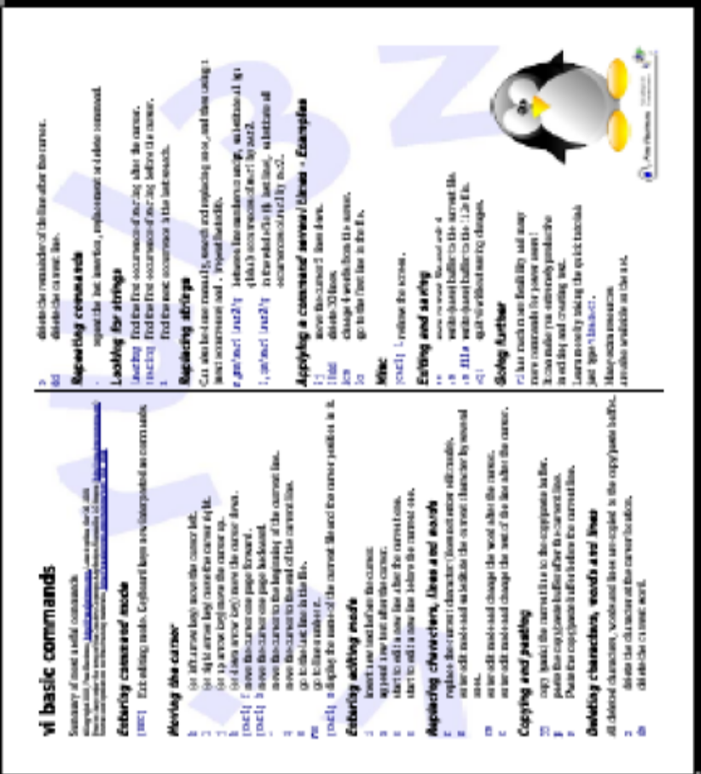
vi 基本命令
Though vi is extremely powerful, its main 30 commands are easy to learn and are sufficient for 99% of everyone's needs!
Get vi memento sheet http://freeelectrons.com/training/intro_unix_linux

Slide 43
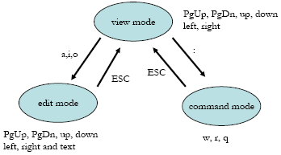
vi之模式切換

Slide 44
實驗- vi (I)
Viewer mode
  PgUp, PgDn, up, down, left, right
Editor mode
  a(append), i(insert), o(over write)
Command mode
  :w(write), :q(quit), :r(read)
  :set nu, :set nonu, :set ai(autoindent)
/etc/vimrc or ~/.vimrc
  [root@linux ~]# vi ~/.vimrc
  :set ai
  :set nu
http://linux.vbird.org/linux_basic/0310vi.php

Slide 45
實驗- vi (II)
yy: copy whole line at cursor position
nyy: copy n line from cursor position
p: paste into cursor position
dd: delete whole line at cursor position
ndd: delete n line from cursor position
u: Undo action

Slide 46
壓縮
Very useful for shrinking huge files and saving space
  [un]compress <file>
    Traditional Unix compression utility. Creates .Z files.
    Only kept for compatibility. Average performance.
  g[un]zip <file>
    GNU zip compression utility. Creates .gz files.
    Pretty good performance (similar to Zip).
  b[un]zip2 <file>
    The most recent and the most effective compression utility.
    Creates .bz2 files. Usually 20~25% better than gzip.
    Use this one! Now available on all Unix systems.

Slide 47
打包Archiving(1)
Useful to backup or release a set of files within 1 file
  tar: originally “tape archive”
  Creating an archive:
  tar cvf <archive> <files or directories>
    c: create
    v: verbose. Useful to follow archiving progress.
    f: file. Archive created in file (tape used otherwise).
  Example:
    tar cvf /backup/home.tar /home
    bzip2 /backup/home.tar

Slide 48
打包(2)
Viewing the contents of an archive or integrity check:
  tar tvf <archive>
  t: test
Extracting all the files from an archive:
  tar xvf <archive>
Extracting just a few files from an archive:
  tar xvf <archive> <files or directories>
  Files or directories are given with paths relative to the archive root directory.

Slide 49
同時打包與壓縮
Can compress and uncompress archives on the fly. Useful to avoid creating huge intermediate files. Much simpler to do than with tar and bzip2!
  j option: [un]compresses on the fly with bzip2
  z option: [un]compresses on the fly with gzip
Examples
  tar cvf bills_bugs | bzip2 > bills_bugs.tar.bz2
  tar jcvf bills_bugs.tar.bz2 bills_bugs

Slide 50
實驗- tar
檔案打包
  檔案打包與解包
    tar -cvf src.tar src.c update.c
    tar -xvf src.tar
  檔案打包與壓縮-用gzip
    tar -zcvf src.tgz src.c update.c
    tar -zxvf src.tgz
  檔案打包與壓縮-用bzip2
    tar -jcvf src.tar.bz2 src.c update.c
    tar –jxvf src.tar.bz2
目錄打包
  目錄打包與壓縮-用gzip
  目錄打包與壓縮-用bzip2

Slide 51
標準I/O,導向與pipes
All the commands outputting text on your terminal do it by writing to their standard output.
Standard output can be written (redirected) to a file using the > symbol
Standard output can be appended to an existing file using the >> symbol

Slide 52
標準輸出導向
ls ~/saddam/* > ~/gwb/weapons_destruction.txt
cat obiwan_kenobi.txt > starwars_biographies.txt
cat han_solo.txt >> starwars_biographies.txt
echo “ No such file or directory” > README

Slide 53
標準輸入
Lots of commands, when not given input arguments, can take their input from standard input.
  Sort <enter>
  Windows <enter> // begin
  linux <enter>
  [Ctrl][D] // end
  Linux // result
  windows
sort < participants.txt
  The standard input of sort is taken from the given file.
sort takes its input from
the standard input: in this case,
what you type in the terminal
(ended by [Ctrl][D])

Slide 54
Pipes
Unix pipes are very useful to redirect the standard output of a command to the standard input of another one.
Examples
  cat *.log | grep -i error | sort
  grep -ri error . | grep -v “ignored” | sort -u \
  > serious_errors.log
  cat /home/*/homework.txt | grep mark | more
This one of the most powerful features in Unix shells!

Slide 55
Environment Variable
Shells let the user define variables. They can be reused in shell commands. Convention: lower case names
You can also define environment variables: variables that are also visible within scripts or executables called from the shell. Convention: upper case names.
env
  Lists all defined environment variables and their value.

Slide 56
Shell variables examples
Shell variables (bash)
  projdir=/home/marshall/coolstuff; \
  ls -la $projdir; cd $projdir
Environment variables (bash)
  cd $HOME
  export DEBUG=1

Slide 57
重要的環境變數
LD_LIBRARY_PATH
  Shared library search path
EDITOR
  Default editor (vi, emacs...)
HOME
  Current user home directory
HOSTNAME
  Name of the local machine
PATH
  Command search path
SHELL
  Current shell name
TERM
  Current terminal type
USER
  Current user name

Slide 58
環境變數-PATH
PATH
  Specifies the shell search order for commands
  /usr/local/bin:/bin:/bin:/usr/bin
LD_LIBRARY_PATH
  Specifies the shared library (binary code libraries shared by applications, like the C library) search order for ld
  /usr/local/lib:/usr/lib:/lib

Slide 59
別名-Alias
Shells let you define command aliases: shortcuts for commands you use very frequently.
Examples
alias ls='ls -la'
  Useful to always run commands with default arguments.
alias rm='rm -i'
  Useful to make rm always ask for confirmation.
alias frd='find_rambaldi_device asap risky'
  Useful to replace very long and frequent commands.
alias cia='. /home/sydney/env/cia.sh'
  Useful to set an environment in a quick way
(. is a shell command to execute the content of a shell script).

Slide 60
~/.bashrc file
~/.bashrc
  Shell script read each time a bash shell is started
• You can use this file to define
  Your default environment variables (PATH, EDITOR...).
  Your aliases.
  Your prompt (see the bash manual for details).
  A greeting message.
  …

Slide 61
bash_profile
Use vi editor to open /root/.bash_profile, add appropriate path for executing file in any directory.
  [root$super root]# vi ~/.bash_profile
  PATH=$PATH：$HOME/bin
  PATH=$PATH：…..
  [root$super root]# source ~/.bash_profile

Slide 62
網路設定(1)
ifconfig -a
  Prints details about all the network interfaces available on your system.
ifconfig eth0
  Lists details about the eth0 interface
ifconfig eth0 192.168.0.100
  Assigns the 192.168.0.100 IP address to eth0 (1 IP address per interface).
ifconfig eth0 down (or up)
  Shuts down the eth0 interface(frees its IP address).

Slide 63
網路設定(2)
route add default gw 192.168.0.1
  Sets the default route for packets outside the local network.
  The gateway (here 192.168.0.1) is responsible for sending them to the next gateway, etc., until the final destination.
route -n
  Lists the existing routes
route del default
route del <IP>
  Deletes the given route
  Useful to redefine a new route.

Slide 64
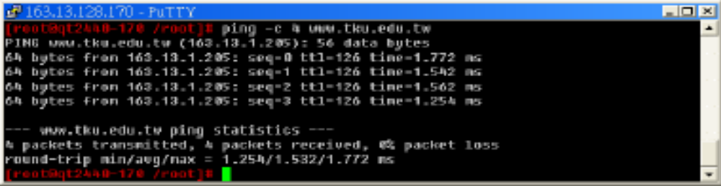
網路測試
ping -c 4 freshmeat.net
ping -c 4 192.168.1.1
  Tries to send 4 packets to the given machine and get acknowledgment packets in return.
When you can ping your gateway, your network interface works fine.
When you can ping an external IP address, your network settings are correct!

Slide 65
網路設定總結
Connect to the network (cable, wireless card or device...)
Identify your network interface:
  ifconfig -a
Assign an IP address to your interface (assuming eth0)
  ifconfig eth0 192.168.0.100 (example)
Add a route to your gateway (assuming 192.168.0.1) for packets outside the network:
  route add default gw 192.168.0.1

Slide 66
Name resolution
Your programs need to know what IP address corresponds to a given host name (such as kernel.org)
Domain Name Servers (DNS) take care of this.
You just have to specify the IP address of 1 or more DNS servers in your /etc/resolv.conf file:
  nameserver 168.95.1.1
  nameserver 168.95.192.1
The changes takes effect immediately!

Slide 67
安全網路連線ssh
telnet send password and commands in clear text.
The most popular ssh package in Linux is
OpenSSH(http://www.openssh.com)
Another ssh package for embedded system is dropbear(http://matt.ucc.asn.au/dropbear/dropbear.html)
Logging into a remote machine with ssh is similar to using telnet.
ssh account@domain.ip
ssh account@domain.ip -p port

Slide 68
安全檔案傳送sftp
Open a secure connection to the remote host and transfer files via encrypted TCP/IP packets.
Commands:
  put LocalFile [RemoteFile]
  get RemoteFile
  bye or quit - shutdown the current connection
  cd RemoteDirectory
  lcd LocalDirectory
  help

Slide 69
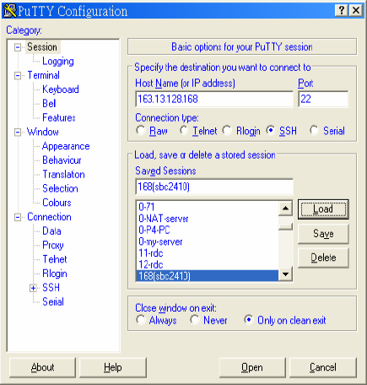
Windows平台之安全網路連線putty
A free implementation of Telnet and SSH for Win32 and Unix platforms.
http://www.chiark.greenend.org.uk/~sgtatham/putty/download.html

Slide 70
參考資料
Free Software for embedded systems
  http://free-electrons.com
  http://free-electrons.com/training
  http://free-electrons.com/doc/vi_memento.pdf
  http://free-electrons.com/doc/command_memento.pdf
LinuxBasics.org
  http://linuxbasics.org/course/book/allallofs
  http://linuxbasics.org/LDP/LDP/intro-linux/intro-linux.pdf

