Slide 1
OTODO
The new online tasklist.
https://github.com/Posejdos/OTODO

Slide 2
Why?
Are you dualbooting and need your task list on both systems? Or maybe to you want it synchronized between PCs and smartphones?
Look no more. OTODO is a cloud-based TODO list manager.
It has great customization potential and almost limitless expandability, from synchronized calendars to smart home extensions.

Slide 3
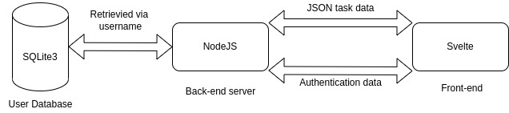
Architecture

Slide 4
Technologies used for frontend:
HTML for basic webpage content
CSS for webpage styling
Javascript + Typescript for functionality
Svelte for bundling them all together and adding new, dynamic and easy-to-use functionalities
Technologies used for backend:
NodeJS with Express as a server
SQLite3 as a database
bcrypt for cryptography

Slide 5
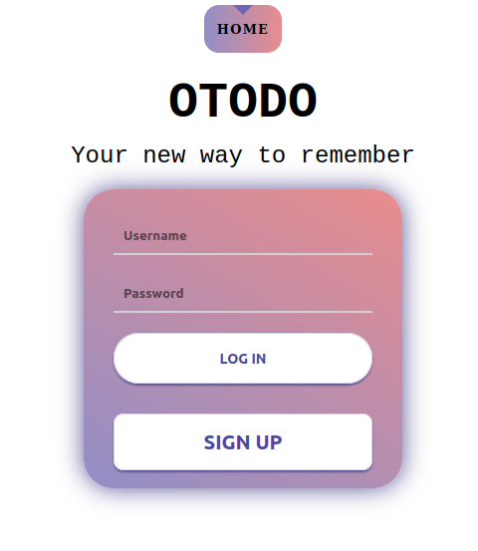
Home (login page)
This is the Login view.
Users can both login and create an account using the same credentials fields.
At the top is the navbar, currently only giving access to the Home page.

Slide 6
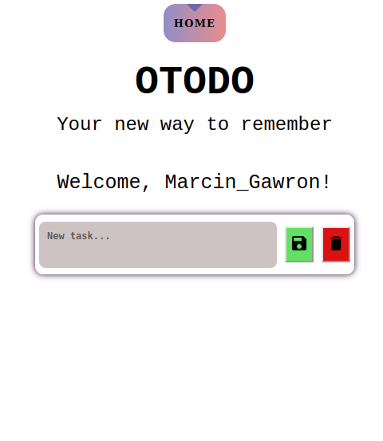
Task view (empty)
When the list is empty, the only field visible is the empty one, waiting for the user to add a task.

Slide 7
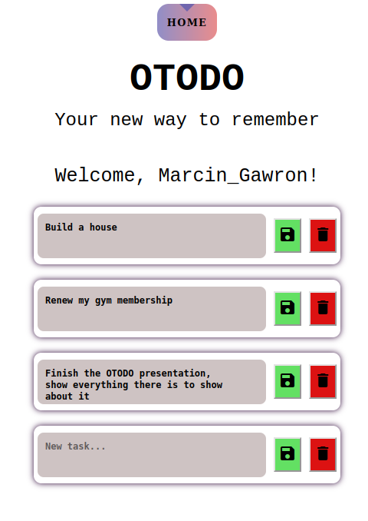
Task view (not empty)
User can see here all of his tasks. Multiline inputs are allowed. Users use the green Save button to save the new/modified task to the database and the red Delete button to delete a given task from the database.

Slide 8
Changes since the original concept
The original concept included using two separate databases: one for user authentication and the other one for storing users’ tasks. This has been changed to only use a single database for the sake of simplicity.

Slide 9
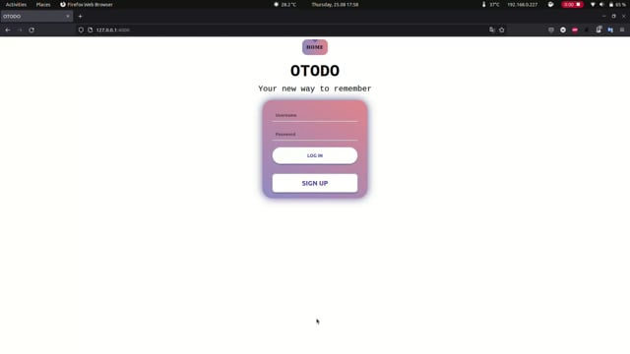
A video presentation

