Slide 1
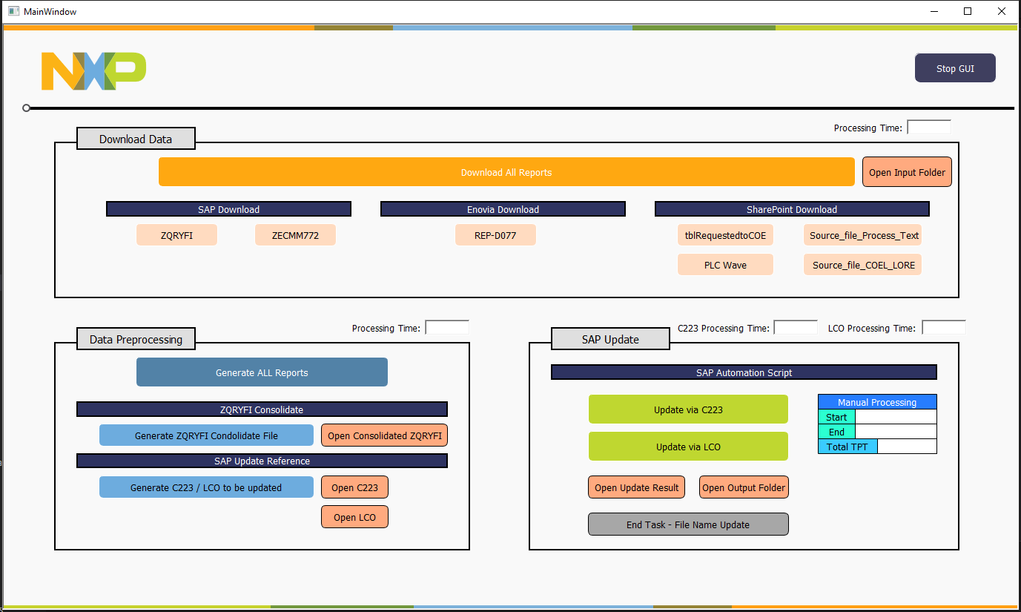
Close the GUI
Download all reports at once
Timer to record the data downloading time if button “Download All Reports“ is clicked
Open the folder where all downloaded data saved
Download each report individually
Generate all reports (to be update) at once
(ZQRYFI_Consolidate, C223, LCO)
Timer to record the SAP Update time if button “Update via C223“ or “Update via LCO“ is clicked
Timer to record the SAP Update time if button “Generate ALL Reports“ is clicked
Timer for user to records the time manually
Trigger tcode C223 to auto-update attributes in master recipe
Trigger tcode ZREL to auto-update attributes via LCO releasing
Open C223
Open the update result file /
Open the folder where the result saved
Open LCO
Generate each report individually
Open ZQRYFI_Consolidate in Output folder
Rename the final consolidate file (both ZQRYFI and C223/LCO) with finish time

Slide 2
Proposed WoW
SAP reports and Enovia table
Downloading
Data Pre-processing
(Feature generation)
Data Pre-processing
(Mapping)
Generate Final Report by attribute
Auto-Correction via SAP
SAP - (ZQRYFI, ZECMM772)
ENOVIA - (REP-077)
SharePoint - (tblRequestedtoCOE, EMPDM Source file)
ID_KEY
Process Text
Naming Rule
INNU
Work Center
Cost Elem
Outline Agreement
Item Outline Agreement
GUI Design

