Slide 1
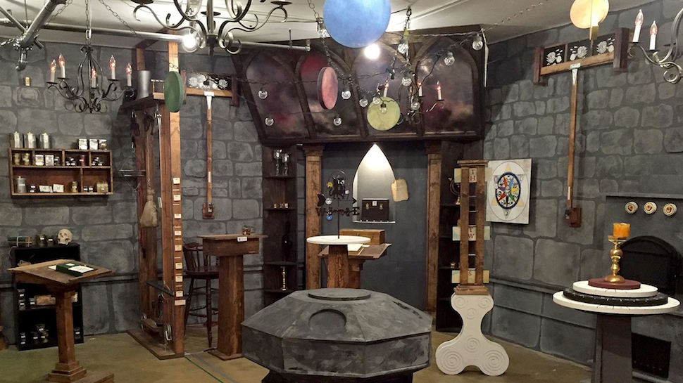
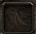







Slide 2

After tearing up the letter you find a beautiful flat jewel.

Slide 3
11 | 12 | 13 | 14 | 15 | 16
21 | 22 | 23 | 24 | 25 | 26
31 | 32 | 33 | 34 | 35 | 36
41 | 42 | 43 | 44 | 45 | 46
51 | 52 | 53 | 54 | 55 | 56

