Slide 1

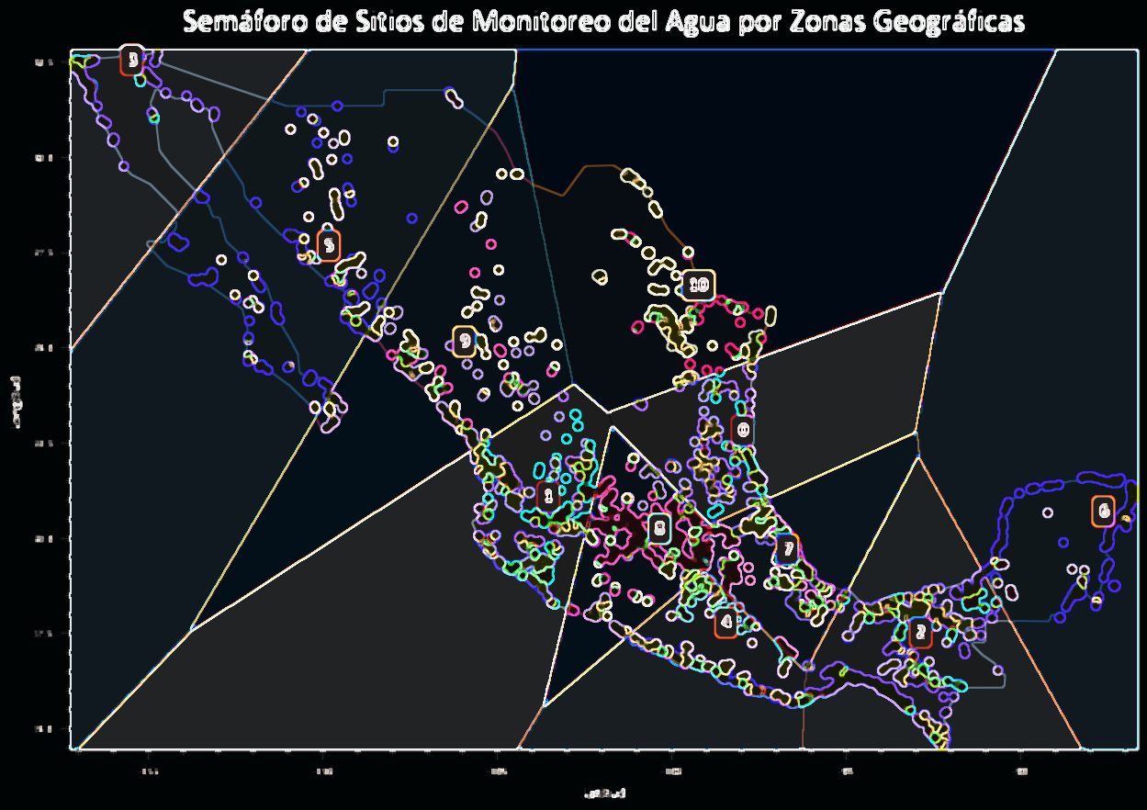
Ciencia y Analítica de Datos
Proyecto Final – Calidad del Agua
Armando Bringas
Walter Rosales
Dra. María de la Paz
Mtra. Victoria

Slide 2
Limpieza de Datos

Slide 4
Análisis

Slide 5
k - means

Slide 7
Clasificación

Slide 9
Resultados

Slide 11

Conclusiones
With PowerPoint, you can create presentations and share your work with others, wherever they are. Type the text you want here to get started. You can also add images, art, and videos on this template. Save to OneDrive and access your presentations from your computer, tablet, or phone.

