Slide 1
On Feature Combination for Multiclass Object Classification
Peter Gehler and Sebastian Nowozin
Reading group October 15, 2009

Slide 2
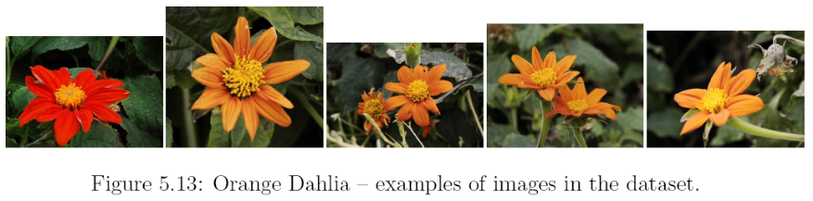
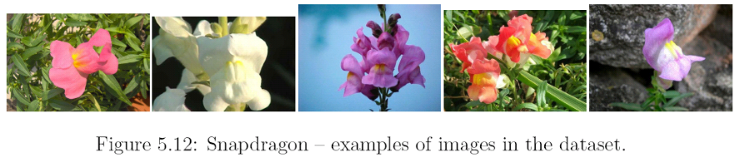
Introduction
This paper is about: Kernel selection (feature selection)
Example: Flower classification
Features: colour and shape
→ 2 kernels
Problem: how to combine these
2 kernels (input to SVM: 1 kernel!)
Simple: take average
Smarter: weighted sum with as many weights as kernels
Even smarter: different weights for each class

Slide 3
Combining kernels – baseline method
Compute average over all kernels:
Given: distance matrices dl(xi,xj)
Goal: compute one single kernel to use with SVMs
Recipe:
Compute RBF kernels: kl(xi,xj) = exp(-gl*dl(xi,xj))
Rule-of-thumb: set gl to 1/mean(dl) or 1/median(dl)
Trace normalise each kernel kl such that trace(kl) = 1
Compute average (or product) over all kernels kl

Slide 4
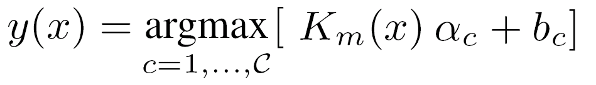
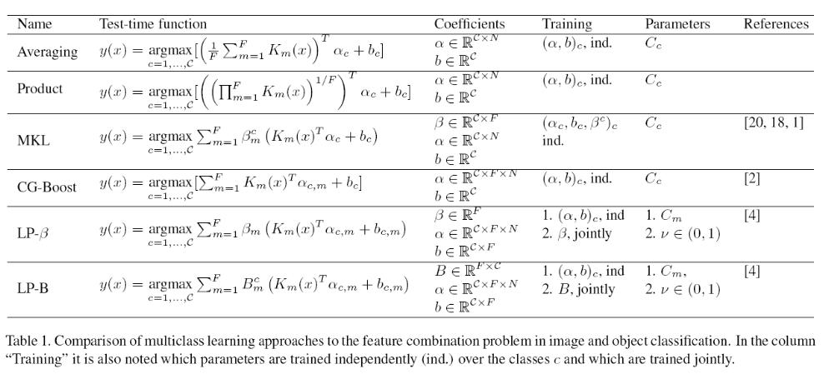
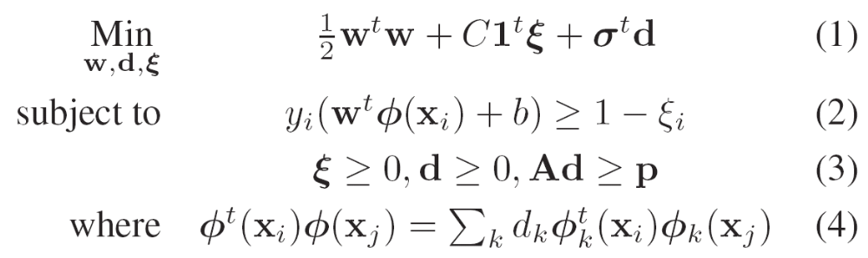
Combining kernels
Combination of kernels
Decision function for SVMs:
added
Multiple Kernel Learning (MKL)
Objective function [Varma and Ray]
Near identical to l1 C-SVM
but added l1 regularisation
on the weights d

Slide 5
Combining kernels
Combination of kernels
Decision function for SVMs:
All kernels share the same
alpha and beta values

Slide 6
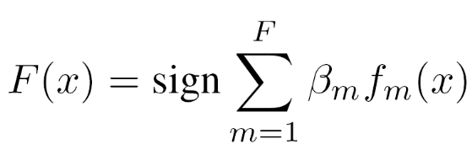
Combining kernels
Boosting of individual kernels
Idea:
Learn separate SVMs for each kernel
→ each with own values for alpha and beta
Use boosting based approach to combine the individual SVMs
→ linear weighted combination of “weak” classifiers
Authors propose two versions:
LP-beta – learns a single weight vector
LP-BETA – learns a weight vector for each class

Slide 7
Combining kernels
Combination of kernels
Decision function for SVMs:

Slide 8
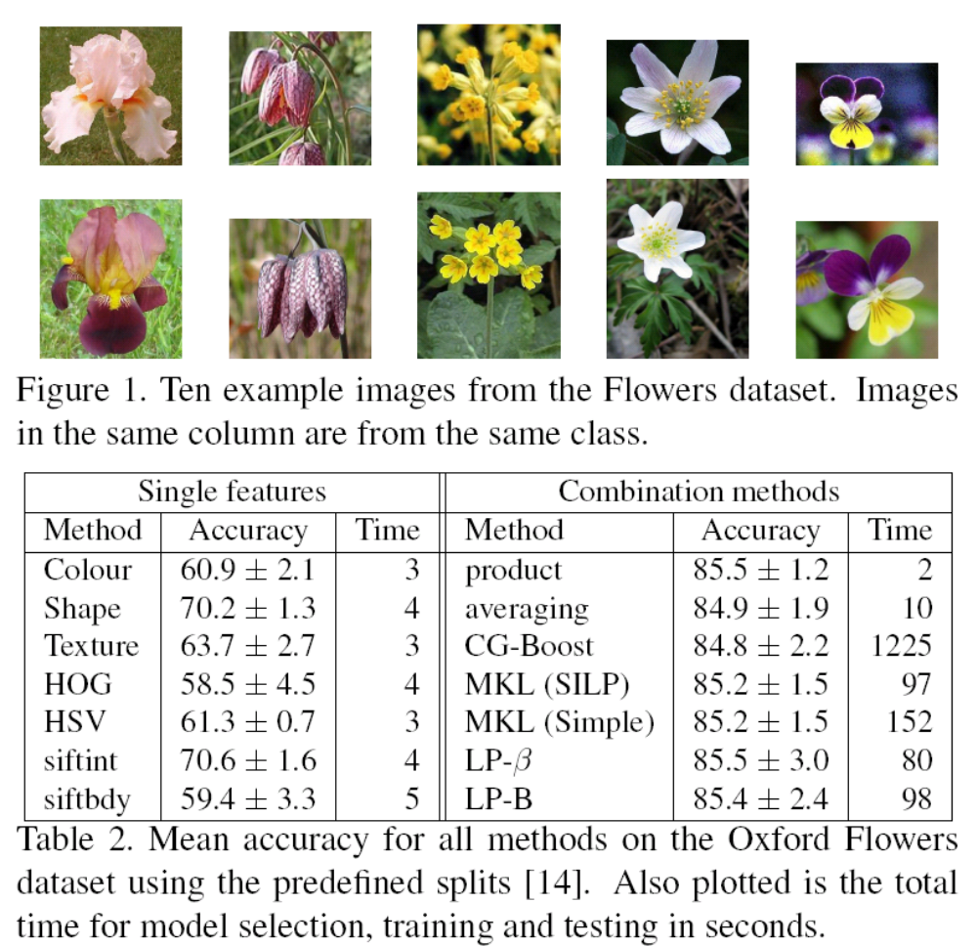
Results
Results on Oxford flowers
7 kernels
Best results when
combining
multiple kernels
Baseline methods do
equally well and are
magnitudes faster
The proposed LP
methods don’t do better
than the baseline either
→ not explained why!

Slide 9
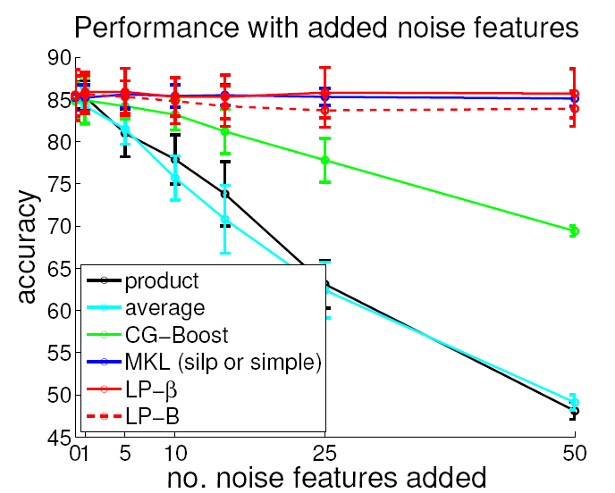
Results
Results on Oxford flowers
adding “noisy” kernels
→ MKL able to identify these kernels and set weights to ~zero
→ Accuracy using “averaging” or “product” goes down

Slide 10
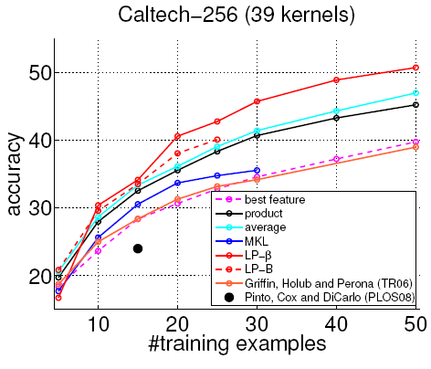
Results
Results on Caltech-256 dataset
39 kernels
LP-beta performs best
Using the baseline
“average” accuracies
are within 5% to best
results

Slide 11
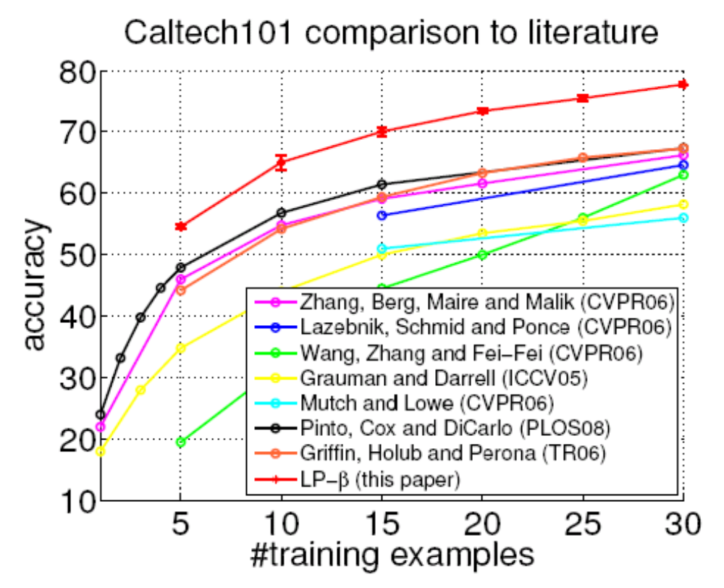
Results
Results on Caltech-101 dataset
LP-beta 10% better than state-of-the-art

