Slide 1

n Angular

Slide 2
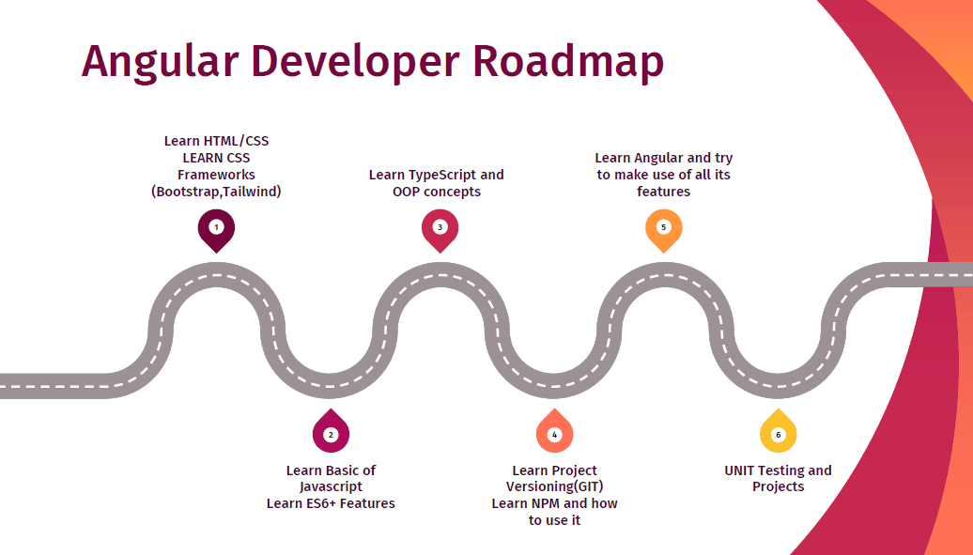

Slide 3
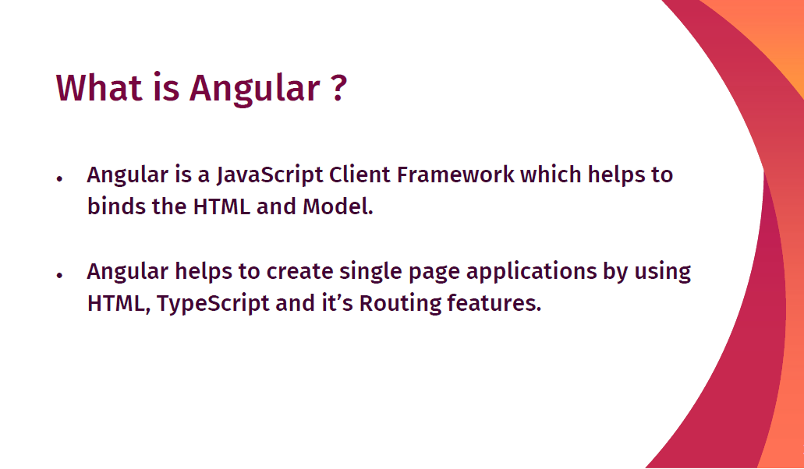

Slide 4
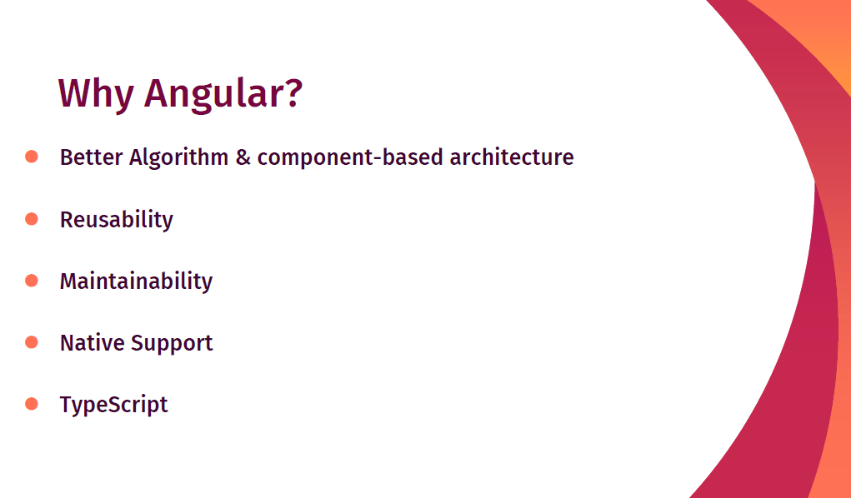

Slide 5
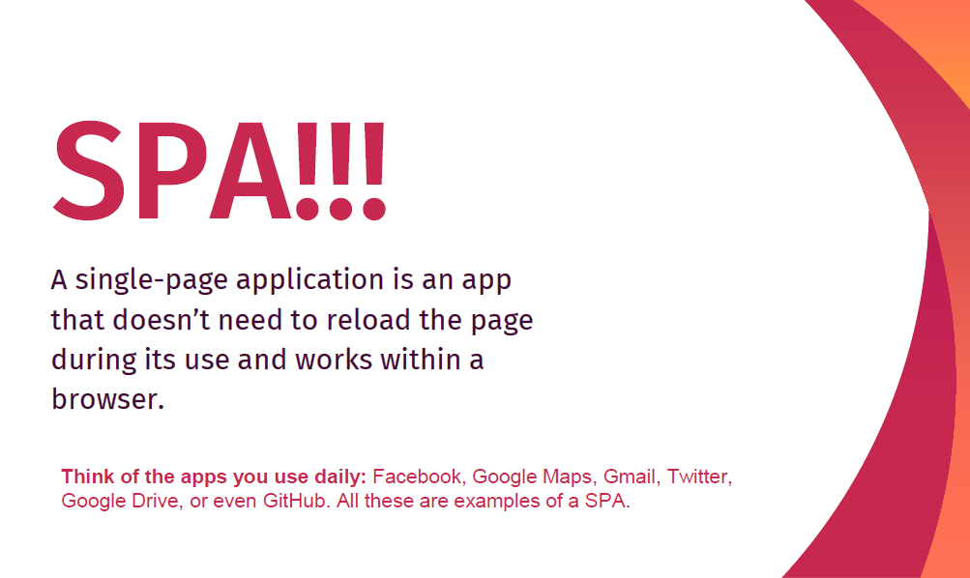

Slide 6
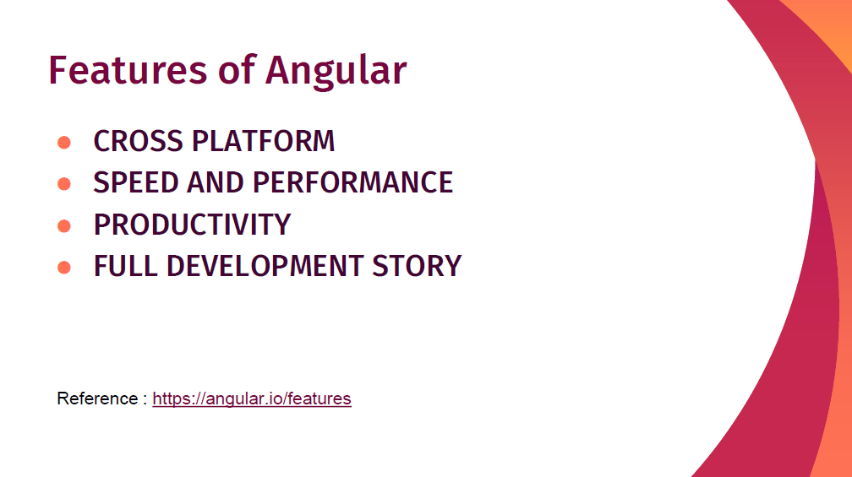

Slide 7
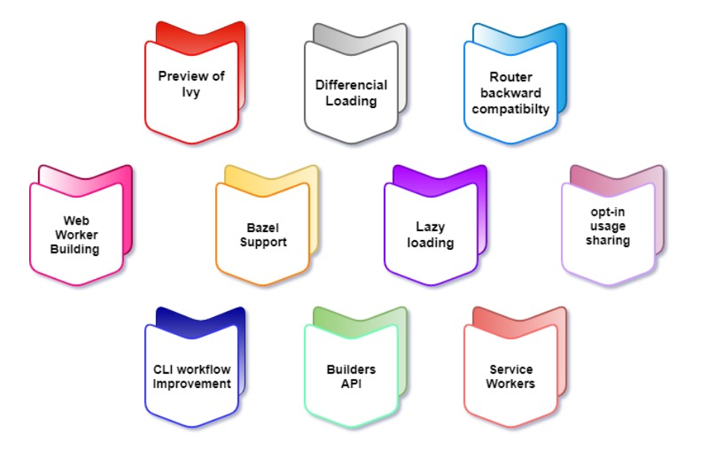
Features of Angular

Slide 8
Preview of Ivy
The Ivy project is rewriting the Angular compiler and run-time code to make it better, faster, and smaller.

Slide 9
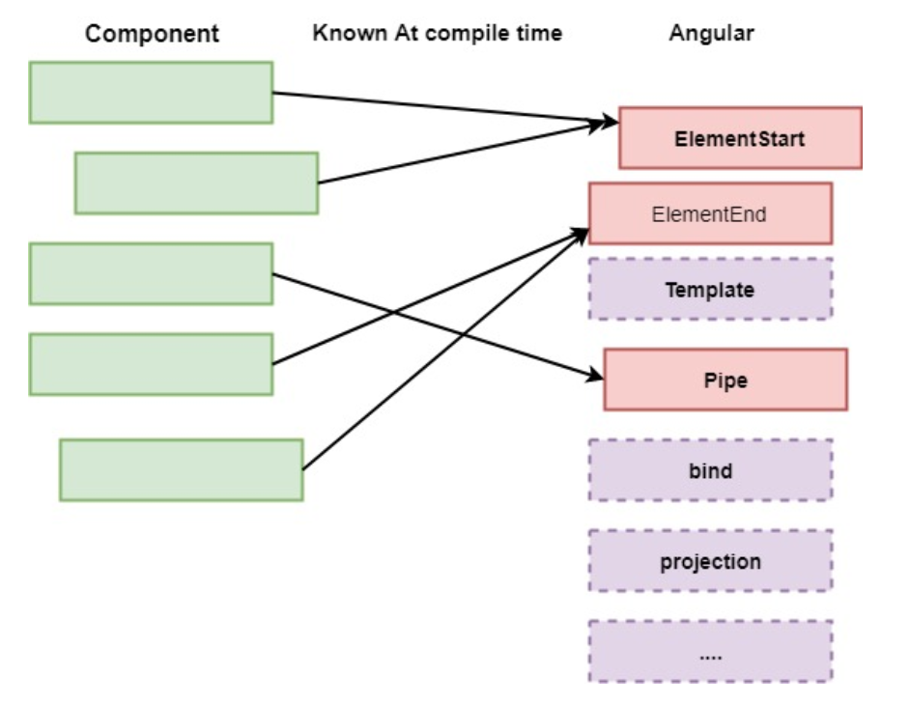
Components of Ivy
Tree shakable: It removes unused pieces of your code; the framework does not interpret the component. Instead, the component references instructions. If it doesn't reference appropriate guidance from the bundle results in smaller bundles and faster load times.

Slide 10
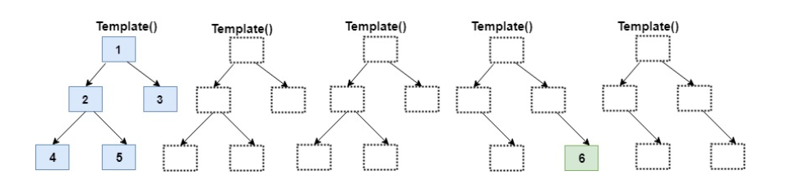
Low memory Footprint
It is anincremental DOM that didn’t need any memory to render the view if the view doesn't change the DOM. So, it allocates the memory when the DOM nodes are added or removed. Since most of the template calls don't change anything result in substantial memory savings.

Slide 11
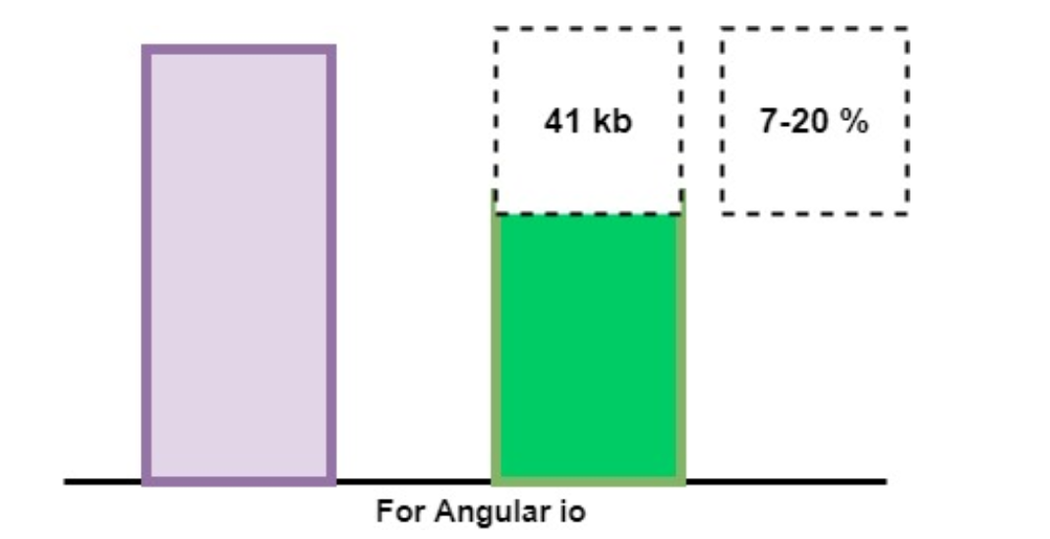
Differential Loading
The new app generated by Angular CLI will now contain separate bundles & it will be loaded automatically by the browser that load and render faster. Following is a diagram which represents that it decreases the bundle size in this way.

Slide 12
Router Backward Compatibility:
Angular Team added backward compatibility mode to Angular router that helps to generate the path for large projects and make it easier to move to Angular with lazy loading.
Web Worker Bundling:
A web worker is included while building the production bundles, which are essential for improving the parallel ability and help to increase the performance.

Slide 13
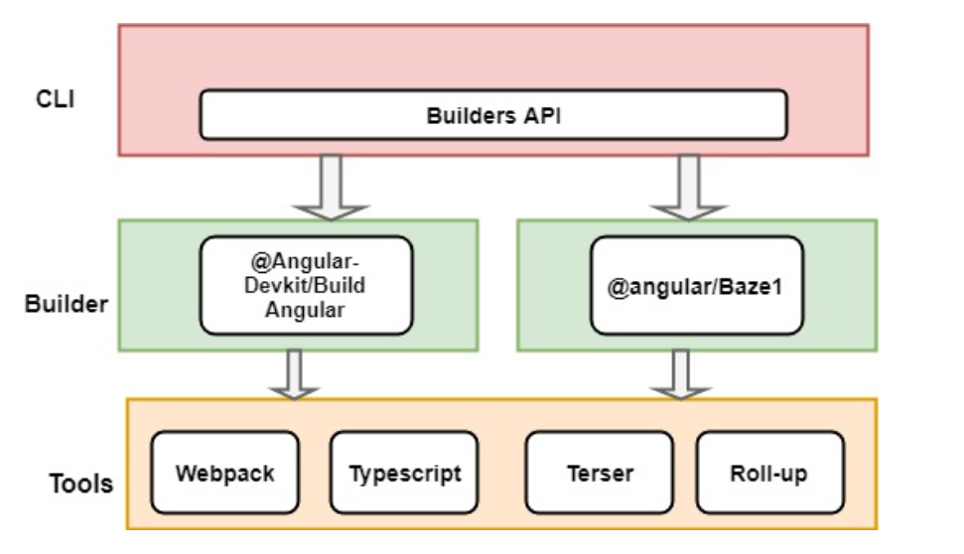
Bazel Support
Bazel is aiming for precisely reproducible builds, but concurrent builds will be a lot faster & it is beneficial if your app uses several modules and libraries. The angular framework itself built with Bazel. It is expected to include in @angular/cli in version9.

Slide 14
Lazy Loading:
Lazy loading is based on the concepts of Angular Routing and it helps bring down the size of large files by lazily loading the data that are required.
Opt-In Usage Sharing:
Opt-in sharing telemetry can collect data commands used and the build speed if users allow them, which will help developers improve in the future.

Slide 15
What is Angular CLI?
Angular CLI is known as Angular Command Line Interface. It is a command-line tool for creating angular apps. It is mentioned to use angular CLI for creating angular apps as if we do not need to spend time to install and configure all the required dependencies and wiring everything together. Angular CLI is a helpful tool to create and work with Angular Applications efficiently.

Slide 16
What is Ng in Angular?
The prefix ng stands for "Angular;" all of the built-in directives that craft with Angular use that prefix. Similarly, it is suggested that you do not use the ng prefix on your instructions to avoid possible name impacts in future versions of Angular.

Slide 17
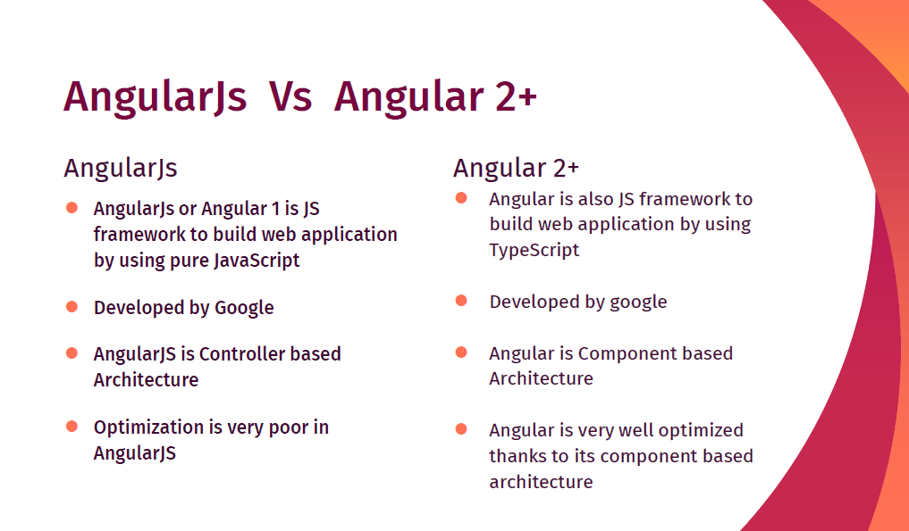

Slide 18
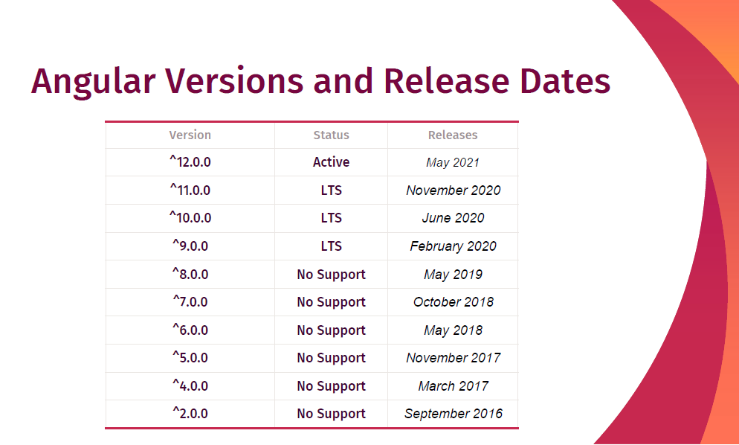

Slide 19
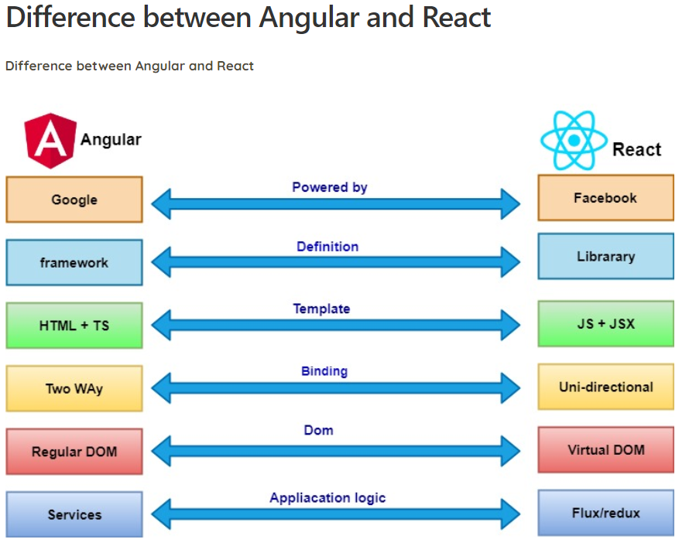

Slide 20
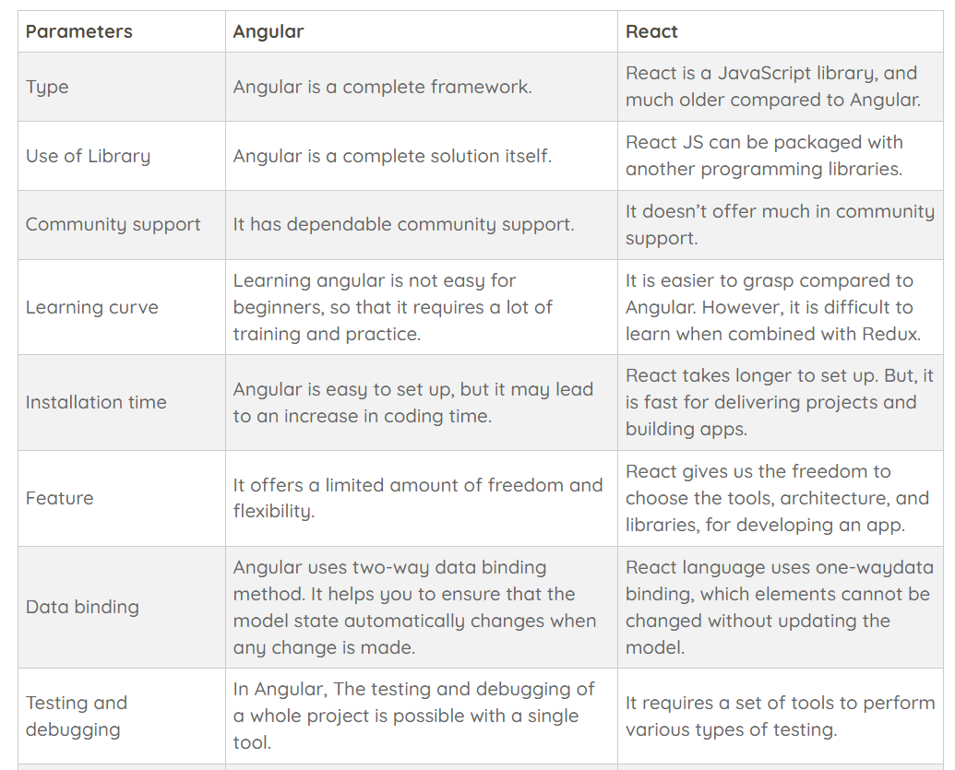

Slide 21
History and Versions of Angular
Introduction to Angular JS
Misko created Angular JS and the first version of Angular also name as "Angular 1". He built a framework to handle the downfalls of HTML. The first version of the structure, known as Angular JS, was launched in the year 2009. It is one of the best single-page application development solutions.

Slide 22
Features of Angular JS
Allows easy event Handling.
Support for data binding.
Built-in Template Engine and Routing
Form validation and animations
Dependencies Injection
A JavaScript MVW Framework

Slide 23
Introduction to Angular 2
After releasing Angular JS, Angular team released that Angular 2 which is a complete rewrite of its original Angular 1. Angular 2 version is built in the concept of the component. It offers better performance to web developers.
Some Essential Features of Angular 2 are:
New, faster, and highly scalable framework.
Useful for web, mobile, and desktop apps.
Support hierarchical dependency injection.

Slide 24
Why not Angular 3?
In Angular 3 all packages names were assigned version 2, but router package by mistake was given version 3 so that, the development team skipped Angular Version 3 and directly named it Angular 4 to maintain compatibility.

Slide 25
Introduction to Angular 4
This Version has some additional features:
This version introduced the Http Client, a smaller, easier to use, and more powerful library for HTTP Requests.
It provides a new router and life cycle events for Guards and Resolvers. Four new games: GuardCheckStart, GuardsCheckStart, Guardschecked, resolved to join the extent set of life cycle event like Navigation Start.
It provides the support of disabling animations.
Reduce the size of the generated bundles code up to 60%
Supports for if/else statement
Support for email validation.

Slide 26
Introduction to Angular 5
Angular 5 doesn’t bring significant change from Angular 4. But lots of features and many new improvements are done in the versions.
Features of Angular 5
Make default AOT
More comfortable to built attractive web pages
Type checking in templates
It supports international number, date, and currency pipes.
New router lifecycle events.
Lambda Support

Slide 27
Introduction to Angular 6
Angular 6 is a JavaScript framework for building interactive web applications and Typescript, which is a super-set of JavaScript. It provides build-in features for animation, HTTP service, and materials such as auto-complete, navigation, toolbar, menus, etc.

Slide 28
Introduction to Angular 7
Features of Angular 7
CLI prompts
Application performance
Angular Material and CDK
Improved Accessibility
Angular elements
Dependency updates
Ivy progress

Slide 29
Introduction to Angular 8
Angular 8 supports for web workers. There are also many features included there to improve our productivity.
Attractive Features of Angular 8
Preview of Angular Ivy
Router backward compatibility
Opt-in usage sharing
Lazy loading
Service workers
Bazel support
CLI Workflow environment.

Slide 30
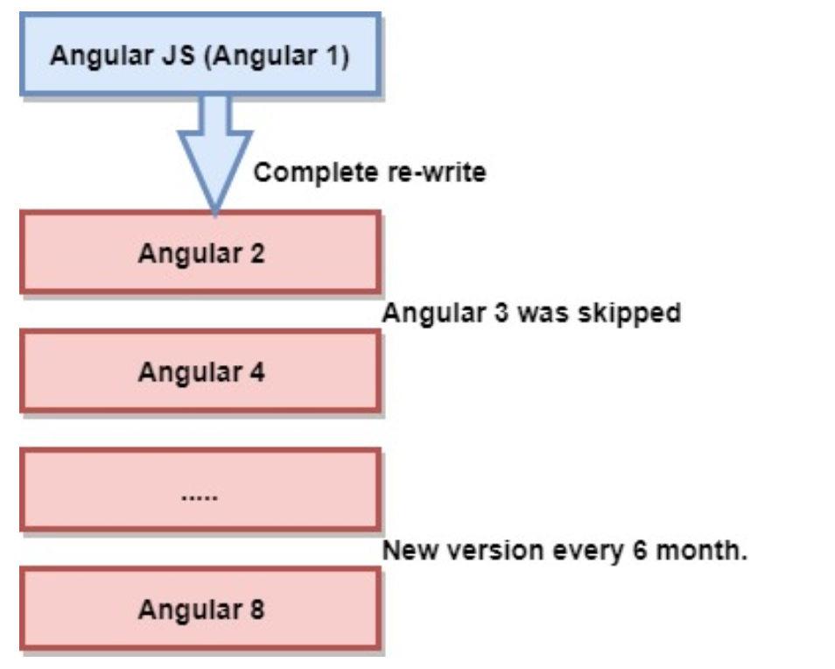
Angular Evolution

Slide 31
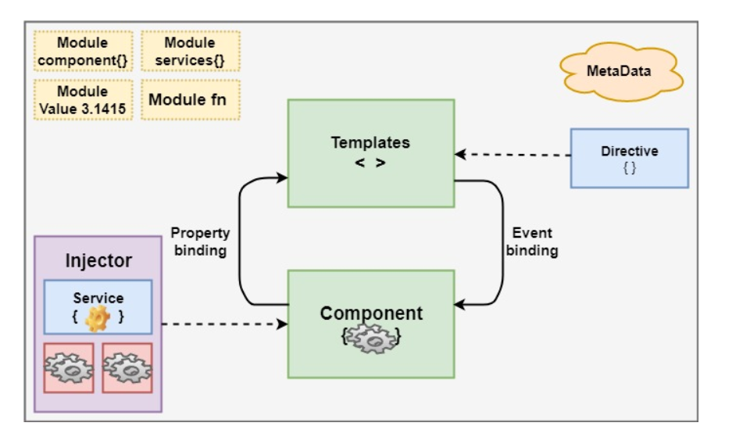
Architecture of Angular 8

Slide 32
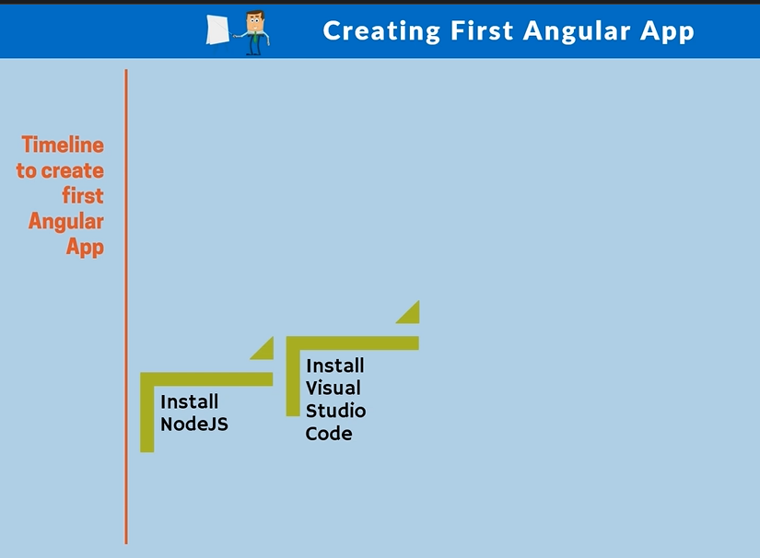

Slide 33
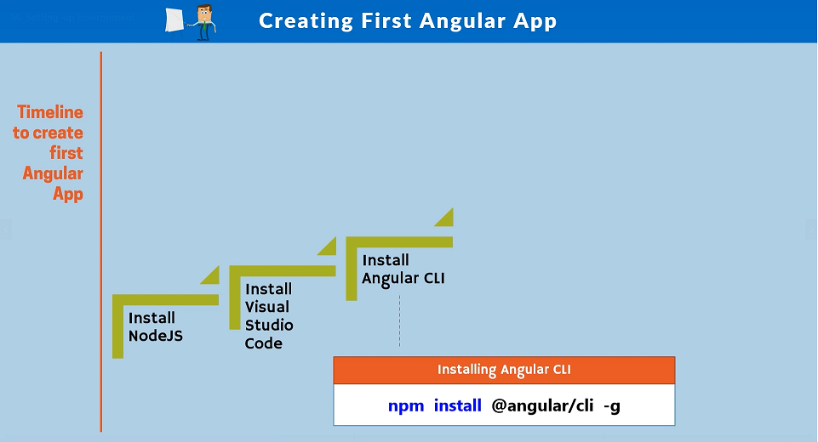

Slide 34
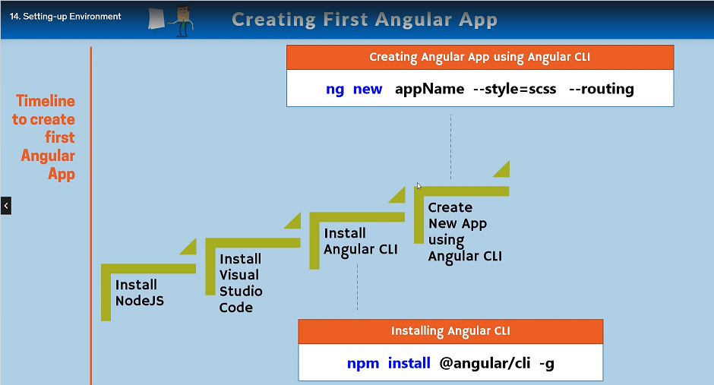

Slide 35
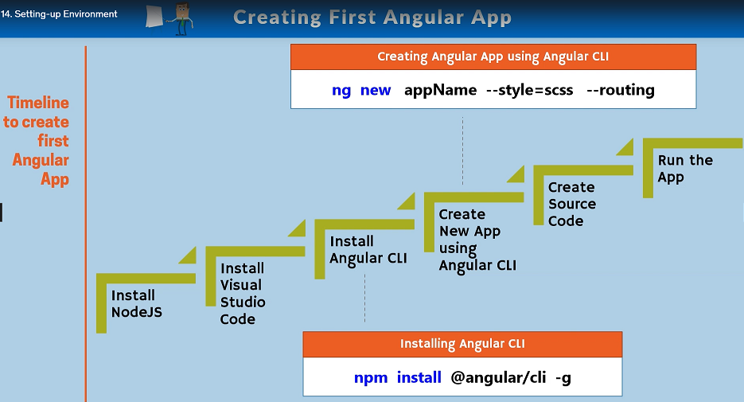

Slide 36
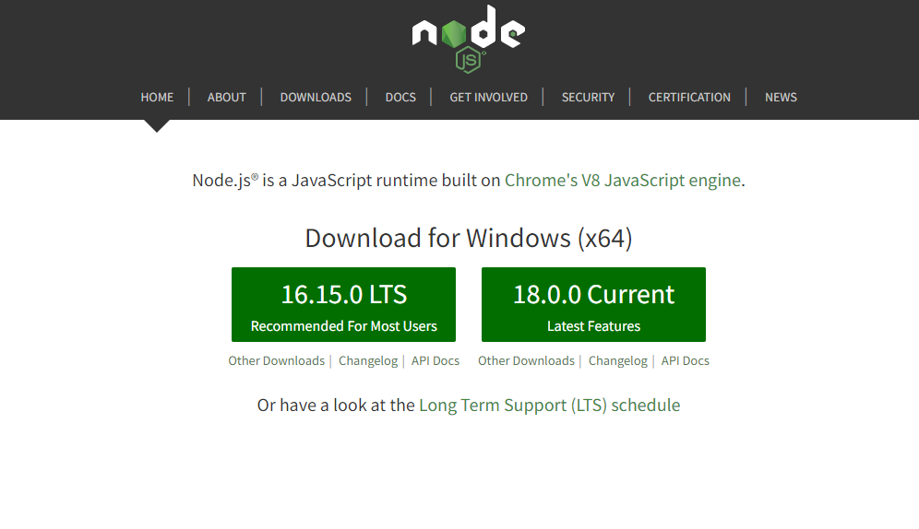

Slide 37
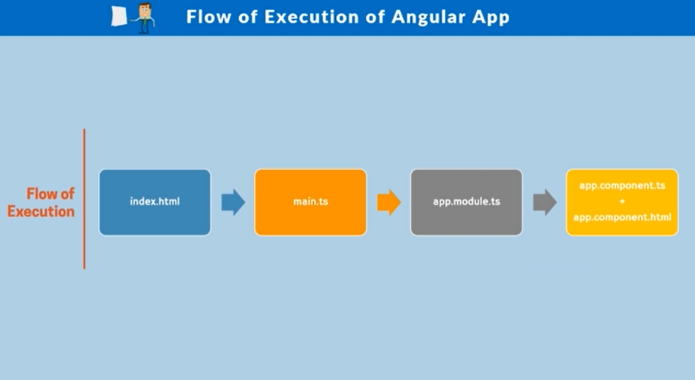

Slide 38
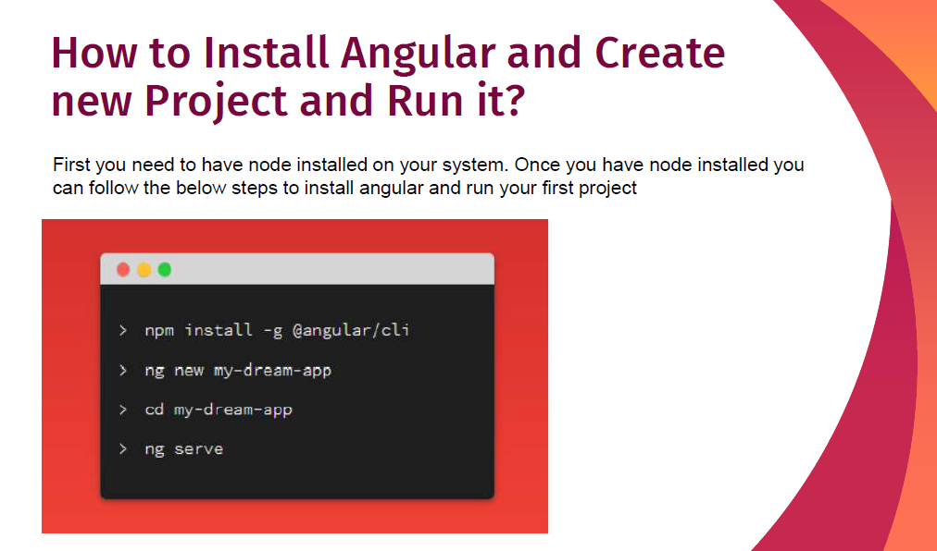

Slide 39


