Slide 1
2016 IEEE International Conference on Simulation, Modeling, and Programming for
Autonomous Robots
Alejandro M. Castro
San Francisco
December 13-16, 2016
Notes:
‹#›

Slide 2
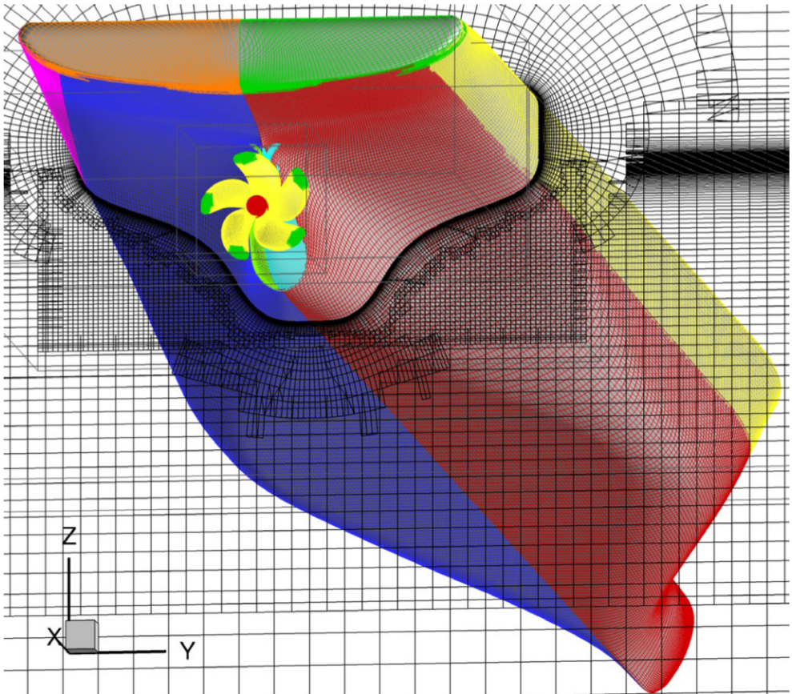
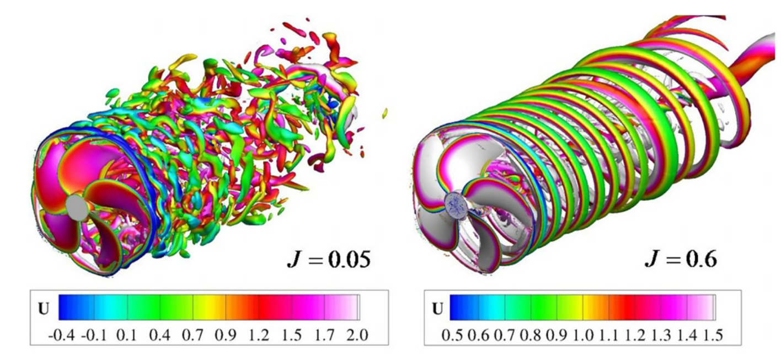
Most recent work before TRI: Fluid Mechanics for Ship Hydrodynamics
Work at IIHR – The University of Iowa with Pablo Carrica in the development of the CFD code Rex:
General curvilinear multiblock grids.
Single phase level set for free surface tracking.
Overset method allows for large amplitude motions.
Parallel implementation using MPI and PETSc.
Typical cases would involve 500 processors running for about two weeks to run in the order of 20 ship lengths.

Slide 3
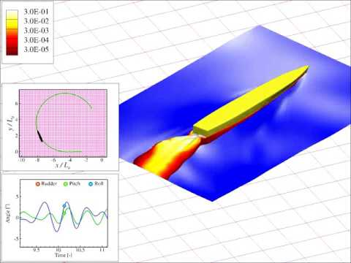
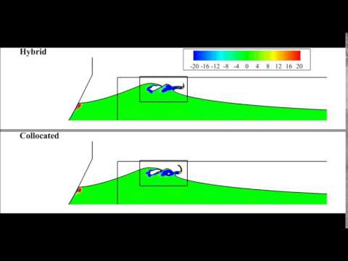
Work on Bubbly Wakes. Air Entrainment and Transport Modeling
Bubbly wake generated by a ship in a turn maneuver. A Castro, P Carrica. Int. Shipbuilding Prog., 2013.
Wave breaking simulation experiments with bubble entrainment.
J Li, A Castro, P Carrica, IJNMF 2015.
Notes:
Castro, A.M. and Carrica, P.M., 2013. Eulerian polydispersed modeling of bubbly flows around ships with application to Athena R/V. International Shipbuilding Progress, 60(1-4), pp.403-433.
Li, J., Castro, A.M. and Carrica, P.M., 2015. A pressure–velocity coupling approach for high void fraction free surface bubbly flows in overset curvilinear grids. International Journal for Numerical Methods in Fluids, 79(7), pp.343-369.

Slide 4
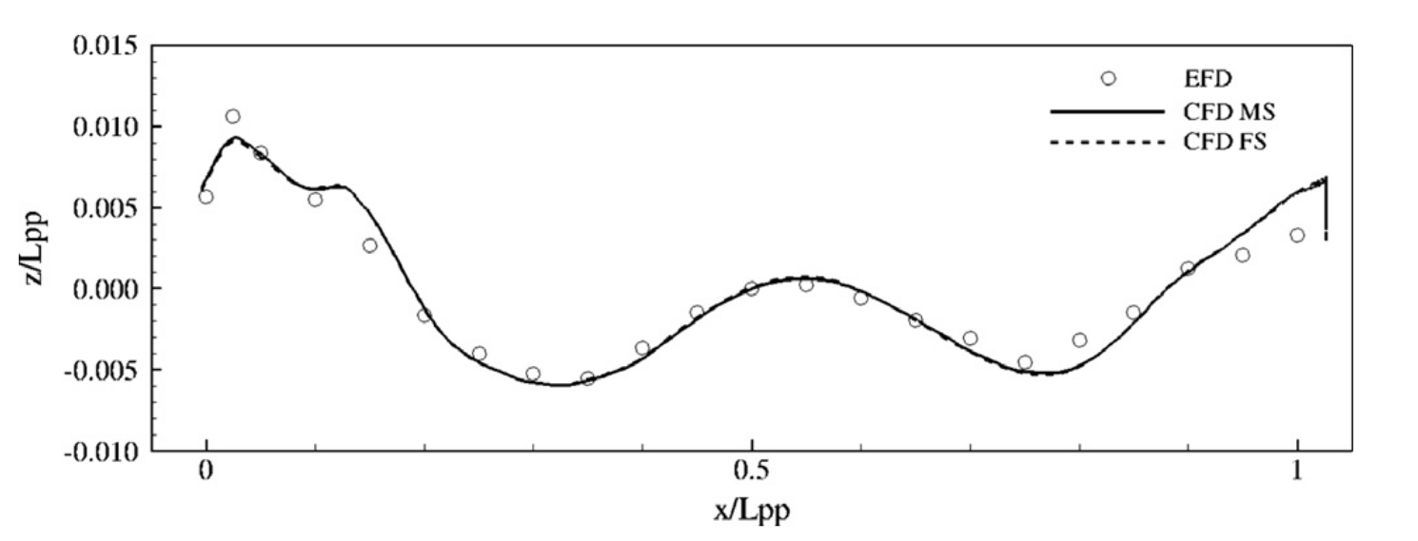
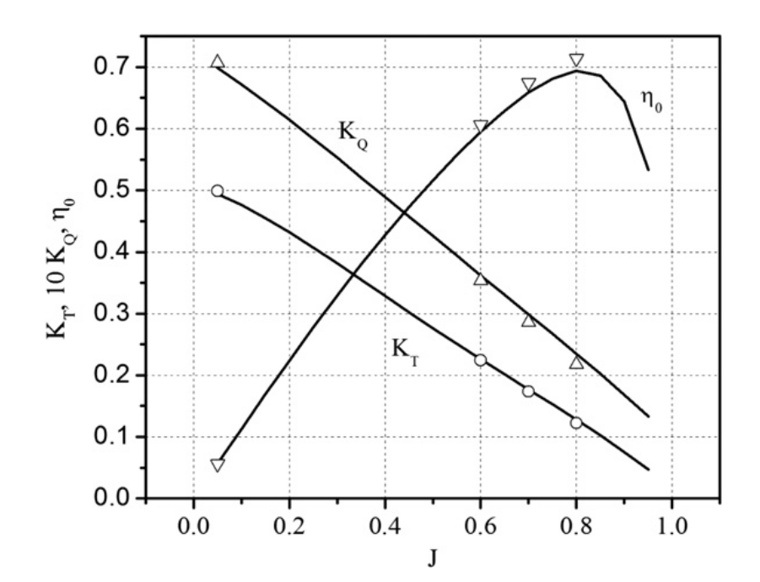
Importance of V&V in Simulation: KCS
A Castro, P Carrica, F Stern. Computers & Fluids. 2011.
Video
Free surface elevation at the contact line with the ship's hull
Open water propeller characteristics
Notes:
Castro, A.M., Carrica, P.M. and Stern, F., 2011. Full scale self-propulsion computations using discretized propeller for the KRISO container ship KCS. Computers & Fluids, 51(1), pp.35-47.

Slide 5
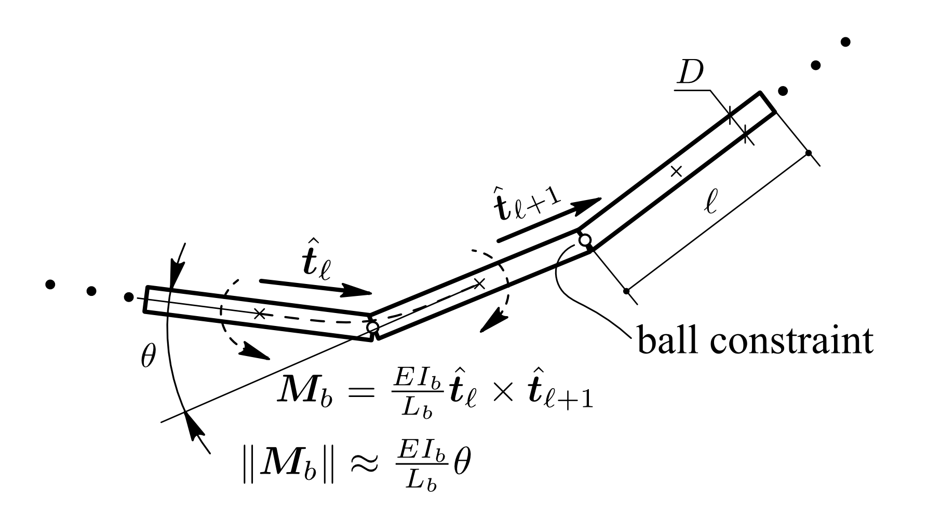
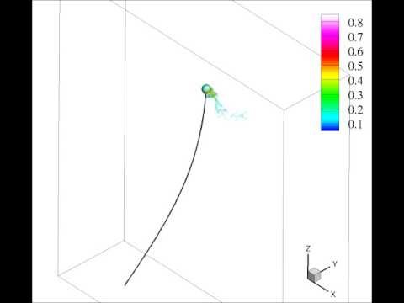
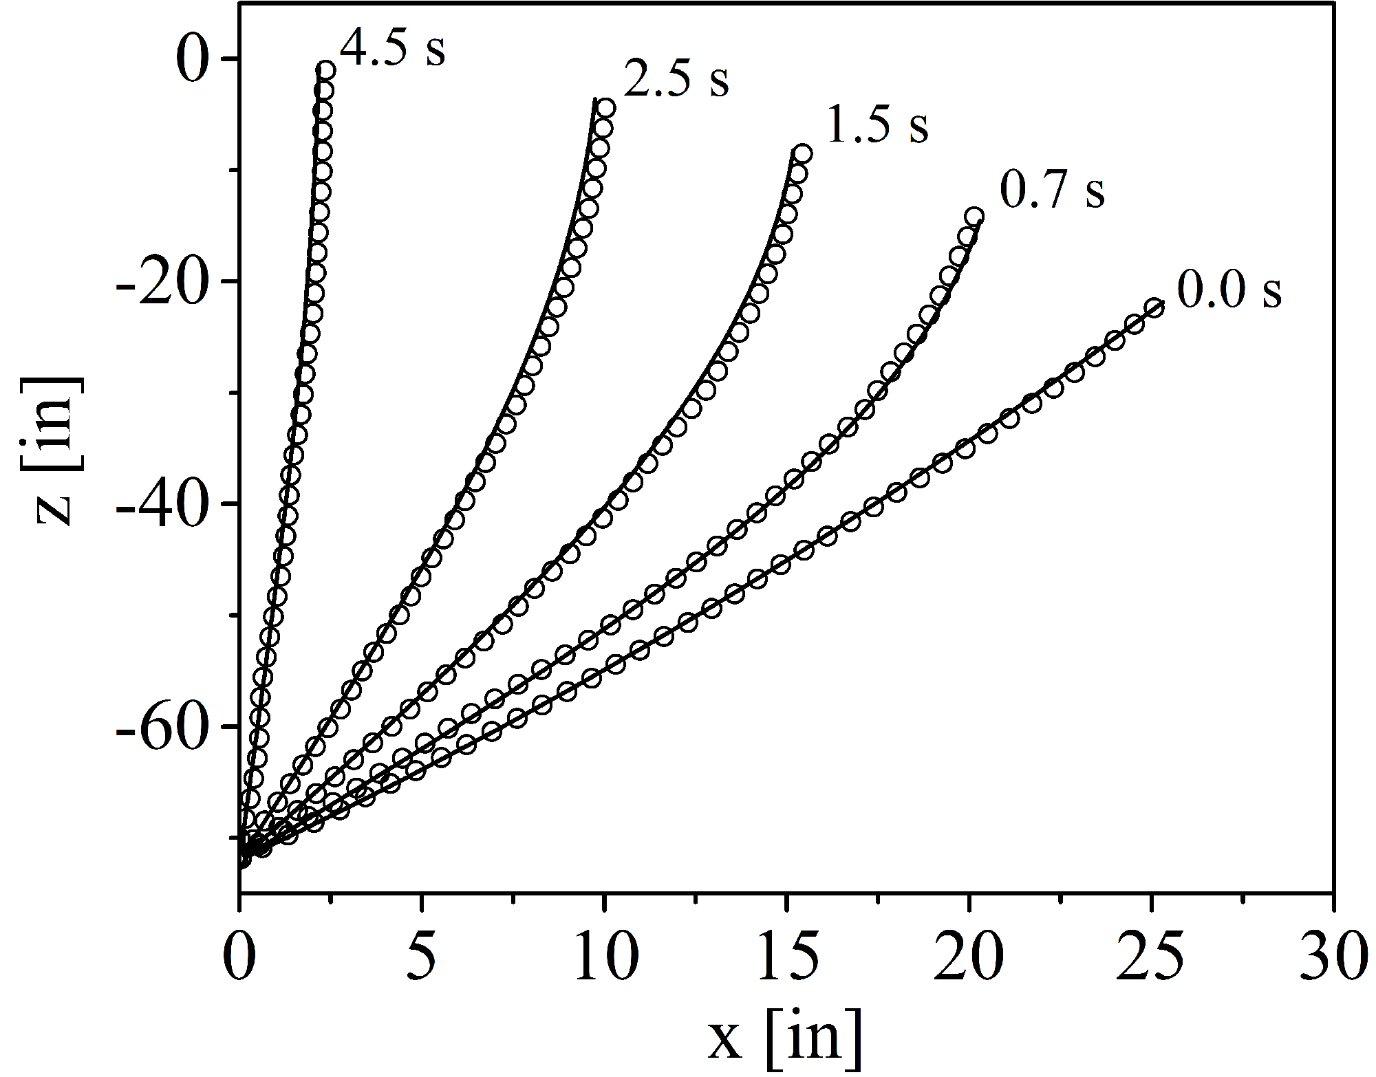
MBD Modeling of Cables.
Rigid links connected with beam elements.
Model includes hydrodynamic forces on the cable: Drag, virtual mass, buoyancy.
Validation
Notes:
Development of MagnusDyn, a C++ MBD code.
Integrated into CFD code Rex, two-way coupling.
Modeling of cables as a collection of rigid links connected by beam elements.

Slide 6
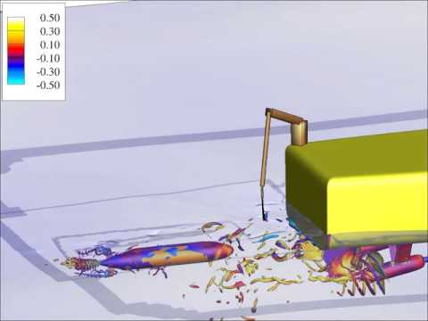
Simulation of a Recovery Scenario
Discretized propellers and rudders for both the ship and the UUV.
Simulation on irregular waves.
Cruise and heading control for ship.
UUV follows a target point at the stern of the ship.
UUV’s rudders controlled to follow target point.
Crane implements a simple PD control strategy for the end effector.
Notes:
Development of MagnusDyn, a C++ MBD code.
Integrated into CFD code Rex, two-way coupling.
Modeling of cables as a collection of rigid links connected by beam elements.

Slide 7
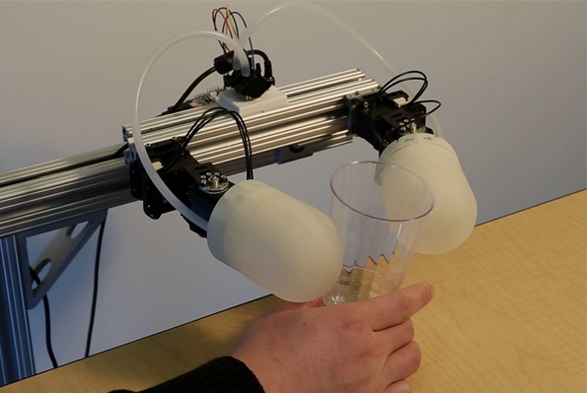
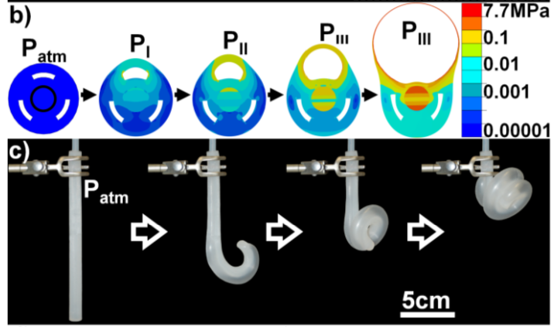
Soft Robotics Research at TRI
Mechanical compliance.
Grasping without detailed kinematics models.
Walking without detailed knowledge of terrains.
Safety due to softness.
Incredible progress on manufacturing and instrumenting soft mechanisms.
High precision actuation and sensing might get replaced by these lower precision/low cost solutions.
3D Printed Soft Skin
J Kim, A Alspach, K Yamane.
Disney Research (2015).
Harvard robotic tentacles
Martinez et al. Advanced Materials. 2011.
Notes:
References:
Martinez, Ramses V., Jamie L. Branch, Carina R. Fish, Lihua Jin, Robert F. Shepherd, Rui M. D. Nunes, Zhigang Suo, and George M. Whitesides. 2013. “Robotic Tentacles with Three-Dimensional Mobility Based on Flexible Elastomers.” Advanced Materials 25 (2) (January 11): 205–212.
Kim, J., Alspach, A. and Yamane, K., 2015, September. 3d printed soft skin for safe human-robot interaction. In Intelligent Robots and Systems (IROS), 2015 IEEE/RSJ International Conference on (pp. 2419-2425). IEEE.

Slide 8
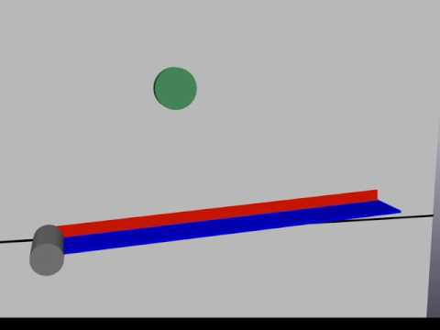
A Humble Start – Soft Juggler
Working on rich dynamic models that are tractable for control design.
Finite Elements based approach (Shabana 1988).
Model order reduction by modal decomposition.
Used AutoDiff / optimization to find the nominal limit cycle.
Poincare map between points of maximum height found by numerical integration.
AutoDiff passed through the Poincare map with paddle aim and stroke power as variables.
Next: (Periodic) LQR to stabilize.
Implementation of
the “soft juggler” in Drake.

Slide 9
Soft Robotics – Grand Challenges
Though highly accurate models exist in the FE community, they can be very computationally demanding. Typically it is believed that:
Computationally expensive.
Difficult parameter estimation.
Intractable for control design.
Encouraging new research: “30 ms per step on a 2.5 GHz Intel Core i7, 1628 nodes”, C Duriez, T Bieze, In Soft Robotics: Trends, Applications and Challenges(2017).
Lessons from the CG community: simulation of soft bodies and clothing. R Sheth et al. (2015), R Goldenthal et al. (2007).
Need for tractable models of dynamics and a framework for control design of these models.
Parameter estimation and experimental validation: How well does the model predict forces and long term dynamics?
Notes:
Duriez, C. and Bieze, T., 2017. Soft Robot Modeling, Simulation and Control in Real-Time. In Soft Robotics: Trends, Applications and Challenges (pp. 103-109). Springer International Publishing.
Rony Goldenthal, David Harmon, Raanan Fattal, Michel Bercovier, and Eitan Grinspun. Efficient simulation of inextensible cloth. ACM Transactions on Graphics, 26(3):49–1 – 49–7, July 2007.
Sheth, R., Lu, W., Yu, Y. and Fedkiw, R., 2015, August. Fully momentum-conserving reduced deformable bodies with collision, contact, articulation, and skinning. In Proceedings of the 14th ACM SIGGRAPH/Eurographics Symposium on Computer Animation (pp. 45-54). ACM.

Slide 10
Soft Robotics – Grand Challenges
Integration of simulation tools with analysis tools for control design: Very well developed frameworks for rigid body robots need extension to soft applications.
Particularly difficult are applications with large deformations:
Are small deformation models enough?
Observation: Small deformations do not imply small displacements.
Formal robustness analysis to understand on the extent to which mechanical compliance can improve robustness to deal with geometric uncertainty.
Uncertainty quantification.
Rich spectrum of design alternatives require an ample variety of simulation strategies: articulated rigid bodies with soft skin, pneumatic actuation, airtight cavities, wire “tendons”.
Notes:
Rony Goldenthal, David Harmon, Raanan Fattal, Michel Bercovier, and Eitan Grinspun. Efficient simulation of inextensible cloth. ACM Transactions on Graphics, 26(3):49–1 – 49–7, July 2007.

