Slide 1

Simpar 2016 Workshop Grand Challenges in Robotic Simulation
Michael Sherman (Sherm)
Toyota Research Institute
13 Dec 2016

Slide 2
Topics
Background
Current work
Grand challenge

Slide 3
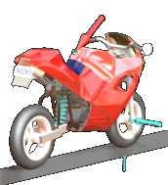
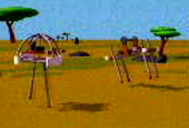
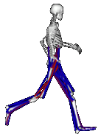
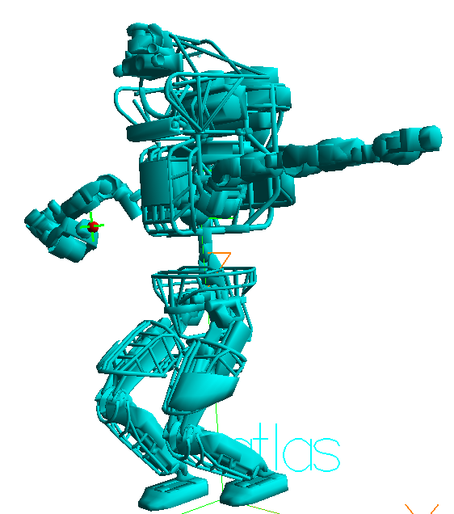
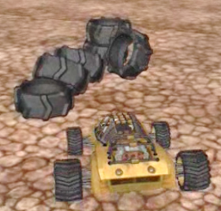
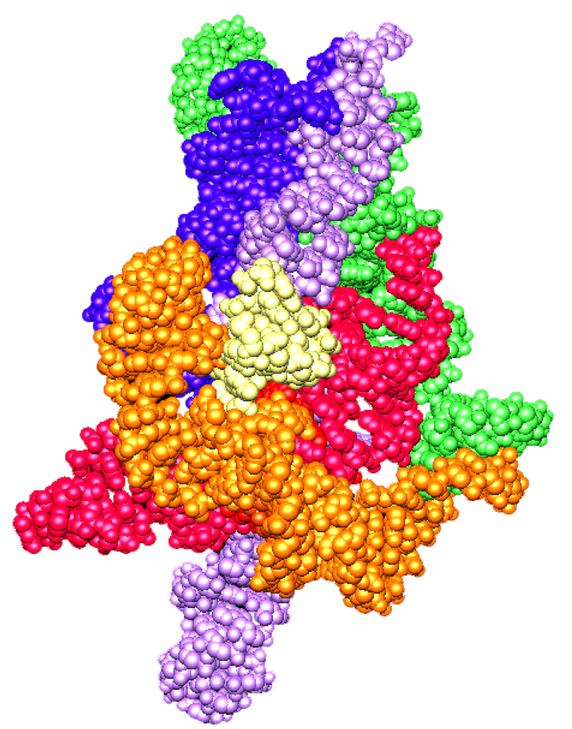
Simulation background
CS: 10 years in operating system software (1980s)
Mechanical simulation (1990s)
Wrote SD/FAST multibody code (with Dan Rosenthal)
Wrote Mechanica/Motion for PTC (with Linda Petzold)
Aerospace & ground vehicles, robots, animation, machine design
Biomolecular simulation (2000)
Founded VC-funded startup to simulate large molecules
Stanford Bioengineering (2005-15, open source)
Wrote Simbody for physics-based simulation of humans (NIH)
Worked with OSRF to use Simbody for robots (DARPA)
Chief Simulation Officer for virtual world startup

Slide 4
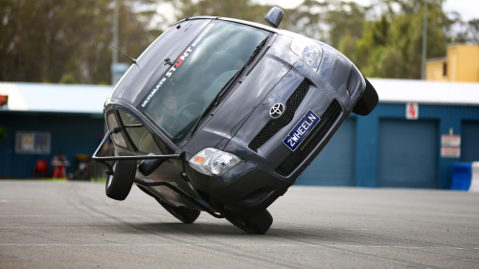
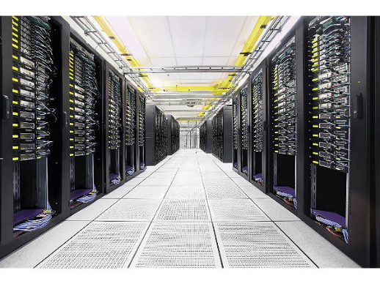
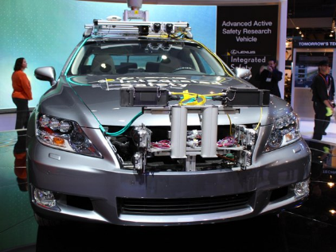
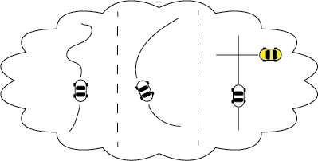
Current work (TRI, 2016- )
Toyota wants to field autonomous cars, mobile robots & manipulators
Accurate simulation is critical to our mission:
Train and validate controllers for rare events
Can’t get enough data from real world
Create physically-meaningful regression tests
Simulation is fast and repeatable
Perform “what if” design studies
Slow and expensive in real world

Slide 5
My work at TRI
Lead for dynamics team (w/Evan, Sean, Alejandro, Paul M)
Part of Russ Tedrake’s Simulation & Controls group
Open source development in Drake (drake.mit.edu)
SD/FAST symbolic, Simbody numerical, Drake is “semi numerical”
Team responsibilities
Dynamic system abstraction
Modeling of hybrid (discrete/continuous) systems
Simulator for dynamic systems
Accuracy-controlled numerical integration
Discrete time-stepping; event detection & response
Computational geometry
For contact, planning, sensing
Shared environment for composite dynamic system
Multibody dynamics
Vehicle / robot / environment physics
Validated accuracy
Regression-packaged tests vs. analytical results
Validation against real world experiments
Careful verification of numerical methods
Strategy
Accuracy
Breadth
Speed
In that order!

Slide 6
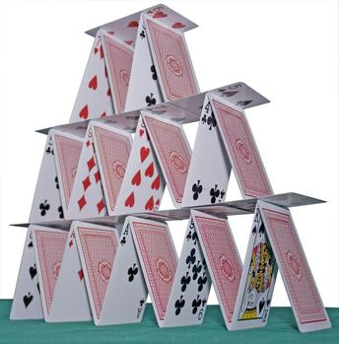

Grand Challenge: Overcome complacency & fatalism about accurate simulation
It’s hard not impossible!
Accurate simulation is routine in many engineering fields
Aerospace, vehicle dynamics, structures, electronics, mechanism design, …
Appropriate metaphors
House of cards; each layer must be solid
Chain of dependencies; strong as its weakest link
Bad arguments
“Why bother with X when we don’t even know Y?”
“I’ve tried X, it doesn’t work.” (Is everything else right?)
“It’s too slow.” (For what purpose? How much accuracy are you giving up?)
Complacency
“It’s good enough.” (How do you know?)
Low expectations, e.g. loose numerical tests, no energy conservation

Slide 7
Just need to get all of these right …
Choice of important physical effects
Flexibility? Compliance? Static vs. dynamic friction? LIDAR reflectivity? Noise?
Realistic mathematical models
Discretized friction? Primitive vs. mesh?
Accurate parameters/data for models
Reliable algorithms, symbolic & numerical methods
Error estimation and control
Rigorous software development processes
Verification and regressions! (you changed it, you broke it)
Systematic validation: Simple to complex
Does your system track & conserve E=PE+KE-W? No? It’s wrong.
Check in with real-world experiments
But that’s not enough.

Slide 8
Thank you! Discussion? sherm@tri.global

