Slide 1

Utilizing a Domain Specific Language for test automation
Bas Hamer Possum Labs

Slide 2
Domain specific languages
Who has used them?

Slide 3
Some archaic examples; Regex
/(?(DEFINE)
# Note that everything is atomic, JSON does not need backtracking if it's valid
# and this prevents catastrophic backtracking
(?<json>(?>\s*(?&object)\s*|\s*(?&array)\s*))
(?<object>(?>\{\s*(?>(?&pair)(?>\s*,\s*(?&pair))*)?\s*\}))
(?<pair>(?>(?&STRING)\s*:\s*(?&value)))
(?<array>(?>\[\s*(?>(?&value)(?>\s*,\s*(?&value))*)?\s*\]))
(?<value>(?>true|false|null|(?&STRING)|(?&NUMBER)|(?&object)|(?&array)))
(?<STRING>(?>"(?>\\(?>["\\\/bfnrt]|u[a-fA-F0-9]{4})|[^"\\\0-\x1F\x7F]+)*"))
(?<NUMBER>(?>-?(?>0|[1-9][0-9]*)(?>\.[0-9]+)?(?>[eE][+-]?[0-9]+)?))
)
\A(?&json)\z/x

Slide 4
Other invocations: xpath
//table/tbody/tr/td[count(//table/thead/tr/th[.="$columnName"]/preceding-sibling::th)+1]

Slide 5
But they can also clarify
Ask Alexa...
"Set a timer for 10 minutes"
"How much time is left on my timer?"
"What timers are set?"
"Cancel the timer"
"Stop"
"Set an egg timer for 3 minutes"

Slide 6
A story : 5280 Apex Human Resource Solutions
*A fictional company, if any of this sounds familiar that is because these events happen often.

Slide 7
In the beginning
The tests were green
Deployments happened
And nobody wondered much about how

Slide 8
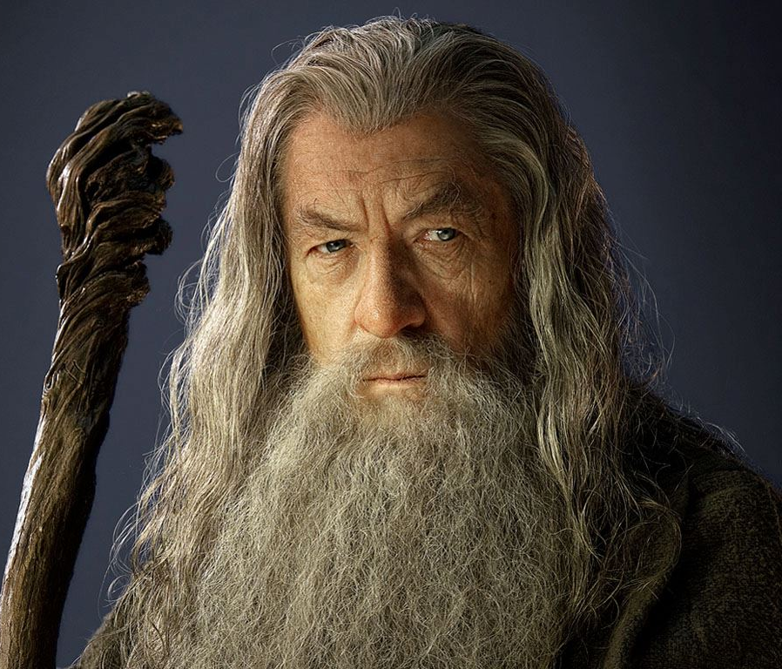
In the beginning
The tests were green
Deployments happened
And nobody wondered much about how
It was a bit like magic

Slide 9
Then something went wrong
It was bad
Really bad
No one is quite sure what exactly happened, but boy was it bad.

Slide 10
The next release
The tests were green
It was magic

Slide 11

The next release
The tests were green
It was magic
People didn't trust the magic

Slide 12
It's all good, trust me.

Slide 13
Show me.

Slide 14
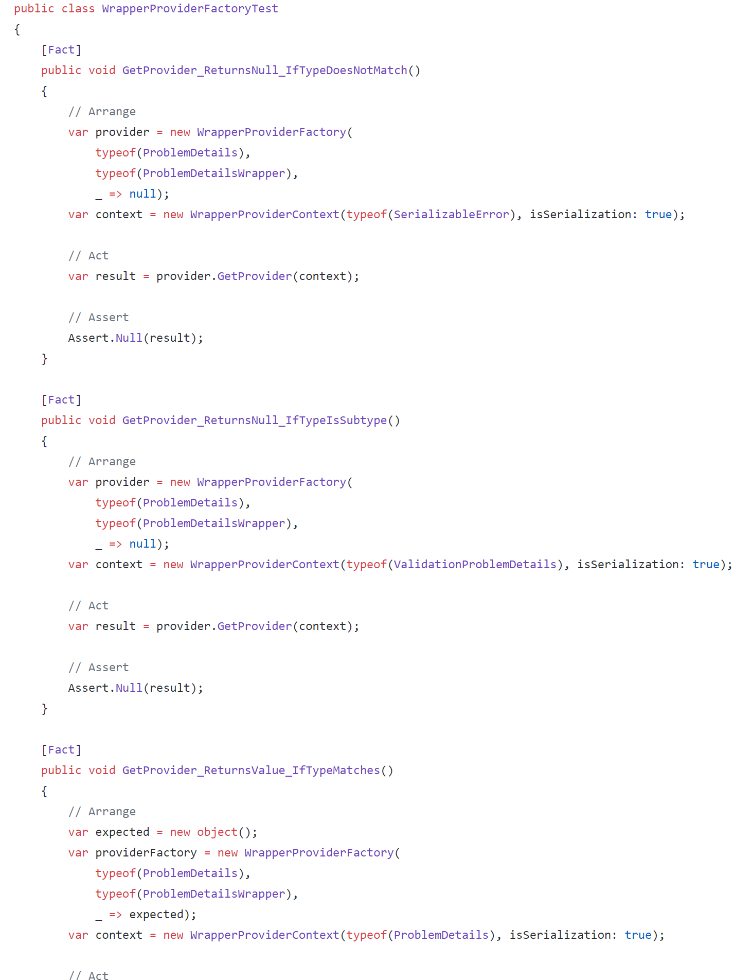

Slide 15
The costs of Distrusts
Internal
External
Manual regressions
Signoff processes
Slower releases
Customers refuse to take major version updates
Multiple maintained branches (versions) of your product

Slide 16
Successful test automation has to be trustworthy

Slide 17
We trust what we understand
Let's make the tests transparent

Slide 18
Limitations
The business will never learn to read C# / Java / Javascript / Lisp etc.
The business can read English
The business needs to read tests
Tests are written in English
Aka, manual regression scripts.

Slide 19
Starting with English
What are the benefits and drawbacks of using English

Slide 20
English tells stories

Slide 21
A Story
A businessman had just turned off the lights in the store when a man appeared and demanded money. The owner opened a cash register. The contents of the cash register were scooped up, and the man sped away. A member of the police force was notified promptly.

Slide 22
A Story
A businessman had just turned off the lights in the store when a man appeared and demanded money. The owner opened a cash register. The contents of the cash register were scooped up, and the man sped away. A member of the police force was notified promptly.
A man appeared after the owner had turned off the lights.
True Unknown False

Slide 23
A Story
A businessman had just turned off the lights in the store when a man appeared and demanded money. The owner opened a cash register. The contents of the cash register were scooped up, and the man sped away. A member of the police force was notified promptly.
The man who opened the cash register was the owner.
True Unknown False

Slide 24
A Story
A businessman had just turned off the lights in the store when a man appeared and demanded money. The owner opened a cash register. The contents of the cash register were scooped up, and the man sped away. A member of the police force was notified promptly.
The store owner scooped up the contents of the cash register and ran away.
True Unknown False

Slide 25
Natural language is terrible for clarity
Most people have an answer different than yours.
When communicating it isn't about being right, it is about sharing the same understanding. Being right only is useful when everyone is right.

Slide 26
A Story
A businessman had just turned off the lights in the store when a man appeared and demanded money. The owner opened a cash register. The contents of the cash register were scooped up, and the man sped away. A member of the police force was notified promptly.
The story and statements are a portion of the "Uncritical Inference Test". copyrighted, 1955,1964,1967 by William V. Haney.

Slide 27
A Robbery Story with variables
Person 'A' had just turned off the lights in the store when Person 'B' appeared and demanded money. Person 'A' opened a cash register. The contents of the cash register were scooped up, and Person 'B' sped away. A member of the police force was notified promptly by Person 'A'.

Slide 28
A Story from customer rights perspective
Person 'A' had just turned off the lights in the store when Person 'B' appeared and demanded money. Person 'A' opened a cash register. The contents of the cash register were scooped up, and Person 'A' sped away. A member of the police force was notified promptly by Person 'B'.

Slide 29
A Story from a female business owners support perspective
Person 'A' had just turned off the lights in the store when Person 'B' appeared and demanded money. Person 'C' opened a cash register. The contents of the cash register were scooped up, and Person '?' sped away. A member of the police force was notified promptly by Person 'C'.

Slide 30
A Story by M. Night Shyamalan
Person 'A' had just turned off the lights in the store when Person 'A' appeared and demanded money. Person 'A' opened a cash register. The contents of the cash register were scooped up, and Person 'A' sped away. A member of the police force was notified promptly by Person 'A'.

Slide 31
Variables remove ambiguity
This is why names are so useful when telling stories

Slide 32
Let's apply it to some test cases
Our HR manager has one function
Keep track of the CEO and reports after someone retires.

Slide 33
5280 Human Resources
Given an organization with 'P1' and 'P2'
When 'P1' retires
Then 'P2' is the CEO

Slide 34
5280 Human Resources
Given an organization with 'P1', 'P2', 'P3', 'P4', 'P5', 'P6', 'P7' and 'P8'
When 'P5' retires
Then 'P8' is ????

Slide 35
5280 Human Resources
Given a VP-less medium flat organization
When 'P3' retires
Then 'P8' is Lead

Slide 36
The Golden Data Set
Existing well known data
Easy to start, tricky to scale, hard to maintain.

Slide 37
Let’s Describe the data
Given the Employees
| var | Name | Seniority |
| E1 | Bob1 | 1 |
| E2 | Bob2 | 2 |
And the Employee
| var | Name | Reports |
| E3 | Mary | E1, E2 |

Slide 38
What we want out of our DSL
Clear
No ambiguity
Limited vocabulary
Name anything that you need to refence
Functional
Human readable
Machine parsable

Slide 39
This is against our natures
Words by age
3 years old 300 words
4 years old 1,500 words
5 years old 2,500 words
8 years old 10,000 words
20 years old 27,000 to 52,000 words

Slide 40
A successful DSL is simple yet powerful

Slide 41
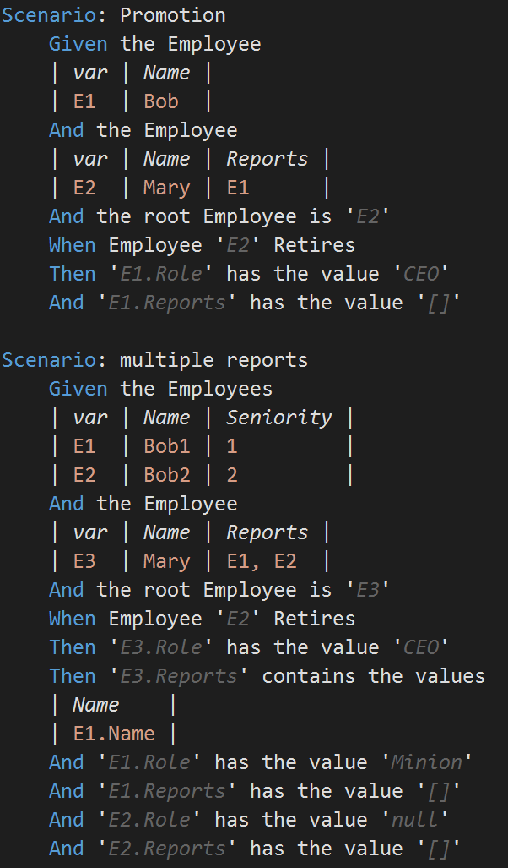
Back to 5280 Apex Human Resource Solutions

Slide 42
Is this behavior-driven development (BDD)?
BDD is defined as follows:
define a test set for the unit first;
make the tests fail;
then implement the unit;
finally verify that the implementation of the unit makes the tests succeed.

Slide 43
How to get started

Slide 44
1. Setup
References
Configuration
Selenium Grid
Importing steps
Importing initialization

Slide 45
Out of the box
Given navigated to 'http://google.com'
When entering 'Possum Labs' into element 'Search'
And clicking the element 'Google Search'
Then the page contains the element 'About'

Slide 46
Hardcoded Login
Given navigated to 'https://possumlabs.pipedrive.com/'
When entering 'pipedrive@possumlabs.com' into element 'Email'
And entering 'nbojSPYy@84m' into element 'Password'
And clicking the element 'Log in'
Then the page contains the element 'Add deal'

Slide 47
2. Customization
Given navigated to 'https://possumlabs.pipedrive.com/'
When entering 'Admin.Email' into element 'Email'
And entering 'Admin.Password' into element 'Password'
And clicking the element 'Log in'
Then the page contains the element 'Add deal’
Given logged in as User 'Admin'

Slide 48
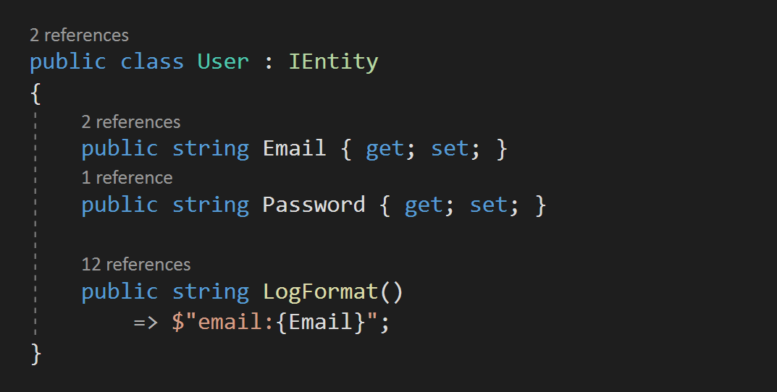
User entity

Slide 49
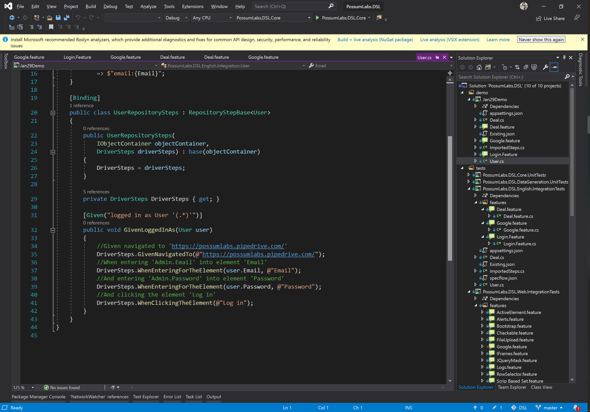
User Repository

Slide 50
User Repository

Slide 51
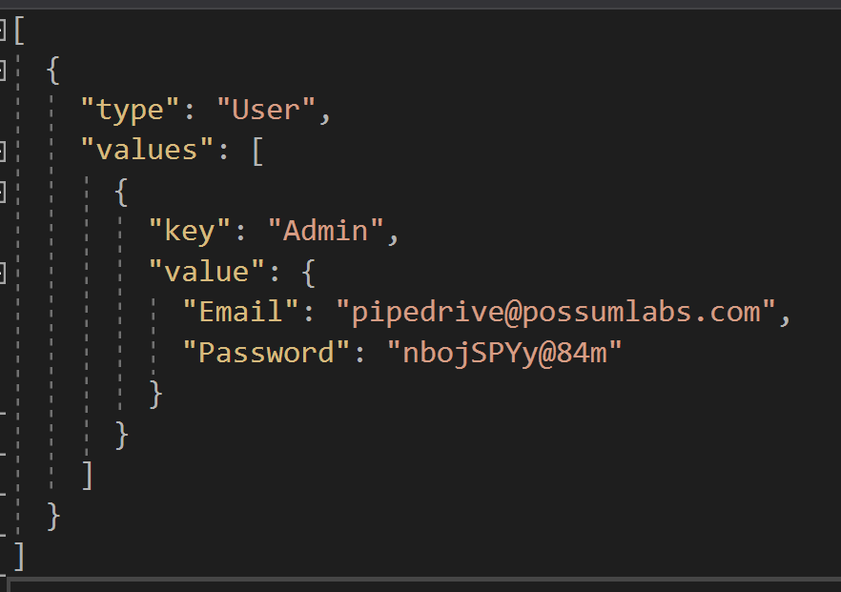
Existing Data json file

Slide 52
Examples
C# examples are available at
https://github.com/Possum-Labs/DSL
MIT license

